Slide 1
Developing an Implementation Strategy for a System of Environmental-Economic Accounting (SEEA) Central Framework 6-7 February 2014, Castries, Saint Lucia
Lara Blanco, Deputy Resident Representative, UNDP

Slide 2
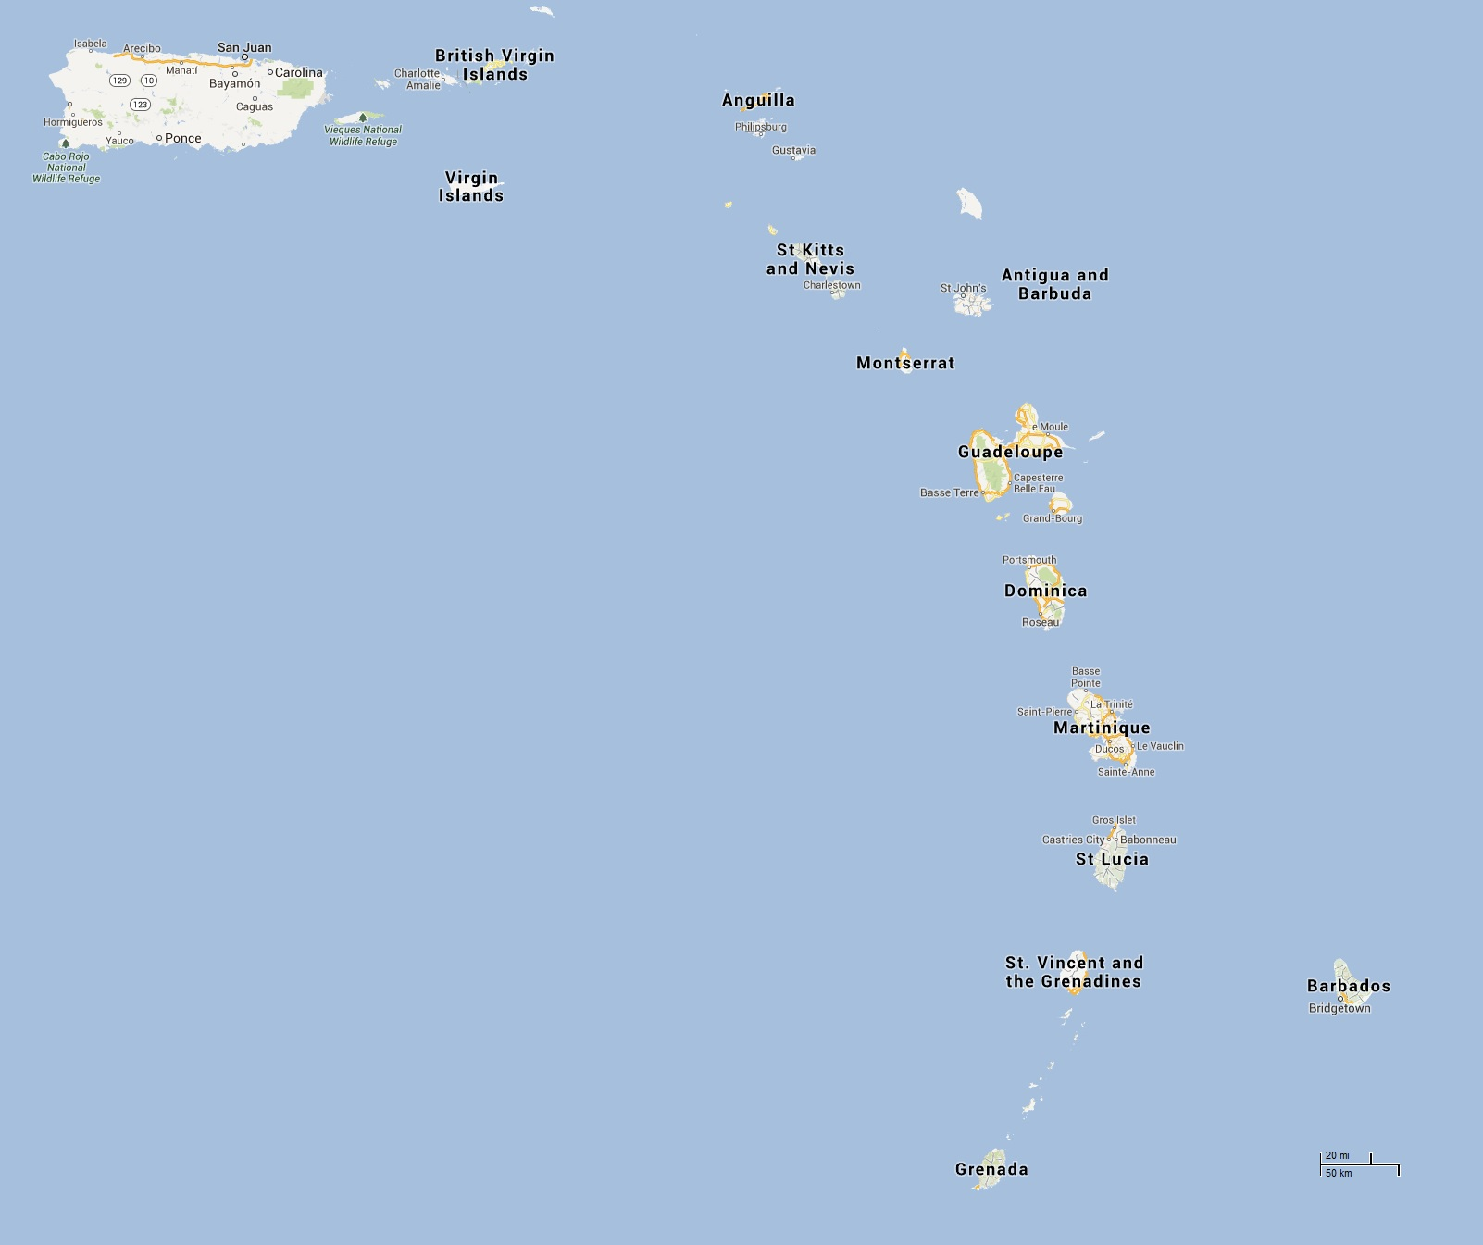
Barbados, the OECS, 3 OTs

Slide 3
Hard core vulnerability
Natural hazards and climate change
Small size and openness
Changing demographic patterns
Increasing levels of unemployment and under-employment
Dependence on fossil fuels
Ongoing loss of experienced skilled professionals to larger countries
Rising food prices and growing dependence on food imports to meet domestic needs
Limited progress in developing and deploying science and technology to address common development challenges
Loss of social cohesion and rising criminal activity and drug use

Slide 4
UNDP in the Eastern Caribbean
Programme structured around a set of priorities:
Improved governance and regulation of environmental and energy issues taking account of the 2012 Barbados Declaration and post Rio+20 policy and programme priorities;
Evidence-based inclusive governance and citizen security policy and programme development;
Harmonisation of social, environmental and economic data collection and increased use of evidence-based policy and decision-making processes at the subregional and national level;
Improved social protection services and systems to reduce poverty and inequity, with increased economic participation and social inclusion projects that target vulnerable populations.

Slide 5
UNDP in the Eastern Caribbean
Reaffirmation of SIDS specific, frameworks
-Post 2015 consultations Grenada and St. Lucia
-7 SIDS 2014 National consultations
-Regional/Inter Regional Preparatory Meetings for SIDS 2014
Economic, environmental, social dimensions

Slide 6
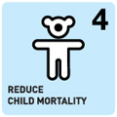
MDGs 8 Goals, 18 targets and 48 indicators
Already an integrated framework, from which we can identify lessons, challenges going forward.
Political, technical, institutional fragmentation.

Slide 7
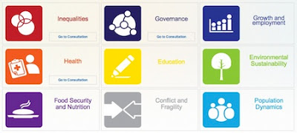
The World We Want Post 2015
A Comprehensive, Integrative and Sustainable Approach to Development

Slide 8
Propositions
Sustainable development is not possible without comprehensive data collection on both social and environmental factors
A ‘Data Revolution’ is required to secure a Human rights based development approach in Barbados and the OECS for example multi-dimensional approaches to measuring poverty, and social inequality and recognition that GDP is not an adequate measure of development

Slide 9
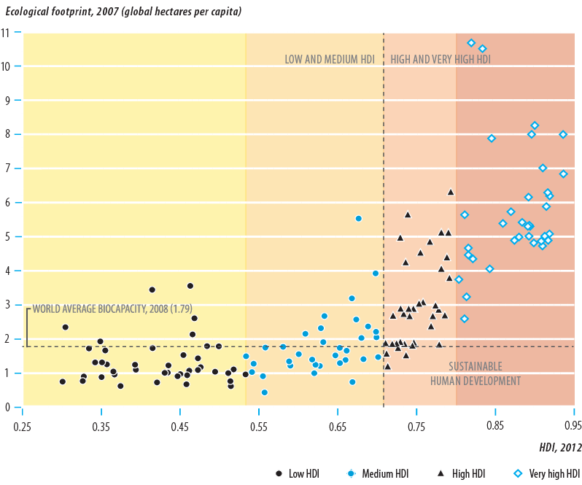
Confronting environmental challenges
Notes:
What we see here is that countries that rank under the category of High and Very high human development need to look at the environmental sustainability of their development model.
To ensure sustainable economies and societies, new policies and structural changes are needed. Low emission, climate resilient and innovative public private financing mechanisms must be adopted to achieve human development.

Slide 10
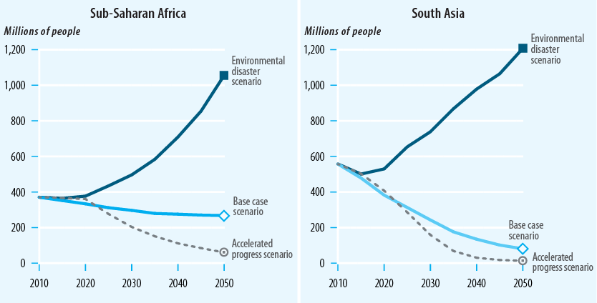
Cost of inaction: potential environmental impact on poverty
Notes:
The risk is that if the environmental challenges are not confronted gains in human development and poverty reduction will be reversed.

Slide 11
3 examples
1. Assessing and Addressing Loss and Damage Resulting from Slow Onset Events Associated with Climate Change in Small Island Developing States (SIDS)
Ways to assess and address loss and damage from climate change
How loss and damage is assessed has direct implications for how loss and damage is addressed.
Develop regional expertise and sources of information to help SIDS address loss and damage.
Creation and collection of a list of data needs as well as the level of data required to implement a robust assessment.
Notes:
Climate-related impacts can cause irreparable loss, such as loss of freshwater sources, as well as damage than can be repaired or restored, such as wind damage to a roof. Here we focus on loss and damage in small island developing states (SIDS) resulting from sea level rise, increasing temperatures, ocean acidification, and other slow-onset events (SOEs) related to climate change.

Slide 12
3 examples
2. Adoption of a Multi-dimensional Approach to Poverty
Develop a policy framework to ensure the MPM approach is widely adopted and applied
Develop a permanent, sustainable sub-regional mechanism to support the MPM approach and the periodic measurement of the MPI
Invest in the mainstreaming of an understanding of multidimensional poverty in public opinion debates, policy and programme design

Slide 13
3 examples
-Use UNDP/Oxford model -3 dimensions
-Include dimensions -income/employment (under LS)
-Make decisions about the indicators
St. Lucia, Grenada, Dominica, St. Kitts, Barbados

Slide 14
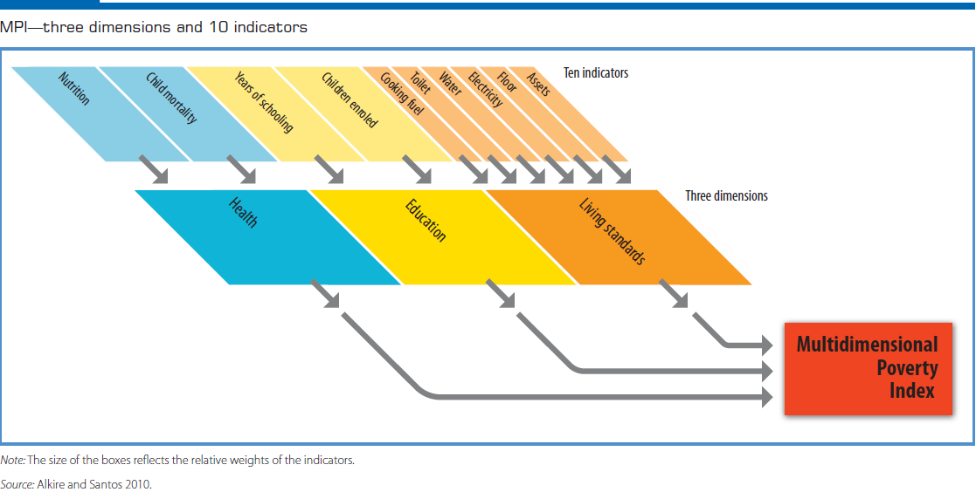
MPI
Employment/Income
Environmental vulnerability

Slide 15
3 examples
3. UNDP/UNISDR/WB GFDRR initiative to develop Loss Accounting databases to support enhanced risk management in public sector.
-Strengthening of national databases on hazard impacts;
-Development of inputs to inform specifics of DRR strategies;
-Incorporation of DRR into national public investment and development.
Notes:
Loss excedence curves

Slide 16
Among other strategic priorities
Support to structural transformation of productive capacities through:
Policies, systems and measures in place to support jobs and livelihood investments in sustainable development
Inclusive and sustainable social protection
Natural systems management on national and sub-national levels
Increased energy efficiency
Scaling up of interventions for disaster risk reduction and climate change mitigation and adaption

Slide 17
UNDPs Energy Programming for Sustainable Development
Balancing production and consumption
Developing renewable energy sources
Improving accountability of energy service providers with a focus on the State
Participatory decision making
Monitoring the impact of energy policies at national, regional and global levels

Slide 18
UNDP Initiatives which SEEA can support
The UNDP-UNEP Poverty-Environment Initiative (PEI)
Green, Low-Emission and Climate-Resilient Development Strategies and related green economy work
Notes:
PEI: was launched in 2005 to support integrated development planning for poverty reduction and inclusive green growth at national, sector and local levels. The SEEA could be used to inform some aspects of PEI, including the ecosystem accounts and other high priority PEI areas.

Slide 19
Relevance of SEEA to UNDPs Work
Will provide information for evidence based decision making
Will compliment the HDI and family of indexes
Will compliment the MPI and will serve to expand UNDPs range of data collection tools to address key areas of development

Slide 20
If development is our business, data is our raw material

