Slide 1
Carbon Stock Accounting: a report on progress within Australia and estimates of geocarbon
19th meeting of the London Group, 12-14 November 2013

Slide 2
Overview
Carbon stock accounts in the SEEA
The need for carbon stock and flow information
Developing carbon stock accounts for Australia
Preliminary estimates of geocarbon stocks for Australia
Questions for London Group

Slide 3
Carbon stock accounts in the SEEA
Briefly mentioned in the SEEA Central Framework
Articulated in the SEEA Experimental Ecosystem Accounts (SEEA EEA) – Table 4.6
- SEEA EEA text also encourages a classification that reflects quality differences among different reservoirs

Slide 4
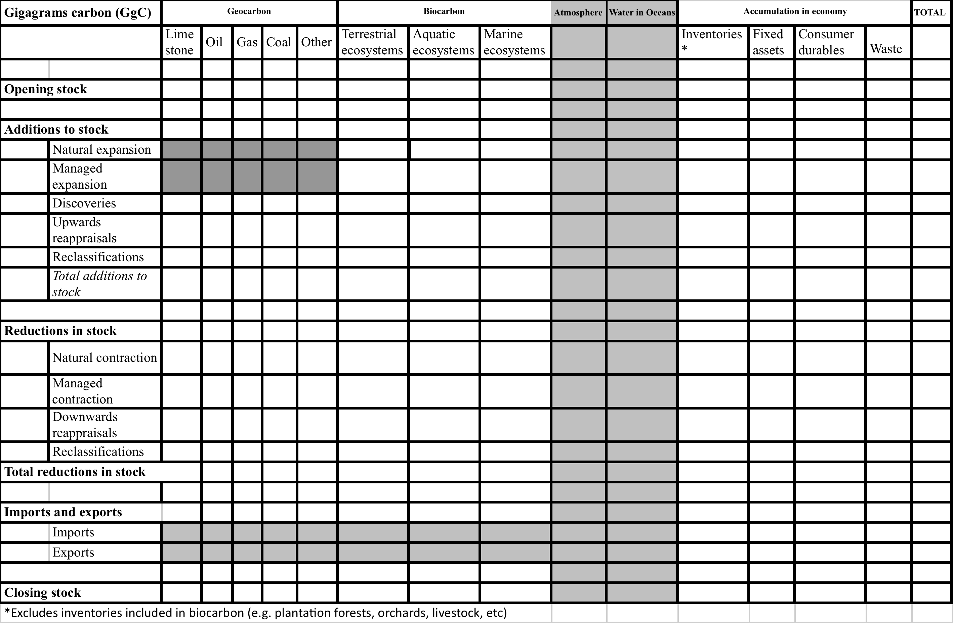
Carbon stock accounts in the SEEA, continued… (SEEA EEA Table 4.5)

Slide 5
The need for carbon stock accounts
Kyoto protocol and UNFCCC reporting designed to deliver flow information i.e. GHG emissions to atmosphere
Carbon stock and flow accounts support more complete understanding of the carbon cycle
e.g. at present, certain policies target the biosphere for achieving atmospheric carbon goals
Stock information on the biosphere can inform on how easily carbon moves from biosphere to the atmosphere and elsewhere

Slide 6
Global carbon flows
Billion tonnes carbon
Atmosphere
Data in this diagram are reproduced from
Ajani et al. 2013.
3.6 ± 0.2
atmospheric increase in 2011
(measured)
Oceans
Geosphere
Biosphere
est. 3.4ª
ocean sink in 2011
(calibrated modelling)
0.9 ± 0.5
land use change emissions 2011 (measured/modelled)
9.5 ± 0.5
fossil fuels & cement emissions 2011 (measured)
est 3.4ª
land sink in 2011 (estimated as residual)
Permanent removals from the atmosphere
- 0.1 a year (i.e. carbon deposits on ocean floor)^{b}
Applying reported removals of anthropogenic emissions by natural sinks during 2002-2011, in percentage terms.
Estimated by Freely et al. 2004 as a long term annual average.

Slide 7
Developing carbon stock accounts for Australia
Initiative of the ANU Coombs Policy Forum – collaboration between ANU, ABS and Department of Environment (DoE). Project objectives:
Identify need for carbon stock accounts
Experiment to populate SEEA Carbon Stock Account
Identify research priorities, further refine accounts
Present findings and recommendations to Australian government (and internationally)
Assess what is needed for a regular carbon account for Australia
Notes:
Solid progress to date against objectives 1, 2 and 3.

Slide 8
Developing carbon stock accounts for Australia, continued…
A research paper is currently being drafted and relates to the first 3 of these 5 objectives
This paper aims also to provide the following focus points for a workshop of key Australian stakeholders:
The need for carbon stock and flow information
Estimating geocarbon and biocarbon
Statistical units, classifications etc, and
Linkages to existing carbon information
Notes:
Solid progress to date against objectives 1, 2 and 3.

Slide 9
Primary reservoir | Geocarbon Tonnes Carbon (million) | Hectares (million) | Biocarbon Tonnes Carbon (million)
 |  |  | Biomass carbon | Soil organic carbon | Total Biocarbon
Geocarbon
Fossil fuel
Black coal | 242300^{d}
Brown coal | 278500 ^{d}
Crude oil^{b} | 146
LPG^{c} | 91
Natural gas | 1629
Shale oil | 82864
Total fossil fuel | 605530
Carbonate rocks
Limestone | n.r.
Other carbonate rocks | n.r.
Total carbonate rocks | n.r.
Other (includes methane clathrates) | n.r.
Biocarbon
Natural ecosystems
Rangelands |  | 596.3 | X | X | X
Non rangelands:
Eucalypt native forests |  | 16.7 | X | X | X
Shrub lands & woodlands |  | 14.7 | X | X | X
Grass, shrub & heath lands |  | 1.6 | X | X | X
Rainforests |  | 2.3 | X | X | X
Other |  | 0.7 | X | X | X
Marine ecosystems |  | 1.8 | X | X | X
Fresh water ecosystems |  | 9.9 | X | X | X
Total Natural ecosystems |  | 644.0 | X | X | X
Semi-natural ecosystems
Highly modified rangelands |  | 50.0 | X | X | X
Grazing in modified pastures outside rangelands |  | 32.9 | X | X | X
Total Semi-natural ecosystems |  | 82.9 | X | X | X
Agricultural ecosystems
Cropping |  | 25.5 | X | X | X
Irrigated agriculture |  | 2.6 | X | X | X
Plantation wood |  | 2.4 | X | X | X
Reservoir/dam |  | 0.6 | X | X | X
Other |  | 6.3 | X | X | X
Total Agriculture ecosystems |  | 37.4 | X | X | X
Settlements |  | 2.6 | X | X | X
Other |  | 0.5 | X | X | X
Total biocarbon |  | 3.1 | X | X | X
Preliminary estimates of geocarbon stocks in Australia
(tonnes million, carbon)
Notes:
Estimates of geocarbon for coal are preliminary and subject to likely revision, pending assessment of carbon content factors for coal resources.

Slide 10
Questions for London Group
Have any other agencies begun work on carbon stock accounts?
Are there important information sources that have been overlooked in the Australian work?
What should the scope of physical carbon accounts be? (noting that the scope for the SNA is economically demonstrated resources)
Notes:
Solid progress to date against objectives 1, 2 and 3.

