Slide 1
‘Exchange-Value’ Accounting for Ecosystem Services
Mark Eigenraam
14 November 2013, Prepared for London Group on Environmental Accounting
19th Meeting, London

Slide 2
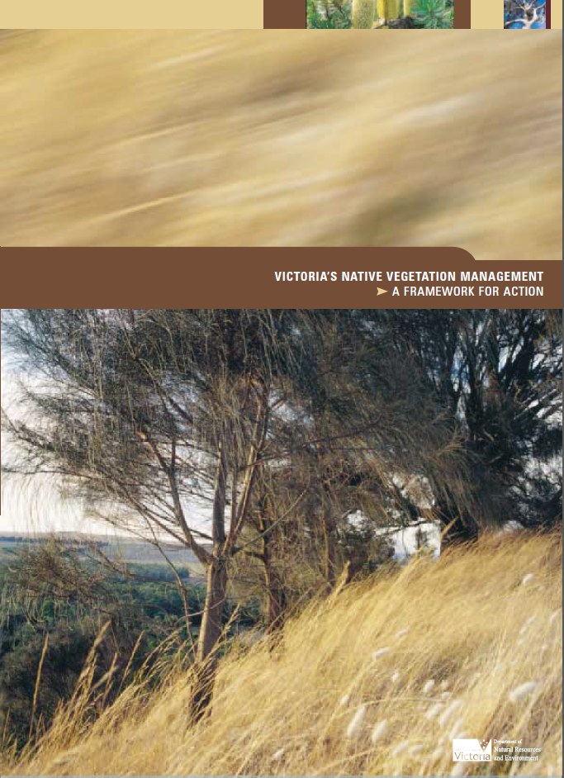
A brief history…
2005
2007
2012
2002
2013
Vegetation policy -
“Net Gain”
• Native Vegetation Credit Register
• BushBroker
OFFSETS
INVESTMENT
• BushTender
http://www.dse.vic.gov.au/land-management/victorias-native-vegetation-management-a-framework-for-action
Notes:
Native Vegetation Management: A Framework for action (the Framework) was released in 2002. It was developed to implement the objectives of Victoria’s Biodiversity Strategy and the Australia’s Biodiversity Conservation Strategy 2010-2030.
The Main Goal: Net Gain
The Framework’s main goal is to achieve a reversal, across the entire landscape of the long-term decline in the extent and quality of native vegetation, leading to a net gain.
Net gain is where overall gains in native vegetation are greater than overall losses and where individual losses are avoided where possible. This recognises that although it’s better to retain existing native vegetation, it is possible to partially recover both amount and quality by active work and therefore improve the result as a whole. Net gain will be achieved as a result of landholder and government-assisted efforts to protect and improve native vegetation. In addition, permitted clearing must be offset in a way that adequately addresses the future impacts of such clearing.
The framework has four guiding principles:
1. Retention and management of remnant native vegetation is the best way to conserve biodiversity
2. Conservation of native vegetation and habitat depends on the maintenance of catchment processes.
3. Costs should be equitably shared according to benefits that the landholder, community and region get
4. A landscape approach to planning native vegetation management is required and priorities should be based on bioregions within Catchment Management Authority regions.
Quality vs Quantity
Most concern for native vegetation is focused on clearing, but maintaining good quality native vegetation is just as important for conserving plants and animals and for maintaining our land in good condition.
DEPI has developed a standard approach for estimating the quality of an area of vegetation. Known as habitat hectares, it measures a site’s condition and landscape context.
In applying the policy, there are three key steps for land managers and owners to address when considering vegetation clearing:
1. Avoid adverse impacts, particularly through vegetation clearance;
2. If impacts cannot be avoided, minimise impacts by careful planning, design and management; and
3. If clearing must occur, the clearing must be offset*
Native Vegetation offset market
Cap on total native vegetation
Clearing needs to be offset
Environmental Tenders
One sided market
Government is the main purchaser
Private firms and individuals manage their ecosystem assets to produce ecosystem services

Slide 3
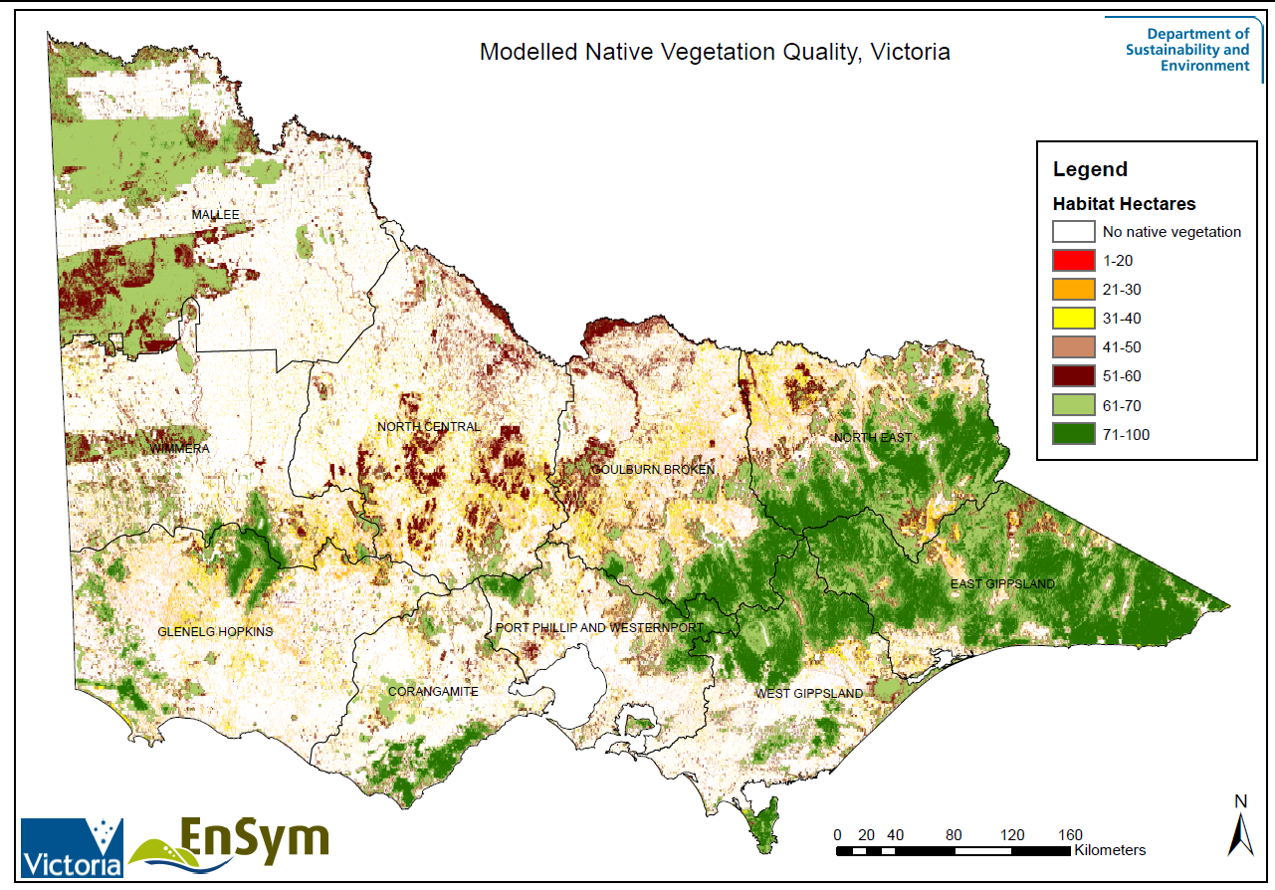
A brief history…
2002
2005
2007
2010
2013
Vegetation type, extent and condition mapping
http://mapshare2.dse.vic.gov.au/MapShare2EXT/imf.jsp?site=bim
Notes:
EVC benchmarks allow for comparison across different ecosystem types.

Slide 4
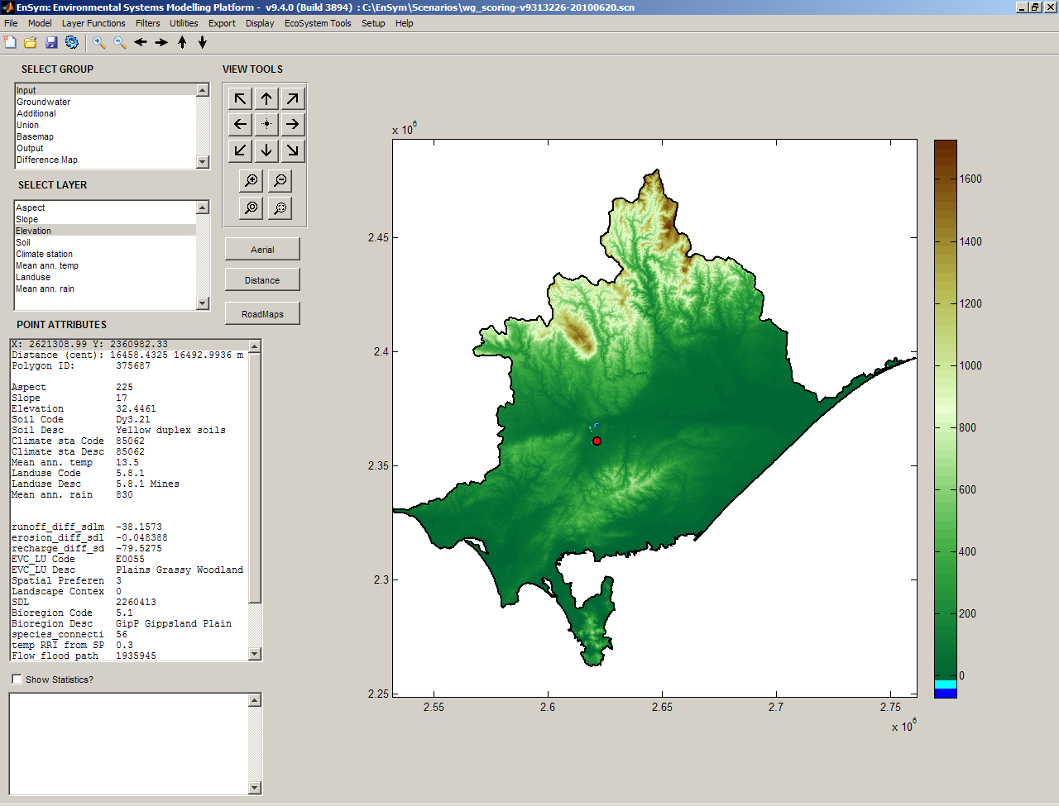
A brief history…
2002
2005
2007
2012
2013
ecoMarkets
• Payments for multiple ecosystem services
EnSym
• Environmental modelling
https://ensym.dse.vic.gov.au/cms/
Notes:
Unlike BushTender that looked at a single dimension (Terrestrial habitat), ecoMarkets looks at the multiple dimensions of environmental investment (e.g. Rivers, Wetlands, Soils, catchment condition, changes in ecosystem services)
A sophisticated tool was necessary to be able to predict the mulitple outcomes, this tool is known as EnSym.
ecoMarkets is a service delivery unit, focusing on deploying market based approaches to regional users. This map shows how extensively the approach has been used across the landscape.

Slide 5

More recently…
2005
2007
2012
2002
2013
Victorian Environmental Partnerships
http://www.depi.vic.gov.au/environment-and-wildlife/environmental-partnerships
Notes:
Environmental Partnerships is built on three aspirations:
Value the environment and what it has to offer.
Act to protect, conserve and maintain the environment.
Enjoy the wide range of benefits of a healthy environment now and into the future.
The Victorian Government has identified eight priorities which will help achieve these aspirations:
7. Drive best practice environmental regulation and innovative market approaches.
8. Ensure accountable and efficient environment agencies.

Slide 6
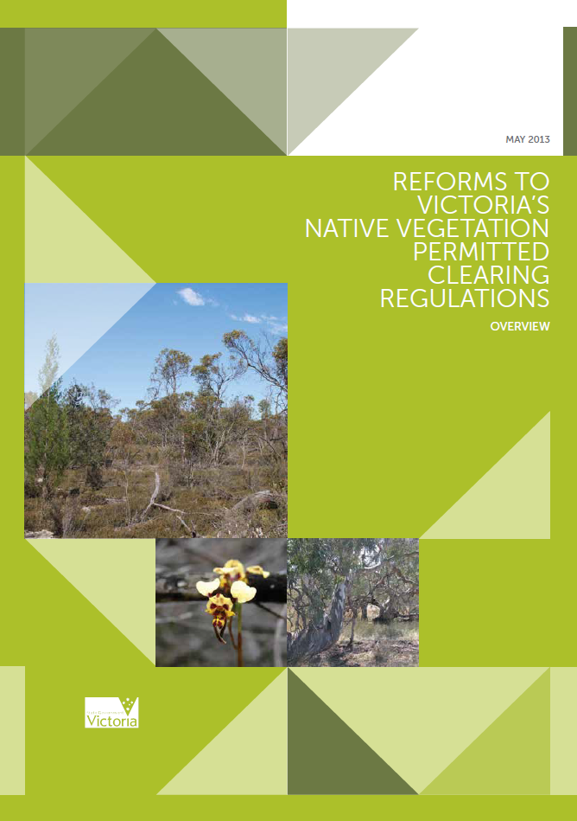
2005
2007
2012
2002
2013
Offset reform
http://www.depi.vic.gov.au/environment-and-wildlife/biodiversity/native-vegetation
Notes:
In September 2012, the Victorian Government announced a review of Victoria’s native vegetation permitted clearing regulations. The aim of the review was to improve and strengthen the regulatory system to deliver better outcomes for the environment and the community.
As a result of the review, reforms to the native vegetation permitted clearing regulations will be implemented. These will ensure:
>> a stronger focus on the value of native vegetation for statewide biodiversity
>> reduced regulatory burden for landholders while at the same time providing upfront information about the value of native vegetation on their land
>> improved decision making.
Reform 1 – Define state and local government regulatory and planning
Reform 2 – Better regulatory performance
Reform 3 – Improve offset market functionality
Reform 4 – New approaches to compliance and enforcement
Reform 5 – Continuous improvement program
Reform 3 – Improve offset market functionality
New processes and guidance materials are required to implement policy changes to improve the functionality of the offset market. These changes are designed to enhance offset market functionality through improved competition and increased flexibility of how offsets can be provided.
Measures to facilitate this include increased information availability and the provision of a broader range of offsetting options. This reform includes the expansion and improvement of over-the-counter offset programs, and the development of an integrity framework for offsetting on public land.

Slide 7
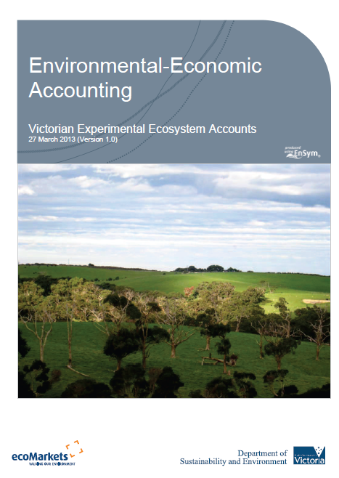
2005
2007
2012
2002
2013
Victorian Experimental-Ecosystem Accounts
“establish internationally recognisable environmental accounts that improve the way we allocate resources”
(Environmental Partnerships: Priority 8, 2012)
https://ensym.dse.vic.gov.au/cms/index.php?option=com_content&view=article&id=60&Itemid=71
Notes:
Environmental accounting it NOT a new approach to valuing ecosystem services
It is a framework to link economic activity to ecosystem assets and services
Environmental accounting is not a one of effort, it is about putting in place a system/framework
Provisioning services
Wheat, meat, forest products, wood, water, etc
Regulation and maintenance services
Pollination, air quality, biodiversity, water filtration, habitat, etc
Cultural services
Tourism, existence, amenity, etc

Slide 8
Current context
What does it mean for business, government and the economy?
  Bookable assets – marginal agricultural land
  Government resource allocation to the management of land for environmental and agriculture purposes etc
  Environmental markets – opportunities for investment
Notes:
Environmental Tenders
Provide an alternative income stream for land management the provides ecosystem services
Joint outcomes
Carbon, water, biodiversity, etc
Environmental accounts
Links economic agent (business) to the management of environmental assets
Provide standards that are common and understood by all market participants
Recognition of businesses use and or reliance on ecosystem services
Challenge
Bookable assets?
Bookable services?

Slide 9

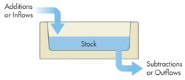

SEEA Central Framework (CF)
ASSET
ASSET
ASSET
1.
2.
3.
http://unstats.un.org/unsd/envaccounting/seearev/
Notes:
The SEEA Central Framework is based on agreed concepts, definitions, classifications, and accounting rules.
The SEEA provides information in relation to a broad spectrum of environmental and economic issues. For example:
the assessment of trends in the use and availability of natural resources,
the extent of emissions and discharges to the environment resulting from economic activity,
the amount of economic activity undertaken for environmental purposes.

Slide 10
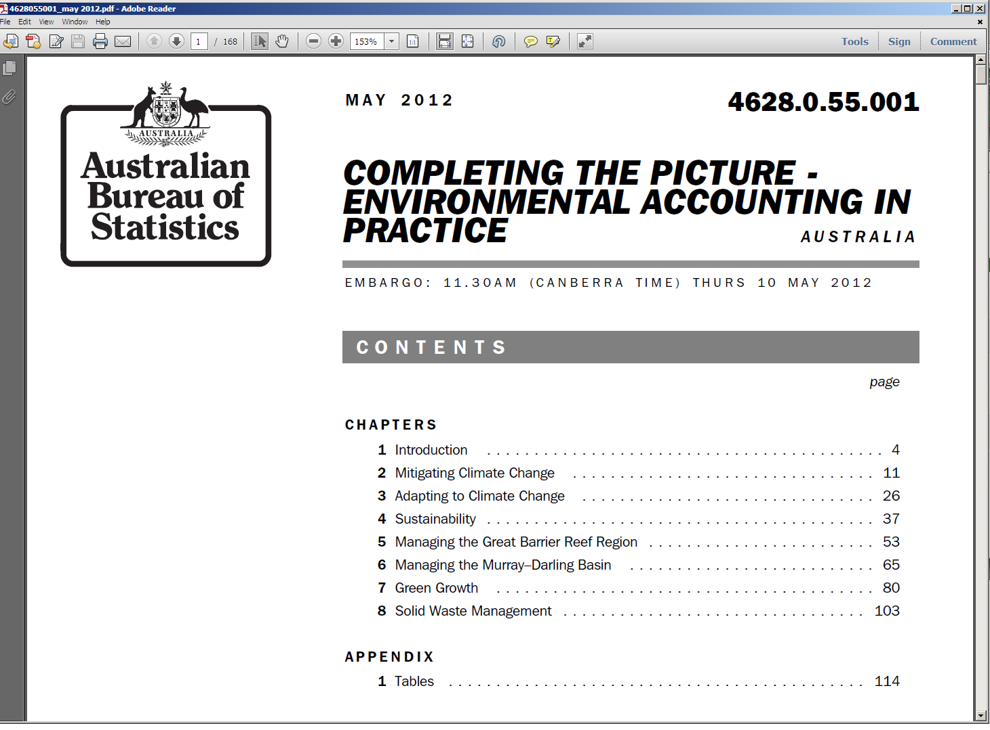
SEEA CF in practice
http://www.abs.gov.au/ausstats/abs@.nsf/mf/4628.0.55.001

Slide 11
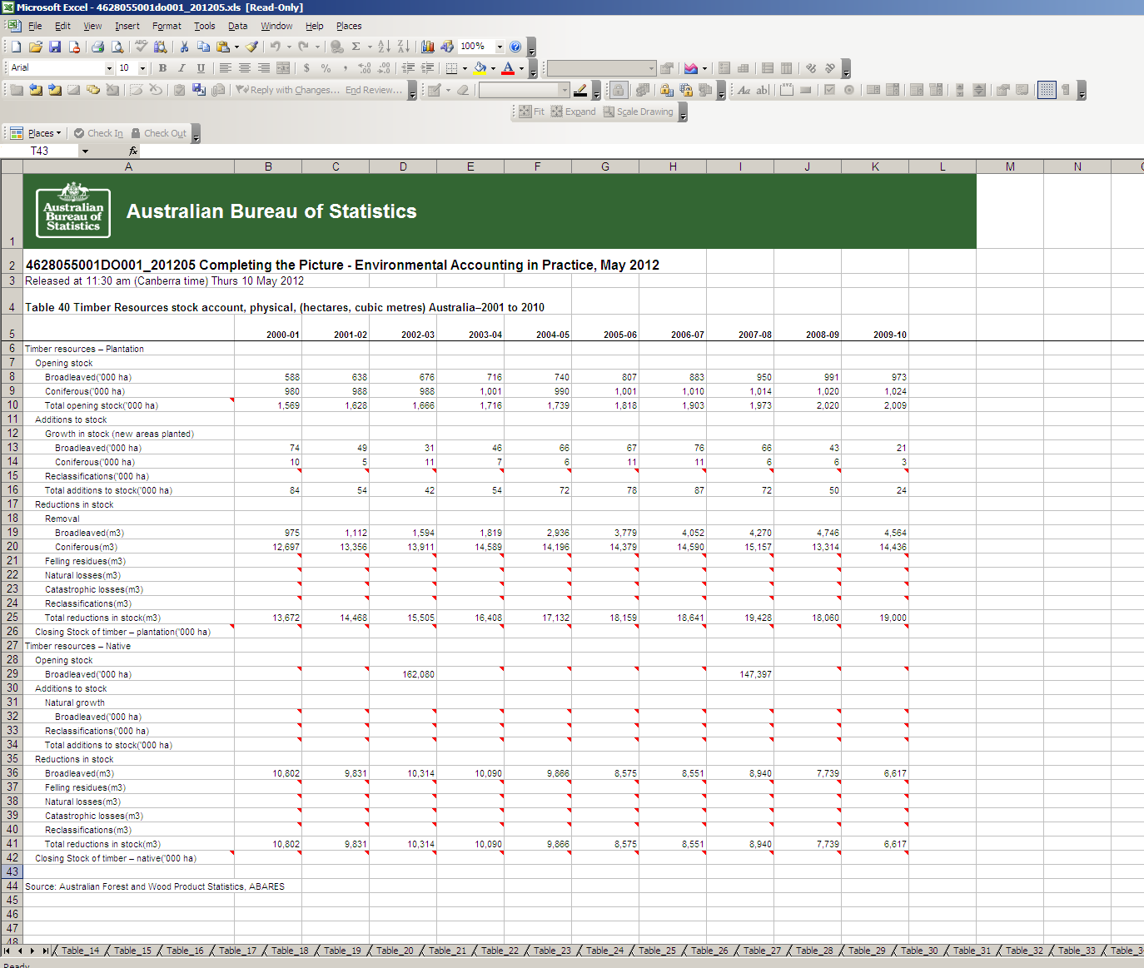
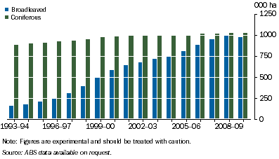
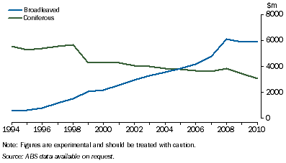
Spreadsheets & charts
7.16 Economic demonstrated stock of timber, Physical
7.17 Value of timber resources, Monetary
Notes:
Timber
The total area for hard wood (broad-leaved) and soft wood (coniferous) plantations almost doubled to reach 2 million hectares between 1994 and 2010. As Figure 7.16 shows, the majority of this change was due to the expansion in the area of broadleaved plantations. Between 1994 and 2000 hard wood timber plantation areas increased from 159,000 hectares to 973,000 hectares. The area of soft wood plantations remained relatively stable. A fall in price led to the market value of Australia's soft wood resource falling by 45% between 1994 and 2010.

Slide 12
Services
SEEA Ecosystem Accounts
ASSET
Services
Services
Services
Victorian approach to Ecosystem Accounts
Notes:
SEEA Experimental Ecosystem Accounts: provide a consistent and coherent summary of the state of the art of using a systems approach to the measurement of ecosystems within a broad framework that extends on the SEEA Central Framework.
SEEA Experimental Ecosystem accounts:
Measurement of the flow of benefits to humanity by ecosystems
Measurement of environmental conditions in terms of the capacity of ecosystems to provide benefits.
Increasingly, policies in all areas of public concern are being considered in a more integrated, multi-disciplinary fashion with economic, social and environmental factors being assessed in determining appropriate policy responses. In this regard the integrated structure of the ecosystem accounts is of particular relevance. Ecosystem accounts will provide a new perspective that can be used to support decisions on the most effective use of ecosystems in support of human well-being.
Some of the key questions that could be answered with the information obtained from ecosystem accounts include:
Which ecosystems produce the most important ecosystem services? What ecosystem services are produced?
Which ecosystems are in the best condition and which are the most degraded?
What changes have occurred over time—have ecosystems become more degraded? What was the impact on the provision of ecosystem services?
What monetary values can be attached to ecosystems? Which is the contribution of ecosystem services to the economy?
How do you optimize economic, environmental and social benefits and grow the economy while ensuring that the capacity of ecosystems to renew themselves and to provide services is maintained?

Slide 13
Victorian Ecosystem accounting concepts
Inter
Flows (input)
Ecosystem
Services (output)
ECOSYSTEM
ECOSYSTEM
ECONOMY/SOCIETY
Intra flows
Inter
Flows (output)
Intra flows
Inputs/Residuals
Eigenraam et al., 2012
Notes:
Experimental ecosystem accounts V1 –
• Existing condition data (intra) – terrestrial (Habitat Hectares – site condition), wetlands (IWC, threat based approach), rivers (ISC)
• Measures of inter-flows (inter) – terrestrial (Habitat Hectares – landscape context), wetlands (significance layer)
• Measures of ecosystem services – Environmental Benefits Index; disaggregated services like erosion control

Slide 14
Gross Ecosystem Product (GEP)
Step | Gross Domestic Product (GDP) | Gross Ecosystem Product (GEP)*
1 | Estimate the Gross Output of various economic activities | Estimate the Gross Ecosystem Output (clean air, water, etc) from an ecosystem asset (sum of ecosystem services and inter flows)
2 | Determine the intermediate consumption, i.e., the cost of material, supplies and services used to produce goods or services | Determine the inputs (inter-flows) to the asset, i.e., pollination, habitat, water, nutrients used to produce Gross Ecosystem Output
3 | Deduct intermediate consumption from Gross Output to obtain the Gross Value Added (summed for all businesses is GDP) | Deduct inputs from Gross Ecosystem Output to obtain the Gross Ecosystem Product
4 | Deduct depreciation from Gross Value Add to obtain Net Value Added | Deduct depreciation (degradation) from Gross Ecosystem Product to obtain Net Ecosystem Product
*) Eigenraam et al., 2012

Slide 15
Gross Ecosystem Product
Inter flows
(3.5 t/y nutrients)
Inter flows
(2.5 t/y nutrients)
GEP = 2.5 t/y
FOREST
Intra flows
Change GEP = 1.5 t/y
Ecosystem Service
- Clean water
The ecosystem (FOREST) is improved to process more nutrients
Inter flows
(3.5 t/y nutrients)
Inter flows
(1 t/y nutrients)
FOREST
GEP = 1 t/y
Intra flows

Slide 16
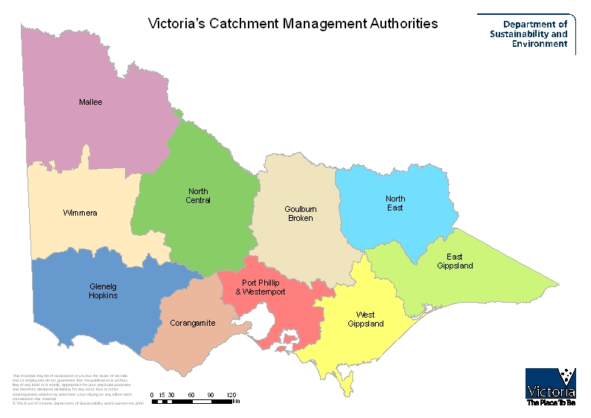

Slide 17
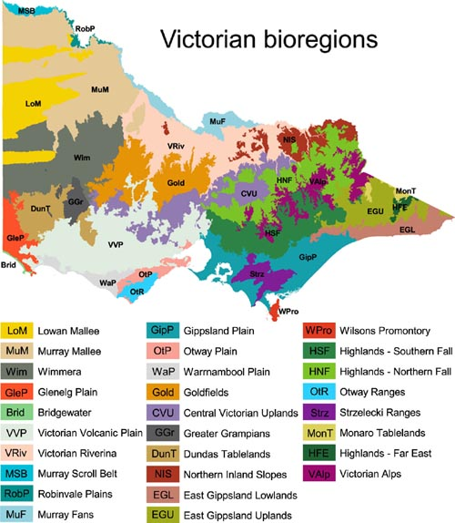

Slide 18
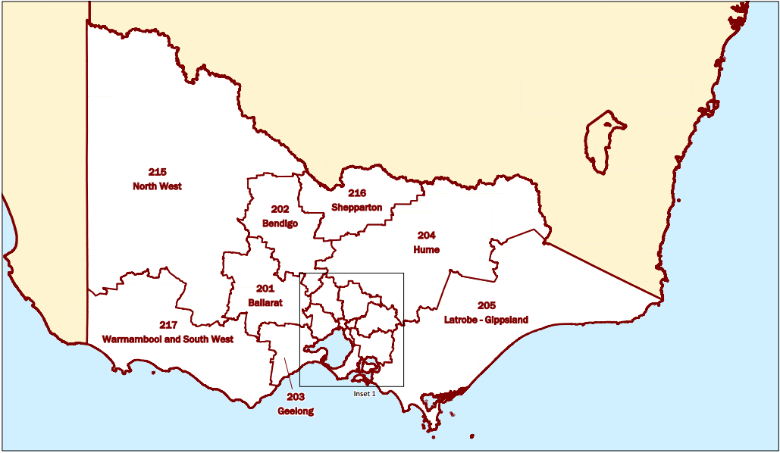
ABS – Statistical Areas Level 4

Slide 19
Table 14. Ecosystem service flow account, by land use, 2010 and 2015 (predicted)

Slide 20
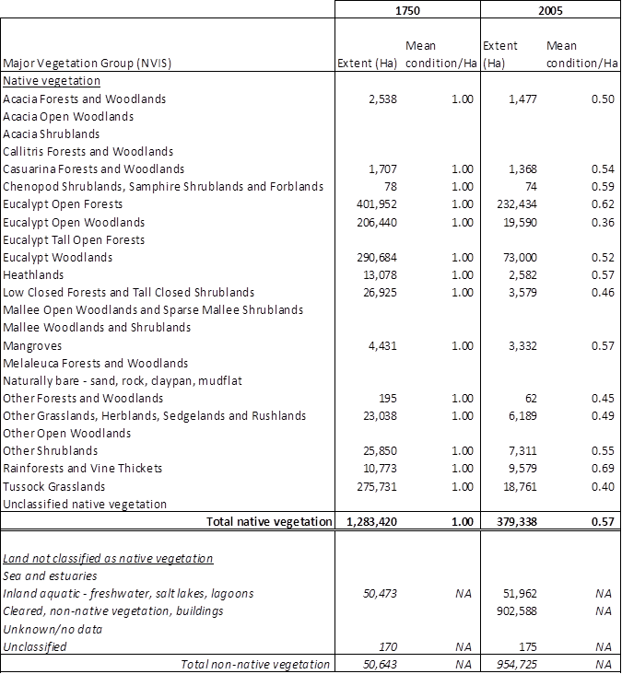
Corangamite Catchment Management Authority: Terrestrial vegetation type by area and average vegetation condition, 1750 and 2005

Slide 21
