Slide 1
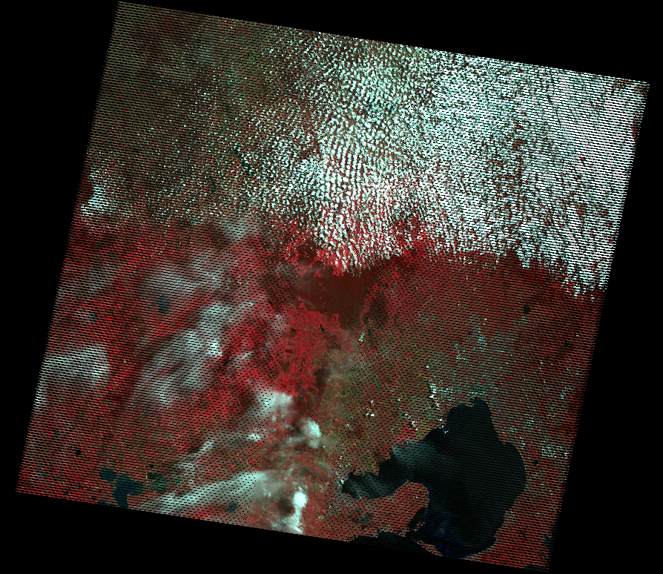
Big Data for Official Statistics Ian Ewing <affil> Chief Methodologist UNCEEA June, 2015

Slide 2
What is Big Data?
“… a blanket term for any collection of data sets so large and complex that it becomes difficult to process using on-hand database management tools or traditional data processing applications.” (Wiki, 2014)
“… there are many definitions of Big Data, which differ on whether you are a computer scientist, a financial analyst, or an entrepreneur pitching an idea to a venture capitalist…” – Big Data Privacy Report to President Obama
Big Data are the increasingly available digital trails (exhausts) from the ubiquitous information gathering technologies – ABS working definition

Slide 3
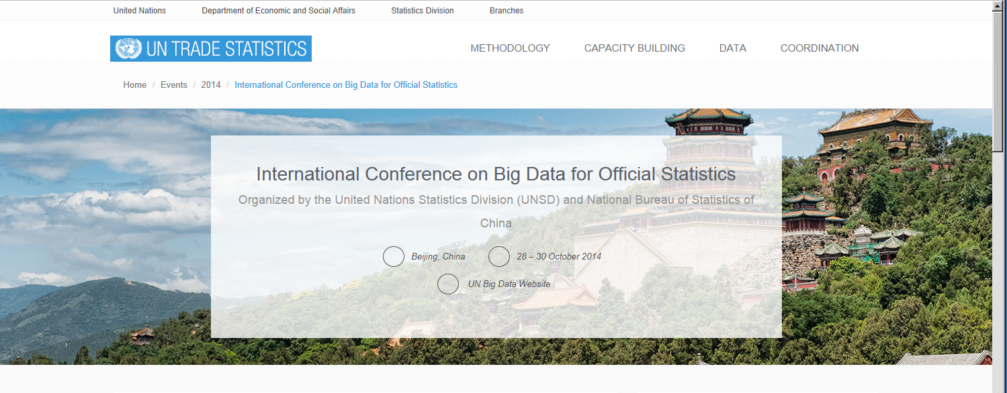
UN Statistics Division Global Working Group
UNSD and NBS China organised conference chaired by Trevor Sutton in 2014
Collocated inaugural meeting of GWG on Big Data for Official Statistics

Slide 4
9 Task Teams Established
Big Data and the Sustainable Development goals
Advocacy and Communication
Satellite Imagery, Remote Sensing and Geo-spatial Data
Social Media and Web-Scraping
Mobile Phone data
Access and Partnerships
Skills, Training and Capacity Building
Cross Cutting Issues
Coordination

Slide 5
Task Team on Satellite Imagery, Remote Sensing and Geo-spatial Data
Chaired by Siu-Ming Tam and coordinated by the ABS
7 national statistical agencies
9 international organisations and companies
UN Committee of Experts on Global Geospatial Information Management to be invited
Regular Meetings
Terms of Reference established and pilot studies commenced

Slide 6
TT on Satellite Imagery, Remote Sensing and Geo-spatial Data: Goals
Strategic vision and direction-setting for utilising satellite imagery and geo-spatial data for official statistics and indicators for post-2015 development goals.
Build methods to address challenges via pilot studies

Slide 7
TT on Satellite Imagery, Remote Sensing and Geo-spatial Data: Goals
Identify the most reliable and accurate statistical methods for estimating quantities of interest.
Suggest approaches for collecting representative training data of sufficient quality.
Research, develop and implement assessment methods for predictive models including measures of accuracy and goodness of fit.
Establish strategies to reuse and adapt algorithms across topics and to build implementations for large volumes of data.

Slide 8
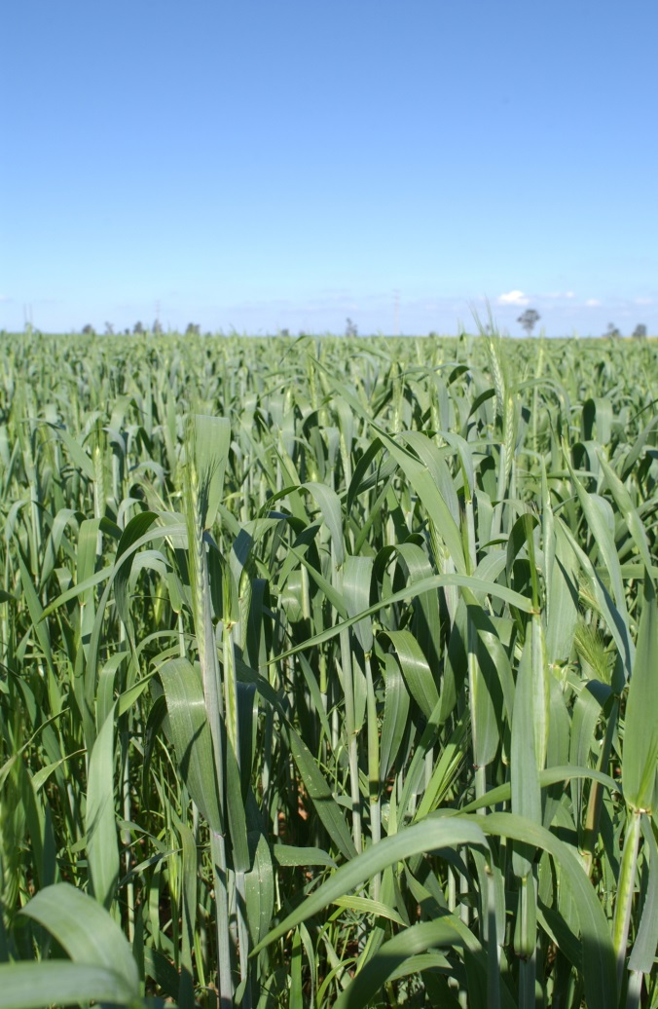
Pilots
Colombia: land urbanisation
Google: crude oil consumption
ABS: crop type and yield
ITU: Satellite capacity stocktake
UN FAO: validating agricultural observations
Mexico: Climate patterns
Mexico: Urban-rural systems statistics
QUT: Methodological analysis for agriculture

Slide 9
Agricultural Production and the Great Barrier Reef

Slide 10
What is a Land Account?
A tool for integrating data about a piece of land
Economic
Environmental
Social
A method of tracking change in land attributes such as land use, land cover and industry over time.
A method for identifying causes of change.
Land Account consist of a series of tables showing interactions with land measured in both physical and monetary terms.
Notes:
Land Account are part of a suite of environment-economic accounts being developed by the ABS under the United Nations (UN) System of Environmental and Economic Accounts (SEEA) framework - SEEA Definition Section 5.6.2 of the SEEA Central Framework covers the definition and classification of land. It states “Land is a unique environmental asset that delineates the space in which economic activities and environmental processes take place and within which environmental assets and economic assets are located.”
What are the main indictors of land stated by SEEA?
Land use – “Land use reflects both (i) the activities undertaken and (ii) the institutional arrangements put in place; for a given area for the purposes of economic production, or the maintenance and restoration of environmental functions”. (zoning – permitted use) Land cover – “refers to the observed physical and biological cover of the Earth’s surface” SEEA also highlights economic units (i.e. industry and institutional sector) as important information. Eg land owned by government and different industries.

Slide 11
Why a Land Account?
Land is fundamental to economic production
Land represents a major proportion of the nation’s value and is a significant cost of production
Worth $3,872.8 b (43.02%) in 2012-13
(Australia’s National Accounts)
The way we use land effects the quality of the environment
Integrated economic, environmental, and social data adds value – contributes to informed decision making
Notes:
So Why a Land Account?
Economically land represents a major proportion of a nations assets in the National Account (43 % in 2012-13) and represents a significant cost of production.
Also the way we use land has a large impact on the quality of the environment.
Integrating the economic, environmental and social data contributes to informed decision making.
The way we do this with land accounting is by measuring change in land use, land cover and ownership (by industry and industry sector) over time. Ideally we also try to record the reasons for this, but it is difficult to get this information.
The resultant land account can help us systematically track and respond to human impacts on land.

Slide 12
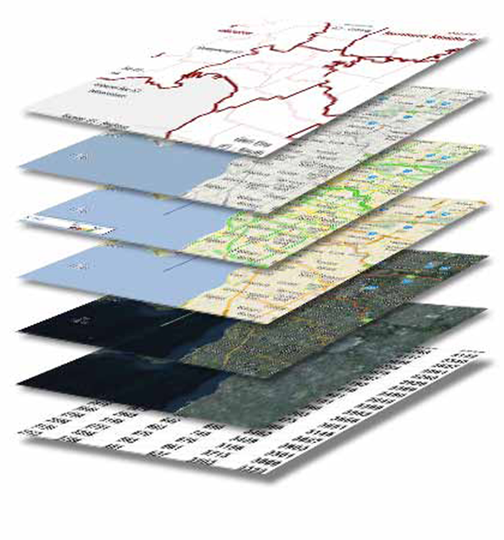
How is a Land Account prepared
Integrate existing environmental and economic information at the finest level possible.
Use Geographical Information Systems technology to integrate data.
Presenting results at various geographic levels.
Present results for at least two time periods
Notes:
It can’t be that hard can it?
In a perfect world where all the data was on the same geography, using the same standards and for the same reference periods it would be relatively easy.
The catch is we don’t live in a perfect world so we have to use spatial analysis to integrate the data
The general approach we’ve taken in producing the land account is to map as much information as possible to the property level using GIS to geocode and integrate it. We then aggregate it with other socio economic data at the SA1 level of geography, and provide cross classified information at higher levels of geography such as the Natural Resource Management region and state.
Then we repeat the process and introduce the tables that measure change.
10 steps are outlined in the ABS technical Note: Land Accounting (Version 1.1)

Slide 13
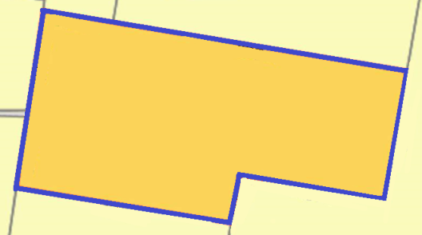
Spatial units
Land parcels - the areas of land defined by land ownership as identified in land title registers (this is the main unit ABS use for production of land accounts)
Gridded data - A raster grid consists of a matrix of cells where each cell contains a value representing information
Point data – data attributed to a particular point (e.g. via coordinates of latitude and longitude).
Notes:
Producing a land account is a very spatial process and the units used as the basis for production of land accounts are spatial units
The units commonly used are:
Land parcel – valuations data, including land use which we obtain from land management / valuation authorities (so this is the main unit ABS uses for construction of out land account)
Gridded data – dynamic land cover – processed and classified satellite remote sensing data
Point data – anything geocoded, i.e. business register where we have an address and need to obtain geographic coordinates

Slide 14
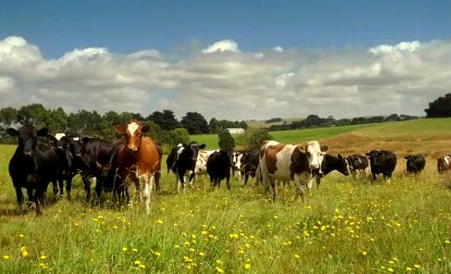
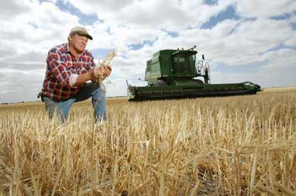
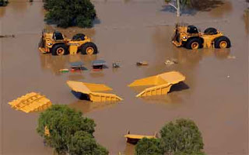
What has ABS done?
Past output Great Barrier Reef region in Queensland (2011)
Land Use by Industry (area and $)
Land Cover by Industry (area and $)
States of Victoria (2012) and Queensland (2013)
Land Cover by Land use (area)
Land Cover by Land use ($)
Great Barrier Reef region in Queensland (2014)
Land use change matrix (2009 – 2013)
Land cover change matrix (2009 – 2013)
Work in progress
State of South Australia (late 2015)
Land use change matrix (2006 – 2011)
Land cover change matrix (2006 – 2011)
Notes:
ABS has been working on land accounts since 2009, and has produced a number of “ experimental” land accounts since that time.
We are still experimenting with different data sources and working with users and data suppliers to determine the specifications and production methods – these have changed since the first land account.
Essentially we are now concentrating on measuring Land use and Land cover physical and monetary accounts, together with the change matrices. We are having trouble cross classifying by industry – or populating the reasons for change but expect improve address information in the Australian Business Register to facilitate Industry and Sector analysis in the next 1-2 years.

Slide 15
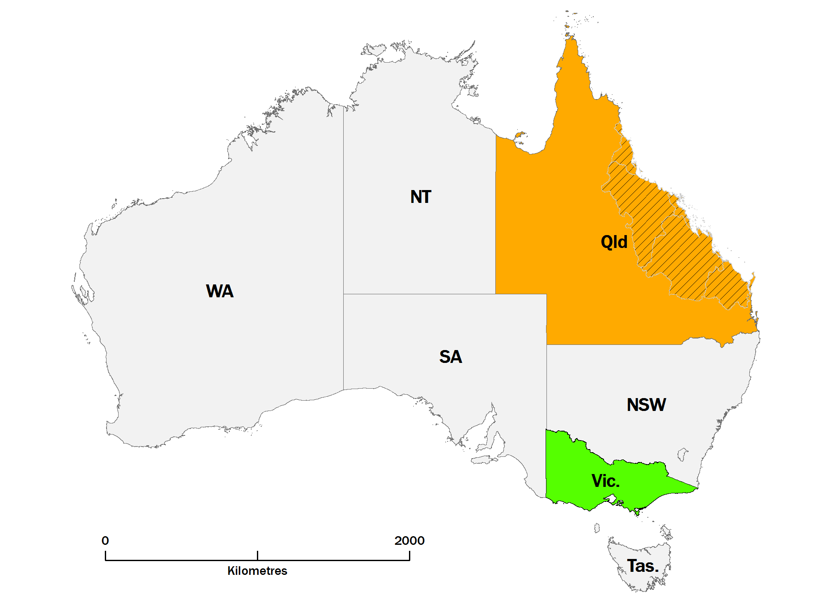
Notes:
Map of regions we’ve produced accounts for

Slide 16
Uses of the Land Account, informing debate on
population settlement;
understanding the impact on land of the mining and agricultural industries;
measuring the health of the environment;
understanding the economic, environmental and social costs and benefits of economic activities occurring on land;
public and private investment environmental protection, e.g. biodiversity conservation.
determining the value of land used for Coal Seam Gas production. How has it’s value changed since CSG extraction began?
(Insert your own use here!)
Notes:
The value of a set of land accounts is the ability to measure land attributes by examining stocks at different points in time to support policy around sustainable economic and environmental management.

Slide 17
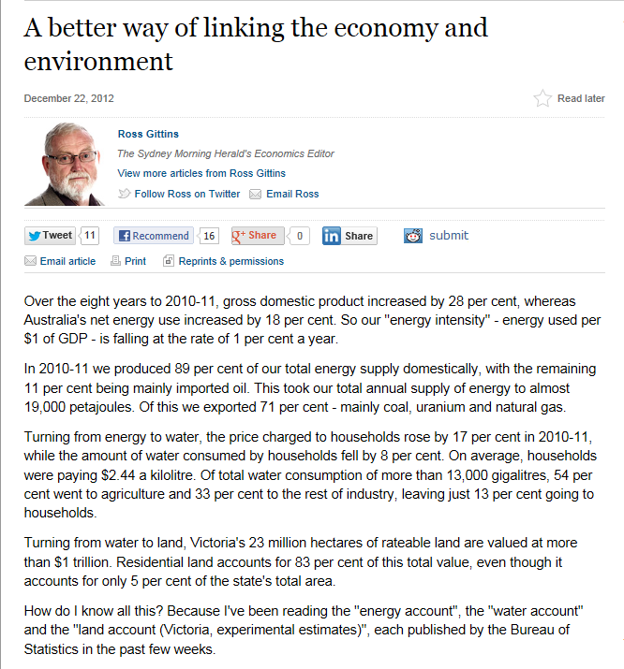
Notes:
A leading economic journalist published this article after our environmental accounts were published in December 2012.
He rarely wrote about energy, water and land statistics before because they were not published in an economically consumerable format. So we see that Environmental Economic Accounting can contribute to greater understanding by a broader audience, leading to increased use of this information for decision making.

Slide 18
Questions on Global Working Group:
Siu-Ming.Tam@abs.gov.au
Questions on Agricultural Production and the Great Barrier Reef: Shaun.Copley@abs.gov.au

