Slide 1
Data Accessibility, Confidentiality, Copyright and Meta-Data – Experience of Nepal
Pushpa Raj Poudel
Computer Officer
Data Processing and GIS Section
Central Bureau of Statistics (CBS), Nepal

Slide 2
Contents
National Statistical System in Nepal
Central Bureau of Statistics
Introduction
Objective
Structure
Coverage of Information
Demographic and Social Statistics
Economic Statistics
Compilation of Information
Primary Sources
Secondary Sources
Data Accessibility
Confidentiality
Copyright and Meta-Data

Slide 3
Statistical System in Nepal
Organizational Domain
CBS
Central Office with 3 Divisions and 15 Sections
33 Branch Statistical Offices (BSOs)
Other Agencies
Only few have separate section for statistical activities/work
Mostly within administrative wing

Slide 4
Statistical System in Nepal (cont:)
Legal Domain
Statistical Act 1958
The Act mandates CBS and no other agency of the government, person or organization to collect data for professional purposes.
Central Bank (NRB) Act : permits to collect financial statistics.
Self Governance Act : permits local bodies to collect information of its needs.
Etc.
Human Resources
Nepal Economic Planning and Statistics Service in CBS and
some ministries.
Not related to Statistical Service in many other ministries and organizations.

Slide 5
Statistical System in Nepal (cont:)
Technical Domain
Data Collection
enumeration, office records, GPS
Analysis
use of micro computer, statistical software
Dissemination
news media, electronic media, publications (hard print copies), CDs, micro data

Slide 6
Central Bureau of Statistics (CBS)
Introduction
CBS was created in 1958 -@)!% ;fn kf}if !& ut]_ by virtue Statistics Act, 2015 as the sole agency for the collection, consolidation, publication and analysis of statistics.

Slide 7
Objectives
To produce and provide reliable socioeconomic data to the government for plan and policy making.
To maintain coordination among all the governmental and non-governmental organization that conduct economic and social data collection, processing, analysis, and publication activities.
To provide appropriate condition for the development of standardized Statistical System in Nepal.
To provide training and develop statistical manpower in the country.

Slide 8
Organizational Structure of CBS
National Planning Commission Secretariat
National Statistical Council (NSC)
Central Bureau of Statistics
33 Branch Statistical Offices (BSOs)
Planning and HRM (PHRM) Division
Economic Statistics Division
Social Statistics Division
Planning , coordination Section
Establishment Census & Survey Section
Population Section
HRD and Training Section
Agriculture Statistics Section
Household Survey
Section
Publication, Distribution and Library Section
National Account Section
Social Statistics Section
Administration Section
Price Statistics Section
Data Processing and GIS Section
Financial Administration Section
Environment Statistics & Satellite Account
Trade Statistics Section

Slide 9
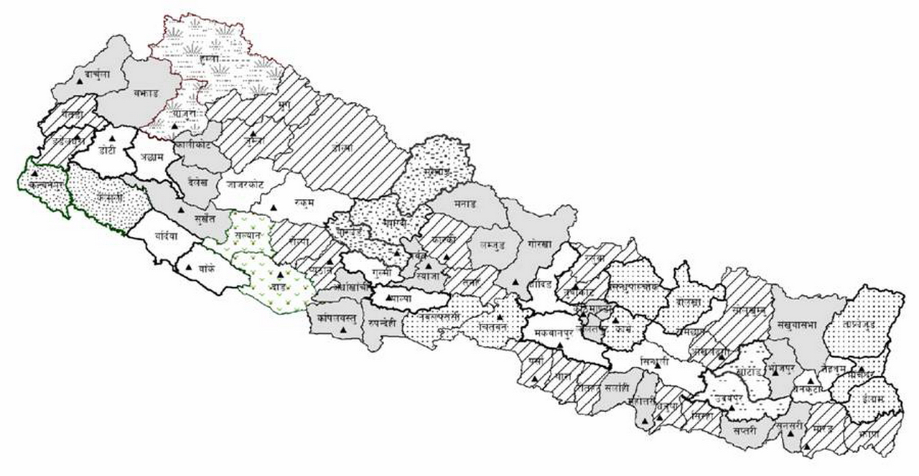
Branch Statistics Offices

Slide 10
Coverage of Information
Demographic and Social Statistics
Size and growth of population
Vital Statistics
Information on
Health
Education
Labor Force
Refugee
Crimes
Natural Disaster

Slide 11
Coverage of Information (contd:)
Economic Statistics
Information on
Food and Agriculture
Manufacturing establishments (Industries)
Tourism, Transport and Communication
Water, Power and Irrigation
Prices, Money and Banking
Government finance
Foreign trade and BOP
National Accounts
3. Environmental Statistics
Information on
Climate
Fauna and Flora
Waste collection and disposal

Slide 12
Compilation of Information
Primary Sources
Through Surveys and Censuses by CBS & BSOs
For example:
Population Censuses – Population statistics
Food and Livestock Surveys – Agriculture statistics
Nepal Living Standards Surveys – Poverty estimates
Nepal Labor Force Surveys – Economic activities & Labor force information
Censuses of Manufacturing Establishments – Industrial input and output

Slide 13
Compilation of Information (contd:)
Secondary Sources
Collection of official records from different governmental and non-governmental organizations
For example:
Ministry of Agriculture and Cooperatives
Annual estimates of crop yield, area under crops and livestock products
Central Bank of Nepal
CPI, WPI, BOP, Household budget survey (in every 5 years)
Ministry of Health
Annual Health Report, Demographic Health Survey (in every 5 years)
Ministry of Education and Sports
Flash report on education (number of students, teachers, schools)
Department of custom
Foreign Trade statistics
Ministry of Finance
Public finance and expenditure, Economic Survey

Slide 14
Data Accessibility in Practices
Publication of results and reports – Leaflet, Books
Use of electronic media – Press release
Free distribution and sale of publications (50%/50%)
Dissemination workshops/seminars at national, regional and district levels
Dissemination in electronic formats – CDs
Statistical Year Book/Statistical Pocket Book (Every Two years)
Population and Agriculture Census Results/Reports
Population census results from 1952-54 that previously published in hard copies are now converted to electronic formats and provided in CDs.
Household Survey Reports (NLSS, NLFS, …)
In Website (http://www.cbs.gov.np; census.gov.np)
Availability of Micro Data (for specific user’s need)

Slide 15
Data Confidentiality
Interim Constitution of Nepal, 2063 (2007): "right to information“ is balanced by "right to privacy". The Constitution guarantees that every citizen has the right to demand and receive information on any matter of public importance (except as provided by law). The Constitution, on the other hand, has declared the privacy of person, house, property, document, correspondence or information of anyone as inviolable (except as provided by law). Besides, there is a statistical act, which preserves the confidentiality of the respondents in the censuses and surveys.
Statistics Act, 2015: "any information or details relating to any person, family, firm or company, which has been supplied, obtained or prepared ... shall not be described or published directly except to the Director General or to any officer of the Bureau without the written permission or of his authorized representative supplying such information or details".

Slide 16
Data Confidentiality (Cont…)
CBS maintains the confidentiality and privacy of data providers in accordance to the Nepal Statistics Act, 2015. It guarantees the confidentiality of the individual data providers.
Further, CBS has to publish the notified order in the Gazette before collecting any information through censuses and surveys. These provisions support all dissemination activities, from publication to Internet access. Under these prevailing rules and regulations, the CBS is striving to make available and fully known to users the non-confidential information gathered by the Bureau.

Slide 17
Meta Data
CBS has maintained the Meta data since 1993 by the help of ADB (Crops and Livestock Survey (CLS) in Nepal.
Crops and Livestock Survey (CLS) 19993
Nepal Living Standard Survey (NLSS) 1995/96
Nepal labor Force Survey (NLFS) 1998/99
ADP in Nepal
In October 2009, the Nepal Central Bureau of Statistics (CBS) requested to be considered for the program after learning of the ADP from a participating country. Training on the Microdata Management Toolkit was held on 17-21 May 2010 to determine the country’s readiness to participate in the Program. After the training a Support Proposal was drawn up for the ADP implementation in the country. ADP in Nepal is being coordinated through PARIS21 with the assistance of the Philippine based consultants.

Slide 18
Meta Data (Cont…)
Support is provided to CBS for: - Conducting a DDI Production Workshop to document 10 surveys with microdata. - Controlling and improving the quality of the survey archives produced. - Developing and publishing an on-line catalog of surveys based on the IHSN NADA cataloguing application , which provide users with access to rich metadata. - documentation of surveys and online publication of DDIs.
Meta Data Source: ADP

Slide 19
Copy Right
CBS has no formal mechanism to protect the copyright of data it produces yet. I hope it will come in practice near future. In other sector it is gradually emerging this issue in Nepal even late hour.
Some Conditional provision – A new practice in CBS
All potential users of the NLSS and NLFS data set will be required to adhere to the following conditions:
1. NLSS and NLFS data is given to all users subject to the provision that (i) they duly acknowledge that the data used has been provided to them by CBS, and that (ii) CBS be provided with one copy of all publications in which NLFS data has been used.
2. They provide an undertaking that they will not pass copies of the data received to other
individuals or organizations without first obtaining written permission from CBS allowing them to
do so.
3. A fee will be levied on all users to cover the cost of preparation of the following materials. In the interests of encouraging as many users as possible to use the NLSS and NLFS data, this fee will be levied at a different rate on users according to the following criteria: ……………………..

Slide 20
Annex - I
Statistics Act 2015 (1958) :
+7 A. Permission of Central Bureau of Statistics required to collect data
Any government office, government owned such other organizations receiving government
aid for this purpose or foreign national
or any other institution desiring to collect any detail, information or data for professional
purpose shall have to obtain permission from
the Central Bureau of Statistics.
(2) Any person or organization, desiring to obtain permission for the purposes of collecting
data under subsection (1), shall provide detailed information to the Central Bureau of
Statistics regarding the purpose of collection of data, the area in which the collection is to
be made, the methodology for the collection of data and the programme for carrying out
such activities.
(3) If the request to collect data pursuant to subsection (1) appears to be reasonable, the
Central Bureau of Statistics shall give its permission. The Bureau may specify in its
permission the methodology and other conditions
deemed to be essential for such collection.
+ As inserted by the Statistics (Second Amendment) Act, 2030.

Slide 21
Annex – I (Cont…)
+7 B. Data to be authenticated before use or publication
Any person organisation, having obtained permission pursuant to Section 7A to collect data, shall before making use of or publishing such data, cause them to be authenticated by the Central Bureau if Statistics.
(2) In case the Central Bureau of Statistics has to incur expenses in connection with the
authentication of the data pursuant to subsection (1) above, the person or organisation
which seeks such authenticity shall pay the cost to the Bureau.
(3) No statistical information shall be given to any foreign national or institution or international institution without the permission of the Central Bureau of Statistics.
8. Restriction on publication of information and details
Any information or details relating to any person, family, firm or company, which has been supplied, obtained or prepared pursuant to section 3, section 4, section 5, section 6 to section 7, or any part of such information or details, shall not be disclosed or published directly except to the Director General or to any officer of the Bureau without the written
person or of his authorised representative supplying such information or details.
For the purpose of instituting any suit under this Act, nothing mentioned in sub-section (1)
shall be deemed to prevent production of such information before any court of law.

Slide 22
Annex – I (Cont…)
9. Punishment
Any person, having the duty to supply information or details pursuant to section 3, section 4 or section
5 committing any of the following offences shall be liable to be punished with *fine up to two hundred
rupees or imprisonment up to two months or both for each offence.
*(a) Deliberately withholding or refusing to supply information or details within the prescribed
period;
Deliberately giving or causing to give false information or details. Provided that if any offence
Under this sub-section is committed by any company or any corporate organisation, except when it is
Proved that the crime was committed without their knowledge or that they had done their utmost to
Prevent such crime, the Director, Manager, Secretary or any other Officer or representative of such
company shall be punishable with +fine up to three hundred rupees or with imprisonment up to three
months or both.
(2) Any person obstructing the exercise of power of the Director General or any other officer
authorised by him under section 6 to make entry into any house or land pursuant to clause (a)of the
same section, or deliberately refusing to produce any document or article required to be produced
pursuant to clause (b) of the same section, or refusing to answer any queries or deliberately giving false
answers to inquiries made pursuant to clause (d) of the same section, shall be liable to be fined up to
rupees one hundred or imprisonment upto one month or both.
+ As inserted by the Statistics (Second Amendment) Act, 2030.
* As amended by the Statistics (Amendment) Act, 2018.

Slide 23
Annex – I (Cont…)
*(2.A) Any person or organisation, who collects data without obtaining prior permission in accordance with section 7 A, or who collects the data against the methodology or the conditions stipulated while granting permission or who makes use of any data or published it without
obtaining prior authentication pursuant to section 7 B. Before using or publishing them, shall be punishable with a fine upto five thousand rupees for each such offence.
Provided that if any offense is committed under this subsection by any corporate organisation, the punishment under this section shall be imposed on the General Manager, Manager of the chief of the organization except it is proved that the offence was committed without his
knowledge.
In case the Director General or any officer of the Bureau or any officer authorised under
this Act commits any of the following offences he shall be liable to punishment for each such
offence with a fine upto two hundred rupees or with imprisonment up to two months or both:-
Has published any information or details or any part thereof in contravention of Section 8.
Does not carry out or refuses to carry out any order issued in pursuant to this Act or
the rules there under, or does not exercise due care or show promptness; or (c) Has destroyed statistical records negligently, or deliberately or has caused damage to such record in any manner, or has fabricated or used in any other manner, so as to cause wrong results, or has used such record for his personal gains or unauthorized purpose.

Slide 24
Annex – I (Cont…)
Any person who obtains information or details from any authorised officer or any officer of the Bureau in contravention of Section 8, shall be liable to punishment with fine up to two hundred rupees or with imprisonment up to two months or both.
Provided that if the information so obtained has been published as well, the punishment shall extend up to five hundred rupees as fine or imprisonment up to two months or both.
(5) Any person who induces the general public not to obey any order issued pursuant to this
Act or not supply information or details lawfully demanded by any authorised officer, shall be liable to be punished
with *fine up to five hundred rupees or imprisonment up to five months or both.

Slide 25
Thank You !

