Slide 1
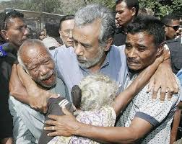
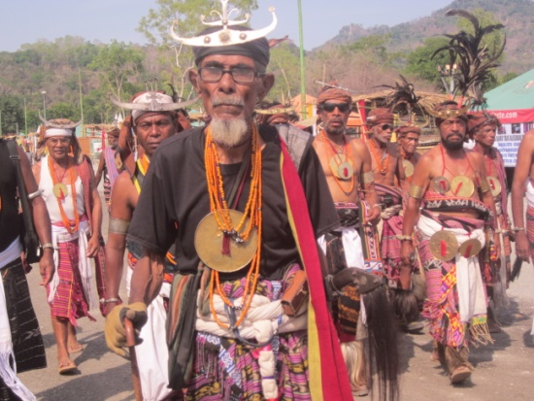
Country best strategies to improve Vital Statistics
Timor-Leste
Daejeon, 30 May 2014

Slide 2
Is vital statistics produced from civil registration?
To the context of
Timor-Leste,
the answer
would be
Yes,

Slide 3
Health and Administration Data
Birth Registration and Certificate

Slide 4
Vital Registration In Timor-Leste
Civil Registration Vital Statistics | Centralized System (in Central Government)
Responsible Implementention | Department Civil Registry (Ministry of Justice)
Data Collection System | Ministry of Justice: District Office, Mobile Registration Ministry of Health: Hospital and Cummunity Health Center Ministry of State Administration : Head of Villagese General Directorate of Statistics – Harmonization all data and final reporting for CRVS
How data is registered | National level and District level ( at time birth of the child, completed by a competent health worker. And death by village heads, for marriage and divorce by ministry of justice)

Slide 5
Does the vital statistics system ensures Universal coverage? If no, elaborate
Yes, it does

Slide 6
Coverage
Confidentiality? Yes, as top priority. DGE practices is personal information or micro-data only use for statistics purpose (Degree law no 17/2003);.
Regular dissemination? Yes, the dissemination process twice in a year, based on Mid-year and annual.

Slide 7
What is the role of health institutions in the system?
Providing administration data through HIS to NSO and line Ministries
In Collaboration Civil Registration-Ministry of Justice, issuing birth and death certificate.

Slide 8
Is there a body coordinating between statistics, civil registration, health and other institutions?
CRVS scheme in Timor-Leste, the committee been established at the nation wide.
National committee for CRVS-Lead by Prime Minister;
The Technical Committee;
CRVS Secretariat

Slide 9
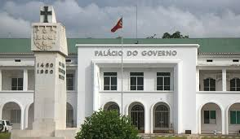
Advocacy
NSO
National Committee
SDP CRVS
TIMOR - LESTE
Resolution of CRVS
report every 6 months and annual
Technical committee
Co-ordination Body

Slide 10
Do the definitions of vital events in the vital statistics system comply with international standards?
Yes

Slide 11
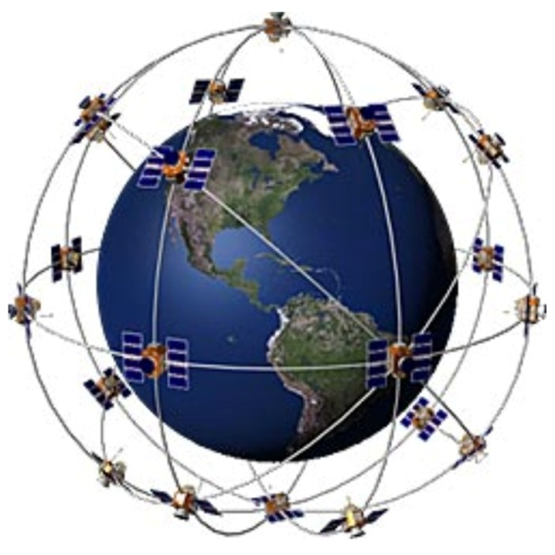
Definition of Vital Statistics system
“ Vital statistics constitute the collection of statistics on vital events in a lifetime of a person as well as relevant characteristics of the events themselves and of the person and persons concerned. Vital statistics provide crucial and critical information on the population in a country".
Data are to be collected for vital statistics purposes and its recommended definition is provided directly below:
“ Live birth , Death, Foetal death (First Priority )”
“Marriages, Divorces ( Second priority )”
“ Annulment, Judicial separations, adoptions,
Legitimation and recognition (Third Priority ) “

Slide 12
Does the list of topics in the vital statistics system comply with internationally recommended core topics?
Yes

Slide 13
What is the coverage of civil registration?
CRVS in Timor-Leste, is universal coverage. Capturing vital events occurring every geographical and every population group.
Administrative Data at National level, Districts, Sub-districts and Sucos/Villages
Information recorded at Ministry of Health trough hospital and post health;
Villages information recorded at Ministry of State Administration;

Slide 14
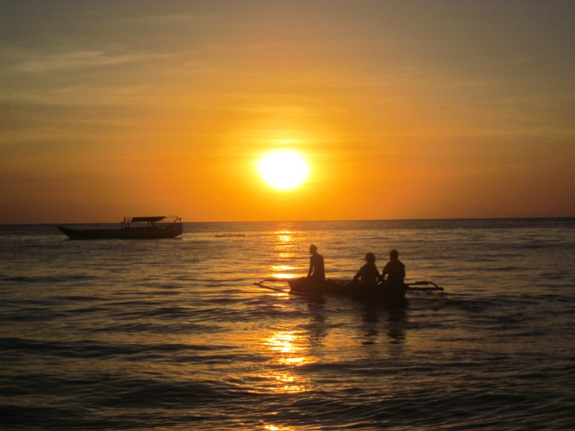
Methods
Direct Methods and
Administration Data

Slide 15
Are any of the quality assessment methods applied in the vital statistics system?
Yes,
Country Through Rapid Assessment/Yearly (WHO, UNICEF, MOH,MOJ AND NSO );
Assessment trough Technical committee.

Slide 16
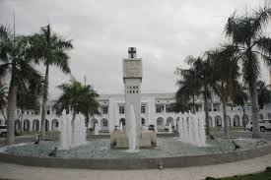
Elaborate on possible strategies to align the vital statistics system in your country with international standards?

Slide 17
Strategies of implementation CRVS
The New Resolution of Establishment of a National Steering Committee in the capacity of providing direction, oversight and mandate to CRVS system in Timor-Leste;
Development of strategy plan for implementation CRVS in Timor – Leste according to International Standard;
Continue investment on program Capacity and Capability
Dissemination and civic education to Institution
implement CRVS and user;
Routine Assessment every year
and monitoring evaluation
Notes:
This committee will be comprised of key individuals involved in making decisions in relation to development of the CRVS vision.
The steering committee will coordinate, oversee implementation and monitor, evaluate activities on an ongoing basis

Slide 18
Action Areas
Political commitment
Public engagement and participation
Coordination
Policies, legislation and implementation of regulations (CABINET RESOLUTION )
Infrastructure and resources
Operational procedures, practices and innovations (SDP TL-CRVS)
Data quality, production, dissemination and use of vital statistics

Slide 19
Recommendations
Regular assessment from United Nations Statistics Division on quality of CRVS result and action plan for improvement ;
Simple guide line for implementation CRVS especially for public education ( Civic Education program) ;
Continue program capacity and capability building on CRVS;
Standardization of use IT for CRVS (TL)

Slide 20
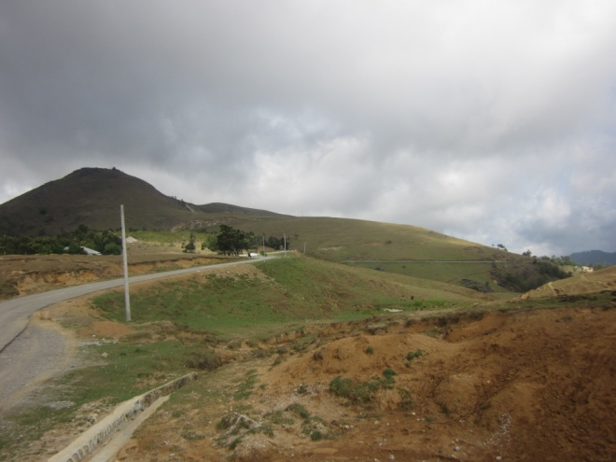
Conclusion
The Politic will on implantation of CRVS is very determine ;
Formulation SDP-CRVS in Timor – Leste as guide;
Strengthening coordination in country between line Ministry implementation CRVS;
Understand the standard International for CRVS and I line with National plan;
Dissemination and publication of
result of CRVS

Slide 21
Obrigado
Thank you

