Slide 1
Measuring violence against women: the case of Mexico
International Seminar on Gender Statistics,
Incheon Korea
13 November 2013
Jimena Tovar

Slide 2
Sample: At the national and state level
ENDIREH 2003
ENDIREH 2006, 2011
Urban and rural areas
11 states:
Baja California
Coahuila
Chiapas
Chihuahua
Hidalgo
Michoacán
Nuevo León
Quintana Roo
Sonora
Yucatán
Zacatecas
At the national level
Urban and rural areas
With representativity for the 32 states of Mexico

Slide 3
National Survey on the Dynamics of the Relationship within the Households (ENDIREH) 2003, 2006, 2011: Population
Population | 2011 | 2006 | 2003
Total women of 15 years old and older | 152 636 | 133 398 | 34 184
Married or united women | 87 169 | 83 159 | 34 184
Women separated, divorced or widows | 27 203 | 15 773
Single women | 38 264 | 34 466

Slide 4
National Survey on the Dynamics of the Relationship in the Households (ENDIREH) 2011
Objectives:
To generate statistical information related to violence inflicted:
by their partners, in terms of frequency and magnitude; and
at school, in the realm of work and at the community level.

Slide 5
Methodological Considerations of (ENDIREH) 2011
Unit of analysis: All women 15 years or older, regular residents of the household selected, classified in three groups:
Unit of Analysis
Women united, or living together
Women not united (separated, widows, divorced)
Women never united (single women that have not lived with a partner)

Slide 6
Design of National Survey on the Dynamics of the Relationship in the Households (ENDIREH) 2011
Appropriate informer:
Women fifteen years old or older, resident of the household, with information of the rest of the family members.
Depending of the situation of the women the appropriate questionnaire was used.

Slide 7
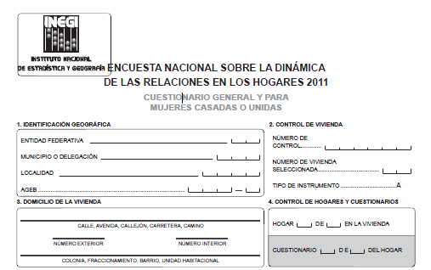
Data collection tools
Questionnaire for women married or united;
Contents:
Information of household characteristics and its members
Specific section with information of women, married or united

Slide 8
Data collection tools
Questionnaire for women once united:
Includes questions to women once united (separated, divorced or widows) with no relation of actual cohabitation
Questionnaire for single women:
Includes a battery of questions for single women (that have never been united)

Slide 9
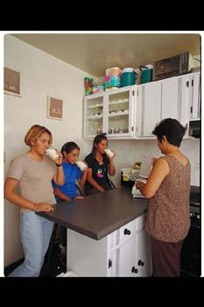
DISEÑO DE LA ENDIREH 2011
Design of ENDIREH 2011
Components of the questionnaire:
Characteristics of the household
Residents and Household
Socio-demographic data
Work, school and social setting
Family origin
Proprietary situation
Life in couple
Tensions and conflicts

Slide 10
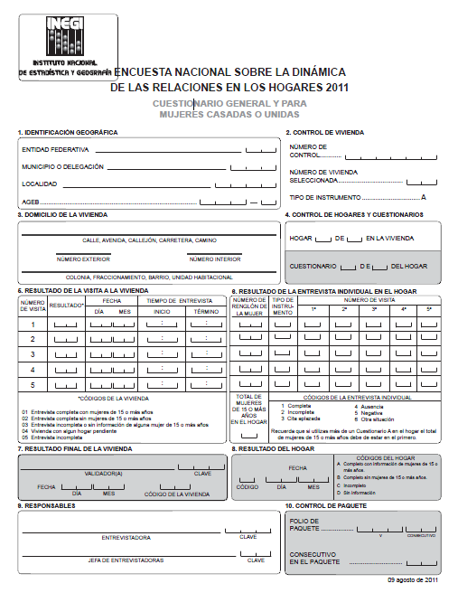
Design of ENDIREH 2011
Components of questionnaire
Relationship
Decision making
Economic contribution and
access to resources
Personal freedom
Opinions on female and male roles
Social resources
Distribution of household chores
Women 60 years old or more

Slide 11
Preliminar results
Violence perpetuated by her partner:
Proportion of Women 15 years or older, actually united or previously united, that have experienced violence from their partner:
46.1% of the cases at the National level
At the local level:
Highest in the State of México: 56.9%
Lowest in Chiapas state: 29.8%
13.5% were victims of physical violence that caused temporal or permanent damage
7.3% reported being victim of sexual violence
42.4% have suffered emotional or psychological aggressions
24.5% lack control of their income

Slide 12
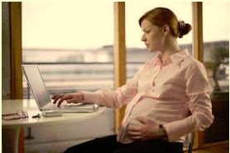
Preliminar Results
Violence against women in working settings:
A proportion of 20.6% of interviewed women, ages 15 years old or more with a job, have stated they had faced discrimination in their working place in the last year.

Slide 13
Percentage of women married or united, 15 years old or more, that have stated at least one incident of violence by her partner , by number of unions and type of violence 2011.
 | Emotional | Economical | Physical | Sexual | Total
During the relation | 40.0 | 25.3 | 11.6 | 5.2 | 44.8
One union or marriage | 39.4 | 24.8 | 11.3 | 5.0 | 44.3
Two or more unions or marriages | 45.3 | 30.2 | 13.8 | 7.0 | 50.1
In the last 12 months | 27.4 | 17.3 | 6.3 | 2.8 | 33.7
One union or marriage | 26.5 | 16.6 | 6.0 | 2.6 | 32.8
Two or more unions or marriages | 35.0 | 24.2 | 9.0 | 4.5 | 41.9

Slide 14
Survey Results
Violence by their partner in the last 12 months
In 201, in Mexico, there were 42.6 million women, 15 years old or more; 93.4% of them (39.8 million), had a partner.
Of the 39.8 million women, 15 years old or more, that had a partner: 62.7% were united or married, 10.6% separated or divorced, 7.8% widows and 18.9% singles.
Of the total number of women: united, separated or divorced, and single with ex-partners: 29.4% (10,787,103 million) suffered at least some event of violence (emotional, economical, physical or sexual) in the last 12 months (1010 to 1110), by the actual o last partner or husband.

Slide 15
Survey Results
It is estimated that 9.1 million (24.8 %) suffered emotional violence, 4.7 million (13 %) economical violence, 1.9 million (5.2% ) suffered at least one physical aggression, and 920 thousand some type of sexual aggression from the actual partner or last partner or husband in the last 12 months.
The age groups that present the highest rates of violence are: women 20 to 29 and 30 to 39 years old.

Slide 16
Rate of prevalence of violence against women, 15 years old and more, excercised by their partners or ex partners in the last 12 months, per age group and type of violence (2011)
Age Group | Total | Emotional | Economic | Physical | Sexual
Total | 29.4 | 24.8 | 13.0 | 5.2 | 2.5
15-17 | 29.6 | 28.4 | 4.3 | 3.1 | 1.9
18-19 | 31.2 | 28.6 | 8.0 | 4.4 | 1.9
20-29 | 32.8 | 28.6 | 13.9 | 5.6 | 2.0
30-39 | 33.3 | 27.8 | 17.1 | 5.9 | 2.9
40-49 | 28.2 | 23.0 | 14.3 | 5.5 | 3.1
50-59 | 25.4 | 19.8 | 12.2 | 5.0 | 3.1
60-69 | 20.5 | 15.5 | 8.7 | 4.3 | 1.7
70 and more | 15.0 | 10.7 | 4.6 | 4.3 | 1.2
Not specified | 13.0 | 11.7 | 6.0 | 4.1 | 1.0
Note: Includes women 15 years or older married or in union, separated and divorced and single. Excludes widows
Source: INEGI ENRIEH 2011 Estimations SESVCM of DGEGSP

Slide 17
Survey Results
Violence exercised against women by location: urban vis a vis rural areas
Of every 100 women living in urban areas, 49 had suffered violence from their partner (or ex partner) during their relationship, and 28 had suffered violence in the last 12 months.
In rural areas (less than 2,500 inhabitants), 41 % suffered violence exercised by their partner thru the life span of their relationship; and 24%, in the last 12 months.

Slide 18
Survey Results: Rate of prevalence of violence exercised against women 15 years old or more, by their partner, per age group and geographical location.
Age | Violence by actual partner (or last) | During the relationship | Violence by actual partner (or last) | In the last 12 months
 | Urban | Rural | Urban | Rural
Total | 48.6 | 41.2 | 28.2 | 24.2
15-24 | 43.0 | 36.3 | 32.3 | 27.0
25-34 | 50.5 | 41.6 | 35.4 | 28.8
35-44 | 51.9 | 43.4 | 30.8 | 27.1
45-54 | 51.6 | 43.1 | 26.2 | 23.8
55 and older | 46.7 | 42.8 | 15.6 | 13.8
Not specified | 37.4 | 28.8 | 11.6 | 5.6
Source: INEGI, ENDIREH 2011 Estimations SESVCM of DGEGSP

Slide 19
Survey Results
Women 15 years old or more, in rural areas, had suffered less emotional and economic violence in the last 12 months by their partner; but more physical and sexual violence, relative to women in urban areas.

Slide 20
Rate of prevalence of violence against women 15 years old or more, exercised by their partner, by period of reference, type of violence, depending and location.
 | Total | Urban | Rural
During the relationship | 47.0 | 48.6 | 41.2
Emotional | 43.1 | 44.8 | 36.8
Economic | 24.5 | 25.4 | 21.0
Physical | 14.0 | 13.9 | 14.5
Sexual | 7.3 | 7.4 | 7.0
Last 12 months | 27.3 | 28.2 | 24.2
Emotional | 23.0 | 24.1 | 19.3
Economic | 12.1 | 12.5 | 10.8
Physical | 4.9 | 4.8 | 5.3
Sexual | 2.3 | 2.3 | 2.5
Source: INEGI ENDIREH 2011, Estimations SESVCM of DGEGSP

Slide 21
Survey Results
Violence against women exercised by their partner in terms of native language:
During the last relationship ( in the last 12 months) for native women (43.7% and 22.4%) is less than the rate for non-native women (47.2 % and 27.7%).
By type of violence: For emotional and economic violence rates are higher than for non-native (43.3 % and 24.7%) with respect to native (39.5 % and 21.9%); For physical and sexual violence, rates are higher in native women (17 % and 9.2 %) non-native women (13.8 % and 7.2%).

Slide 22
Rate of prevalence of violence exercised by their partner, by age group and condition of speaking native language
Age | Non native speaker (during the relationship) | Native speaker (during the relationship) | Non native speaker (in the last 12 months) | Native speaker (in the last 12 months)
Total | 47.2 | 43.7 | 27.7 | 22.4
15-24 | 41.7 | 36.1 | 31.4 | 24.4
25-34 | 48.8 | 43.5 | 34.2 | 29.4
35-44 | 50.5 | 44.0 | 30.3 | 25.6
45-54 | 50.1 | 48.2 | 25.9 | 23.4
55 and older | 45.9 | 45.1 | 15.4 | 12.6
Source: INEGI ENDIREH 2011 Estimations SESVCM of DGEGSP

Slide 23
Type of violence according to condition of speaking native language
Age | Emotional |  | Economic |  | Physical |  | Sexual
 | Native | Non-Native | Native | Non-Native | Native | Non-Native | Native | Non-Native
Total | 39.5 | 43.3 | 21.9 | 24.7 | 17.0 | 13.8 | 9.2 | 7.2
15-24 | 32.7 | 39.1 | 10.9 | 12.7 | 7.7 | 7.2 | 3.0 | 2.9
25-34 | 38.7 | 44.2 | 20.2 | 25.3 | 13.7 | 12.2 | 6.2 | 5.4
35-44 | 39.7 | 46.1 | 24.0 | 29.4 | 16.1 | 15.6 | 9.6 | 8.0
45-54 | 44.3 | 46.2 | 25.5 | 30.3 | 21.1 | 17.1 | 13.6 | 10.1
55 and older | 40.5 | 41.8 | 25.1 | 27.6 | 22.7 | 18.3 | 11.8 | 10.7
Source: INEGI ENDIREH 2011, Data base

