Slide 1
Integrating a Gender Perspective into Time Use Statistics

Slide 2
Availability of Gender Statistics
Many areas related to the contribution of women and men in the economy

Slide 3
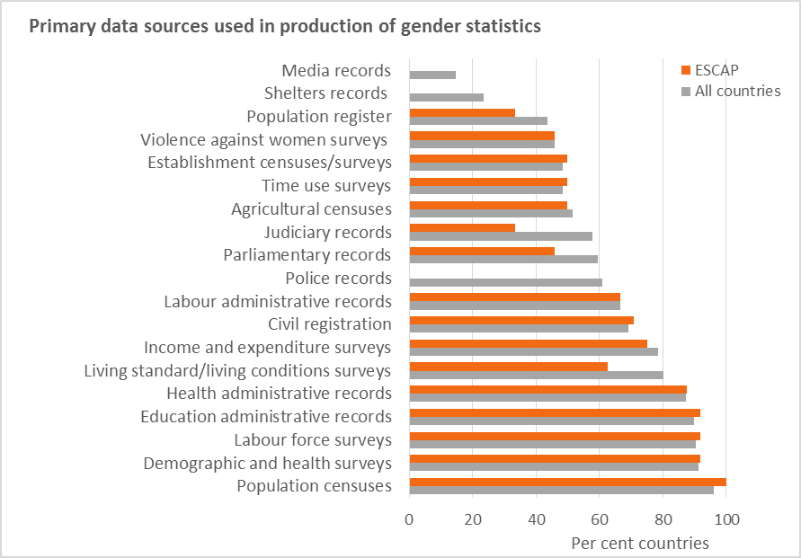
Time Use Surveys as Source of Data
☹
☺
Notes:
Only 48% of the countries use TU data to produce gender statistics. In Africa it is even les with only 39%.

Slide 4
Let’s participate in a TUS

Slide 5
Data Collection Instruments
Diary- main instrument for recording data on time use
24-hour diary
Stylized diary
Background information
Household questionnaire
Individual questionnaire

Slide 6
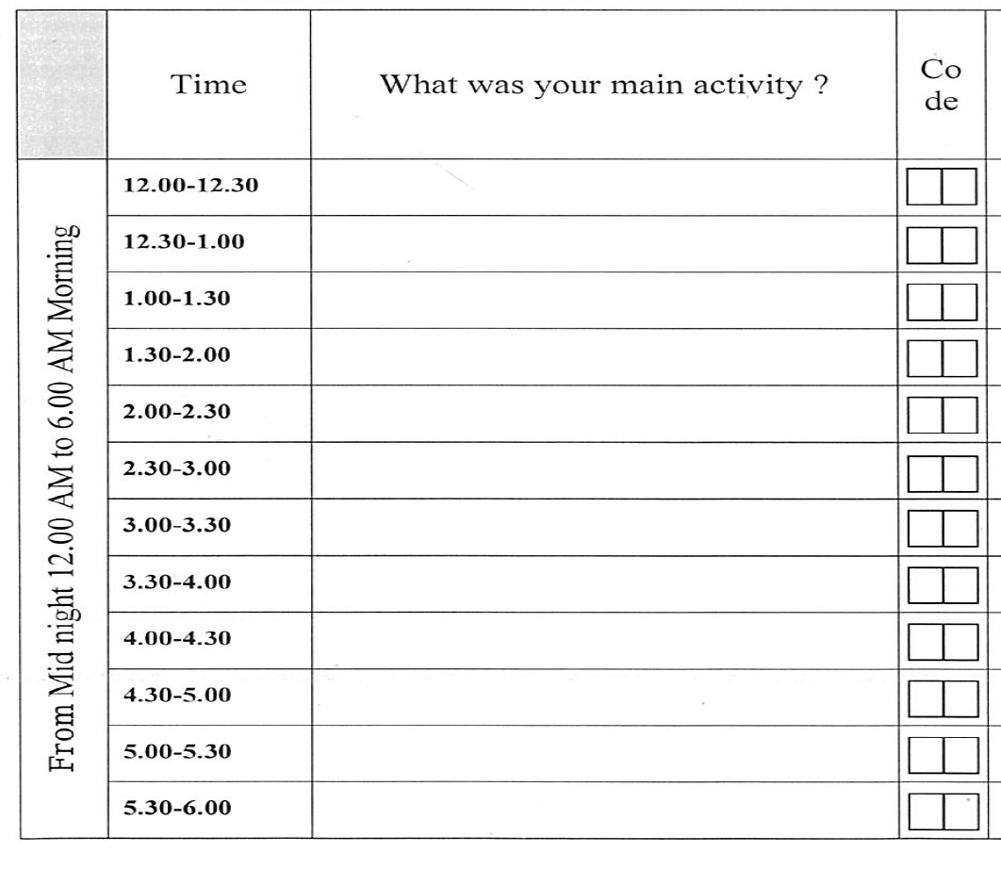
24 hour diary
Writing verbatim descriptions of activities that are coded later on to an activity classification
Another version: “Light” diary

Slide 7
24 hour diary
Pros
Provide more reliable and accurate data
More flexible and more powerful for data dissemination
Allows to record simultaneous activities
Cons
More costly in terms of data collection and data coding
Burden on the respondents (pressure on the participation rates)

Slide 8
Stylized questionnaires
Specific questions where the respondents need to recall the amount of time spent on the related activities.
May target specific activities or be designed to be as exhaustive as possible so as to capture a complete period of time (24 hours, a week)

Slide 9
Stylized questionnaires
Pros
Less expensive
Preferable for a specific and short time period
Cons
High degree of errors
“Normative editing”: Under or over reporting of socially marked activities (ex: childcare versus watching television)
Memory recall errors
Not measuring simultaneous activities: gender bias

Slide 10
Stylized questionnaires vs 24 hour diary: conclusions
Go for the 24 hour diary for accuracy
to avoid biases in activity reporting including gender bias.
… but heavy financial and technical requirements

Slide 11
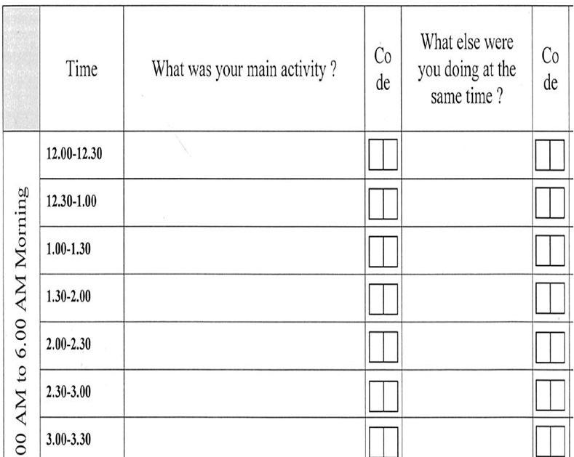
Simultaneous Activities
“Multi-tasking”
Importance to gender statistics?
Many unpaid work activities are done simultaneously
Record all? Record two? Record three?

Slide 12
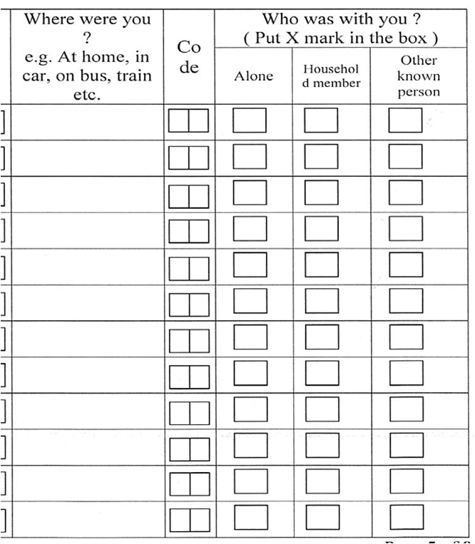
Contextual Variables
… describe the conditions in which an activity takes place

Slide 13
From responses to statistics …

Slide 14
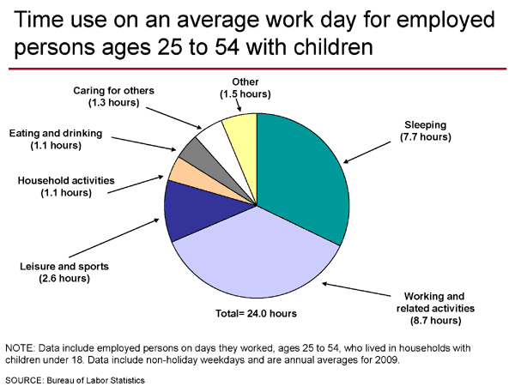
“Time Use” …
What individuals do or what activities they engage in
How much time is spent doing each of these activities
Context in which an activity takes place

Slide 15
Time Allocation by Activity

Slide 16
The Classification of Activities
Reflects the most recurrent activities at the country level (through pilot or previous survey)
Detailed enough to identify separately activities mainly undertaken by women or by men
Example: ICATUS
Particularly in line with the SNA
Oriented to measure unpaid work and set up satellite accounts
Trial version since 2005 but finalization in progress (Expert Group Meeting in 2012)
Major divisions of ICATUS 2012 (provisional)
SNA work and related activities
Unpaid domestic services for own final use within household
Unpaid caregiving services to household members
Community services and help to other households
Learning
Socializing, community participation and religious practice
Leisure and sports
Self-care and maintenance

Slide 17
… Summaries
Denominator | Numerator
 | Total duration of activity | Total number of episodes of activity | Total number of participants
Total number of persons (population) | (1) Average duration | (2) Average number of episodes | (3) Proportion of ‘doers’
Total number of participants | (4) Average duration | (5) Average number of episodes
Total number of episodes of activity | (6) Average duration per episode

Slide 18
Implications for Integrating Gender Perspective in Official Statistics
Improving the measurement of unpaid activities and household production
Reveals activities and social phenomena which are not well captured in traditional statistical system but where inequalities between women and men are numerous and complex
Drastic change of women’s contribution to GDP
Distribution of domestic tasks within the household …

Slide 19
Unpaid Work: Data
Limitations of conventional labour statistics:
Activities that contribute to the production of goods and services as defined by the SNA and cover mainly market activities and some unpaid non-market activities.
Unpaid work referring to own account production of services are outside the general boundary of SNA and therefore not covered at all

Slide 20
General production activities
SNA production activities
General production boundary
SNA production boundary
Cleaning, servicing, repairs
Preparation and serving of meals
Care, training and instruction of children
Care of sick, infirm and elderly
Unpaid volunteer services to other households, community, associations
Unpaid Work

Slide 21
Unpaid work
Why is it important for gender statistics?
Measuring unpaid work is crucial in making the contribution of women to the economy and society more visible.
Women, more often than men, tend to be involved and spend a great amount of time in unpaid work in the home and community.
When only cash transactions are taken into account in measuring the economic production, a large portion of women’s work remains unaccounted for.

Slide 22
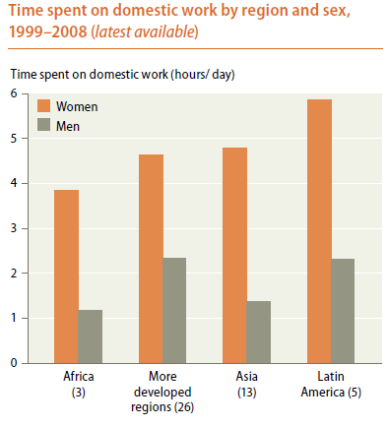

Slide 23
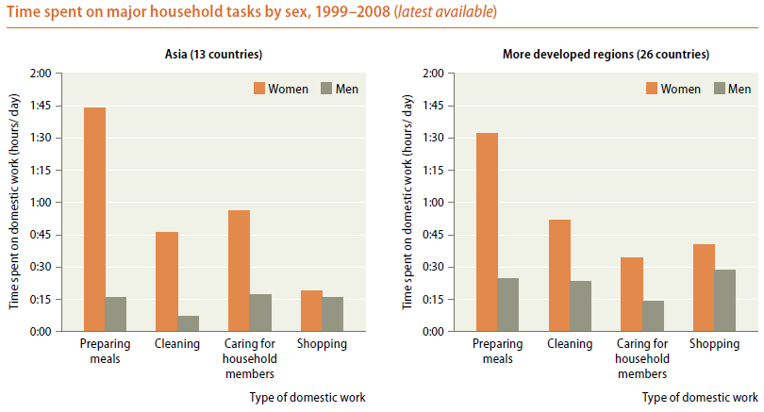

Slide 24
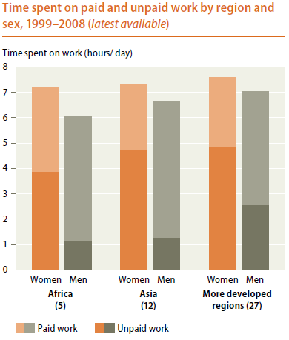

Slide 25
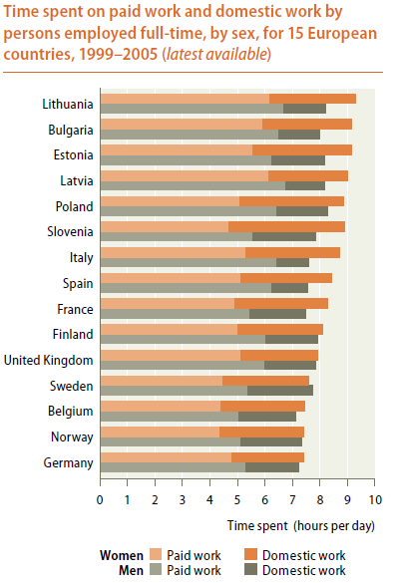

Slide 26
Satellite Accounts
Definition: the System of National Accounts recommends the use of supplementary accounts for nonmarket activities rather than the expansion of existing accounts.
Allow for experimentation with changes in scope and measurement.
Consistent and could be used with the existing national accounts without overburdening them

Slide 27
Satellite Accounts
Direct application of measuring unpaid work: estimating household production in satellite accounts that extend measurement of gross domestic product (GDP) to include non-SNA production
Makes the national accounts more complete and comparable across countries

Slide 28
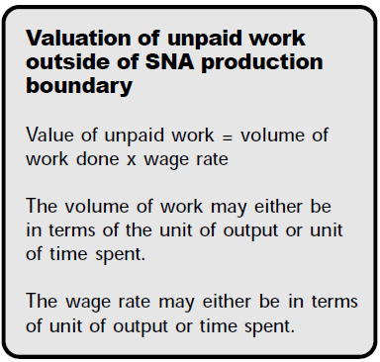
Valuation is a Challenge

Slide 29
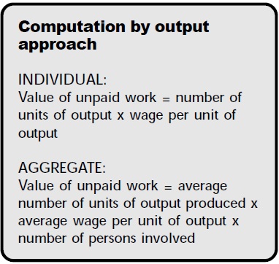
Valuation is a Challenge

Slide 30
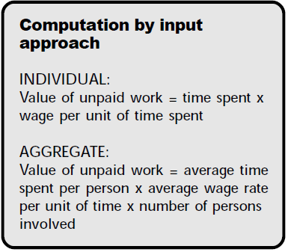
Valuation is a Challenge

Slide 31
Valuation is a Challenge
Opportunity Cost
Comparison

Slide 32
The position of the contextual variables
There are 3 locations to collect contextual variables (diary-based survey):
The diary (for each activity)
The household/individual questionnaire (characteristics of the formal work)
Within the classification (“I cook” vs “I cook for my kids”)
The position is strategic because it will determine the scope of the areas that could be covered
Example: Unpaid work and Informal Employment

