Slide 1
International Workshop on Population Projections using Census Data
14 – 16 January 2013
Beijing, China

Slide 2
Session V: Projecting the age patterns of mortality, fertility, and migration
Projecting age patterns of mortality
Projecting age patterns of fertility
Projecting age patterns of migration
http://unstats.un.org/unsd/demographic/meetings/wshops/China2013/list_of_docs.htm

Slide 3
Projecting age patterns of mortality
Overview

Slide 4
Projecting age patterns of mortality
Two approaches:
Project age patterns of mortality based on empirical trends. Level of mortality is implicit.
Project age patterns of mortality based on established trends of the level of mortality and determine an associated age pattern based on models.

Slide 5
Life expectancy 2005-2010
The five African countries with the highest and the lowest life expectancy, 2005-2010
Rank | Country | Life expectancy at birth, bot sexes combined
1 | Réunion | 77.26
2 | Mayotte | 77.14
3 | Libyan Arab Jamahiriya | 74.04
4 | Tunisia | 73.90
5 | Cape Verde | 73.54
50 | Guinea-Bissau | 46.76
51 | Zimbabwe | 46.59
52 | Sierra Leone | 46.26
53 | Lesotho | 46.02
54 | Central African Republic | 45.91

Slide 6
Life table survivors, males

Slide 7
Life table survivors, female

Slide 8
Age specific mortality, males

Slide 9
Age-specific mortality, females

Slide 10
The impact of HIV/AIDS Botswana 2000-2005, males

Slide 11
The impact of HIV/AIDS Botswana 2000-2005, males

Slide 12
Projecting age patterns of mortality I: United Nation Model
The software package MORTPAK from the United Nations provides a program “MATCH”, which generates model life tables.
MORTPAK.[MATCH].
The original United Nations model for projecting age patterns of mortality has been documented, but not published as a user-friendly tool.
See the new updated and extended United Nations model life tables :
http://esa.un.org/unpd/wpp/Model-Life-Tables/download-page.html

Slide 13
MORTPAK

Slide 14
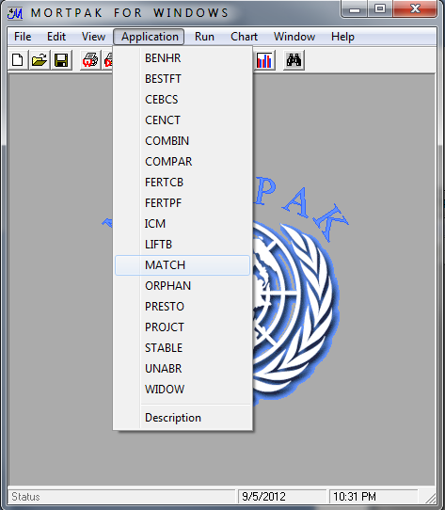
Select module MATCH

Slide 15
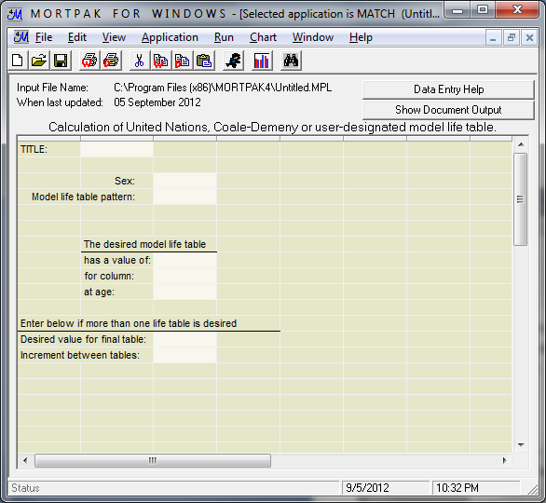
Worksheet MATCH

Slide 16
Selection of reference life table
Two scenarios: User-defined a life table
Using a model life table

Slide 17
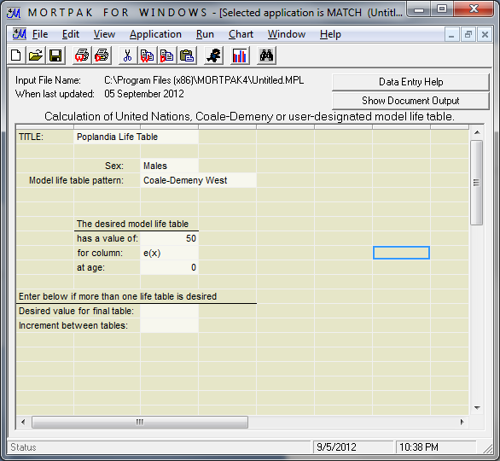
Parameter entry MATCH

Slide 18
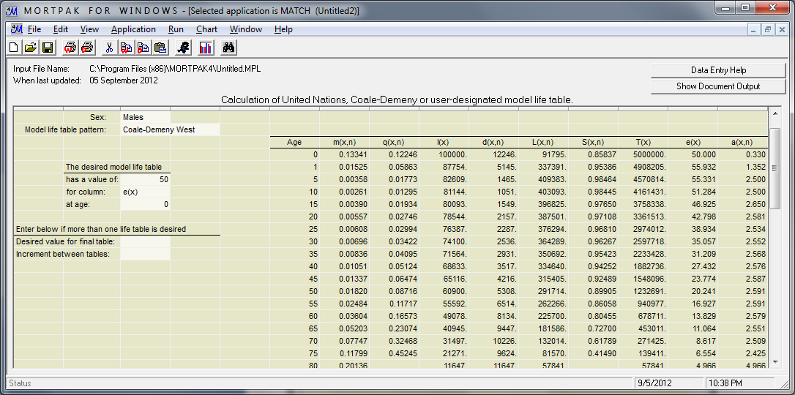
Output MATCH

Slide 19
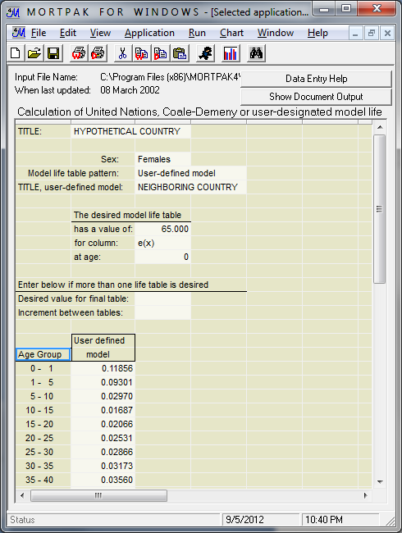
User-defined mortality pattern

Slide 20
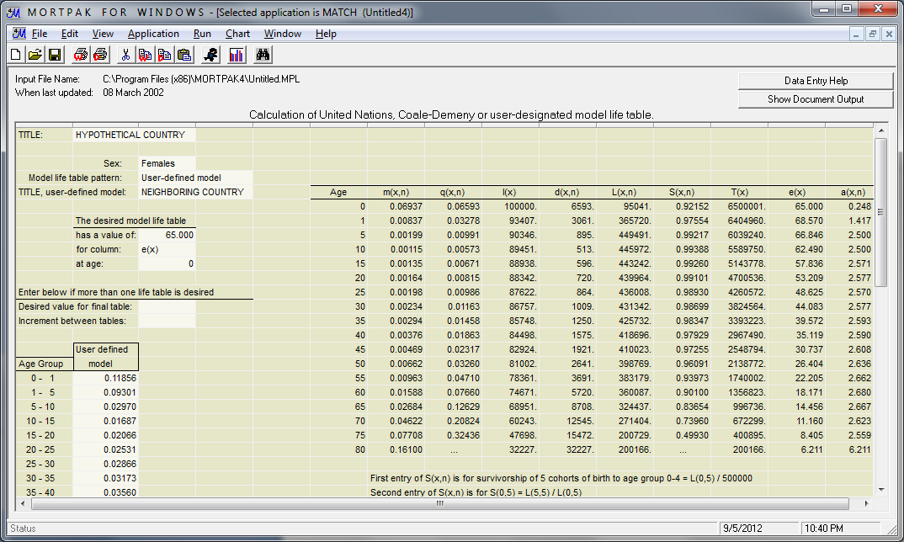
Output MATCH

Slide 21
Projecting age patterns of mortality II: US Census Bureau Model
The US Census Bureau has developed spreadsheets that interpolate life tables, one for each sex. The procedure interpolates between two “pivotal” life tables, based on the probabilities of dying n[_{n}q_{x}]:
INTPLTM Interpolation for life tables for males
INTPLTF Interpolation for life tables for females
Usually, the pivotal life tables are
An empirical life table for the base year of the projection
An ultimate (upper limit) life table
The spreadsheet generates a life table with a desired level of mortality that is between the life expectancies of the base and the ultimate life table. Repeated application of the procedure will generate a set of age-specific mortality rates [_{n}m_{x}] or probabilities of dying [_{n}q_{x}].

Slide 22
INTPLTM.xls/INTPLTF.xls
Input data for INTPLTM/INTPLTF
Table number [“Table 123”]
Country name and Year [“Poplandia: 1960 and 1980”]
Life expectancy at birth for life table 1 (base year)
Life expectancy at birth for life table 2 (ultimate life table)
Life expectancy at birth for desired life table
Lower limit of open-ended age group
Life expectancy for the open-ended age group, life table 1
Life expectancy for the open-ended age group, life table 2
Separation factor for age under 1, life table 1
Separation factor for age under 1, life table 2
Separation factor for ages 1-4, life table 1
Separation factor for ages 1-4, life table 1
Probabilities of dying by age _{n}q_{x} for life table 1
Probabilities of dying by age _{n}q_{x} for life table 2

Slide 23
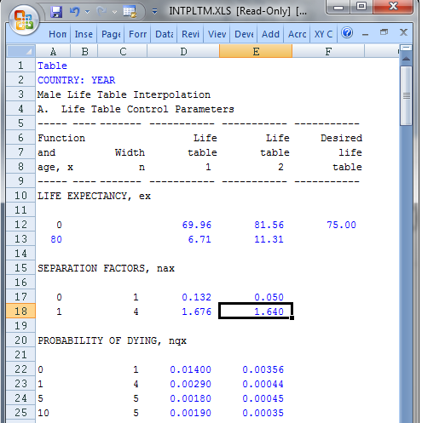
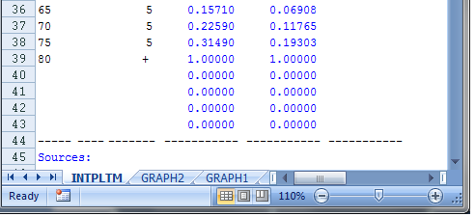
INTPLTM.xls/INTPLTF.xls

Slide 24
Projecting age patterns of mortality III: US Census Bureau RUPEX
The US Census Bureau’s population projection program RUPEX has a built-in functionality that is similar to the spreadsheets INTPLTM and INTPLTF. The user needs to specify two pivotal life tables and, optionally, life expectancies for any year between the base and the last year of the projection. The projection program does the interpolation and adjustments automatically of the age-specific mortality values
See on the companion CD:
Arriaga (2012). Population Analysis with Microcomputers - Volume II - Extract B RUP.

Slide 25
Projecting age patterns of mortality IV: Spectrum
Like RUPEX, Spectrum can generate internally age patterns of mortality based on trends of life expectancy and model life tables.

Slide 26
Hands-on exercise: Mortality patterns
Make yourself familiar with the Excel templates and the MATCH [MORTPAK] package
Use your national data for the exercise or use the test data from Session 4.

Slide 27
Projecting age patterns of fertility
Overview

Slide 28
Projecting age patterns of fertility
Approaches:
Using characteristic empirical age patterns of fertility as a basis for projections. Interpolate between age patterns at the base period and a future target pattern.

Slide 29
Projecting age patterns of fertility I: United Nation Model
Excel template UNPD_ASFR.xls
Using characteristic age-patterns of fertility associated with select levels of fertility, the model generates a series of age patterns by interpolating between a base pattern and a target pattern.
The template allows for extending the target pattern beyond the last year (target year) by keeping it constant.

Slide 30
UN Model age-patterns of fertility

Slide 31
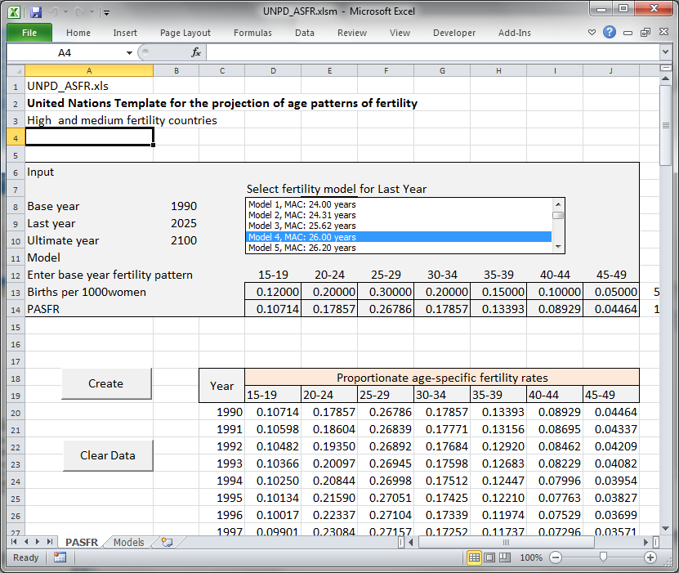

Slide 32
ASFR vs. PASFR
Don’t forget that the UN model provides standardized age pattern, e.g. proportionate age-specific fertility rates. By multiplying each rate with the corresponding TFR, the ASFR are obtained.

Slide 33
Projecting age patterns of fertility II: US Census Bureau Model
The model in spreadsheet ASFRPATT.xls finds age patterns of fertility for a give level of fertility, based on typical age-specific fertility patterns in developing countries.

Slide 34
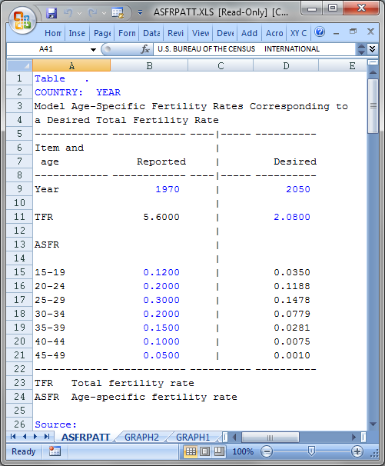
ASFRPATT.xls

Slide 35
ASFRPATT.xls

Slide 36
ASFRPATT.xls

Slide 37
Hands-on exercise: Fertility patterns
Make yourself familiar with the Excel templates
Use your national data for the exercise or use the test data from Session 4.

Slide 38
Projecting age patterns of migration
Overview

Slide 39
Projecting age patterns of Migration I: United Nation Model
Excel template UNPD_Migration Age Patterns.xlsm
The model generates typical age patterns of migration for net-migration.
The model estimates a typical sex ratio.
The user may select one of three typical patterns.

Slide 40
Projecting age patterns of Migration I: United Nation Model
Family migration

Slide 41
Projecting age patterns of Migration I: United Nation Model
Male Labor Migration (immigration)

Slide 42
Projecting age patterns of Migration I: United Nation Model
Female Labor Migration (immigration)

Slide 43
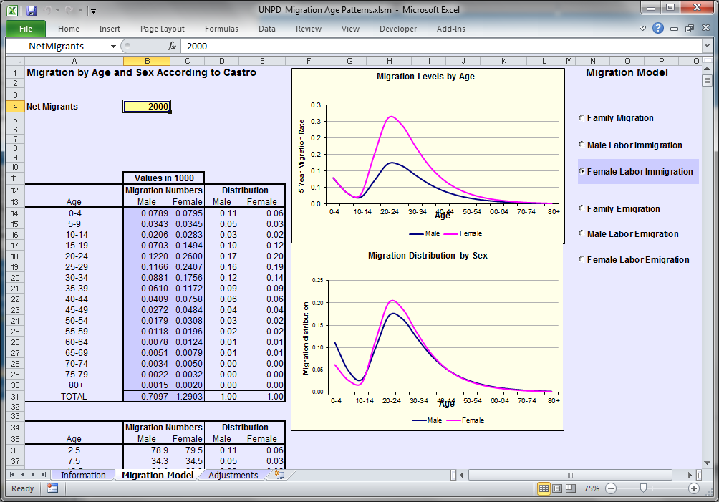

Slide 44
Hands-on exercise: Migration patterns
Make yourself familiar with the Excel template
Use your national data for the exercise or use the test data from Session 4.

