Slide 1

International Workshop on
Population Projections using Census Data
14 – 16 January 2013
Beijing, China

Slide 2
Session III:
Establishing the base population
Detecting errors in data
Correcting distorted or incomplete data

Slide 3
Detecting Errors in
Age and Sex Distribution Data
Basic tools
  Graphical analysis
    Population pyramids
    Graphical cohort analysis
  Age and sex ratios
  Summary indices of error in age-sex data
    Whipple’s index
    Myers’ Blended Method
    United Nations Age-sex accuracy index
Use of stable population theory
Uses of consecutive censuses
Focus of the presentation
Population by age and sex determined by fertility, mortality and migration, follows fairly recognizable patterns

Slide 4
What to Look For at the Evaluation
Possible data errors in the age-sex structure
  Age misreporting (age heaping and/or age exaggeration)
  Coverage errors – net under- or over-count (by age or sex)
Significant discrepancies in age-sex structure due to extraordinary events
  High migration, war, famine, HIV/AIDS epidemic etc

Slide 5
Collecting Information on
Age and Quality
Age - the interval of time between the date of birth and the date of the census, expressed in completed solar years
  The date of birth (year, month and day) - more precise information and is preferred
  Completed age (age at the individual’s last birthday) – less accurate
    Misunderstanding: the last, the next or the nearest birthday?
    Rounding to nearest age ending in 0 or 5 (age heaping)
    Children under 1 - may be reported as 1 year of age
    Use of different calendars in the same country– western, Islamic or Lunar

Slide 6
Basic Graphical Analysis
- Population Pyramid
Basic procedure for assessing the quality of census data on age and sex
Displays the size of population enumerated in each age group (or cohort) by sex
The base of the pyramid is mainly determined by the level of fertility in the population, while how fast it converges to peak is determined by previous levels of mortality and fertility
The levels of migration by age and sex also affect the shape of the pyramid

Slide 7
Population Pyramid (1)
– High fertility and mortality
Quick narrowing -> high mortality
Wide base indicates high fertility
Source: United Nations Demographic Yearbook

Slide 8
Population Pyramid (2)
– Low Fertility and Mortality
WWI
WWII
First baby boom
Fire horse year
Second baby boom
Low fertility level
Source: United Nations Demographic Yearbook

Slide 9
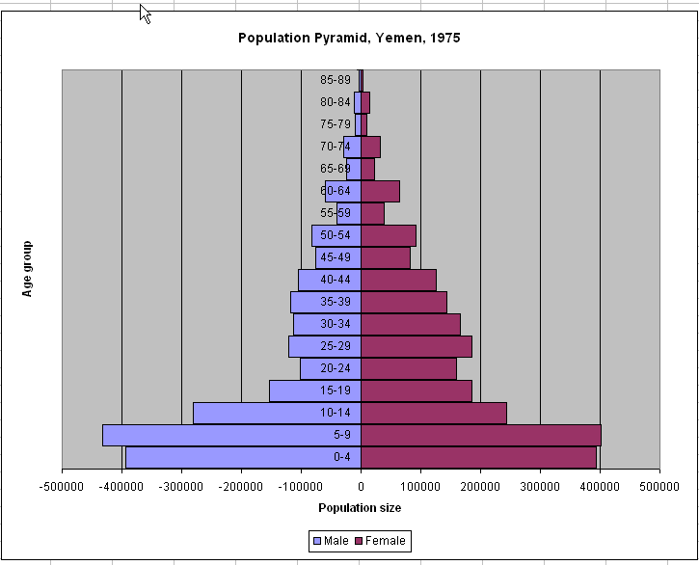
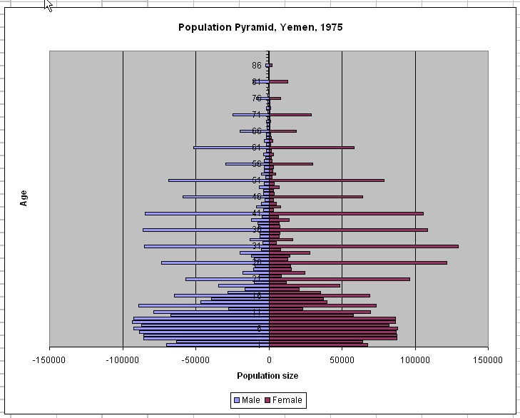
Population Pyramid (3)
- Detecting Errors
  Under enumeration of young children (< age 2)
  Age misreporting errors (heaping) among adults
  High fertility level
  Smaller population in 20-24 age group – extraordinary events in 1950-55?
  Smaller males relative to females in 20 – 44 - labor out-migration?
  Source: Reproduced using data from U.S. Census Bureau, Evaluating Censuses of Population and Housing

Slide 10
Population pyramid (4)
- Detecting Errors
Age heaping? Undercount of children?
Labour in-migration
Source: United Nations Demographic Yearbook

Slide 11
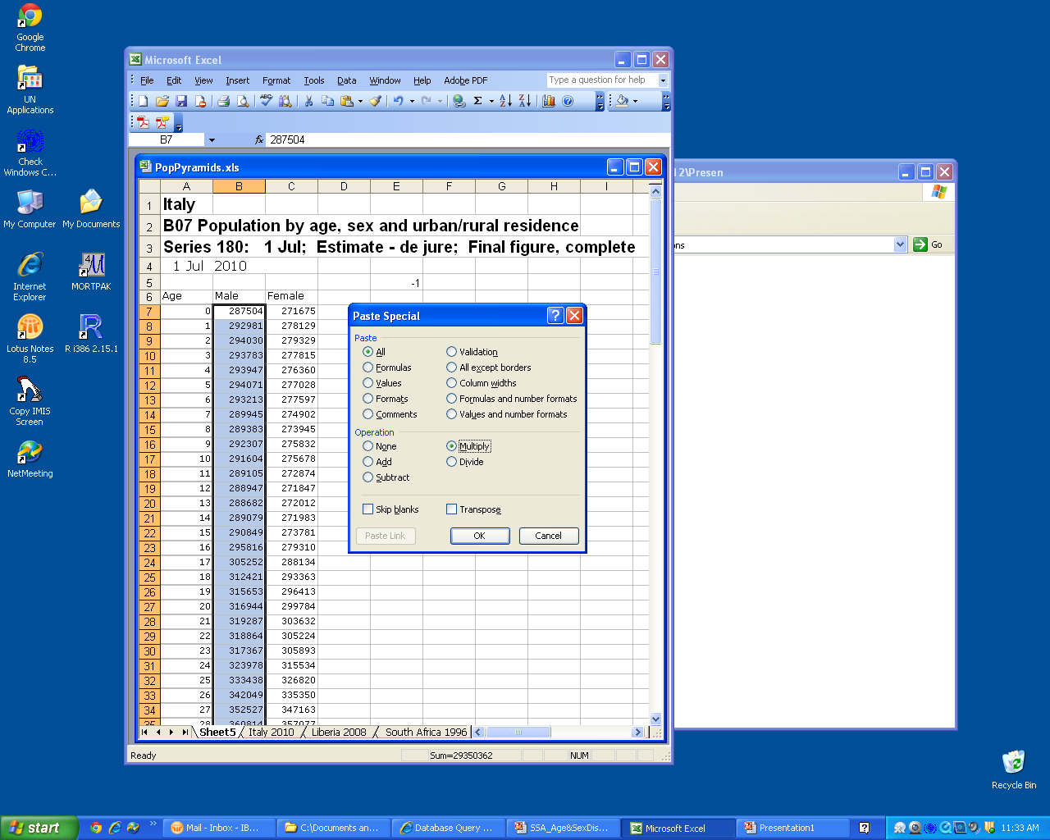
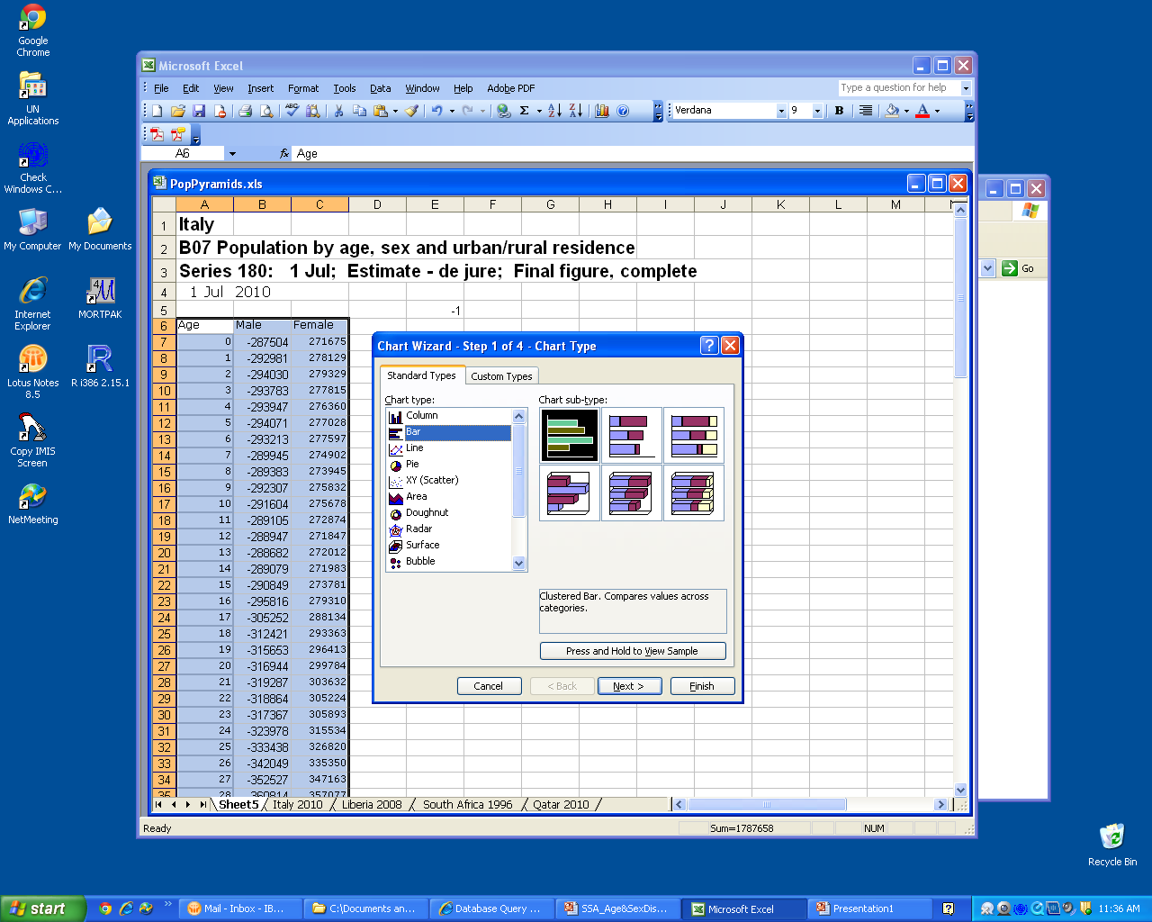
Creating Population Pyramids
Or, PASEX – Pyramid.xls

Slide 12
Basic Graphical Analysis
- Graphical Cohort Analysis
Tracking actual cohorts over multiple censuses
The size of each cohort should decline over each census due to mortality, if no significant international migration
The age structure (the lines) for censuses should follow the same pattern in the absence of census errors
An important advantage - possible to evaluate the effects of extraordinary events and other distorting factors by following actual cohorts over time

Slide 13
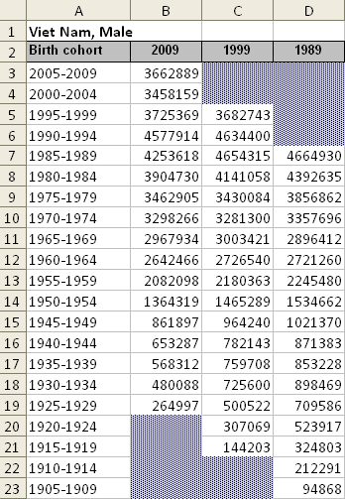
Graphical cohort analysis
– Example (1)
For this analysis we organize the data by birth cohort
New cohorts will be added and older cohorts will be lost as we progress to later censuses
Exclude open-ended age category
Source: United Nations Demographic Yearbook

Slide 14
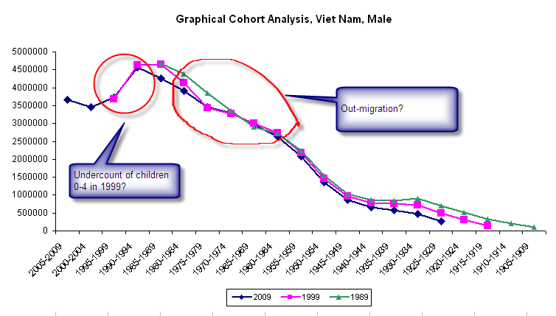
Graphical Cohort Analysis
– Example (2)
Source: United Nations Demographic Yearbook

Slide 15
Age Ratios (1)
In the absence of sharp changes in fertility or mortality, significant levels of migration or other distorting factors, the enumerated size of a particular cohort should be approximately equal to the average size of the immediately preceding and following cohorts
Significant departures from this “expectation” → presence of census error in the census enumeration or of other factors
Age | Population
15 - 19 | a
20 - 24 | b
25 - 29 | c

Slide 16
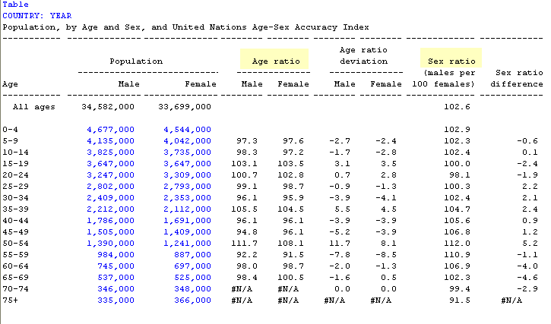
Age Ratios (2)
Age ratio for the age category x to x+4
  ₅AR_{x} = The age ratio for the age group x to x+4
  ₅P_{x} =The enumerated population in the age category x to x+4
  ₅P_{x-5} = The enumerated population in the adjacent lower age category
  ₅P_{x+5} = The enumerated population in the adjacent higher age category
₅AR_{x} = 2 * ₅P_{x}
  ₅P_{x-n} + ₅P_{x+n}
PASEX – AGESEX.xls

Slide 17
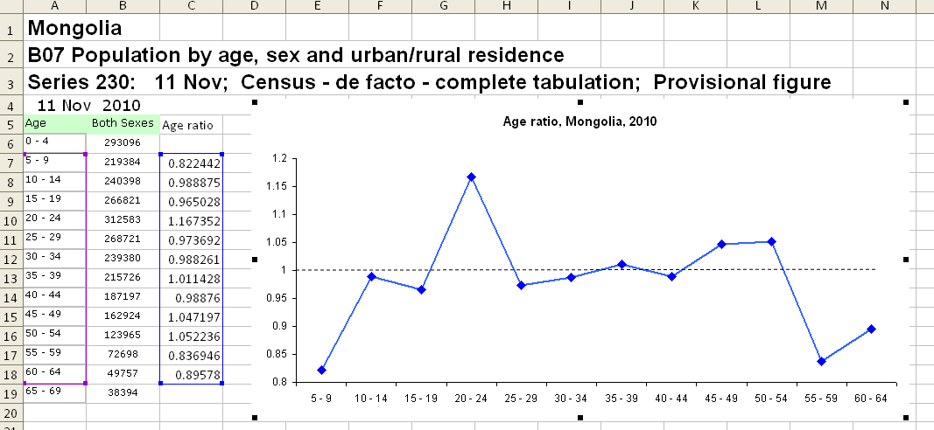
Age Ratios (3) - Example
Source: United Nations Demographic Yearbook

Slide 18
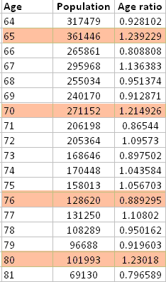
Age Ratios (4) - Example
Source: United Nations Demographic Yearbook

Slide 19
Sex Ratios (1)
Sex Ratio = ₅M_{x} / ₅F_{x}
  ₅M_{x =} Number of males enumerated in a specific age group
  ₅F_{x =} Number of females enumerated in the same age group
PASEX – AGESEX.xls

Slide 20
Sex Ratios (2)
Slightly higher mortality among males in younger ages reverses SR – migration could also play a role
In most societies the SRB is slightly over 1.0
Considerable female advantage in mortality at older ages
Source: United Nations Demographic Yearbook

Slide 21
Sex Ratios (3) – Cohort Analysis
Source: United Nations Demographic Yearbook
Notes:
In general should expect SR to decline over subsequent censuses due to excess male mortality relative to female mortality
First off, the bump in the 95-99 year olds in 2000 (the 1901-1905 birth cohort) clearly does not show up in the other censuses – this suggests that there is an age misreporting issue and the bump is not “real”
The data are also unexpected for the series of cohorts born in the 1930s and 1940s – normally we would not expect a sex ratio over 1 at these ages– need to investigate possible historical causes for excess female mortality in these age groups
(the 10 year gap is fudged a bit – is actually an 8 year gap between oldest two censuses, but shouldn’t cause great difference over 5 year age groups)

Slide 22
Summary indices – Whipple’s Index
Reflect preference for or avoidance of a particular terminal digit or of each terminal digit
Ranges between 100, representing no preference for “0” or “5” and 500, indicating that only digits “0” and “5” were reported in the census
If heaping on terminal digits “0” and “5” is measured;
Index =
Source: Shryock and Siegel, 1976, Methods and Materials of Demography

Slide 23
Whipple`s Index (2)
If the heaping on terminal digit “0” is measured;
Index=
The choice of the range 23 to 62 is standard, but largely arbitrary. In computing indexes of heaping, ages during childhood and old age are often excluded because they are more strongly affected by other types of errors of reporting than by preference for specific terminal digits

Slide 24
Whipple’s Index (3)
The index can be summarized through the following categories:
Value of Whipple’s Index
  Highly accurate data <= 105
  Fairly accurate data 105 – 109.9
  Approximate data 110 – 124.9
  Rough data 125 – 174.9
  Very rough data >= 175

Slide 25
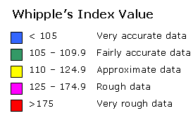
Whipple’s Index Around the World
Source: United Nations Demographic Yearbook
Notes:
Note data are for the most latest (most recent) census conducted between 1985 – 2003

Slide 26
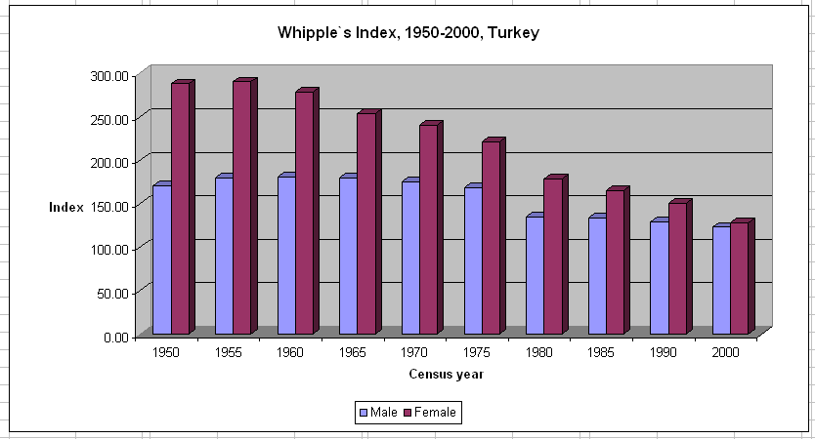
Improvement Over Time Possible
Notes:
Shows long-term trend of reduction in value of Whipple’s index, i.e. improvement of age reporting as measured by age heaping

Slide 27
Summary Indices –
Myers’ Blended Index
Conceptually similar to Whipple’s index, except that the index considers preference (or avoidance) of age ending in each of the digits 0 to 9 in deriving overall age accuracy score
The theoretical range of Myers’ Index is from 0 to 90, where 0 indicates no age heaping and 90 indicates the extreme case where all recorded ages end in the same digit

Slide 28
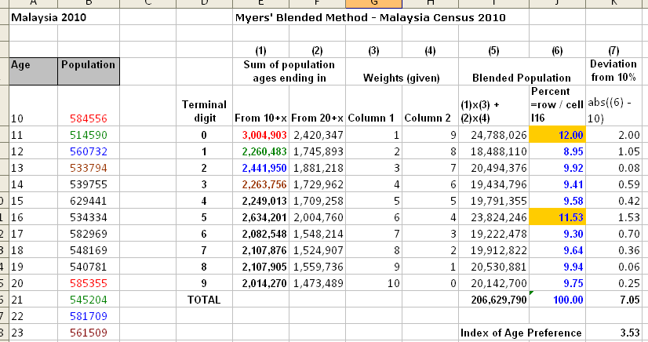
Myers’ Blended Index: Example
Source: United Nations Demographic Yearbook
Notes:
Sum of all ages ending in x, starting from age 10
Sum of all ages ending in x, starting from age 20
and (4) are weights, always stay the same
(5) Multiplication as shown – then convert to a percentage using the total blended population as the denominator
- those ages for which the percentage is over 10% are favored, those with percentage less than 10% are avoided
(6) Calculate absolute value of deviations from 10% - half of this sum is the value of the index

Slide 29
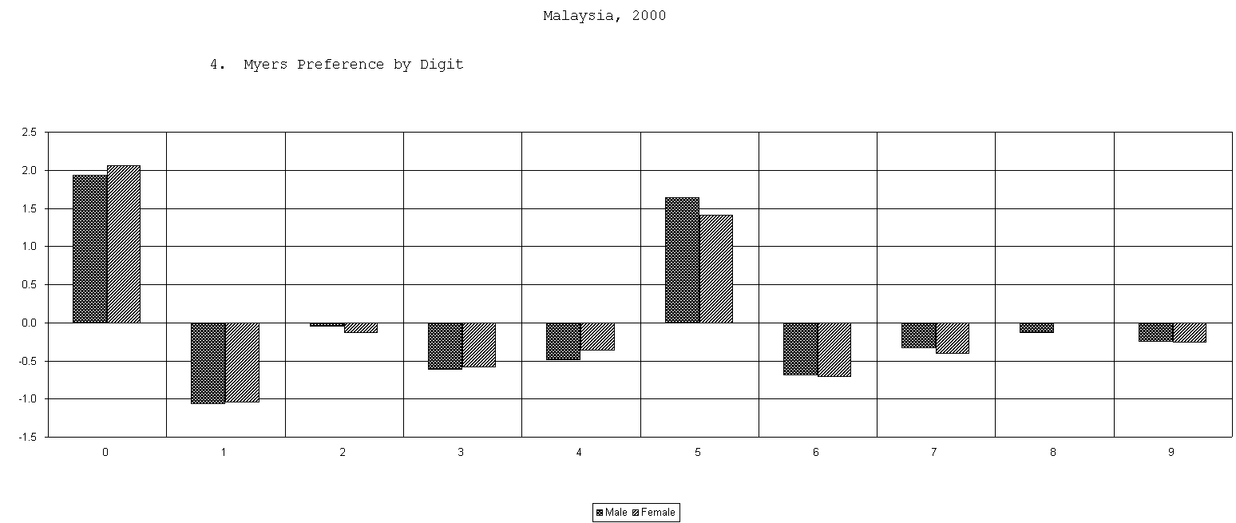
Myers’ Blended Index: Example
Source: PASEX – SINGAGE.xls

Slide 30
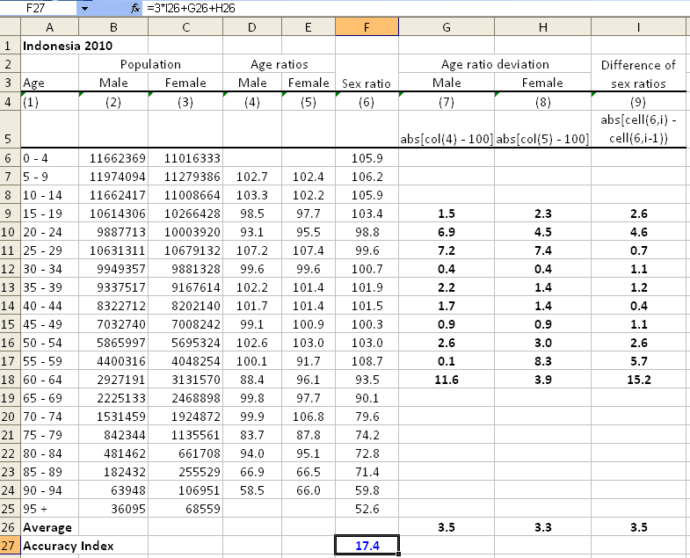
Summary Indices -
United Nations Age-sex Accuracy Index
Source: United Nations Demographic Yearbook

Slide 31
United Nations Age-sex Accuracy Index
<20: accurate
≥20 and ≤40: inaccurate
>40: highly inaccurate
PASEX - AGESMTH.xls

Slide 32
A Few Points about Assessment
Typically the first step in evaluating a census by demographic methods
  Quick and inexpensive on general quality of data
  Providing some evidence of error on specific segments of the population
Limitations
  Can only provide some indication of errors but not on the magnitude
  Needs to work with other assessment methods
Notes:
32

Slide 33
Correcting for Age
Mis-reporting (Smoothing)
Not modifying the total population - accepting population in each 10-year age group, then divide into 5-year
  The Carrier-Farrag
  Karup-King-Newton
  The Arriaga’s formula (also the first and last group)
Age | Population
20-29 | a
30-39 | b
40-49 | c
Pop (35-39) = f(a, b, c)

Slide 34
Correcting for Age
Mis-reporting (Smoothing)
Slightly modifying total population - smoothing the 5-year age groups
  The United Nations Method
Strong smoothing – modifying totals based on consecutive 10-year age groups, then using Arriaga’s for the 5-year population

Slide 35
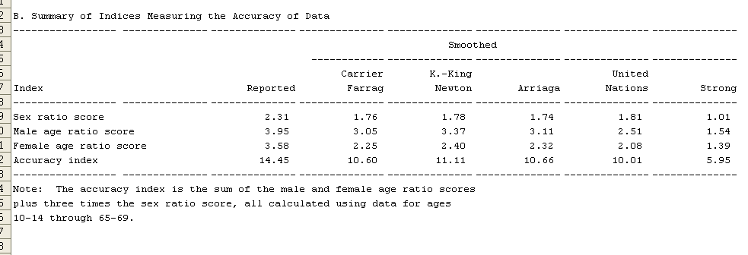
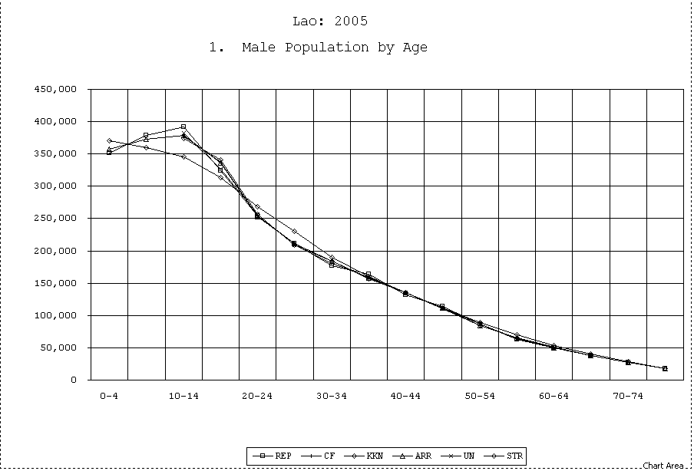
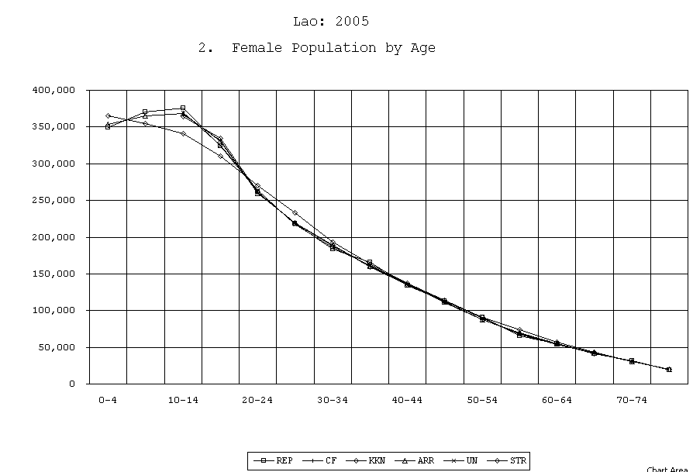
Smoothing Example – Lao, 2005
PASEX – AGESMTH.xls

Slide 36
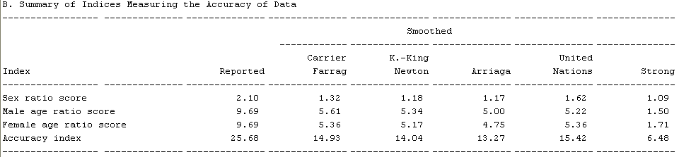
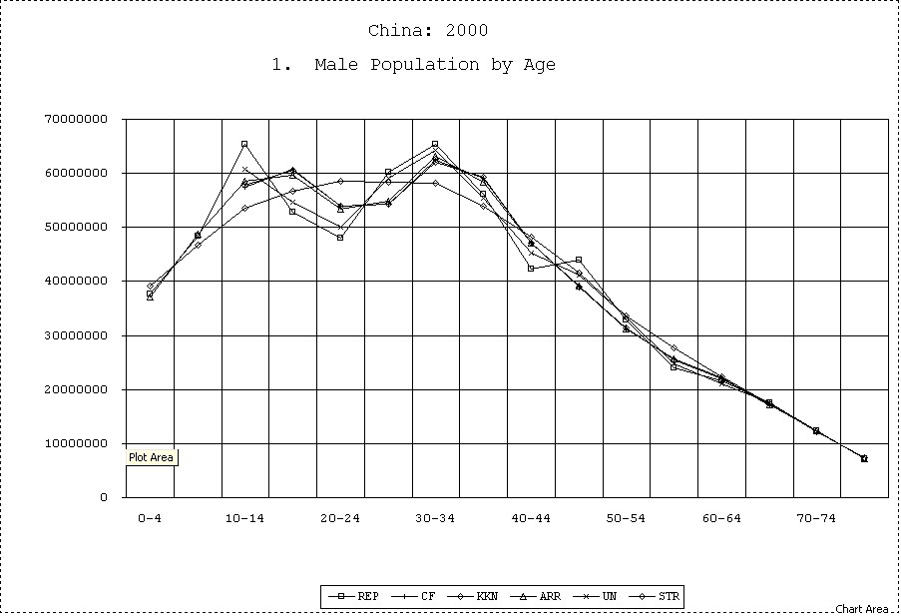
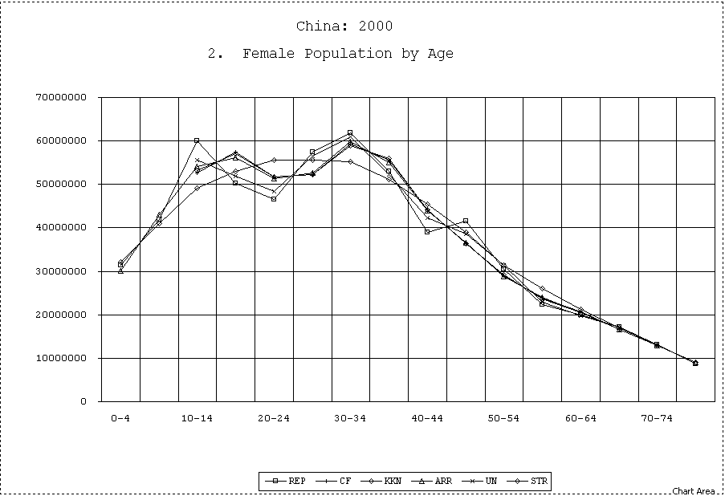
Smoothing Example – China, 2000
PASEX – AGESMTH.xls

Slide 37
A Few Points about Smoothing
No generalized solution for all populations
Methods produce similar results
Technique used depends on errors in age-sex distribution
Be cautious in using strong smoothing
If only part of population distribution problematic, no need for smoothing on entire age distribution

Slide 38
Open-age groups
When terminal age group is too young (younger than 80+ years)
How to break the terminal age groups?
  Contingency table – national data available for 80+ but not sub-national
  Stable population theory – work for any data; needs some guesses on mortality level

Slide 39
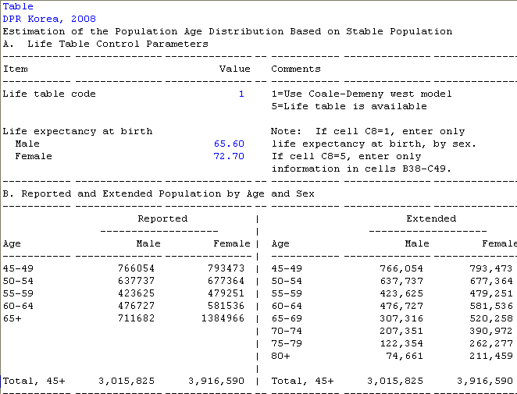
Open-age groups (PASEX – OPAG.xls)

Slide 40
Open-age groups

Slide 41
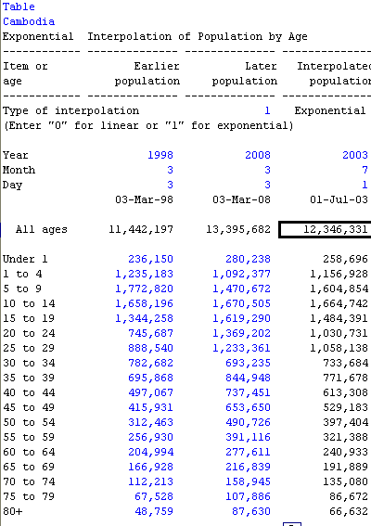
Population Interpolation
Two censuses data available, need population figure in between the census dates
  Linear
  Exponential
PASEX - AGEINT

Slide 42
Population Interpolation

Slide 43
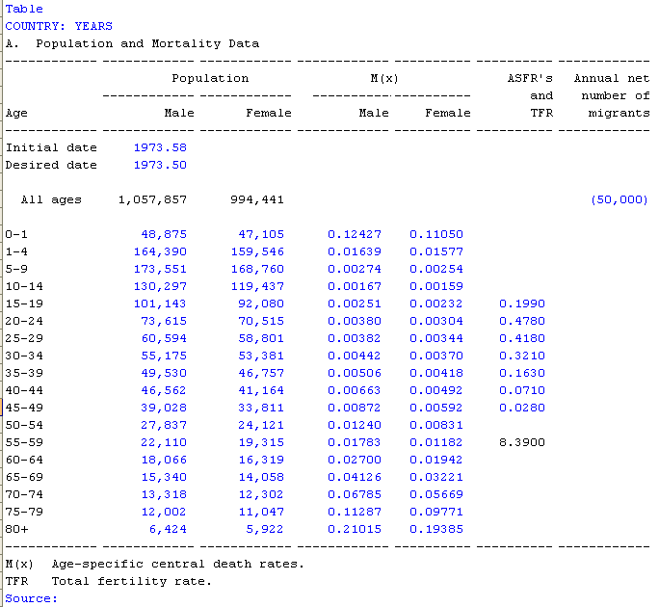
Population Shifting
Moving the population from a given date (census) to another (mid-year)
  PASEX – MOVEPOP.xls

Slide 44
References
Arriaga (1994). Population Analysis with Microcomputers, Volume I: Presentation of Techniques, Bureau of the Census.
Hobbs, F.B. (2004). Age and Sex Composition. In J. S. Siegel & D. A. Swanson (Eds.), The methods and materials of demography (2nd ed., pp. 125–173). Elsevier Academic Press.

