Slide 1

CENSUS PRODUCTS
AND DATA UTILIZATION
Svetlana Nikitina
Director of the Department for population
and healthcare statistics,
Federal State Statistics Service,
Russian Federation
Notes:
1

Slide 2
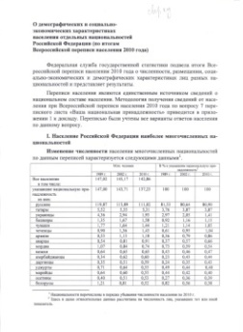
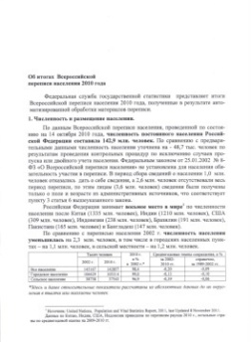





ACCORDING TO THE CENSUS RESULTS THERE WERE PUBLISHED:
3 thematic reports to the Government
of the Russian Federation
11 publications of the official results (on paper and DVD)
10 thematic brochures
Book «Socio-Demographic Profile of Russia»

Slide 3

THE FORMATION OF POPULATION CENSUS RESULTS
FEDERAL LEVEL
Federal Data Base
REGIONAL LEVEL
Part of the federal data base
Part of the federal data base
Part of the federal data base
Regional offices of the Federal State Statistics Service
Notes:
3

Slide 4
Thematic reports to the Government of the Russian Federation
On the results of the All-Russian population Census of 2010
On the demographic and socio-economic characteristics of the population of the Russian Federation by nationalities";
On the duration of stay in the place of permanent residence and living conditions of the population of the Russian Federation

Slide 5

SIZE AND ALLOCATION OF POPULATION
DISTRIBUTION BY AGE AND SEX, MARITAL STATUS OF POPULATION
EDUCATION
Ethnic composition of population and knowledge of languages, citizenship
Population by sources of the means of subsistence
number and composition of households
ECONOMIC ACTIVITY OF POPULATION
Duration of stay of private households population
at the place of permanent residence
Housing premises of population
FERTILITY

Slide 6
All materials are available in free access on the official website of the Federal State Statistics Service WWW.GKS.RU
Similar materials were published on the regional offices of the Federal State Statistics Service websites at the municipal units
Based on the results of the population census have been held: conferences, video presentations; released the film “About Russia – by language of numbers"
Atlas will be released with the results of the population census
In December 2013 a centralized online access to the micro database of Russian population Сensus 2010 will be provided on the official website of the Federal State Statistics Service

Slide 7
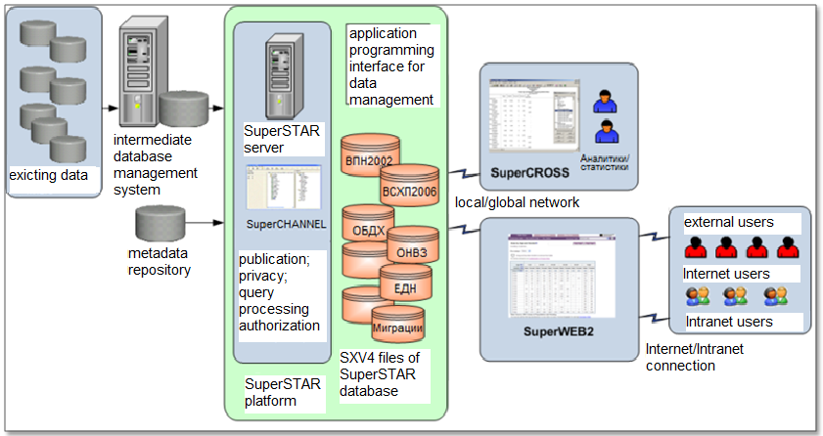
The structure of the software package SuperSTAR for microdata distribution
Notes:
7

Slide 8
SuperSTAR advantages
✓
Rapid report generation including those with complex multilevel structure that includes filters
✓
Programming skills are not required for database query
✓
Single access point to various databases
✓
No need in installation of additional software for
WEB-access

Slide 9
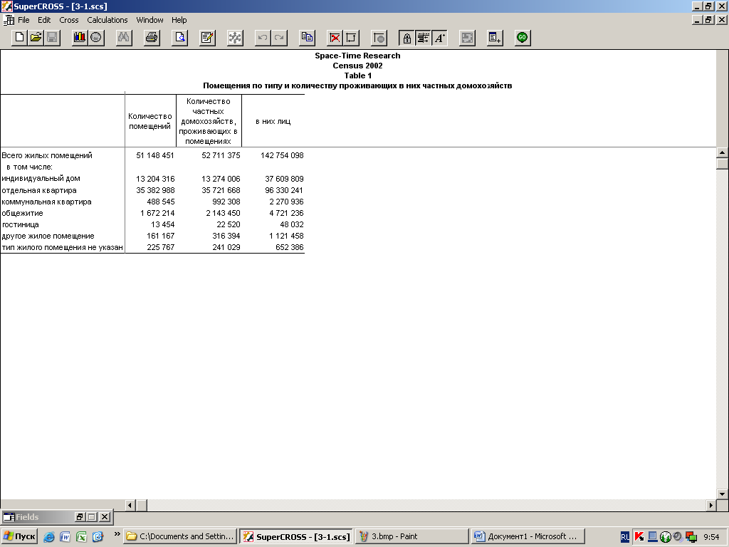
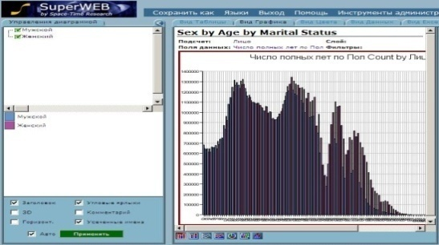
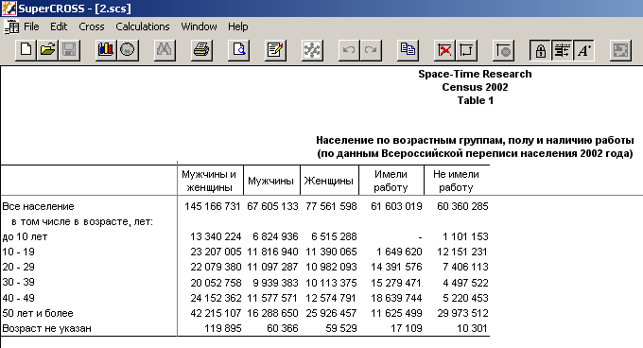
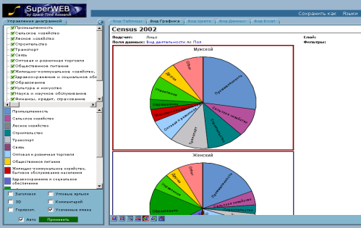
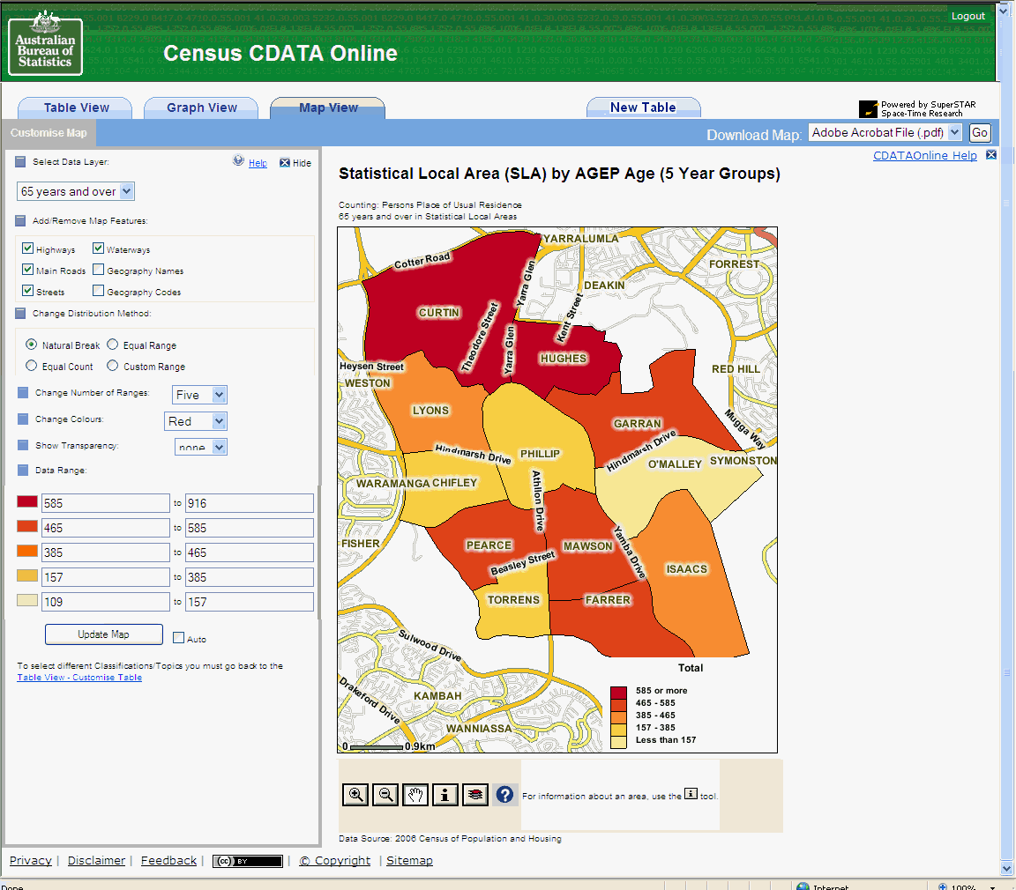
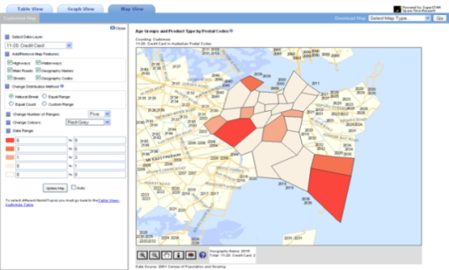
SuperStar
Types of providing the information
Arbitrary tables
Diagrams
Ы
Cartograms
Notes:
9

Slide 10
Maping of the Population Census results
Notes:
Имеется возможность просмотра различных показателей в виде синхронно отображаемых карт.
При выборе 4 показателей область карты поделена на четыре части соответственно, каждая из которых отображает синхронно один и тот же фрагмент карты, но с градиентной заливкой по разным показателям, в разных цветовых схемах.

Slide 11
THANK YOU FOR YOUR ATTENTION!
11

