Slide 1

Data Processes on 2011 Population And Housing Census Of Turkey
Barış DULKADİR
TURKSTAT Expert
Population and Migration Statistics Group
Demographic Statistics Department
28 November, 2016
Amman

Slide 2


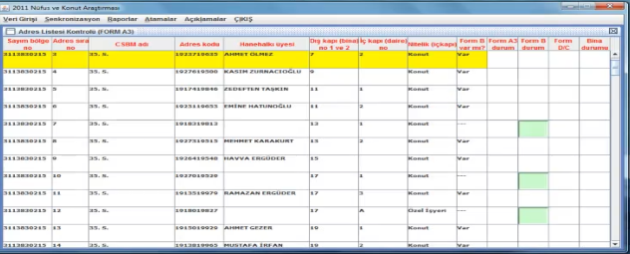

CONTENT
Methodology
Web Application
Netbook Application
Manuel Data Analysis

Slide 3
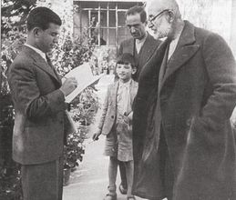
Population Censuses in Turkey
History
first census in 1927,
second census in 1935,
every five years between 1935-1990,
last traditional census in 2000
Totally 14 traditional population censuses.
Method
Traditional census method (face to face interview),
Standard questionnaire,
De facto population census definition,
One day application with national curfew (no permission go out).

Slide 4



Purposes of the ABPRS
MERNIS-Personal Information
ABPRS
Address
MATCHED
personal information from MERNIS * addresses from NAD
(By TR-ID numbers)
Unique code was given to each address.
Purposes of the ABPRS
To define an address standard
Standardized numbering and signboarding
Central address database (NAD) → full coverage…
Covering all people → place of residence…
2011PHC Combined method; by using population from ABPRS and by conducting ABPRS based large-scaled sampling survey
In the design of the census, ABPRS were used priorly;
  to obtain population count and age-sex distribution of the population,
  to construct an address frame

Slide 5
2011 PHC Methodology
The field application was carried out between 3 October-31 December 2011.
About 2.2 million households
Complete enumeration in institutional places.
Information was collected face to face from about 9 million people during the field study.
 | 2000 PC | 2011 PHC
Method | Traditional | Combined
Definition for residency rule | De-facto | De-jure
Duration of field application | One day application with a national curfew | 2-3 month
Questionnaire | Standard | Household + Institutional Places
Collection method | PAPI | PAPI and CAPI
Data entry | ICR | Online data transfer for CAPI, Web-based program for PAPI
# of staff | 1 million | 4.500

Slide 6
PHC Application Chart
Address Control
Label Printing
Web
application
Reports,
data analysis
Institutional
Form E
User assignment
Survey
Household
Form D
Netbook
Notes:
6
6

Slide 7
WEB APPLICATION

Slide 8
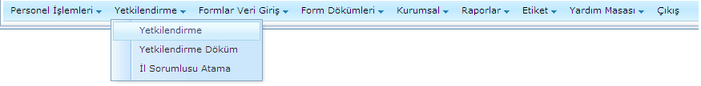
Web Application: Authority Identification Procedures
Data entry and authorisation to any enumeration areas as an interviewer is carried out over the web application by the staff with the role of Supervisor.
Notes:
8
8

Slide 9
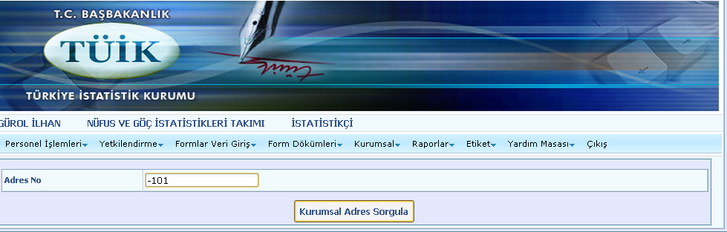
Institutional Places Applications
The address will be searched by entering it in data entry menu. If the address is not found, the new address can be defined on the institutional menu.

Slide 10

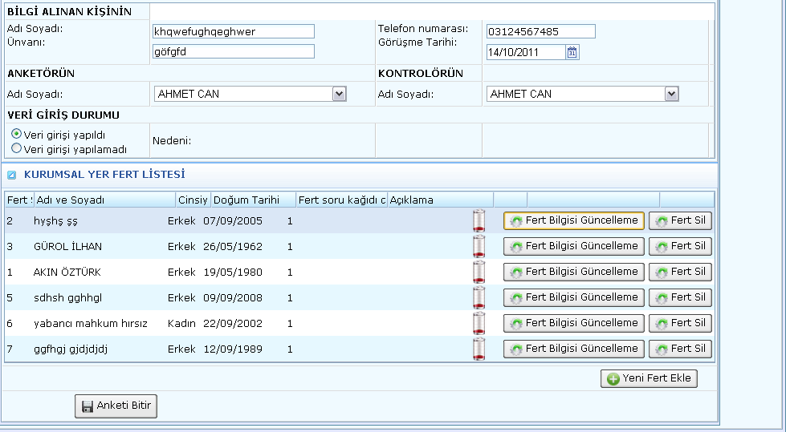
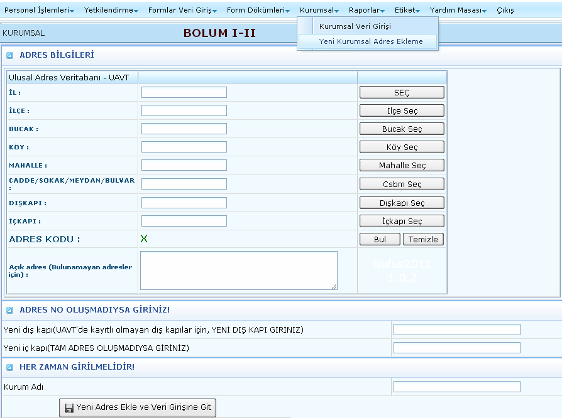
Institutional Places : Data Entry - Adding New Address
When a new institution is found or when there is no institutional data entry, a new institution can be added using add new institution screen.
First, the cover information will be filled completely.
Institutional placeholder list will be formed as an individuals are added.

Slide 11
Web Based Monitoring And Controls
2011 PHC Monitoring and Control
Monitoring and Control by Web Application
Application Support and Orientation
Data Analysis and Notifications to RO
Application Monitoring Reports
Monitoring and Control of Classification of Occupations
Incorrect Records
Provinceial Responsible
FAQ
ABPRS Control Reports
Open-ended Questions Reports
Skip Questions Reports
Migration, Place of Birth, Disability, Labour, Education, Housing Reports

Slide 12
Web Based Monitoring And Controls
Monitoring and Control by Web Application (RO and Headquarter)
Application Monitoring Reports
Incorrect Records
Monitoring and Control of Classification of Occupations
Field Work Follow-up Reports
Non-response follow-up report
Exact Errors
Control of uncertain errors
Quantitative Distribution
Incorrect Record List

Slide 13
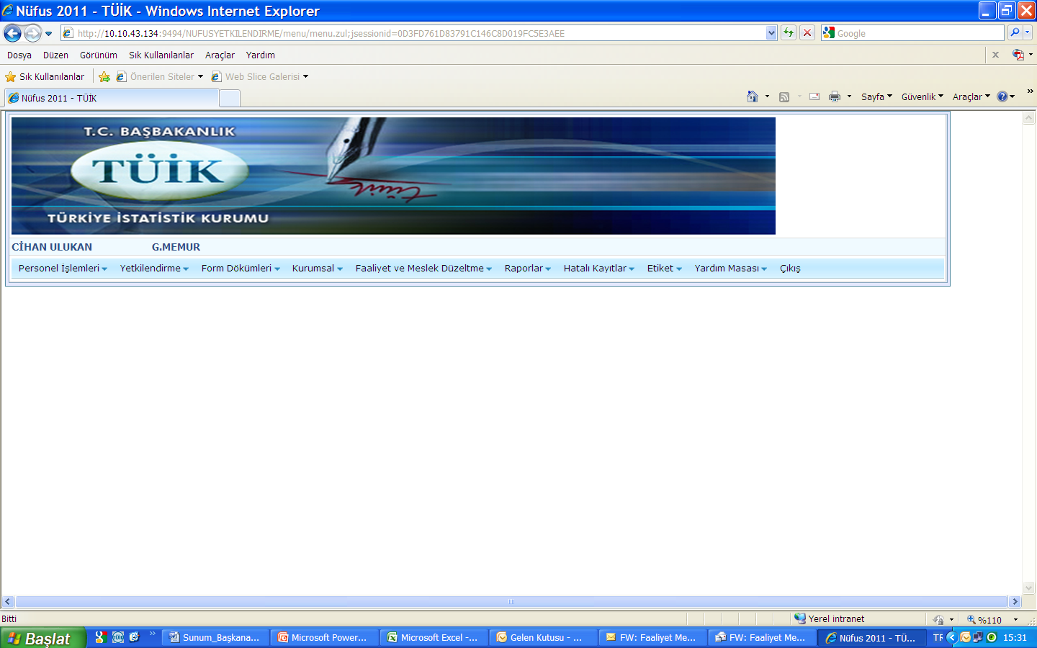
Web Based Monitoring and Controls
Application follow-up reports and lists of related data
Reports for incorrect registration lists and their numerical distribution
Records of "economic activity" and “occupation"

Slide 14
Web Based Monitoring and Controls
Applications Follow-Up Report
On a daily basis field work:
Completed addresses (questionnaire filled, non-response filled form)
Unprocessed / missing addresses
Addresses with / without ABPRS checked
Reasons for non-response
Newly found addresses
province, district, controller, enumeration area and interviewer basis quantitative reports can be monitored.
These reports are also monitored daily by the Demography Statistics Department and when necessary, cooperation is carried out at the point of solution / evaluation of the problem by communicating with the province / district responsible in the field.

Slide 15
Web Based Monitoring and Controls
R.No Report Name
1. Province Responsible Follow-up Report
2. Supervisor Follow-up Report
3. Supervisor Date Report
4. Checked Adress List
5. Unchecked ABPRS List
6. Non Response ABPRS List
7. List Of Addresses To Check Again
8. List Of Unprocessed Addresses
9. Causes Of Non-respond
10. Provincial Follow-up Report
11. District Follow-up Report
12. Distribution Of Non-respond By Causes At The Provincial Level
13. Distribution Of Non-respond By Causes At The District Level
14. Number Of Form Send To Headquarter By Interviewer
15. Distribution Of Non-respond By Interviewer

Slide 16
Web Based Monitoring and Controls
Incorrect Records
The PHC web application has a total of 222 error type for 182 "exact" error types and 40 for “potential" error types. In addition, a report has been made for ID number that were entered incorrectly.
Web Error Reports are made by taking into the consideration;
Edits that can not be placed in the data entry module due to the capacity of the software (slowing, locking)
Edits that can not be added to the software due to time constraints,
Error types predicted from household surveys, previous census, pilot and pre-test studies,
Errors that may occur during the interview (timing problems, interviewer mistakes)
Errors and inconsistencies that are not predicted at the beginning.

Slide 17
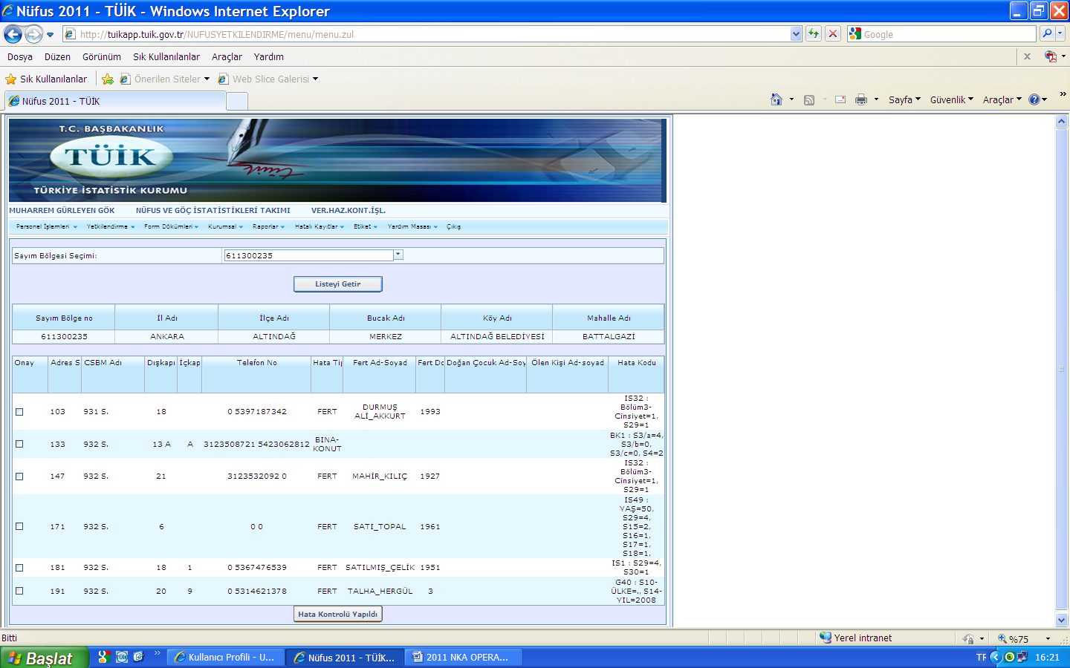
Web Based Monitoring and Controls
Potential Errors - Confirmation Screen
If there is no error, the "check" box is ticked
The record is checked within the type of error reported
By confirming the operation, the "error log" is reduced from the list.

Slide 18
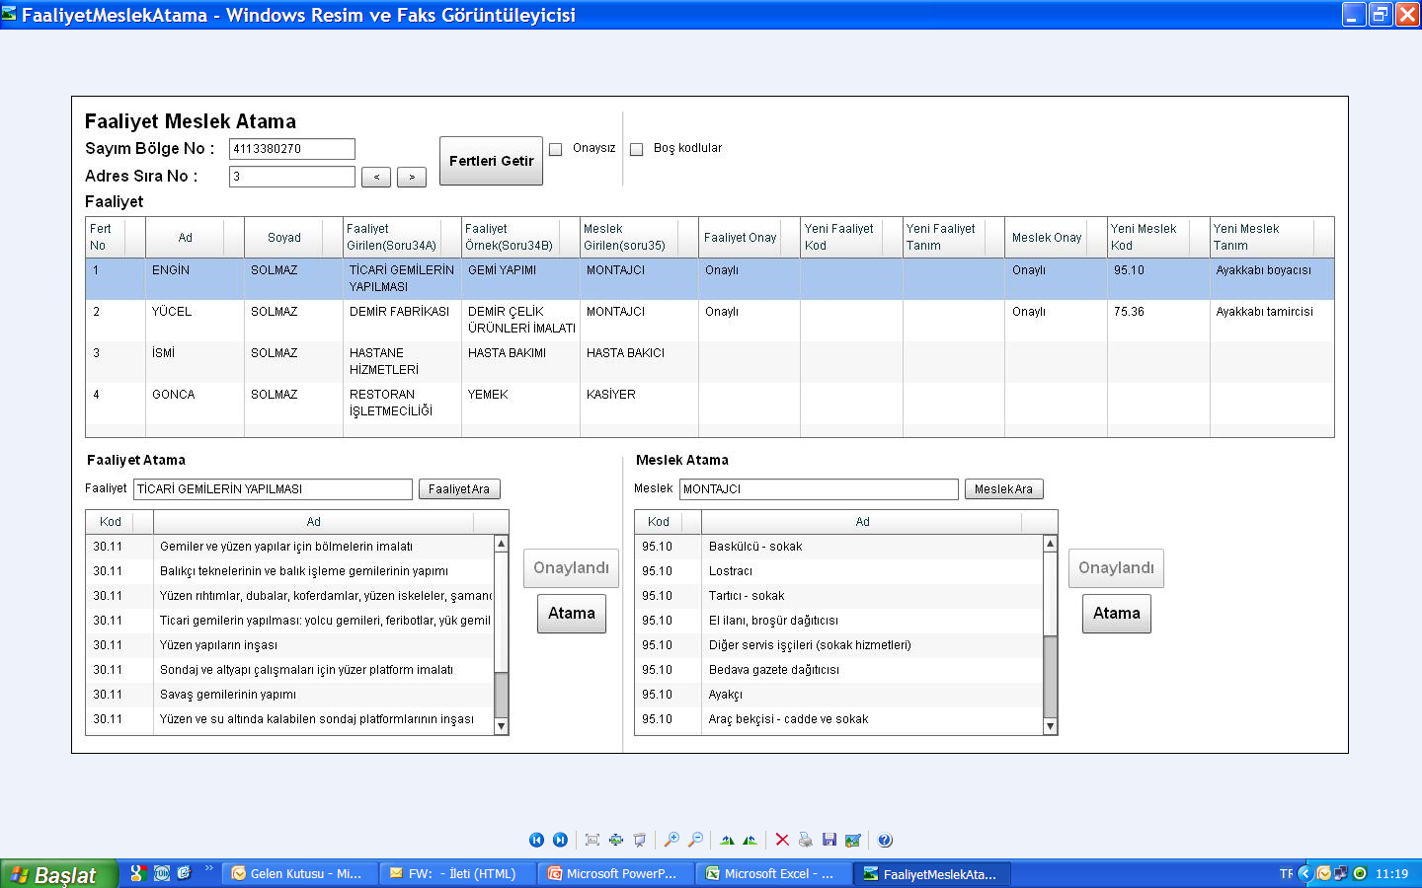
Web Based Monitoring and Controls
Occupation / Activity Codes Control and Corrections
Occupation and activity code assignments compiled in the field were checked with the web interface by comparing explanations and the code in the regional offices.
Occupation / activity information from the field
If the code is correct CONFIRMATION, If not correct code ASSIGNMENT option.
Assigning activity code
Assigning occupation code

Slide 19
NETBOOK APPLICATION

Slide 20
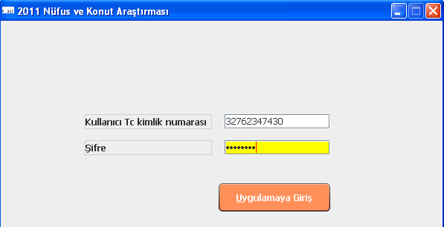
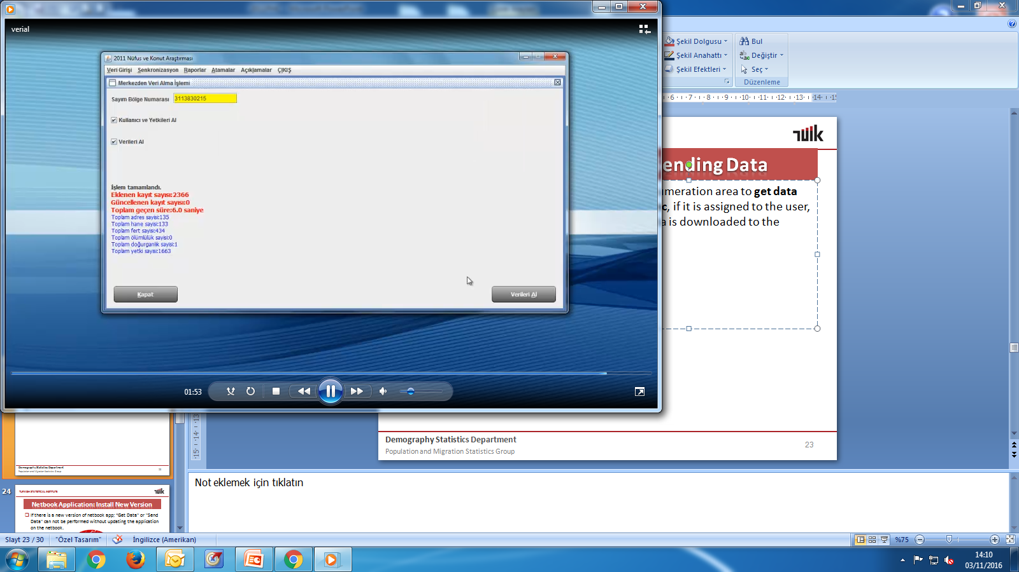
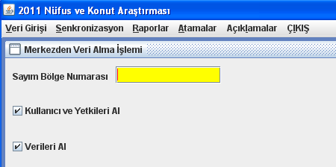
Netbook Application: First Entry and Receiving Data
Right to access to the enumeration area is given via the web application.
Interviewer log on to the netbook with username and password.
By using Get Data option under the Synch menu, the user name, password and authority of the interviewer assigned to that enumeration area are stored in the local database of the netbook.
If the request will be successful number of register , address , people dead and born can be seen as summary of this enumeration area.
Notes:
20
20

Slide 21
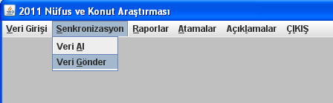

Netbook Application: Sending Data
During this process the computer must be connected to the internet.
Only newly entered and updated data are sent. Record can be sent more than one during the day, but the last sent is taken as a backup.
Since sending data is a burden on the system, it was useful to do this one a day like the end-of-day operation. Sending data will be turned off after 24:00 for backup process.
To be able for sending data the interviewer need to be authorized to the enumeration area.
PRODUCTION
DATABASE
CAPI
Firewall
Daily data backup operation
Notes:
21
21

Slide 22

Netbook Application: Consistency checks
There was no independent transition over sections to avoid inter-relationship,
Consistency control was applied to the application as much as possible,
Nonetheless, inconsistencies that have been overlooked are detected in web monitoring and SAS reports and send to RO.
Notes:
22
22

Slide 23
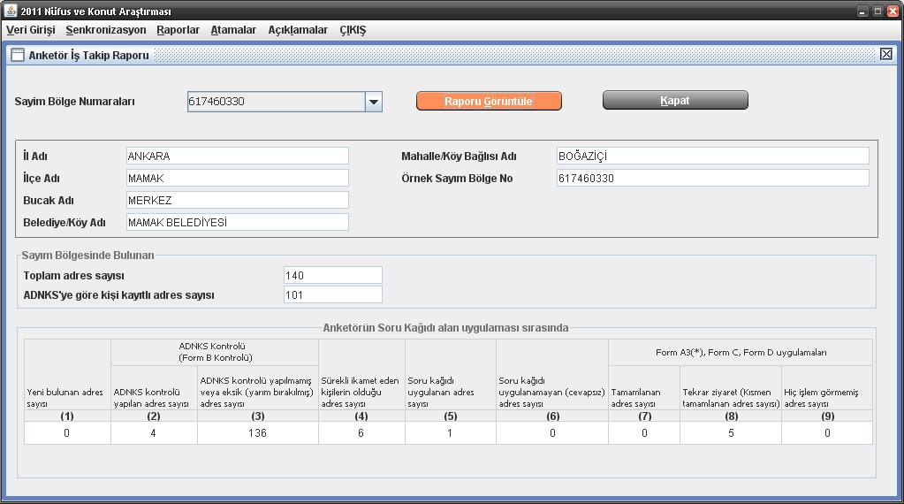
Netbook Application: Reports

Slide 24
Manuel Data Analysis

Slide 25
Data Analysis and Notifications to RO
ABPRS (Form-b) Control Results
Responses To Open Ended Questions
Skip (Bypass) Questions
Migration Questions
Labor Force Status
Fertility Status
Mortality
Education
Chronic Disease And Quality Of Life Indicators
Births, death, health,… data sent from field to the headquarter were matched with administrative records (ABPRS, social security records etc. ) for consistency control; and statistically compared with the results of related surveys (LFS, health survey, disability survey) for coherence.
Generated analyses are sent to RO to be checked.

Slide 26
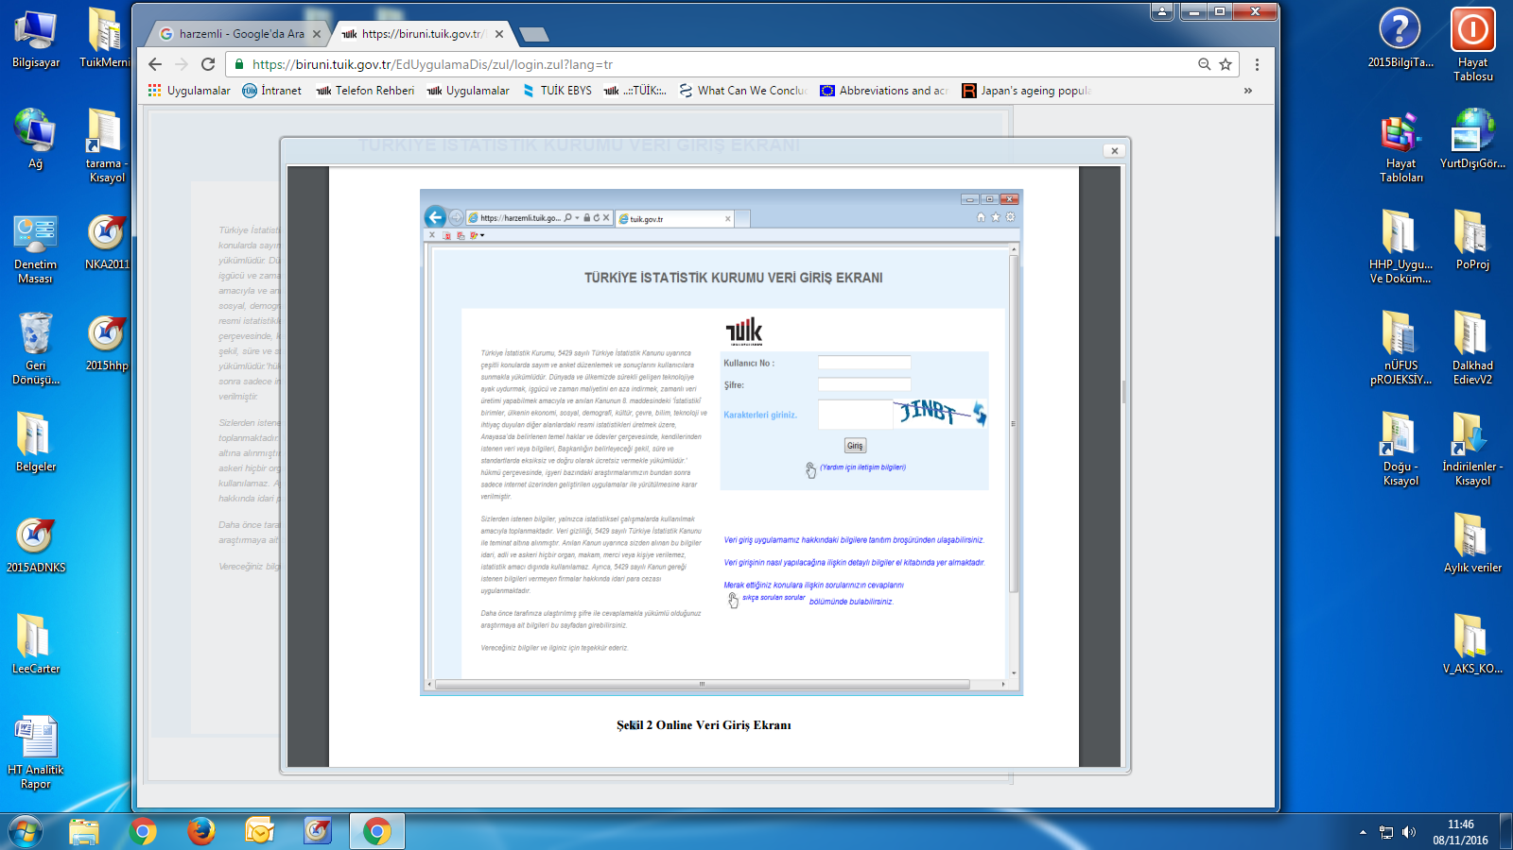
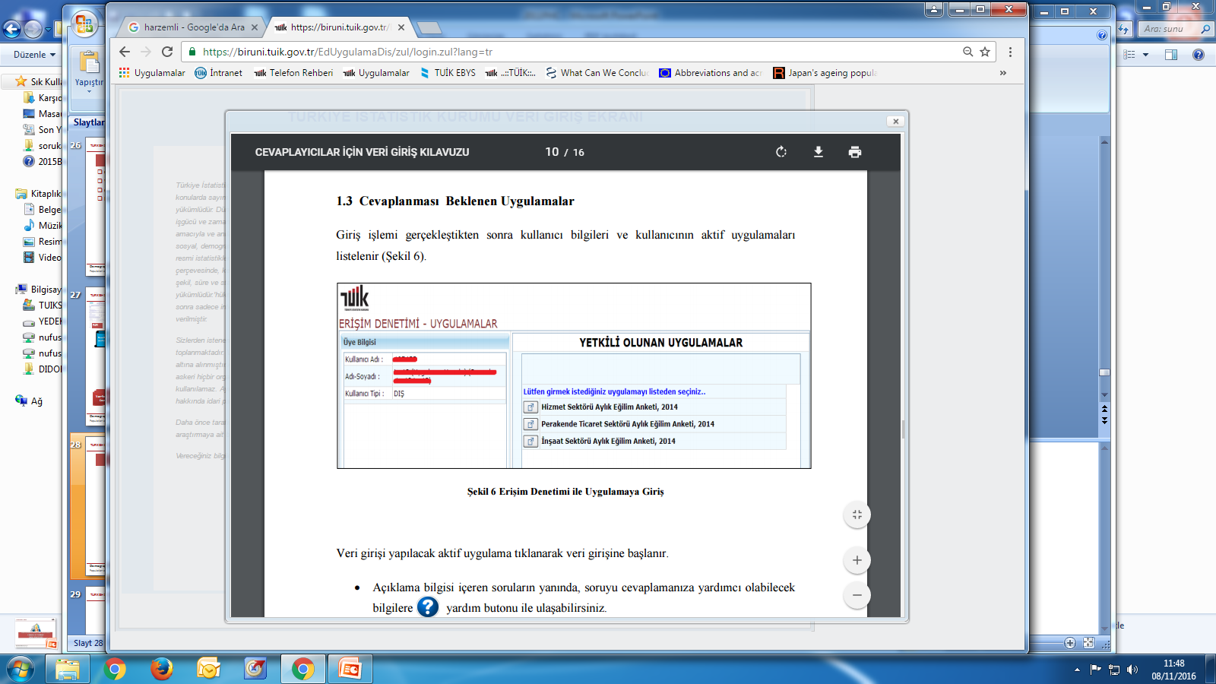
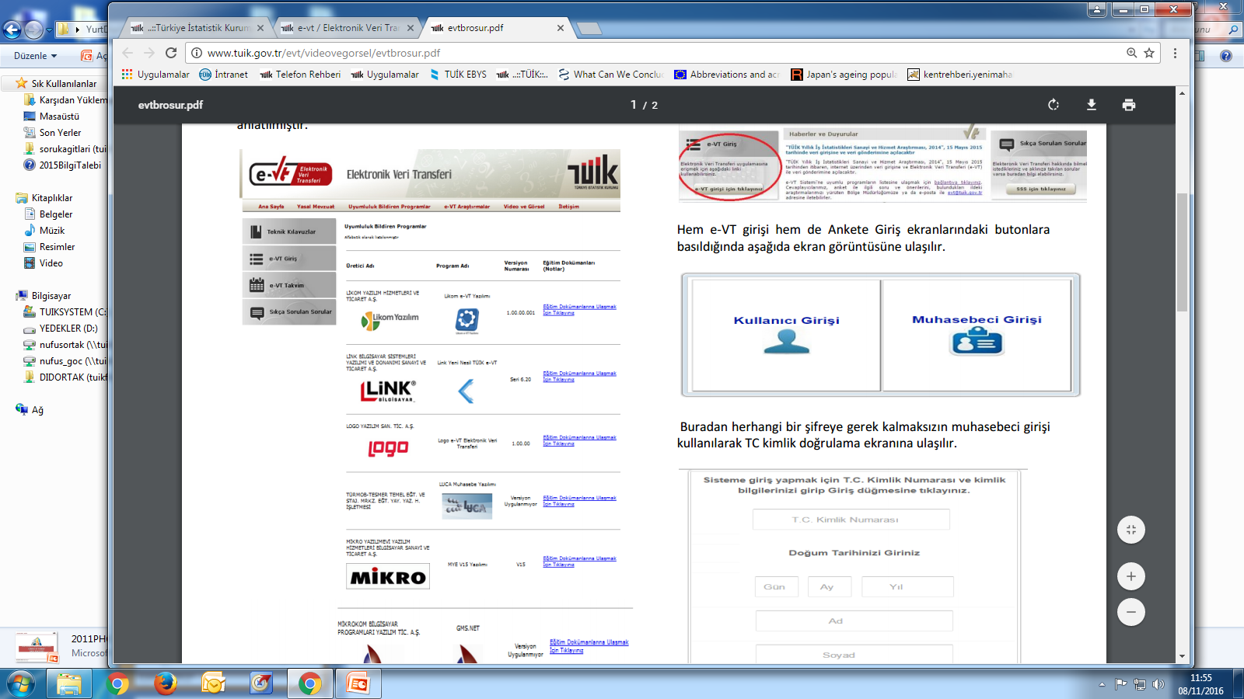
HARZEMLİ
To reduce;
labor,
time,
cost and,
to produce up-to-date data
Harzemli Web Application
Harzemli Netbook Application

Slide 27

TARGETS
Main goal is changing the system from combined method to completely register based census.
In addition;
Use of grid data
Using data of regular household surveys by combining them with related registers
Preparations for the next round has been started in 2015.

Slide 28





Summary
Online data transfer
Web based data transfer
CAPI
Online field application monitoring
Several quality crosscheck
Time
Cost
Labor
Quality

Slide 29
Thank you for your attention !

