Slide 1
THE IMPACT OF USING FULLY AUTOMATED SOLUTION ON CENSUS DATA PROCESSING. JORDAN CENSUS 2015
United Nations Technical Meeting on Use of Technology in Population and Housing Censuses
Amman, Jordan, 28 November-1 December 2016
Draft 1
BY Jaffar H. Mansour
RealSoft Advanced Applications.

Slide 2
RealSoft.
Jaffar Mansour,
Manager Partner at RealSoft Advanced Applications.
Provided the software and services for the first electronic population census in Oman 2003.
Delivered data processing solutions for 10 population census projects in the region.
3 Agricultural census.
Tens of social, economical, agricultural , tourism and other statistical surveys across the region.
Consulting and technical services for Register based census.

Slide 3
Agenda
Jordan Census Data Processing at a Glance
Dealing With Data Errors in Electronic Census
Data Imputation Considerations.
The Role of Each Census Systems in Data Quality.

Slide 4
Proposed Solution
Jordan Census Data Processing at A Glance

Slide 5
Project Timelines
4
April
Sign off
7
June
Demarcation
8
Aug.
Listing
11
Nov.
Census
12
Dec.
Preliminary data
2015

Slide 6
High Level of Process Automation. Structure of the implemented solution

Slide 7
Jordan Census Software Programs
The following programs have been used for data processing in the three stages project:-
Demarcation Phase
GIS database and systems
Mobile demarcation data collection and processing.
Survey management.
Listing and Est. Census Phase
Mobile data collection.
Survey management.
Command and control
Tabulation
Census Phase
Mobile data collection.
Self-enumeration.
Call center
Survey management.
Command and control.
Tabulation (GIS, Tables)

Slide 8
How we Delivered?
Having products and models ready to customization and configuration to be used.
RealSoft and DoS experience in electronic census and surveys.
Having a big team specialized in the technology and business domain.
However, it had been a nightmare.

Slide 9
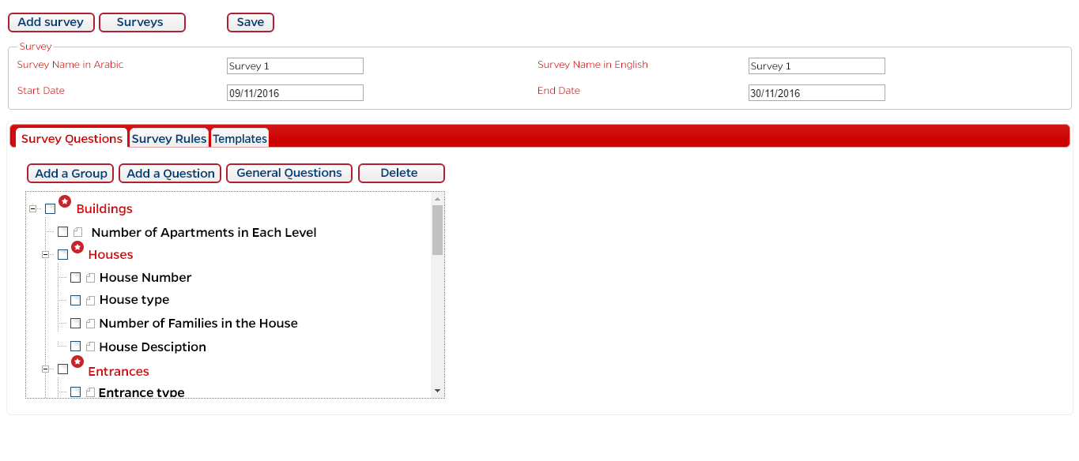
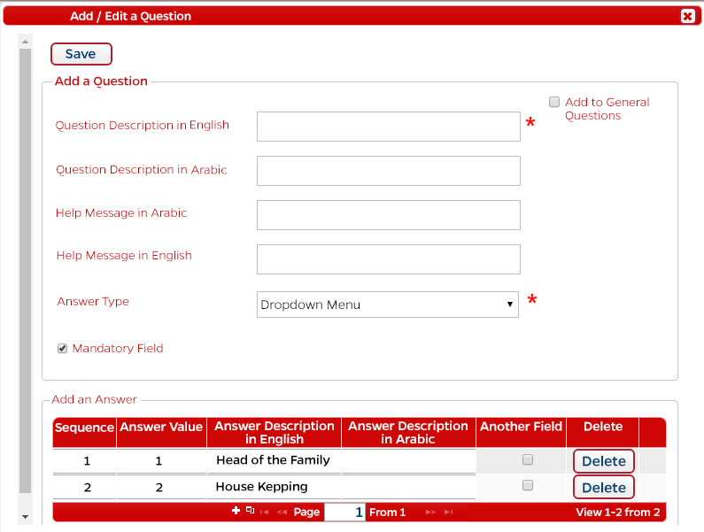
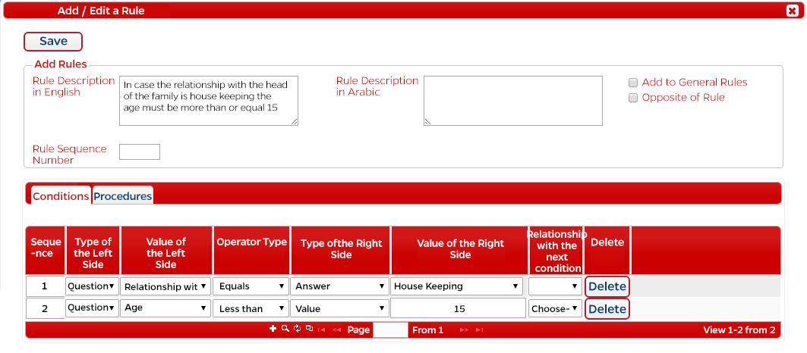
Dynamic Definition and Design of Survey
Define units
Define questions
Define rules

Slide 10
Questionnaire Size
Listing stage | Counts
# of Questions | 69
# of validation rules -stopping | 62
# of validation rules -skipping | 10
# of validation rules - warning | 1
Census Stage | Counts
# of Questions | 120
# of validation rules -stopping | 192
# of validation rules -skipping | 32
# of validation rules - warning | 1

Slide 11
Proposed Solution
Data Errors Source and Resolution

Slide 12
Big Impact On Data Processing
We experienced a big impact on data processing and imputation when implementing electronic data collection programs,we believe there should be a special methodologies, guidelines and considerations when going into electronic census.

Slide 13
Types of Data Errors In Census
Coverage error
Omissions Errors
Duplications of persons or housing.
Content errors
Poorly designed questions
Enumerator errors and self-enumeration.
Coding errors (software bugs and device malfunction)
Data entry error
Tabulation Errors

Slide 14
Types of Data Errors In Census
New tools helped to control and minimize the omissions and duplication errors:
Omissions
DoS utilized the previous phase data and loading it into the system – in Jordan census we used previous phase data to control the direct next phase (demarcation (building level) → listing (Households)→ Census). That used in the Mobile terminal and the back office systems.
Check against the GIS database.
DoS couldn’t get data from registers to better validate the data.
Duplication
(GPS and GIS) GPS and maps helped to avoid duplicate building records.
GIS didn’t include apartment and households .
Using validation rules examples:-
Using control fields at he beginning of interview (like number of persons in the family).
Editing rules enforcement includes defining unique columns or set of columns.
Back office editing is more effective in electronic data collection as the supervisors and data quality teams have access to daily data, the latency can be couple of hours.
E.g.. Check for duplication in names and relations to family inside the household.

Slide 15
Content Errors – Software Design.
The screen design plays vital role in data quality and system ease of use. And should be given enough time and attention.
We had 13 versions of screen designs for census phase mobile.
Piloting and testing helps, however the tight timeline didn’t allow for adequate piloting for design evaluation.
The dynamic nature of the system provided the flexibility needed for more design options.
The design shall consider the modification and deletion of data very carefully, especially when handling the validation rules that involves questions in different pages or different levels.
Automatic handling of skip patterns have a positive impact and helped avoiding human mistakes.

Slide 16
Content Errors – Enumerator Errors
The system includes help text, so the enumerator reads the question in a better way, and gets more explanation electronically from the device for each question.
Using closed lists and data validation rules had remarkably minimized the enumerators errors
Supervisor has access to the system data so he can review the data.
Deliberate errors are minimized by the technology too, this is attributed to the GPS and GIS (Tracking and buffering), and loaded business rules (data integrity, completeness and consistency).
In Jordan census, A better selection of enumerators and adequate training to users would give better results.

Slide 17
Content Errors – Coding Errors.
Bad programs and coding may demolish the whole electronic census projects .
Errors more related to electronic census include data loss and systematic errors.
In Jordan census, we had a multi-level backup procedure, thus there had been no data loss.
High attention had been paid to the testing process. A remarkable size of testing team include third party entity.
Traditional census data entry error Is not a risk of electronic census.

Slide 18
Imputation Consideration.
There had been a need for Imputation in Jordan census however the imputation had been minimized for the following reasons:
Data validation rules include the option to define mandatory questions and skip rules. E.g. (Age, sex, relation are always reported).
extensive editing (validation) were attainable without a considerable delay in the census or survey process.
Each statistical unit has a status value (Complete, incomplete, others …) and it has a cascade relationship, thus the block can’t be closed if there is incomplete information for one person unless it is authorized by the supervisor.
Multi-visits can be managed and controlled by the systems to complete the incomplete data.
many types of serious systematic errors cannot be identified by editing, Granquist (1997)

Slide 19
Imputation Consideration.
Call center helped to decrease the unknown values, however it could do better.
Easy to preserve copies of original data, DoS kept a copy of each device final local dataset.
It is possible to get a consistent however fabricated data, which make it very hard to discover, however

Slide 20
Data Quality Areas.
Roles of Census Systems

Slide 21
The Role of Census Programs in Data Quality - Mobile Data Collection
Dynamic rule engine, that included more than 200 data validation rules.
Manage the status of every statistical unit and present the status in the mobile map and reports.
Geo-fencing and tracking.
Previous stage data to control omissions and double check.

Slide 22
The Roles of Programs in Data Quality - Call Center
The call center played a remarkable role in data quality, the duties of call center had been:
Review the data quality results from the backend and try to resolve the issues through the field team or by conducting telephone re-interview.
Early errors detection
Control quality through recollecting sample of pre-collected data and rechecking it. “ discover consistent however Spurious data”
Evaluating surveyors’ performance and their work quality

Slide 23
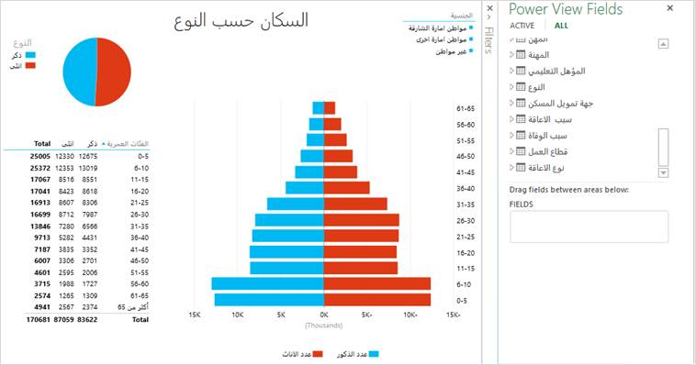
The Roles of Census Programs in Data Quality - Command and control
Display KPIs and indicates on performance and data quality reports at different levels. E.g population pyramid at small area level.
Different levels of KPIs like incomplete data rates, closed units follow up and blocks and enumeration area close.
Accessible by census management and supervisors.
Macro-level data validation of data with the ability to drill down and across to find the root cause and take correction actions.
.

Slide 24
The Role of Census Programs in Data Quality Management System
The Census management system has a role in field force management and process / data quality:
Viewing the collected data at low level to ensure its accuracy.
Monitor validation rules beyond the capacity of the tablet device.
Providing the Supervisors and Observers with detailed reports to track the achievement rate for each observer and surveyor.
Tracking surveyors: through employing geographical information systems (GIS) that enable tracking surveyors’ work flow.
Micro-level data validation.

Slide 25
Recommendations
Go with electronic census if your registers are not ready.
Partner with private sector, however keep your team involved.
Design and pilot ….. and redesign and pilot.
More time for software customization and testing means more control and better quality.
Maintain close coordination and communication between census management, SMEs and data processing team.
More studies and guidelines are needed to enhance the system design and materialize the potential of Electronic Census.

Slide 26
THANK YOU

