Slide 1
Use of electronic data collection technologies in the enumeration phase
Case of senegal
-------
Amman, jordan, 29 November 2016
Mr. Babacar ndir, Deputy Executive
National Agency of statistics and Demography
Dakar, senegal

Slide 2
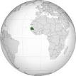
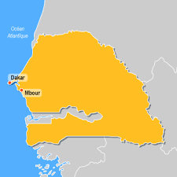
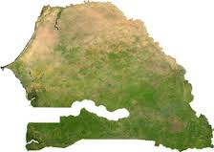
SENEGAL
Surface area = 196,722 km2
Population = 13,508,715 inhabitants
14 administrative regions
45 departments
529 municipalities
4 major rivers: Senegal, Gambia, Casamance, Saloum
The climate is tropical and is characterized by a long dry season from Nov-June and a wet season from July-Oct
Like other Sahelian countries, Senegal has been facing desertification for several decades.
LDC
Mauritania
Mali
Gambia
Guinea-Bissau
Guinea

Slide 3
contents
recruitment, selection and training of field staff
distribution of electronic devices;
management structure and supervision;
mechanisms for monitoring the field enumeration;
procedures for ensuring data confidentiality;
procedures for validation of response and coverage;
data transfer;
management and information systems for monitoring;
potential risks and solutions.

Slide 4
recruitment, selection and training of field staff
Recruitment of field workers
The steps were as follows:
The definition of the profiles sought (selection criteria) by the ANSD;
Launching of the call for applications;
Establishment and installation of the departmental recruitment commissions in the prefectures of the country (these commissions are presided over by the Prefects and supervised by the Governors);
The shortlisted candidates for training;
Confirmation of shortlisted candidates and replacement of desists.

Slide 5
recruitment, selection and training of field staff
Staff training
The objectives were:
Understanding of objectives;
The good adhesion of trainees;
Clarification of concepts;
Mastery of collection tools;
Appropriation of complex situations that may arise.

Slide 6
recruitment, selection and training of field staff
Staff training
The training took place according to the cascade approach (Chaining training plan) at three levels:
Level 1: training of Regional Technical Coordinators (RTCs) at the ANSD headquarters (the national level);
Level 2: training of supervisors at the regional level;
Level 3: training of enumerators at the departmental level, the best of whom have been retained as controllers.
The supervisors trained the enumerators in the same way as they were trained by the CTRs in accordance with the so-called training method by example.
The training methodology at all levels consisted of alternating theoretical and practical aspects (manuals, questionnaires and PDAs).

Slide 7
recruitment, selection and training of field staff
Definitive selection of enumerators
A case study was designed and implemented in the IT application evaluation of enumerators.
At the end of the training, the enumerators were evaluated on the basis of this case study and the correction was made from the supervisor's PDA.
On the other hand, a note of conduct was given to the enumerators by their respective supervisors from the evaluation application.
At the end of these two evaluations, the supervisors carried out the final selection of enumerators in order of merit and as required.

Slide 8
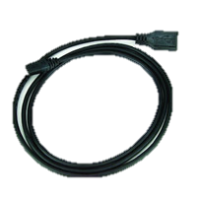
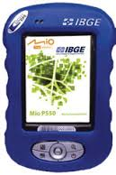
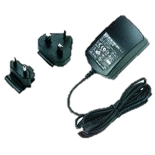
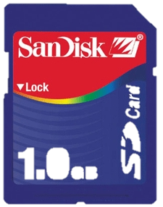
distribution of census materials and electronic devices
Enumerators:

Slide 9
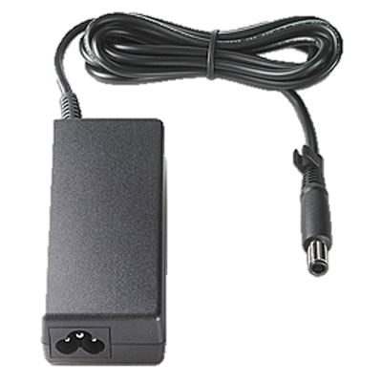
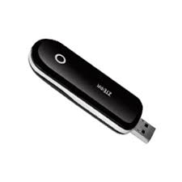
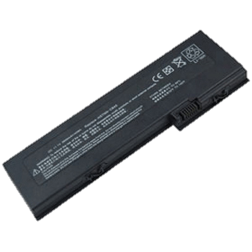
distribution of census materials and electronic devices
Supervisors and ICT Coordinators:

Slide 10
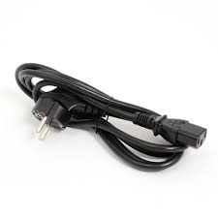
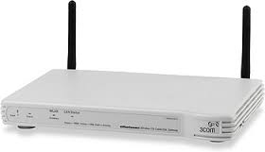
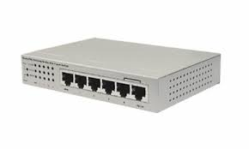
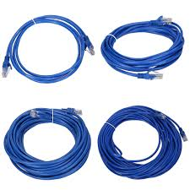
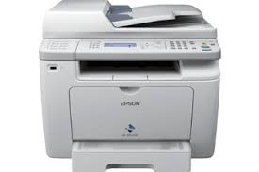
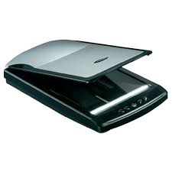
distribution of census materials and electronic devices
Departmental station:

Slide 11
distribution of census materials and electronic devices
The ICT Coordinator:
Installs mobile app on PDAs;
Installs the supervisor application on laptops;
Installs the departmental application on desktops;
Assigns each supervisor his laptop;
Assigns PDAs to enumerators;
Saves assignments in the PMB hardware management tool.

Slide 12
distribution of census materials and electronic devices
Electronic devices | Affectations | Users
PDA | Enumerator | Controllor Enumerator
Laptop (Utraportable) | Supervisor ICTC | Supervisor ICTC
Desktop | Departmental | Supervisor ICTC
Mobile phone | Supervisor ICTC | Supervisor ICTC
Internet key | ICTC | ICTC

Slide 13
management structure and supervision (national level)
A technical coordination team has been set up:
It deals with the technical;
It coordinates, monitors and evaluates the project.
It also contains nine sections:
Design, Analysis and Evaluation of Data,
Cartography,
Field Operations,
Technological Infrastructure,
Logistics,
Human resources,
Finance,
Communication and Awareness, and
Printing.

Slide 14
management structure and supervision (regional level)
STEERING COMMITTEE:
Chaired by the Governor
REGIONAL TECHNICAL COMMITTEE:
Chaired by the SRSD Chief
Organization of collection at the regional level :
Administrative Coordinator (Head of SRSD)
Technical Coordinator
Head of Department
ICT Coordinator
Supervisor
Controller (Enumerators Team)

Slide 15
Three levels of responsibility in the PDA-assisted interview system
1 – Headquarter (Central level)
ANSD Experts
Associated Structures
2 – Supervision (Department level)
Supervisors
ICT Coordinators
3 – Collection (Field level)
Controllers
Enumerators

Slide 16
mechanisms for monitoring the field enumeration
Gathers the data collected by the enumerators and forwards them to the central level using an Internet connection
Supervisor
5 teams under his responsability
Team
Controls the work of enumerators by verifying data collected on a sample of households
Controller
Have PDAs for data collection
4 to 5 Enumerators

Slide 17
management and information systems for monitoring
Web-based tracking tools:
A database of the material: all the material is identified, referenced. The management of assignments and returns of equipment is automated with the PMB software. This has the advantage of allowing traceability of the allocated equipment.
A personnel database: Information on recruited staff is collected in a central database. These data are complemented by information on the composition of teams, the allocation of census districts through a recruitment management application at the departmental level.

Slide 18
management and information systems for monitoring
Web-based tracking tools:
Installed centrally on a server, the web application allows to track the collection with dashboards to see the performance of enumerators in the field. It allows, among others, to:
have aggregate data for the census district according to region, department, and municipality;
display the rate of achievement of collection at the national level by census district. It also measures the duration of the collection in number of days;
give discharge / attestation of service done;
visualize all data from the collection, from the census district to the lowest level.
monitor the flow of information exchanged between enumerators and supervisors, as well as transfers of data from supervisors to departments and departments to the central level.

Slide 19
procedures for validation of response and coverage
The supervisor:
First consists of its teams and assigns census districts to each enumerator from the WEB-tracked application;
Then download the composition on his laptop with the supervisor application;
Loads the base of each enumerator on its PDA;
Deploys its teams on the ground.
Redeploys one or more enumerators who have completed their census district to support another enumerator;
Retrieves concessions for which the enumerator has not begun collecting household information and redistribute it to other enumerators in case of support.

Slide 20
procedures for validation of response and coverage
The supervisor:
After training, selecting and deploying its teams in the field,
He regularly visited his agents to collect the data collected for verification and transfer to the ANSD headquarters via the Internet.
During his tours, he brought the necessary adjustments, reinforced the coaching, found solutions to the administrative or logistical problems.

Slide 21
procedures for validation of response and coverage
The controller:
The controllers, under the supervision of the supervisors, ensured the daily monitoring of the quality and completeness of the collection.
The controller does not have a PDA but works with the PDA of the enumerator.
He repeats the interview in whole or in part on a sample of households already surveyed by the enumerator along with the enumerator.
The application makes a systematic comparison between the seizure of the controller and what had been previously seized by the enumerator.
If a difference occurs, an error message informs the controller about the error.
The data of the enumerator for households taken over by the controller are archived .
The data collected by the controller are those that are considered a priori to be valid.

Slide 22
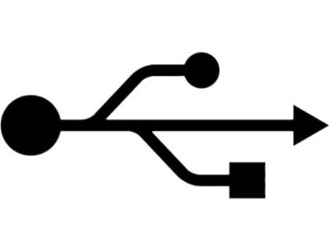
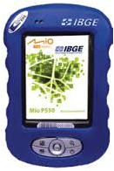
data transfer
central server
(ANSD Headquater)
3. Transfers the database by Internet
Supervisor
2. Transfers the database by network cable
ICT Coordonator
Departmental computer
1. Transfers the database by the PDA cable
Provides on-site technical assistance
Controllor / Enumerator

Slide 23
procedures for ensuring data confidentiality during the field enumeration
The data collected in the electronic devices must be encrypted and accessed only by means of a password;
Each supervisor, controller and enumerator has his / her own password;
Only supervisors are empowered to transfer the data collected by enumerators;
Before any data transfer, the availability of the central server must be tested;
All transfers of data to the central level are monitored by the ICT Coordinator;
Networks used for the transfer of secure sound data (government intranet);
PDAs are kept in their protective shells throughout the duration of field operations.

Slide 24
Potential risks and solutions
Having high-level qualified HR (Developers, ICT Controller, geomaticians, GIS experts, cartographers, enumerators, controllers and supervisors);
Provide supervisors, ICTCs and departmental employees with laptops;
Development of manuals for computer applications;
Secure PDAs and ultra portable devices in the field;

Slide 25
Potential risks and solutions
Good coverage of the national territory (urban as well as rural) in electrical networks;
Good coverage of the national territory in telephony and Internet;
Energy security (PDA, Ultra portable) especially in rural areas (Solar Charger and Reserve Batteries);
Duplication of servers on different sites;
Providing a well-stocked car fleet throughout the period.

Slide 26
THANK YOU

