Slide 1
Multimode census enumeration in Poland
Session 6
Janusz Dygaszewicz
Member of Executive Committee of the UN-GGIM: Europe
President of European Forum for Geography and Statistics EFGS
Director
Department of Programming and Coordination of Statistical Surveys
Central Statistical Office of Poland

Slide 2
Mixed Model for Population and Housing Census
Combining Census
– linking data from administrative sources
(full survey covering base demographic variables – short form)
with data acquired from 20% sample survey
(long form)
2

Slide 3
The IT Census System
Census architecture
For the purposes of census design and conduction, the Central Statistical Office of Poland implemented the IT Census System (ICS)
The ICS integrated various technologies (from applications installed on mobile terminals, through applications managing and assisting in telephone interviews, to specialist bases, data warehouses and analytical and reporting tools)
3
Notes:
A mobile application implemented on a mobile terminal (CAPI method) supported census enumerators in the field operation.
The Stat Call Center system was used to support the CATI-method census. It consisted of functional components supporting the tasks that were given to interviewers:
an application supporting:
the use and management of the incoming traffic (the Interaction Attendant application),
the use and management of the outgoing traffic (the Interaction Scripter.NET application),
an application enabling the constant monitoring of the interviewers’ work, providing access to reports and previews of the interviewers’ work,
an electronic form used to conduct interviews with respondents,
an application allowing interviewers to arrange enumerators’ meetings.

Slide 4
Data collection channels in 2010 Census Round
Administrative Sources
Including spatial data from reference admin. registers
Self-enumeration by Internet
CAWI – Computer Asisted Web Interview
Telephone Interview
CATI - Computer Asisted Telephone Interview
Registered on hand-held terminals with usage GPS and GIS service
CAPI - Computer Assisted Personal Interview
Interview with respondents realized by the census enumerator
4
Notes:
During the census in Poland data were collected from 4 channels:
Administrative registers
CAII
CATI
CAPI

Slide 5




CAxI channels
CAXI
CAxI
CAWI - Computer Assisted Internet Interview,
CAPI - Computer Assisted Personal Interview,
CATI - Computer Assisted Telephone Interviewing.
5
Notes:
All three channels were based exclusively on an adaptive electronic questionnaire, ensuring high quality of data at the collection stage. The electronic questionnaire was adjusted and implemented in accordance with the technology assisting particular modes of obtaining data based on CAxI. An appropriate questionnaire application (available at a mobile terminal or Internet browser) verified if the questionnaire had been filled in accurately, among other things, through logical and accounting control.

Slide 6
Administrative source utilisation

Slide 7
Administrative sources
Data from administrative systems was used in the census:
  as a direct source of census data (personalisation of questionnaires)
  to create:
    compilations of buildings, dwellings and persons lists,
    an address-residence register,
    a sampling frame.

Slide 8

Registers - data acquisition
Data Owners:
Ministry of Finance,
Ministry of Interior and Administration,
Ministry of Justice,
Agricultural Social Insurance Fund,
National Health Fund,
Agency for Restructuring and Modernisation of Agriculture,
Agricultural and Food Quality Inspection,
Agency for Geodesy and Cartography,
State Fund for Rehabilitation of Disabled Persons,
County Offices,
Commune Offices,
Regional Offices,
Telcoms,
Energy Suppliers,
Office For Foreigners,
Social Insurance Institution,
Housing Managers,
8

Slide 9
Operational Microdata Base
OMB was realized processes of :
  cleaning,
  integration and verification of data,
  correcting data,
  data processing,
  generating operational reports,
  depersonalizing data and export of data (as Golden Record) to Analytical Base.

Slide 10
CAxI on-line channels for data collection
Operational Microdata Base
Census
Completeness
Management
List of census
Questionaries'
The control data
History of contacts with the respondent
CAII
CATI
CAPI
Notes:
Due to the simultaneous collection of data in the census, the special status were assigned in OMB and consequently to the Completeness Management System .
After opening the questionnaire in the channel CAII, the system was setting the appropriate status.
Then the unit census was blocked for other channels (CAPI, CATI).
Respondent had 14 days to fully fill in the questionnaire in the channel. After this time the questionnaire was unlocked and the unit was directed to the channel CAPI / CATI.

Slide 11
Golden Record generation
Integration with Census Frame and CAxI data,
Validation,
Correction,
Operational Imputation,
Transfer proper values to Golden Record,
OMB Layers
Registers 1..n
CAxI
Golden Record
AMB

Slide 12


Architecture solution
Registry 1
XML
Stage I – Preparatory works
CAXI
Stage III – Results compilation
TXT
Stage II – Data acquisition
Questionaries
Registry 2
ETL
Tools
Operational Microdata Base
Analitycal
Microdata Base
Statistical Files
Golden Record
Files
SDMX
Registry n
Metadata
Metadata
Metadata
XML
Metadata server
Portal
12
Notes:
EtL tools – there are software which was used to verification, cleaning, and control date from administrative registers.

Slide 13


CAWI method system
OBM
Online questionnaire system
Offline questionnaire
ZKS
Downloading the application file
Internet
Email
Online
Electronic media
Browser
Online method
Offline method
13

Slide 14
Self-enumeration by Internet filling the questionnaire by the respondent
Identification
Used to confirm the identity of the respondent.
  Entering identification data in a questionnaire(f.ex.: PESEL, NIP, first name, last name) or additional authentication qualities (f.ex. a place of birth, mother’s maiden name)
  Establishing a password which was the basis of authentication within 14 days
14

Slide 15
Self-enumeration by internet course of action in completing the survey by person
In case of full scope survey person fulfilled his/her questionnaire , and could also specify adults who lived in the same apartment
In case of sample survey the dwellings questionnaires were completed in the first place. Later were fulfilled personal questionnaires.
After completion of the authorization process the census form was available for 14 days.
15

Slide 16
Self enumeration trend
16

Slide 17
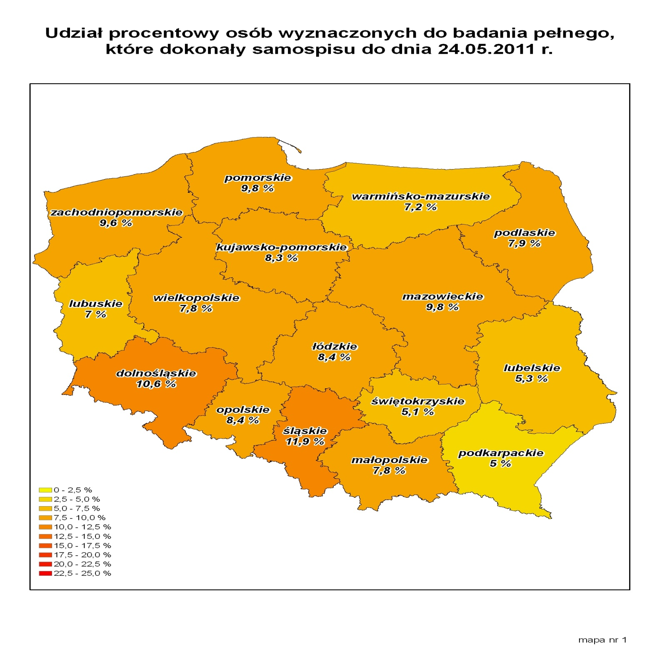
Progress of self-enumeration
The percentage share of persons selected for complete survey,
who performed self-enumeration by 24 May 2011

Slide 18
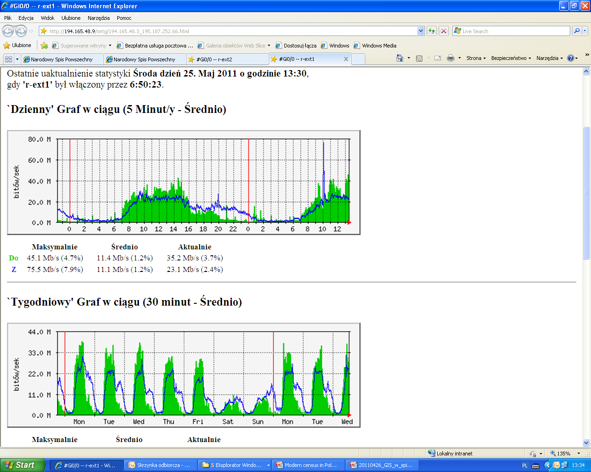

Slide 19
Typical person using selfenumeration
A man
Age: about 24 years old
A city inhabitant
Secondary degree
19

Slide 20
CATI – Computer Assisted Telephone Interview
scheduled as the first or the second (following CAII) channel of collecting data;
working posts of telephone interviewers - located in separated Call Center studies;
telephone interviewers - provided with professional equipment.
20

Slide 21





The most significant functionality
of Call Center
Confirming the identity of the census enumerator
Interviewing
Arranging visits by census enumerators
Hotline
21

Slide 22
CAPI – Computer Assisted Personal Interview
the third channel of data collection in the case of failure to obtain a complete set of data via CAII and CATI channels
direct interviews in households (first or second channel)
    where such a way of proceeding results from adopted methodology or
    whose members has not expressed consent for a telephone survey
22

Slide 23

CAPI method system
OBM
Dispatching application
- server -
Communication server
ZKS
Map server
Management
of a terminal
Mobile network - Dedicated VPN (General Packet Radio Service (GPRS))
WAN CSO
Statistical Office
Cryptographic SIM card
Module GPS
Dispatching application
- client -
Mobile application
23

Slide 24
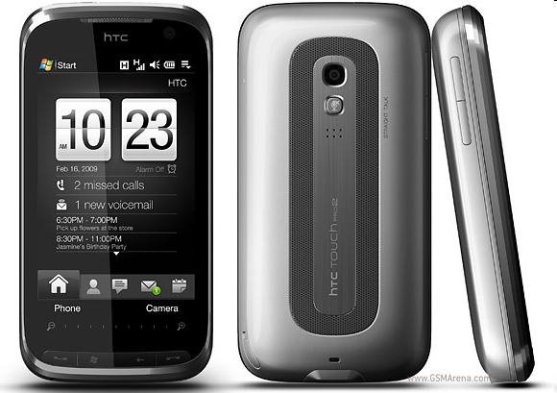
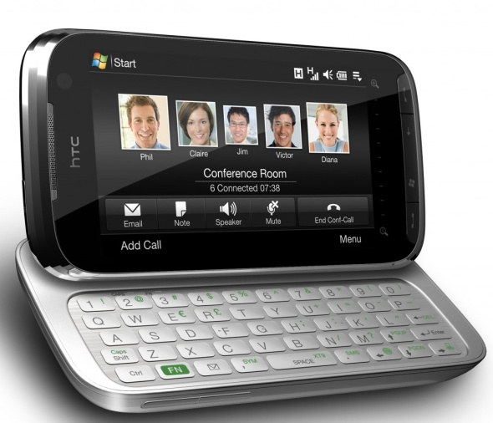
Mobile GPS terminal for census enumerators
HTC Touch Pro2
screen
  touch-controlled
  display size: 3,6’’
  resolution: 480 x 800 pixels
  slide-out, tilted – comfortable in use
slide-out, 5-row QWERTY keyboard
GSM/GPRS/EDGE/UMTS/HSPA
GPS module
3.2 Mpix camera
Windows Mobile® 6.5
Notes:
24

Slide 25
The introduction of handheld devices allowed full management of enumerators’ field work.
The transmission of data was bidirectional.
Census data obtained by the enumerators were transferred to regional communication servers which recorded the progress of the census on-line.
The data were presented in the voivodship census bureaus serving as regional census management centres.
The aggregated data were immediately aggregated in the central census bureau. For this purpose, special ICT infrastructure was created and provided support from GIS applications.

Slide 26
Organization of the Population Census in Poland 2011
16 central controllers
32 managers of the WCZS and the WCC
571 voivodship controllers
642 statistical interviewers
around 2800 gmina leaders
around 18000 census enumerators
Over 10 external companies providing ongoing support
26
Notes:
The number of statistical interviewers was determined by the manager of the voivodship Call Centre (the CATI method management unit in voivodship statistical offices), based on the number of dwellings assigned to the full-scope survey with an available phone number . The final decision on the number of interviewers in a voivodship was issued by the Director of the Statistical Office (in most cases depending on the availability of persons delegated to work as statistical interviewers).
The number of census enumerators employed in particular voivodships depended on the number of dwellings selected for the sample survey.
Additionally, when estimating the number of census enumerators, the number of buildings to be verified as part of the pre-census field check (a stage in which enumerators verified the dwelling locations in the field) was taken into consideration, in order to ensure that each enumerator would be obliged to verify not more than 400 address points.
The number of dwellings per each enumerator did not exceed 150 in the sample survey and 30 in the full-scope survey.

Slide 27
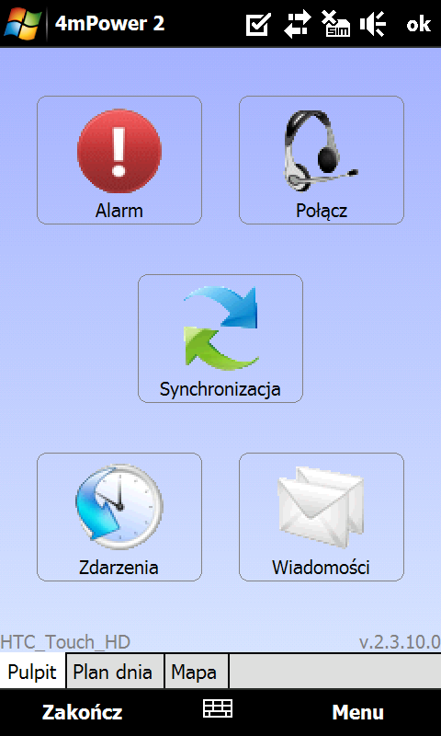
Enumerator duties
Visiting all assigned holdings
  Filling electronic questionnaires
Daily synchronisation
Contact with the supervisor
in terms of task scheduling
Adding newly identified holdings

Slide 28
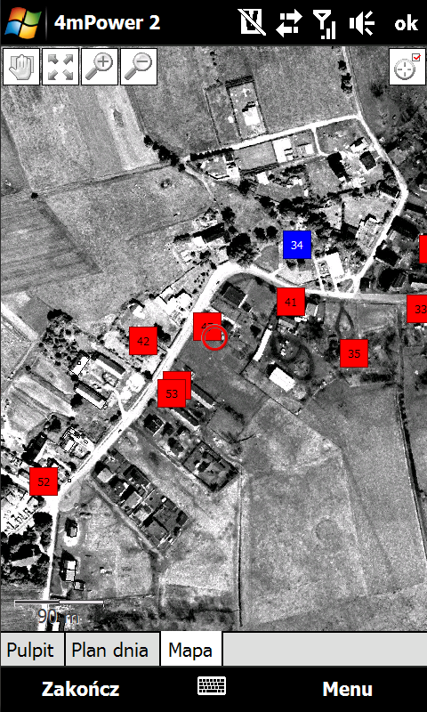
Enumerator – GIS technology
Map module – GIS
  Ortophotomap
  Cadastral Data
  Assigned Tasks
  Started Tasks
  Completed Tasks

Slide 29
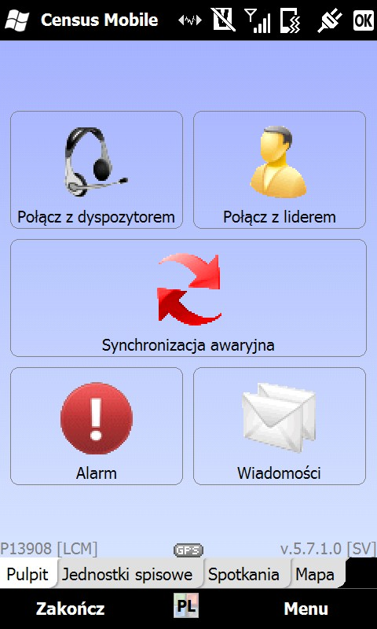
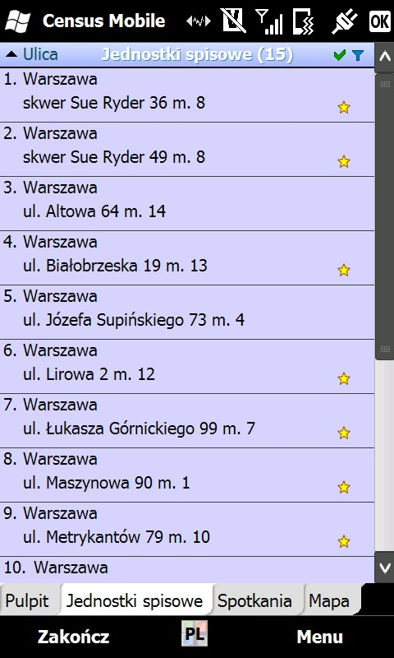
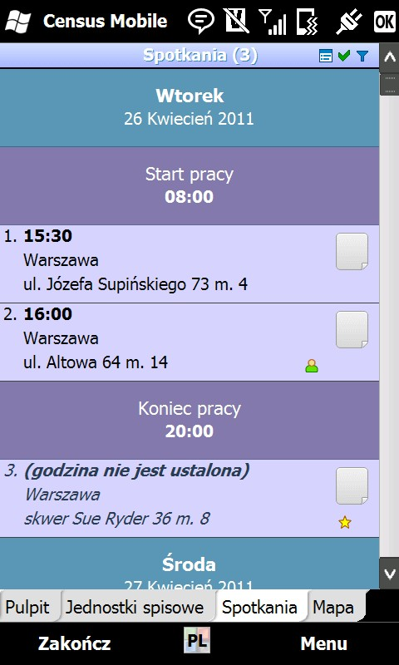
User friendly enumerator’s application

Slide 30
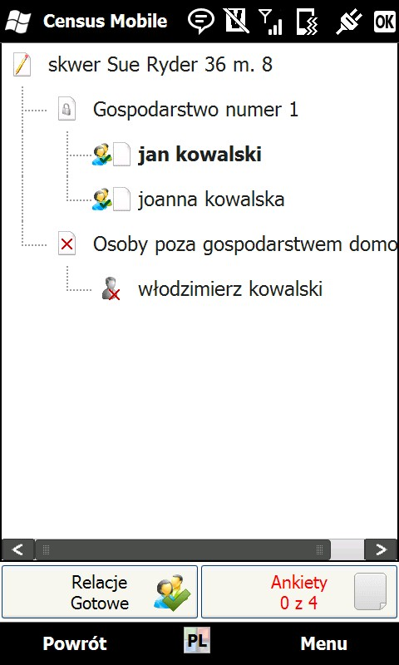
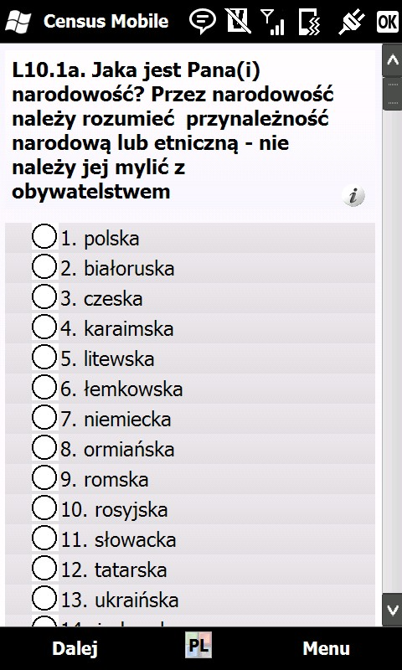
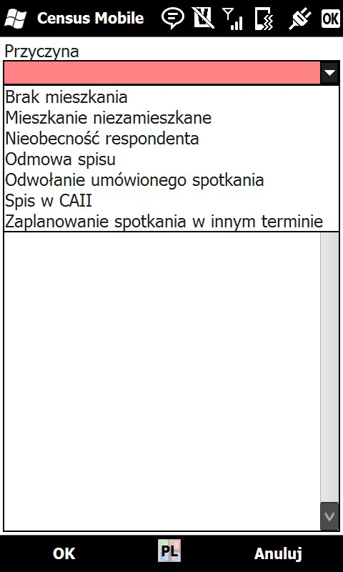
User friendly enumerator’s application

Slide 31
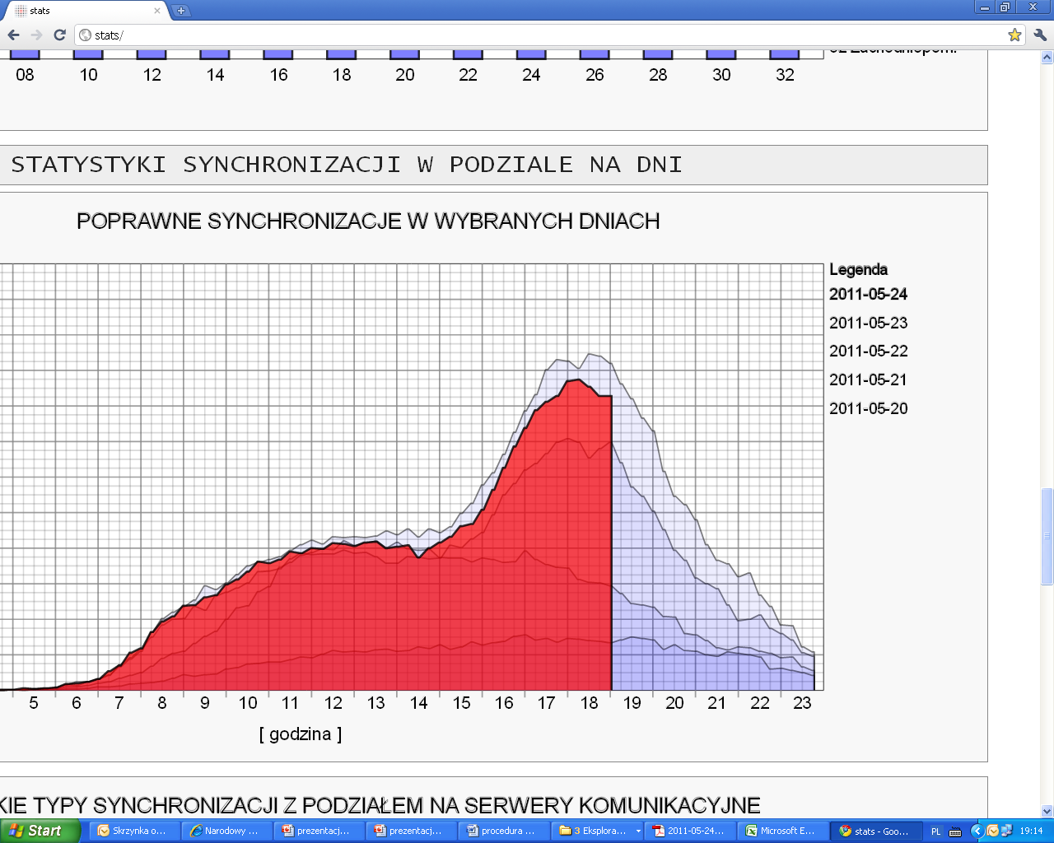
Daily workload

Slide 32
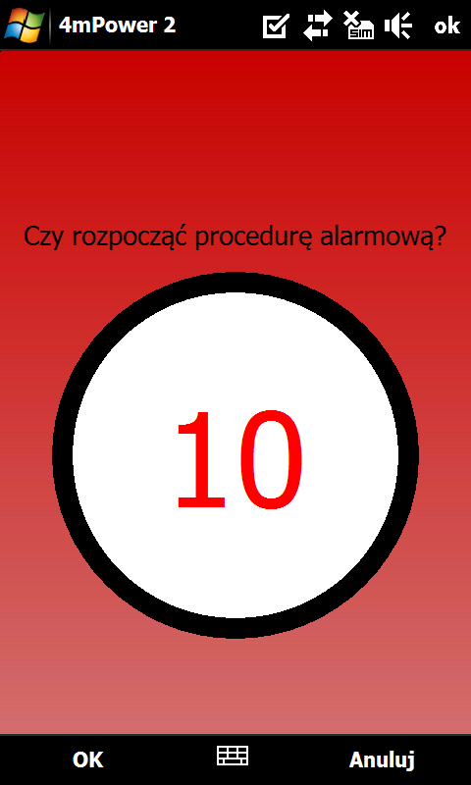
Enumerator safety
Alarm procedure
  In emergency situations, enumerators have a possibility of sending an alarm signal to their supervisors
  Supervisor was able to sent
  a police or other service to pointed address (x.y coordinates)
32

Slide 33




Instead of a conclusion
Census in 2002
Census 2011
180 thousands of census enumerators
120 mln of questionnaires
1 000 tons of papers
At the end shredding
census questionnaires
18 thousands of census enumerators
0 questionnaires
0 tons of papers
ca. 50 mln € less
better data
the more reliable results
statistical surveys in the future

