Slide 1
Session 5 Plans and Preparations
United Nations Technical Meeting on Use of Technology in Population and Housing Censuses
Amman, Jordan
28^{t h} - 1st December 2016
Statistics Estonia
Diana Beltadze

Slide 2
Timetable of Population and Housing Census 2011
31.12.2009-31.03.2010 Pilot
31.12.2011-
31.03.2012
Enumeration
2012- 2013
Post-enumeration
activities
2007-2011
Pre-enumeration
activities
Testing various aspects of census
plan and procedures

Slide 3
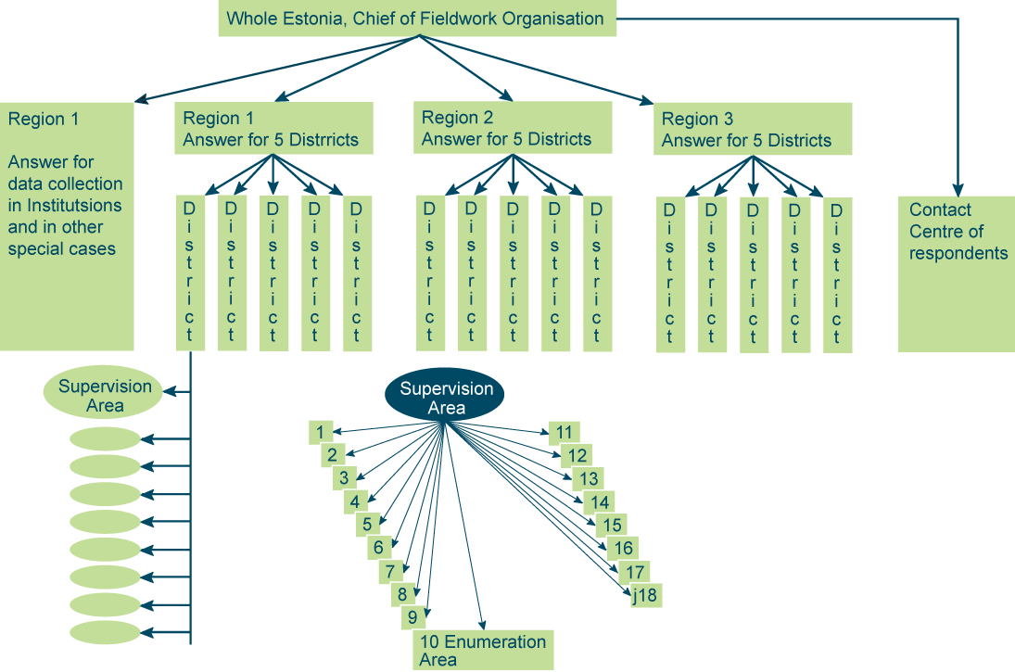

Slide 4
Training
A 5-day training for district chiefs and supervisors (15+132);
A 5-day training for census takers (2,200).

Slide 5
Goals of the information system
Universal software useable in all surveys
Improve the coverage of studies
Improve quality of raw data
Improve efficiency of field work management
Reduce data collection cost
Increase speed of post-collection data processing
Notes:
The goals that we had before we started to develop the software
To make universal software useable in all surveys
To improve the coverage of studies, the quality of raw data and the efficiency of field work management
To reduce data collection cost
And finally to increase speed of post-collection data processing

Slide 6
Description of the applications
Questionnaire definition tool
Enumerators application
E-respondent application
Management application
E-respondent map application
Management map application
Enumerators map application
Notes:
Description of the applications
Questionnaire definition tool is used to prepare questionnaires and it is built on top of Eclipse.
Enumerator’s application is a stand-alone desktop Delphi application that can be used in laptop or desktop computers. It provides possibility to synchronise all data for offline work over encrypted channel (HTTPS). It enables work planning, subject contact scheduling and map usage for easier subject location.
E-respondent application is used by survey subjects independently. It is public system, accessible over internet (HTTPS) is developed in Java and is working on top of Oracle Weblogic. It enables authentication using ID-card, mobile-ID and banks.
Management application is used by fieldwork management, statisticians and help desk. It is a web application that is developed in Java. It is accessible only from internal network.
Enumerators-, E-respondent and management map application’s functionality is covered by our next performer.

Slide 7
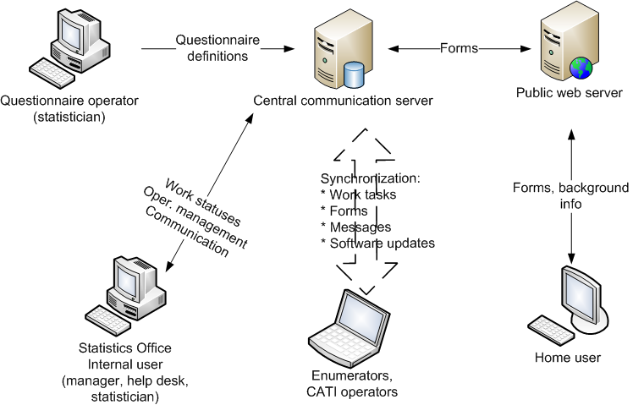
High level view of the involved applications
IT-architecture, security, hardware and Census
Notes:
High level view of the involved applications
The heart of the system is central communication server. Questionnaires are created with questionnaire definition tool and are uploaded into communication server. Fieldworks management application, enumerators application and e-respondents application are all connected to central communication server.

Slide 8
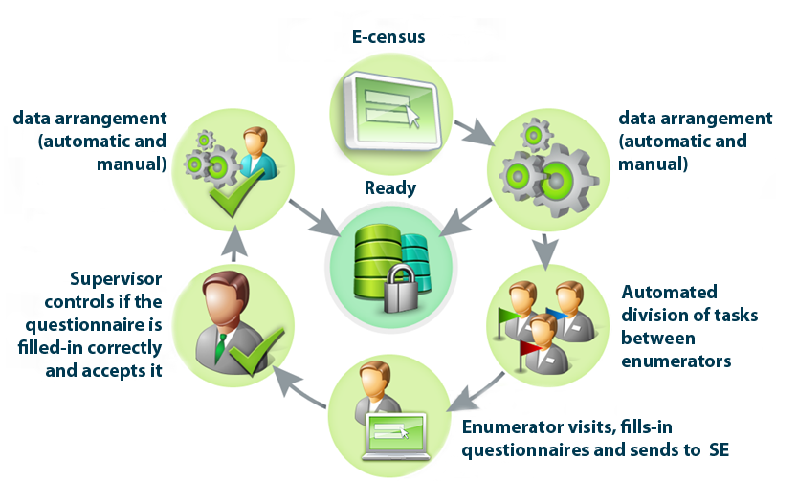
E-census data collection process
IT-architecture, security, hardware and Census
Notes:
E-census data collection process
In E-census environment everyone can fill their own and their family members questionnaires.
After questionnaires have been filled in E-census environment all the questionnaires has to pass the quality control and are divided into to parts – completed and not started/not completed.
“Ready” is the meaning of a safe database that is on Statistics Estonia's servers where only completed questionnaires are stored.
Everybody whose questionnaire is not completed is added into enumerators work list.
Enumerators are visiting homes according to their work list, fill in all the necessary questionnaires and synchronize all the data to Statistics Estonia's servers.
All questionnairs that are filled by enumerators are reviewed and confirmed by their supervisors.
Questionnaires final quality control is performed first automatically and then manually if needed.

Slide 9
Live environment
6 physical (12 virtual) Oracle Weblogic Java application servers
2 Oracle physical database servers
Apache load balancers
ESRI GIS server
Check Point firewall and VPN software
SAS and VAIS data processing servers
Suse Linux Enterprise and MS Windows operating systems used in servers
MS Windows XP operating system used for enumerators laptops
Mainly Hewlet Packard hardware used
IT-architecture, security, hardware and Census
Notes:
Census Live environment

Slide 10
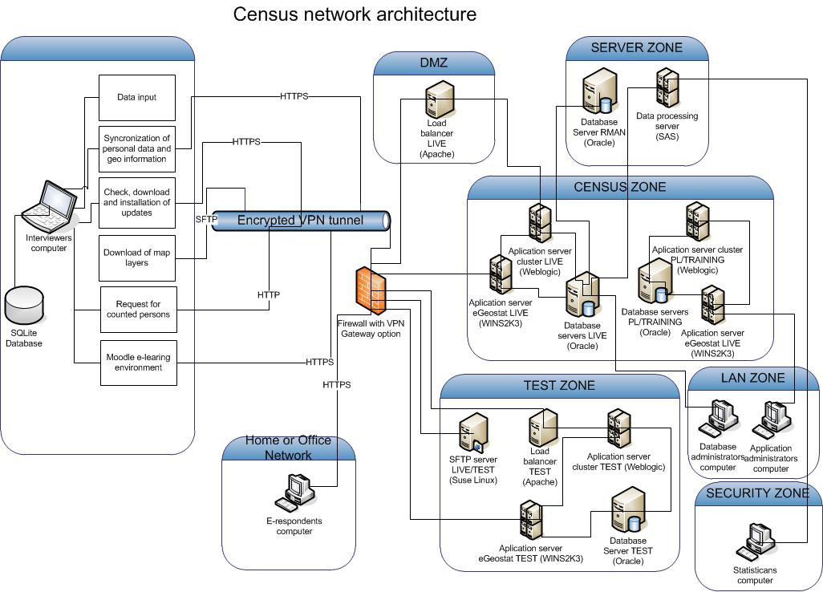
Notes:
This is the Picture of the Census network architecture

Slide 11
External resources
META data database
Active Directory
Statistical database
GIS database
Notes:
We also use many different external resources
META data database is used for displaying Meta-info about studies, Background study information in the web and classifiers used in questionnaires.
Statistical Database is used for
Import of sample
Pre-filling of characteristics in forms
Export of sample and changes in subjects information
Active Directory is used for authentication, from where user names and passwords are taken.
GIS database
Map data
Location info of buildings
Hierarchy of district division

Slide 12
IT security
IT security analyzes (2008)
IT security analyzes and complete testing (2010)
Notes:
IT security
First census security analyzes was made on 2008, where Census processes and tools were analyzed, potential weaknesses and risks were pointed out and possible solutions were offered.
Second analyzes in the end of 2010 was focusing on the weaknesses that was found during the first analyzes and the company who was responsible for the analyzes checked if they were fixed. Also complete security testing was made. Some of the risk that were found were also added to Census risk plan.

Slide 13
IT related risks
Data leakage
Attacks against IT solutions
Load tolerance is not sufficient
Failures of software
Data loss
IT-architecture, security, hardware and Census
Notes:
IT related risks
Data leakage Mitigation measures are
Prohibition functionality in Enumerators computers that is not necessary for their work
Computer hard disk encryption
Using physical and information technology methods for data processing protection
Using the entropy in passwords
Preparing an enumerator computers in a secure environment
Attacks against IT solutions Mitigation measures are
Continuous monitoring of attacks using the IDS system.
Local network load distribution
Transmission channel security
Insufficient load tolerance mitigation measures are
Performing software and systems load tolerance tests
Scattering data entry daily
Notification before filling the questionnaire. If system load is too high the respondents shall be placed on hold.
Software failures mitigation measures is the use of software support service.
We did the Census pilot, agriculture census and minipilot to detect software errors that could cause data loss

Slide 14
Data protection
Operations with sensitive data are logged
Separate log tables and special rights in management system and enumerators application
Hard drive encryption in enumerator’s computer
Database encryption and high availability
IT-architecture, security, hardware and Census
Notes:
The protection of the data
1. All operations with sensitive data were logged, this includes
1. View and change personal data in management system
1. Changing data in enumerators application
1. The change of access privileges
2. Separate log tables and special rights in management system and enumerators application were used
3. We used freeware called DiskCryptor that supports all the necessary encryption standards for Hard drive encryption in enumerator’s computers
4. Oracle Advanced Security option was used for database encryption and high availability was achieved by using Oracle datacard solution.

Slide 15
Hardware and software purchases
Cost efficiency analyzes (laptops)
Load tolerance evaluation (servers)
Later use of hardware and software
IT-architecture, security, hardware and Census
Notes:
Hardware and software purchases
Cost efficiency analyzes. In autumn 2009 cost efficiency analyzes for enumerators computers was made. We analyzed renting and buying opportunities, estimated possibilities to use laptops after the census in public sector institutions. Selling computers in aftermarket was also considered. As a result we concluded that the most reasonable is to buy 13’’ screen laptops with a battery that lasts 8 hours minimum and with a size to fit into our enumerators suitcases.
Load tolerance evaluation (servers). We knew that E-census would take the most of our servers and network and that's why we asked opinion from our methodologists. They said that a six time greater performance would be sufficient when comparing to servers that we used during the pilot Census. Fortunately this was enough and we didn't have to buy any extra hardware during the census.
Later use of hardware and software. All the laptops and most of the mobile phones used by enumerators during the census are divided between different public sector institutions. Servers are used by ourselves in our everyday work.

Slide 16
Preparation of hardware
Servers and other peripherals
were shipped in April 2011, laptops in Sept-Oct 2011
External partners were used
Secure VPN connection between two physical locations created
1979 code lines used in personalization script.
About 26,4 computers per day was prepared on a assembly line
Live sample downloaded during the fieldwork
Notes:
Preparation of hardware
External partners help used. We used our partners help to prepare the enumerator computers. They also helped doing the final configuration of servers and network after load tolerance testing.
We created a secure connection between our server room and our partners physical location where the preparation of enumerators computers took place.
Since the final sample was put together quite late we decided to download the sample during the fieldwork. This was quite risky, because there were no possibility to fix errors if the download of the sample was not successful.

Slide 17
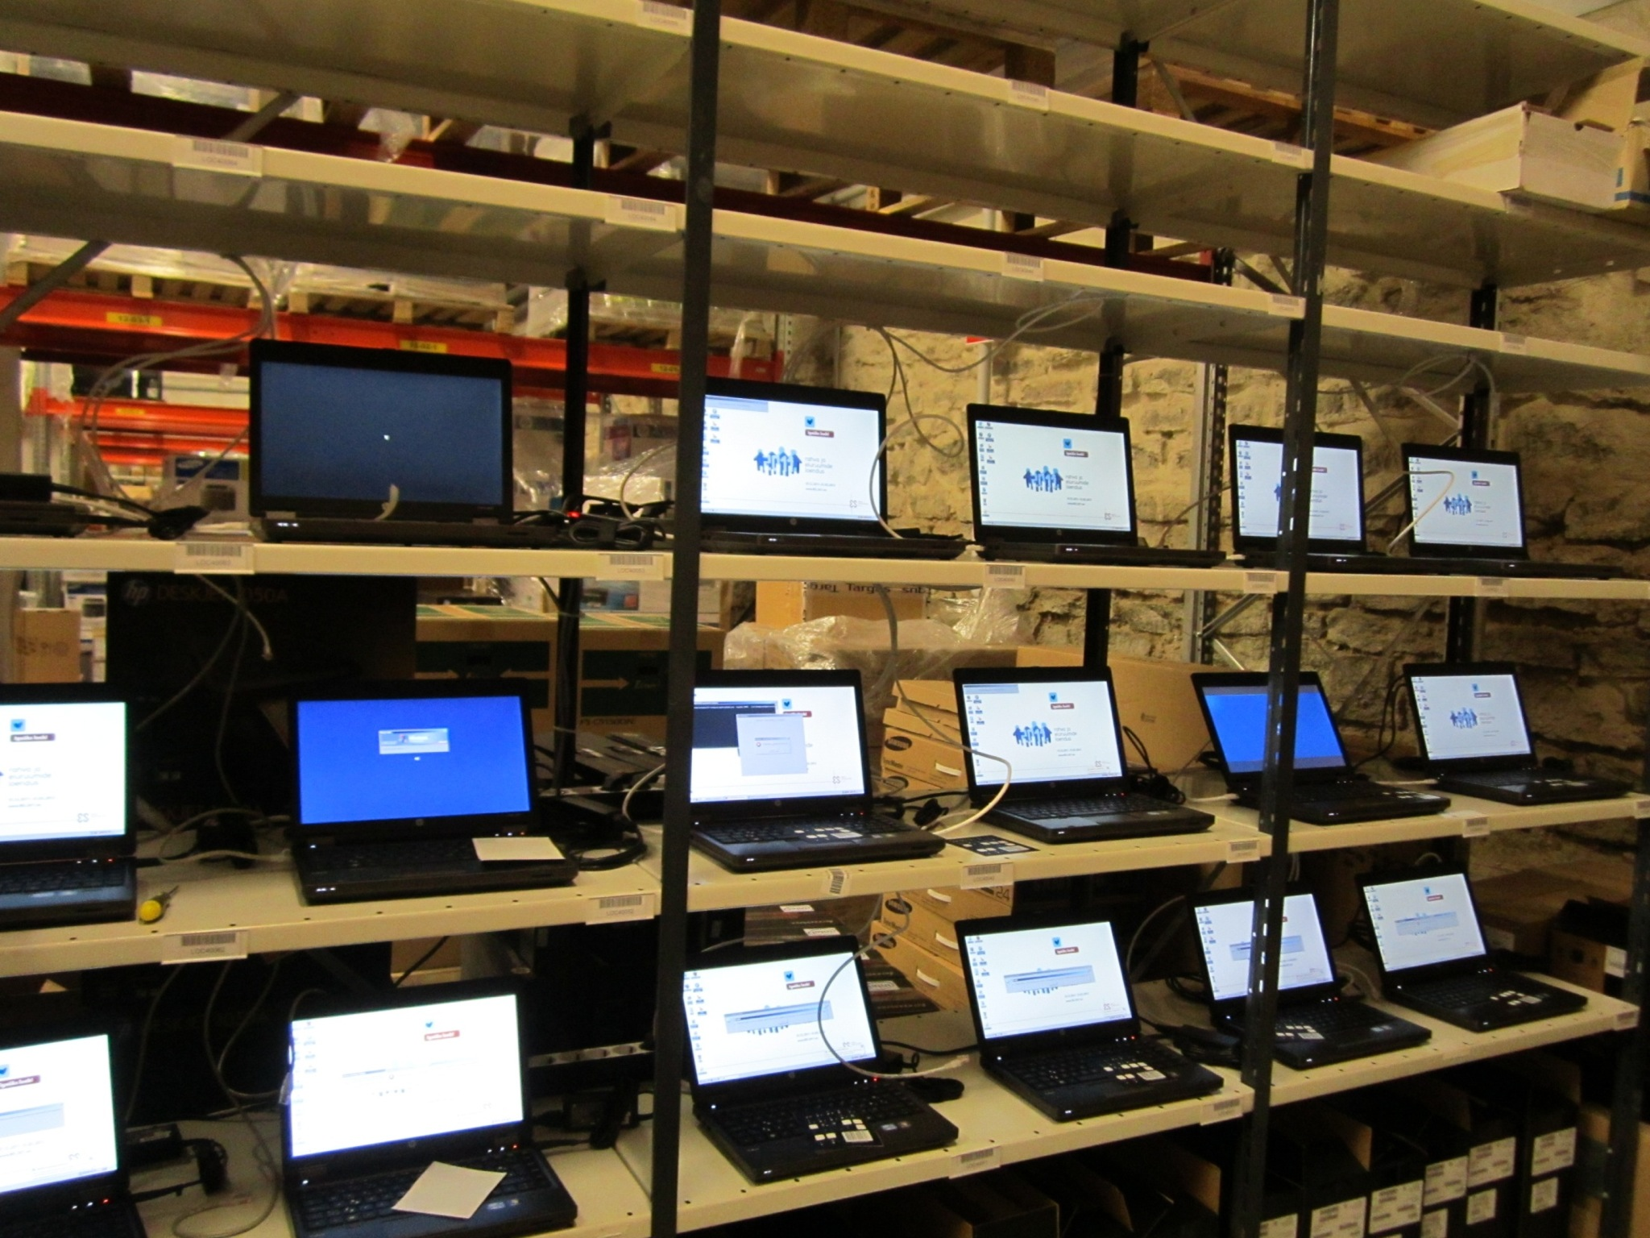
IT-architecture, security, hardware and Census
Notes:
This picture was taken when preparation of enumerator computers software was made.

Slide 18
Load tolerance testing
Tests were done between 2009-2012
Test requirements (Live environment)
E-respondents application - 2500 parallel sessions
Enumerators application – 2000 parallel sessions
Emulating robots used
Testing lasted about 9 months (Live environment)
Notes:
Load tolerance tests
In 2009 we used special simple questionnaire that was created only for test purposes.
Live environment requirements were at least 2500 simultaneous sessions for E- respondents application and at least 2000 parallel sessions for enumerators application.
We used robots to emulate login, user actions, and so on.
And the testing lasted quite long.

Slide 19
Load tolerance testing process
>2500 sessions - personal computers
2500 - 5000 sessions – Amazon cloud
5000 - 7500 sessions – Estonian Information Systems Authority’s servers
IT-architecture, security, hardware and Census
Notes:
Load tolerance testing process
First tests were made form our local area network using personal computers. Soon we realized that computing capability is not sufficient to continue the tests.
After that we moved our robots to Amazon cloud and started testing form there. Quite soon we hit the next bottle neck what was the speed of external connection Estonia.
Then we asked help from Estonian Information Systems Authority who agreed to let us use their servers to complete load tolerance testing.

Slide 20
IT support

Slide 21
IT-architecture, security, hardware and Census
Notes:
This is a screenshot of the e-respondent’s applications login page.

Slide 22
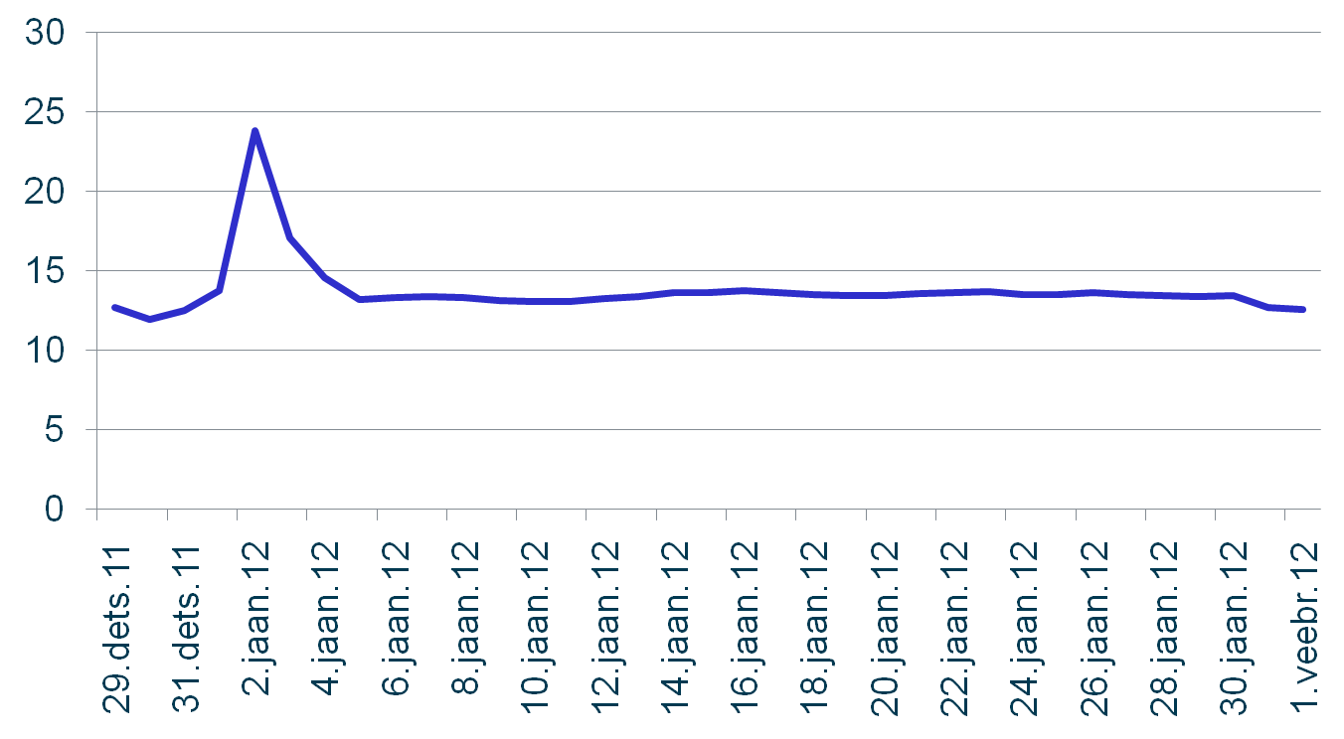
The average time for fulfilling personal questionnaire
IT-architecture, security, hardware and Census
Notes:
[15] The average time for fulfilling personal questionnaire
As you can see from this picture the average time to fulfil personal questionnaire is between 10 and 15 minutes.

Slide 23
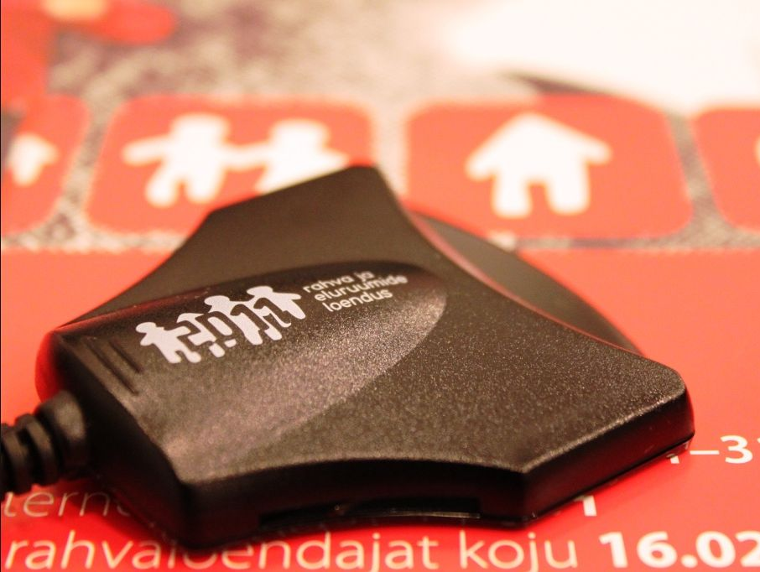
Maailmarekordi sünd läbi rahva- ja eluruumide loenduse e-lahenduse
Notes:
This is the picture of the ID-card reader that has census logo on it. I have to mention that we provided ID-card readers to libraries and public internet access points.

Slide 24
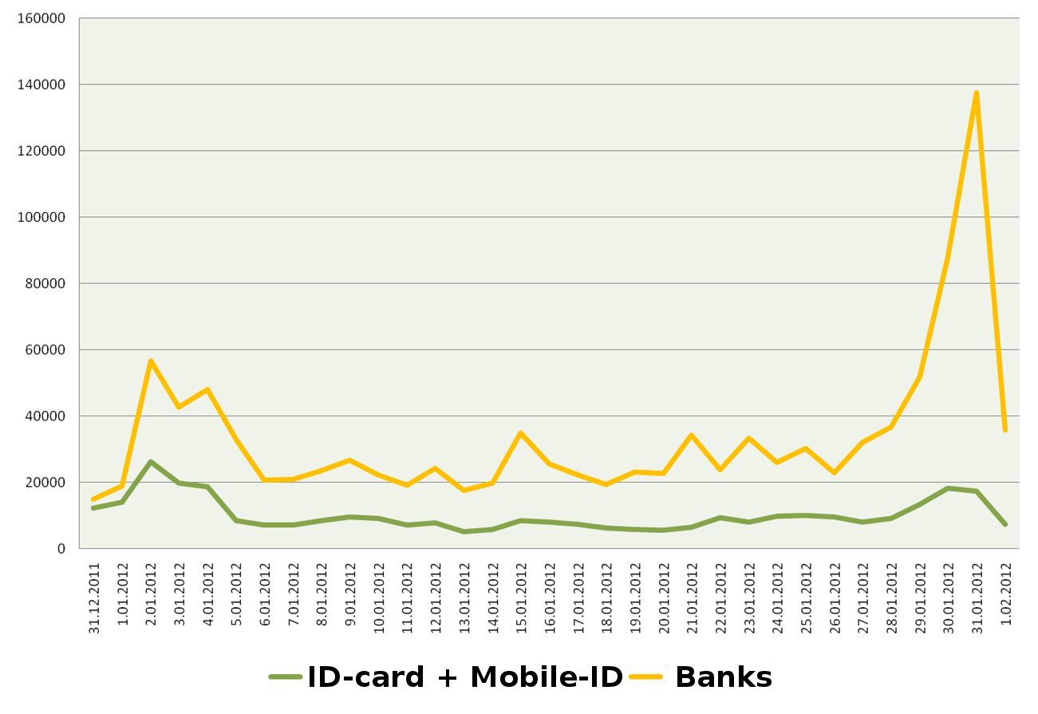
Authentication channels
Notes:
Authentication channels
Bank authentication was most commonly used channel in E-census.

Slide 25
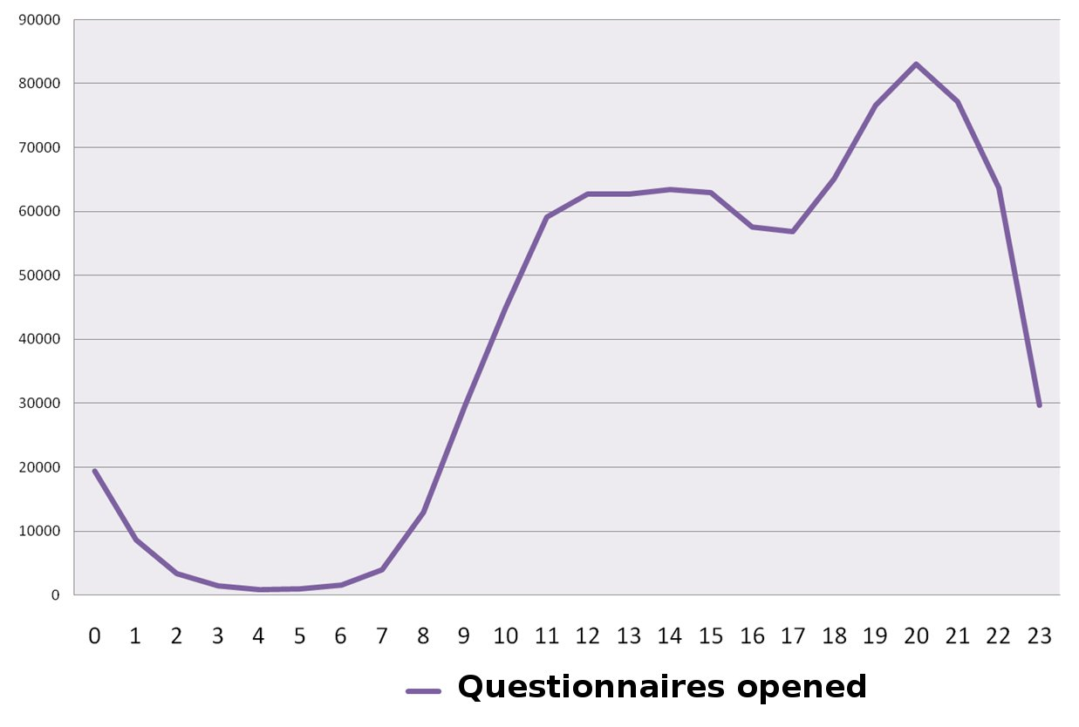
Hourly statistics
IT-architecture, security, hardware and Census
Notes:
Hourly statistics
Hourly statistics shows that people filled questionnaires mainly during the evening time.

Slide 26
Fears and problems during E-census
E-census environment becomes unavailable
System load is too high, people quit
Enumerators computers don’t get
ready in time
Security problems stop E-census
Problems downloading Live sample
Training fails
Fieldworks are getting delayed
Notes:
Fears and problems during E-census
Here are some of the fears and problems we had before and during the census.
We were afraid that cyber attackers or bots create enough network traffic for our E-census environment to fall down. We used static simple webpage that we announced to public where the distribution to E-census environment and to the information page was made. E-Census environment was accessible all 32 days 24/7 without suspension.
Load tolerance was higher than normal during the first days of E-census because of the high interest of E-respondents. The problems were fixed by optimizing the software and changing the network and servers configuration.
There was an opportunity that computers wont be prepared in time because of script errors that were needed to be fixed.
There were some security issues related to the authentication application. Data Protection Inspectorate evaluated them and decided those problems are minor and common to all similar applications used everywhere.
Enumerators training took place in 29 physical places in all over Estonia. The chance that something fails and we were unable to fix it was quite high.
The answering rate during E-census was unexpectedly high and data arrangement was not done in time because of that.

Slide 27
Good decisions
Information system for general service
Sizable load tolerance tests
Buying out laptops used by the enumerators
Outsourcing information system maintenance
Tachometer for indicating system load
Notes:
Some people asked me after the e-census if we had a special post for the person who moved the tachometer’s pointer? The answer is No! It was done automatically and it indicated current system load.

Slide 28
Subsequent knowledge
It’s all about testing
Pilots as real as possible
Hire more people for longer period
Buy experience, because there’s no time to experiment and learn
Notes:
Subsequent knowledge is to
Test everything, processes, functionality, hardware, software, user friendliness, load tolerance, integration and so on. Enough time and money should be planned for load tolerance testing and optimization.
In addition to testing it is very important to go into production with pilot. The larger and closer the pilot is to the real situation, the better. In 2009 we did the census pilot and 2010 the agricultural census. This experience was invaluable, but many problems didn’t come out, because the sizes of the surveys were several times smaller than they were on Census.
Both business and IT team of ours was small. A lack of Estonian IT specialists, low budget and plan to hire additional people at the last minute, led to the situation where so-called old-timers were overburdened with work at the end of training and in the beginning of the census.

Slide 29
Critical competences
System architect
A moderator between software development and maintenance team
IT-architecture, security, hardware and Census
Notes:
Critical competences
What we missed the most, when developing information system, was a system architect who could bind together different pieces of the software and has a clear vision of the system as a whole.
A line between software development and maintenance is quite narrow thats why a middleman is needed. We were lucky that our partner had that person who spoke the same language as the maintenance and the development team.

Slide 30
Hardware Infrastructure
Oracle Weblogic J2EE server LIVE cluster
2 physical server nodes (Linux)
Load balancer (Apache)
Oracle Database server
1 physical server (Linux)
Cold standby (Linux)
Interviewers computers (Acer One netbooks)
Mobile internet connection modems
Portable GPS receivers

Slide 31
Preparation of hardware
Interviewers computers
Windows XP operating system with last updates
Forbidden hardware for non working purposes
Webcam
USB/MMC storage
Wi-Fi/LAN

Slide 32
Preparation of hardware (continues)
Interviewers computers
Forbidden functionality for non working purposes
Local computer and registry
BIOS password protection, denial of bootable removable storage
Web traffic limitations
Forbidden access to control panel functionality
Forbidden access to hidden files
Hibernate in case of closing the lid

Slide 33
Preparation of hardware (continues)
Interviewers computers
Forbidden functionality for non working purposes
Domain Policy
Screen saver with password prompt in case of an idle
Interviewer only specific VPN rules

Slide 34
Preparation of hardware (continues)
Interviewers computers
Forbidden functionality for non working purposes
Domain Policy
Screen saver with password prompt in case of an idle
Interviewer only specific VPN rules

Slide 35
Preparation of hardware (continues)
Interviewers computers
Personalization
True Crypts default password change
Delicate data folders access rights
Hiding the delicate data folders
Verification
True Crypt and Active Directory passwords
VPN connection
Interviewers application load, update and synchronization

Slide 36
Security of data
Passwords
One password for everything
Predefined and unchangeable passwords
True Crypt password changed and stored in the process of personalization
Active Directory authentication for Windows logon and web applications

Slide 37
Security of computers
Fully encrypted hard drive
HTTP/SFTP connection inside encrypted VPN tunnel

Slide 38
Physical security
Servers
Access protected server rooms
Interviewers computer
Based on interviewers training
Handle personal passwords
Protect computer in bad weather conditions
Act in case of robbery or computer loss
Handle unauthorized use of computer

Slide 39
Our partners
IT-architecture, security, hardware and Census
Notes:
Our partners
Webmedia (Nortal) was our main partner and was responsible for the whole development process, IT support and system maintenance.
2. Quretec developed the questionnaires definition tool and enumerators application and central communication server.
3. Elion sold and shipped the most of the hardware used, prepared the computers software, provided us the help-desk software and service and internet connection in several physical locations we had training.
4. Regio and AlphaGIS developed our map applications.
5. Mindworks and their Finnish partner Aureolis developed information system VAIS that we use for data processing.
6. Cybernetica was responsible for information systems security testing.
7. EMT provided mobile internet that we used in the enumerators computers and call connection also.
8. Oracle software was used in our database and application servers, SAS for data processing, Suse Linux for server operating system and Microsoft Windows XP in enumerator laptops.
9. HP provided the most of the hardware including servers, enumerator computers and network devices.
10. And last but not the least we used CheckPoint software in our firewalls and intrusion detection/protection systems.

Slide 40
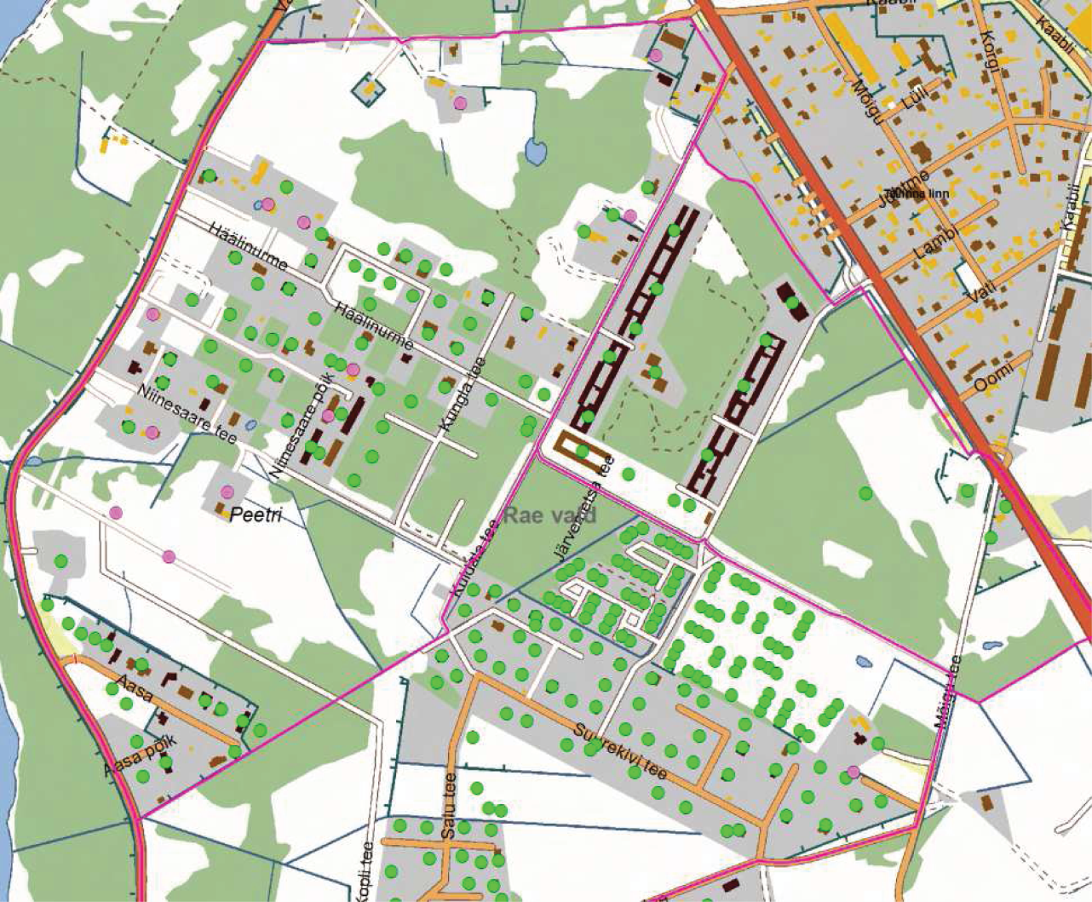
During census spatial- and attribute data were renewed through enumerator’s map application
Enumerator’s tasks:
Renewing of existing buildings attributes - the type and condition of the building
Add new houses to map and add their type and condition

Slide 41
The map data on Enumerator’s map application
Raster data (1:1 - 1:25 000):
Ortophoto – from Estonian Land Board OR
Base Map – topographic data from Estonian Land Board, cartographic work from eGEOStat project – Statistics Estonia

Slide 42
The map data on Enumerator’s map application
Vector data (1:1 – ...)
District borders
Building numbers from ADS
Cadastral parcels (for agricultural census)
Administrative borders
Bus stops
Topographic data (roads, rivers, forests, etc.)

Slide 43
Enumerator’s map application building data update
Data syncronisation
The XY coordinates of new buildings and the type and condition of buildings is sent through secure VPN with GPRS connection to the Statistics Estonia server.
This takes place together with the census data syncronisation

Slide 44
E-census map application
Every citizen can come to our web page and e-count themselves.
They search and choose their address from our database (ADS) and connect all their answers to ADS address point and XY coordinates
If we don’t have data on the citizen’s address, they can add their location on a web map and write their own address
The map is similar to enumerator’s map

Slide 45
Supervisory application’s map
The supervisors can see how their enumerators are working
It is also displayed on a map
The map looks just like enumerator’s map

Slide 46
What are districts?
Districts are bordered areas on the Census enumerator’s map where he/she has to collect data.
Districts are NOT the areas by which the Census data are later being presented.
District borders must be easily detectable on the landscape to make the Census enumerator’s work faster and better.
Kristjan Roosild

Slide 47
GIS technology used
Arc GIS Server for the Java Platform (Advanced/Standard/EDN) 10.0.3 + REST API
Arc GIS Desktop (Info/Editor) 9.3/10.0
Arc SDE
Arc GIS Viewer for Flex
Districting for Arc GIS
X tools Pro

Slide 48
eGEOStat
eGEOStat is the Estonian geostatistical database
Enables to collect, manage, process, analyse, visualise and maintain spatial data
We get data from Estonian Land Board:
Topographic data
Address data
Administrative and settlement units data
Cadastrial information
Ortophotos
Is related to data collection system VVIS:
Maps
Location info of buildings
Hierarchy of district division

Slide 49
Data for data collection system
Vector data and basemaps for enumerators desktop and eCensus application
Address data
Address locators
ArcGIS services

Slide 50
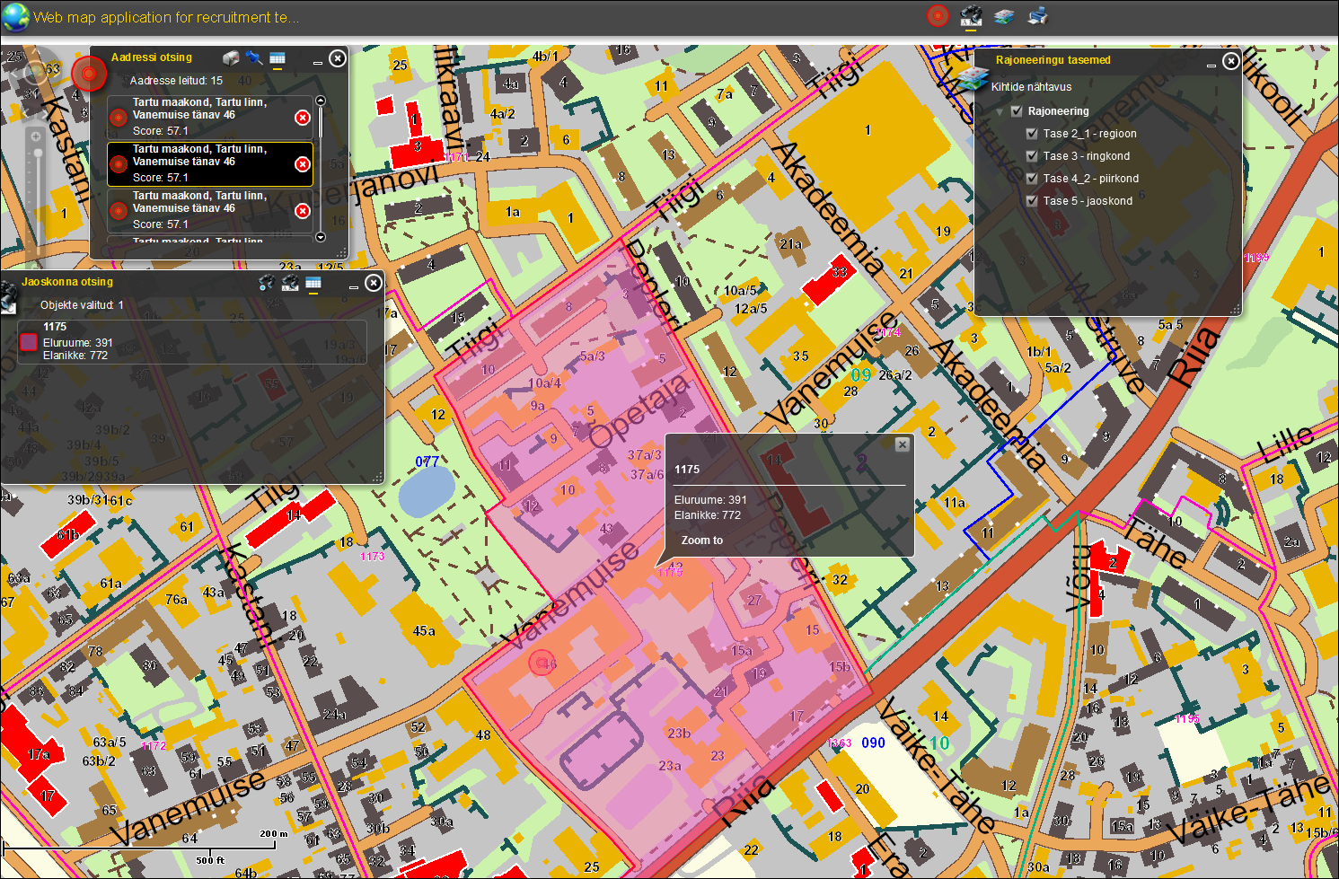
Recruiters map application
Notes:
This was supportive web application, not part of the data collection system.

Slide 51
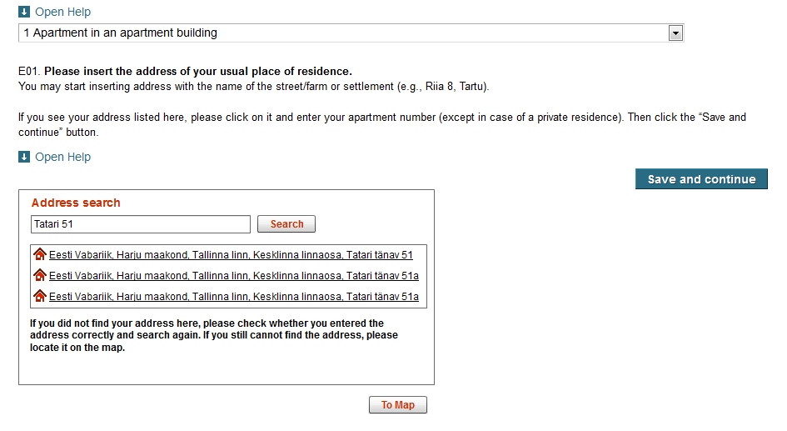
eCensus web map application
Notes:
Search for address

Slide 52
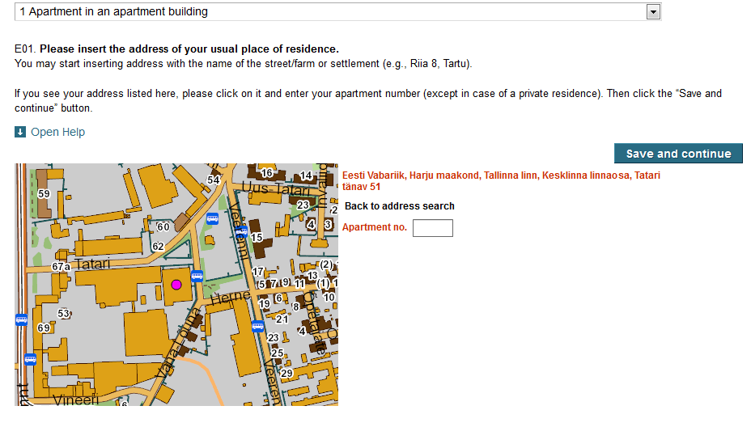
eCensus web map application
Notes:
Confim and enter details if asked.

Slide 53
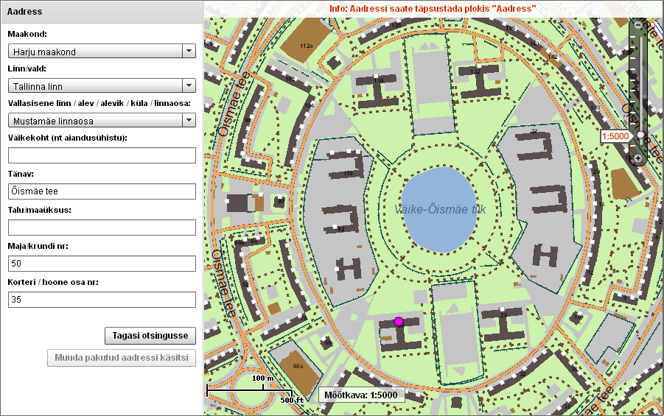
eCensus web map application
Notes:
Zooming to right pleace using either the scrollbar or selecting from the administrative divisions.

Slide 54
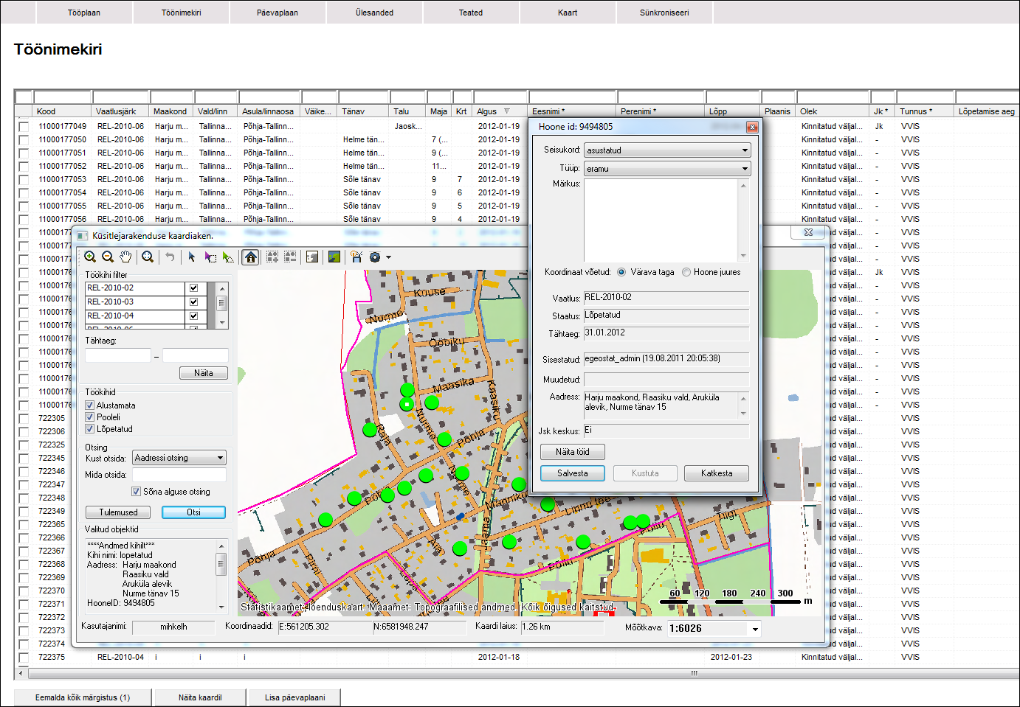
Enumerators desktop application
Notes:
Built-in GPS device

Slide 55
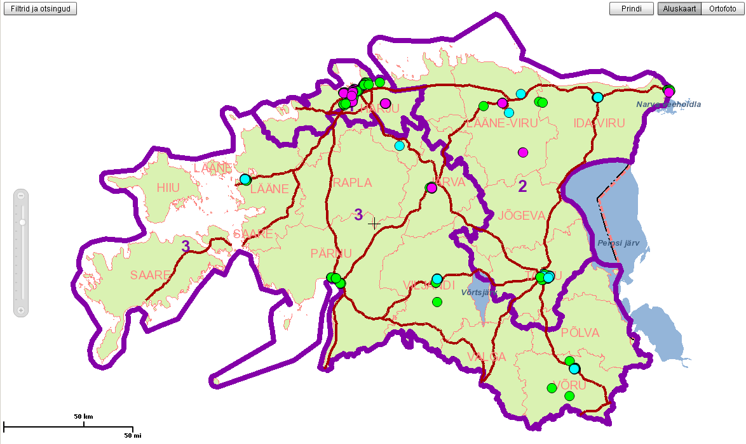
Management Map Application

Slide 56
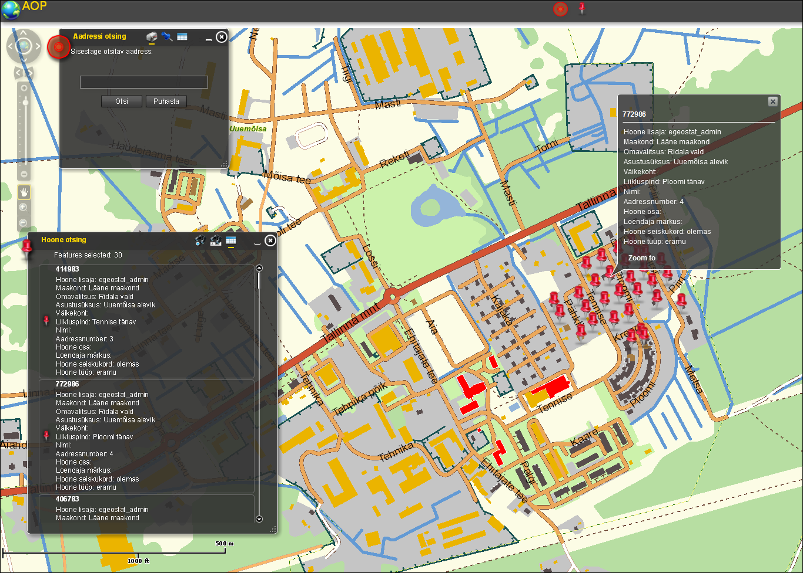
Address operator map application during data processing

Slide 57
Conclusion
Statistics Estonia has built an electronic data collection environment
The system supports the whole data collection process, including
Study form creation
Task division between collectors
CAPI module (filling in of study forms in collectors’ laptops)
CAWI module (public e-survey environment)
Preliminary data quality assurance module
Final testing 2 weeks in 2009 , LIVE launch in 3 months in 2010 during agricultural census
Notes:
57

Slide 58
Thank You!

