Slide 1
2016 Canadian Census of Population Patrice Mathieu, Chief Methodologist, Statistics Canada United Nations Technical Meeting on the Use of Technology in Population and Housing Censuses Amman - Jordan November 29, 2016

Slide 2
Agenda
The 2016 Canadian Census at a glance
Key operations
Wave methodology
Preliminary collection results
How did we do it?
Wave Model for planning, monitoring and forecasting
Multi-mode collection – Wave Methodology
Support systems and infrastructure
New corporate collection systems
Towards 2021 and 2026

Slide 3
The 2016 Canadian Census at a glance
Census Day: May 10th, 2016
Multi-mode collection:
Self-Response (May 2 to July 31, mostly in May)
Electronic and paper questionnaires
Non-Response Follow-up – NRFU (June and July)
Field enumerators complete paper questionnaires with respondents
Support units or Census Help Line operators complete electronic questionnaires from call centres
Failed-Edit Follow-up (During NRFU)
Phone follow-up for incomplete questionnaires or coverage issues (sample)
Special enumeration procedures for collective dwellings, aboriginal communities (reserves), and remote areas

Slide 4
The Wave Methodology
Approach to remind Canadians to fill out their census form, at specific times throughout the collection period
Increases Self-Response while encouraging households to respond by Internet
Concept of the Wave Methodology:
Wave 1: Mail out an Invitation Letter instead of a questionnaire.
No immediate option for paper response but the letter provides an effective method to request a paper questionnaire (about 1 million requests in 2016 (8% of the dwellings)).
Availability of an automated system to request a paper questionnaire was essential
Wave 2: As the returns from Wave 1 starts to decline, mail out a reminder letter
Wave 3: As the returns from Wave 2 starts to decline, mail out a paper questionnaire
Wave 4: As the returns from Wave 3 starts to decline, start NRFU
Aligned public communication messages

Slide 5
2016 Census Wave Methodology
Wave 1
Wave 2
Wave 3
Wave 4
Mail-out
(82%)
NR
Reminder
NR
Quest.
NR
NRFU
Letter
letter
+
& letter
Automated calls
List/Leave
(16%)
Thank you /
Reminder
NR
NRFU
(May 20th)
Quest.
Adcard
Canvasser
(2%)
Interview
May 2nd
May 11-13th
May 19-26th
June 1st
Census Day,
May 10th
5

Slide 6
Collection Response Rates - Highlights
 | 2011 Census | 2016 Census
Collection Rate | Actual | Planned | Actual
Census Collection rate | 98.1% | 98% | 98.4%
Internet | 53.8% | 65% | 68.3%
Paper | 31.3% | 20% | 20.5%
Self-Response | 85.2% | 85% | 88.8%
NRFU | 12.9% | 13% | 9.7%
Workload at start of NRFU | 4.8 M | 4.5M | 3.7 M
Source: MCS of August 4, 2016 – occupied private dwellings

Slide 7
Response Rates by Collection Method
Collection method | Response Mode |  |  |  |  |  |  | Non-response | Total
 | Self-Response |  |  | Interview
 | Mail | Internet | Total | Help Line | NRFU |  | Total
 |  |  |  |  | Field | Support Units
Mail-Out | 12.7% | 76.2% | 89.0% | 1.1% | 7.4% | 0.9% | 9.4% | 1.6% | 100.0%
List-leave / Seasonal | 64.1% | 23.6% | 87.7% | 0.5% | 9.3% | 1.3% | 11.1% | 1.2% | 100.0%
Subtotal | 20.5% | 68.3% | 88.8% | 1.0% | 7.7% | 1.0% | 9.7% | 1.5% | 100.0%
Canvasser/reserves | N/A | 0.2% | 0.2% | 0.0% | 92.1% | 0.0% | 92.1% | 7.7% | 100.0%
Total | 20.3% | 67.6% | 87.9% | 1.0% | 8.5% | 1.0% | 10.5% | 1.6% | 100.0%
Source: MCS of August 4, 2016 – private occupied dwellings

Slide 8
Internet responses by device category
Device category | Response Rate | Relative Rate | Number of Dwellings
Desktop / Laptop | 53.4% | 78.2% | 7,488,580
Tablet | 8.8% | 12.9% | 1,236,616
Smartphone | 5.1% | 7.5% | 714,354
Desktop/Laptop (Touch-Screen) | 1.0% | 1.4% | 134,456
Gaming Devices | 0.0% | 0.0% | 1,110
TV | 0.0% | 0.0% | 8
Unidentified | 0.0% | 0.0% | 1,974
Total | 68.3% | 100.0% | 9,577,098

Slide 9
Wave 1
Received on May 2
Wave 2
Received between May 11-16
Wave 3
Received between May 19-26
Voice Broadcast
On May 30-31
Census Day
On May 10
Impact of Wave 2
Impact of Wave 3
Impact of Wave 4 / Voice Broadcast

Slide 10
Wave 1
Received on May 2
Wave 2
Received between May 11-16
Wave 3
Received between May 19-26
Census Day
On May 10
Voice Broadcast
On May 30-31

Slide 11
How did we do it?
Wave Model - Static
Master control system (MCS)
Wave approach
A process for on-demand Wave 2 letters
A process for on-demand Wave 3 questionnaire packages
An automated system to enable Canadians to call for a paper questionnaire
Corporate collection systems
Wave Model - Dynamic

Slide 12
Wave Model
Needed tools for planning, monitoring and forecasting purposes
Two types of models used in 2016: static & dynamic
Static:
Main uses – provided the planned daily and cumulative volumetrics for printing, collection and processing
Predicted responses by day and by channel, given assumptions before collection started
Started with Address Register projections of dwelling counts on Census day, then daily return estimates based on daily returns from Census 2011, Census Content Test data and guestimates

Slide 13
Master Control System (MCS)
Central system that integrated information from all collection and processing systems.
List of all dwellings in Canada to which a questionnaire is mailed or dropped off
Each record given a unique frame-id and a secure access code
Used to monitor the status of each dwelling throughout collection (Canada Post, internet submissions, Data Operations Centre and NRFU) and processing
Provided almost real-time updates

Slide 14
Wave Methodology – Material
Wave 1 & 2 letters: Self-Mailers
Needed a cost effective way to mail-out a planned 13.3M Wave 1 letters and 8.4M Wave 2 reminder letters (on demand) with variable imaged addresses and secure access codes.
Wave 3 and QRS: Questionnaires packages
About 4M Questionnaire packages prepared in advance with generic barcodes and secure access codes printed on questionnaires
Generic barcode showing through envelope window
As questionnaires are required, MCS transmits the address information and dwelling identifier to Canada Post.
Canada Post prints address and true barcode on envelope, then scan the two barcodes to create the linkage
Linkage file sent back to MCS

Slide 15
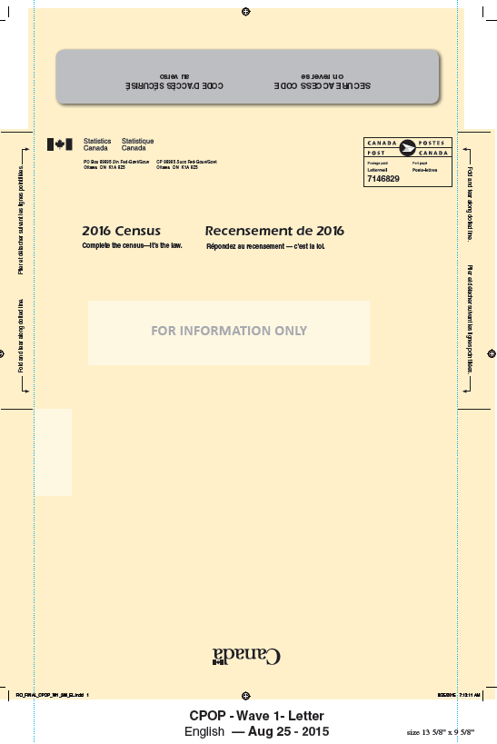
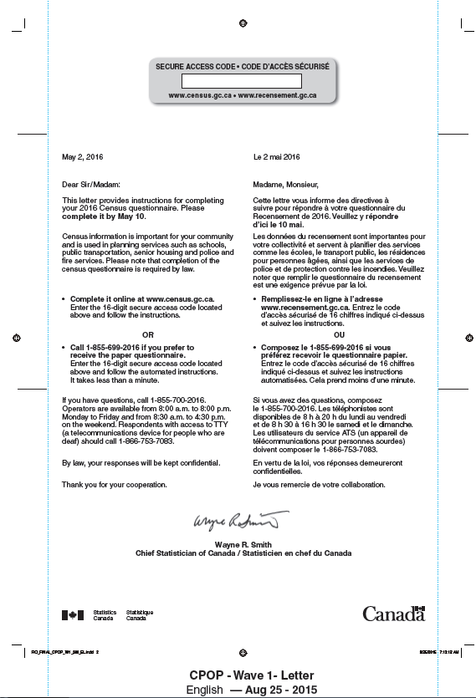
Waves 1 and 2 self-mailers

Slide 16
Wave 3 and QRS questionnaire packages
▀▄█▌▐ ▀▄█▌▐
Read generic barcode through envelope window
123 ABC STREET
ANYTOWN, ANYPROV
▐ ▀▄█▌▐▀▄█▌
Linked
Read true barcode Canada Post prints on questionnaire envelope

Slide 17
Adopting Corporate Collection Systems for the Census
From 2006…
NRFU System located in every Local Census Offices (LCO)
NRFU System linked to the Master Control System, used by the Field Operation Supervisors located in the LCO
Assignment Lists, Notification Lists, NRFU Control Forms and other forms faxed or shipped by courier (to/from Field Operation Supervisors, Crew Leaders and Enumerators)
…to 2011…
Field Management System (FMS)
Controlled-access web portal for field enumerators and supervisors
Linked to the Master Control System, and used by all levels of field staff (assignment lists, pay claims, tracking shipments, birthing dwellings, notifications, etc.
Provided field staff and managers with timely information to manage workloads and control costs
… to 2016…

Slide 18
Adopting Corporate Collection Systems for the Census
Statistics Canada adopted a Corporate Business Architecture which calls for IT solutions and business processes to be developed for corporate use rather than for individual program specific requirements
Allows for more robust solutions
More rigorous risk mitigation strategy
Allows economies of scale for the department
For the 2016 Census: New Integrated Collection and Operation System (ICOS)
Single multi-mode, multi-site, generic and integrated collection environment
Common collection platform for all programs and surveys
Unique portal for all collection users (respondents, interviewers, managers, etc.)
In particular:
Common internet application (eQ) to replace the census-specific application used since 2006
Collection Management Portal (CMP) to replace the Field Management System used in 2011

Slide 19
Collection Management Portal (CMP)
CMP for Field Enumerators:
Obtain and update non-response follow-up assignments (record attempts and outcome codes)
Timely updates on cases resolved from other sources
Submit daily claims for hourly pay and travel expenses
Record tracking information for questionnaires shipped
CMP for Crew Leaders (Supervisors)
Create assignment lists
Review daily productivity and approve pay claims (productivity/travel claims linked to productivity)
Monitor Key Indicator Reports
Perform Quality Control
Record tracking information for questionnaires shipped
CMP for Managers
Daily metrics obtained for non-response follow-up status to monitor progress
Provides basis for monitoring costs

Slide 20
Wave Model - Dynamic
Dynamic predictive microsimulation model to optimize use of human and financial resources in pursuit of response objectives
Updated weekly for parameters to reflect current collection operations, the model projected the end of collection by region based on a number of parameters such as:
Self-response levels and remaining number of cases to be resolved;
Productivity of enumerators;
Projected attrition of enumerators;
Hours worked per day by enumerator by area and by collection supports units
Model was flexible enough to explore different scenarios
Estimated the number of work hours to be added in any given region/area to complete collection operations by the end of July at the targeted response level.
Forecasted collection cost until the end of collection to see if available budget would be sufficient

Slide 21
Towards 2021 and 2026
Ongoing research on increased use of administrative data sources
To replace direct response from respondents
To replace NRFU in some cases – possibly integrated in non-response management strategy
To support other field activities, such as determining the occupancy status of the dwellings
Expand mail-out areas
Use of geospatial technologies, in particular in list/leave areas and to optimize Field Enumerator workload allocation
Reduce the amount of paper we use
Eliminate drop-off of paper questionnaires in list/leave areas?
Paper questionnaires completed by Field Staff - Use of handled devices?
Understand who are the more than 1 million people who used the QRS
Improve systems? – CMP, EQ, others?

Slide 22
Thank you!
For more information, please contact:
Pour plus d’information, veuillez contacter:
patrice.mathieu@statcan.gc.ca

