Slide 1



Jordan Population and Housing Census 2015
Technical Meeting on Use of Technology in Population and Housing Censuses
28 November - 1 December 2016
Amman, Jordan
UNSD
Prepared by: Mohammad Sakhreyah

Slide 2
Census Infrastructure Main Components
Data Center and Disaster Recovery
Data Transmission
Call Center
Technical Support
Operation Room

Slide 3
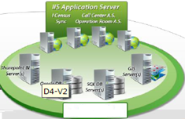





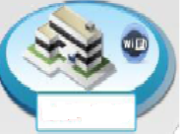
Census Network Topology
Disaster Recovery Site
Data Center
Private Network
Households
Regional
Offices
Call Center
Field Enumerators

Slide 4
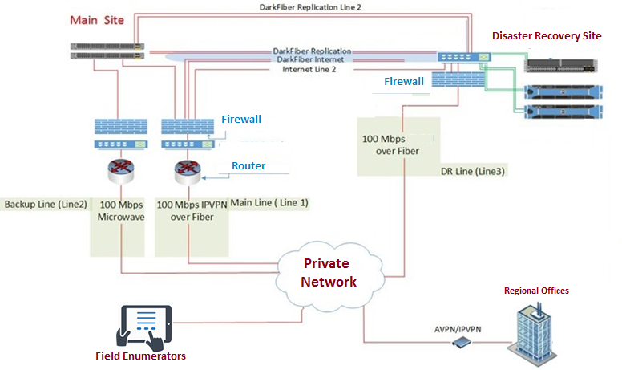
Data Center and Disaster Recovery Design

Slide 5
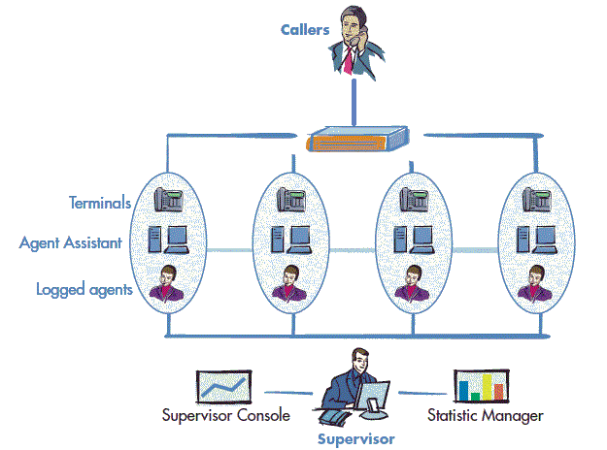
Call Center

Slide 6
Call Center (2)
integrated and centralized contact management, to manage and record incoming and outgoing telephone calls with the ability to retrieve these calls as needed.
Call Center main Functions:
  Receive and reply citizen (households) calls about all subjects related to census.
  Provide statistical support for workers in field and regional offices.
  Provide IT technical support for workers in field and regional offices.
Call center play a vital role during census 2015, we received about 3000 daily calls in the first 4 days , most of them was for IT technical support, with census progress number of IT technical support calls degrade while the calls from households increased.
Call center Technical support team solve a lot of IT Problems by connect to Tablets remotely from call center while talking to enumerators.
Call center Integrated with specialized software applications related to census called (call center system), that provide ability to agents to work with census data according to them privileges and needs.

Slide 7
Operation Room
Main control room, Equipped with specialized devices to enable census top mangers to monitor and control work flow minute by minute through dynamic reports and dashboards using BI applications.
Operation Room components:
  Telephone lines.
  Personal computers connected through computer network with specialized software applications to monitor and control field work (Operation Room System).
  Smart screens connected to network to view the dynamic reports and dashboards using BI applications.

Slide 8
Data Transmission
Provide mechanisms for data transmission from field and regional offices to main data center.
Providing alternative data transmission lines, as backup to main lines by deal with specialized telecommunications companies and national information technology center.
Regional
Offices
Data Center
Field Enumerators

Slide 9








Data Transmission Scenarios
Private
Network
Enumerators
Regional Office
Data
Department of Statistics
DOS Data Center
Data
Data

Slide 10
Regional Offices
Sub-Processes offices, Distributed in all areas according to administrative divisions, Where Provide the following tasks:
  Statistical support to enumerators.
  Administrative tasks, where coordinators and supervisors assign tasks to enumerators using specialized software applications, monitor and control work minute by minute.
  IT Technical support on office components and tablets.
More than 100 Regional Offices all around Jordan.
Regional Offices main Components:
  Personal Computers.
  Network Access Points.
  Data Transmission Lines (Private Network)
  Laser Printers.

Slide 11
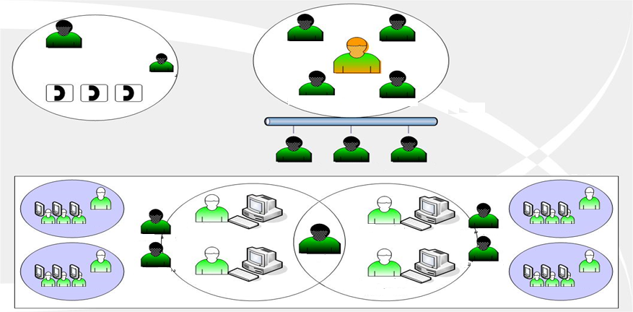
IT Technical Support levels and Methodologies
Technical Support Mechanism
Call Center Manager
System Eng.
Network Eng.
Tech Support
Head of Tech Support
Data Base Eng.
Network Eng.
Central Tech. Support
Call Center and
Quality Control
Tech. Support Supervisor
Tech. Support Supervisor
Tech. Support Supervisor
Field
Enumerators
Enumerators
Supervisor
Supervisor
Coordinator Assistant
Coordinator Assistant
Field Tech. Support
Field Tech. Support
Enumerators
Office Tech.
Support
Field Tech. Support
Enumerators
Supervisor
Field Tech. Support
Coordinator
Coordinator
Supervisor
Regional Office
Regional Office

Slide 12
Data Security
Specified User name and password for each user on tablets.
Data Encryption (Software and Application Levels).
Data Encryption (Data Transmission Level)
Private Network with no Internet access (Private Network) for census data transmission from field and regional offices.
Using Firewalls and load Balancers.
Central Database was secured with authentication and authorization techniques, data encryption as needed.
Stress test and vulnerable tests.

Slide 13
Jordan Population and Housing Census
2015
Thanks a lot

