Slide 1
Census Mobile Data Capture
Glenn Ferri
International Programs
Population Division
U.S. Census Bureau
This presentation is intended to inform interested parties of ongoing work at the U.S. Census Bureau. Any views expressed on statistical, methodological, technical, or operational issues are those of the presenter and not necessarily those of the U.S. Census Bureau.

Slide 2
U.S. Census Bureau International Programs
Promote international development and capacity building on a reimbursable basis through:
Technical assistance
Training
Software and methodological tools

Slide 3
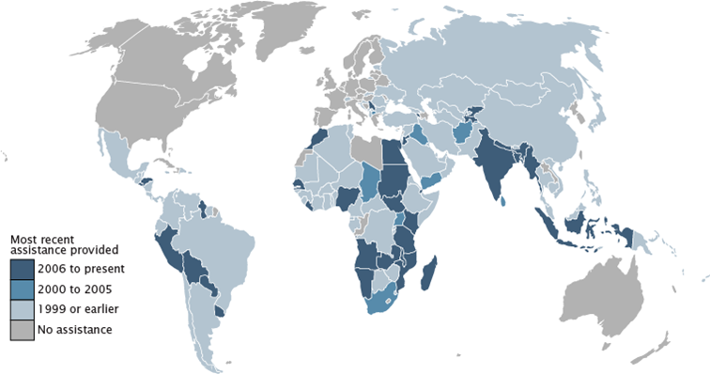
Where We Have Worked

Slide 4
Mobile Data Capture Advantages
Enumeration and data capture in one step
Decreased time between data collection and release of results
Improved data quality
Improved field management and real time monitoring of enumeration activities
Can utilize GPS features and digital mapping capabilities

Slide 5
Mobile Data Capture Disadvantages
High equipment cost
Technological problems could interfere with enumeration
More time needed during preparation phase
Higher programmer skills required
Infrastructure constraints (electricity, connectivity)

Slide 6
Planning Considerations for Mobile Data Capture
Census Timetable
Budget
Infrastructure
IT resources
Questionnaire design
Software

Slide 7
Census Timetable
Procurement
Telecom Agreements
National IT agencies approvals
Instrument and Operational Control Systems
Pilot Testing
Enumerator Training
Notes:
Large scale device procurement needs advance notice to the vendor – same configuration
(Lenovo, xTouch, Click)
Ethiopia National security agency approval for devices and storage.
Work is front loaded

Slide 8
Budget
Devices
Lesotho – 6,000 Android tablets
Ethiopia – 180,000 Android tablets
Accessories
SIM card, Backup Battery , Solar chargers, Protective cases
Cellular data plans
Backup paper questionnaires

Slide 9
Infrastructure
Electricity
Cellular network
Transportation

Slide 10
IT resources
Programmer resources
NSO IT Infrastructure
Servers
Bandwidth
Data Storage
Cloud
Backup Plans
Security

Slide 11
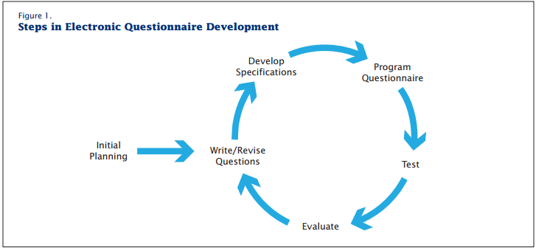
Questionnaire design

Slide 12
Software Considerations
Cost
Platform/operating system
Hardware requirements
Ease of Use for Enumerators
Output data format
Work with existing systems
Technical assistance/training

Slide 13
Thank you https://www.census.gov/population/international https://www.census.gov/population/international/training/select-topics.html

