Slide 1
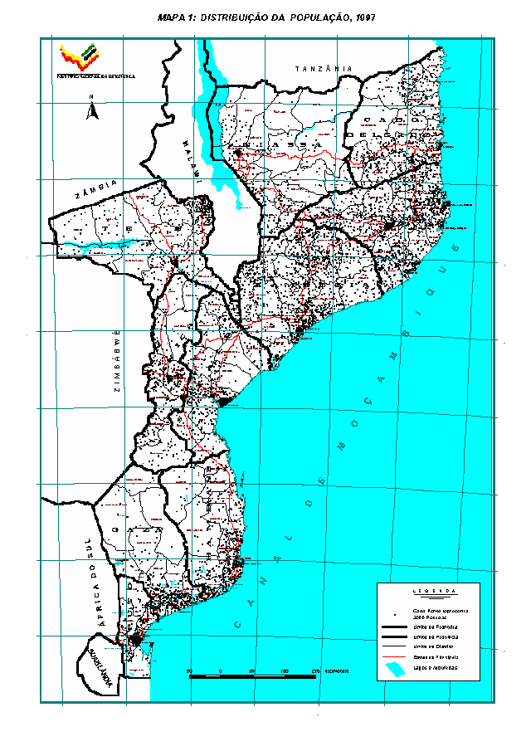
UN Technical Meeting on the Use of Technology in Population Censuses 28 Nov. To 01 Dec. 2016
USE OF THE NEW TECHNOLOGY IN MOZAMBIQUE STATISTICAL DATA COLLECTION PREPARING THE 2017 POPULATION AND HOUSING CENSUS
By
Arão Mbalate
Censsus and Surveys Director
Email: arao.balate@ine.gov.mz

Slide 2
Bakground
Keeping in line with decennial census taking programme, the next population and housing census in Mozambique is scheduled to take place in August 2017
The last Census we use the classic metodology for data collection as well for data processing.
After the Census 2007 we start preparing the digital data collection for next census using the tablets on the households surveys Starting with the agriculture Census in 2010 and number of the hoseholds surveys like DHS, household budget survey and continuos sarveys (2012 – 2015).

Slide 3
Decision on the methodology for the next Census
In 2014 the steering committee of the NSS analyse the outcomes of Digital Data Collection using CAPI. Found good improvement on data quality and reduced time for releasing the results.
At same time analyse other factors like:
Coverage of power/electricity
Coverage of internet/Telecoms
Number of IT people to handle this technology for large scale
And other factors and facilities

Slide 4
Decision on the methodology for the next Census
The conclusion was, no capacity to use the Digital Data Collection for next Census
The steering committee recommend to NSO to find an other solution for the next Census.
The solution was to use scanners
But using scanners the NSO would have the same problem of institutional capacity to handle this technology
Outsourcing was considered as a good solution and one Portuguese Company was selected to do all the Data Processing process.

Slide 5
State of preparation of the next Census 2017
Following the activities defined on the Census Prodoc, in 2015 we conduct the first Pilot Census to test all the equipment for data processing to ensure its function.
Conducted the Pilot Census in large scale in October 2016
Conducted the Post Enumeration Pilot Census in November 2016

Slide 6
State of preparation of the next Census 2017
Now we are busy with mapping which is full digitalized using tablets the same that we are using for the surveys, equipped with GPS

Slide 7
Maping for Census 2017
51 Teams with 51 vehicles total 387 Cartographers envolved.

Slide 8
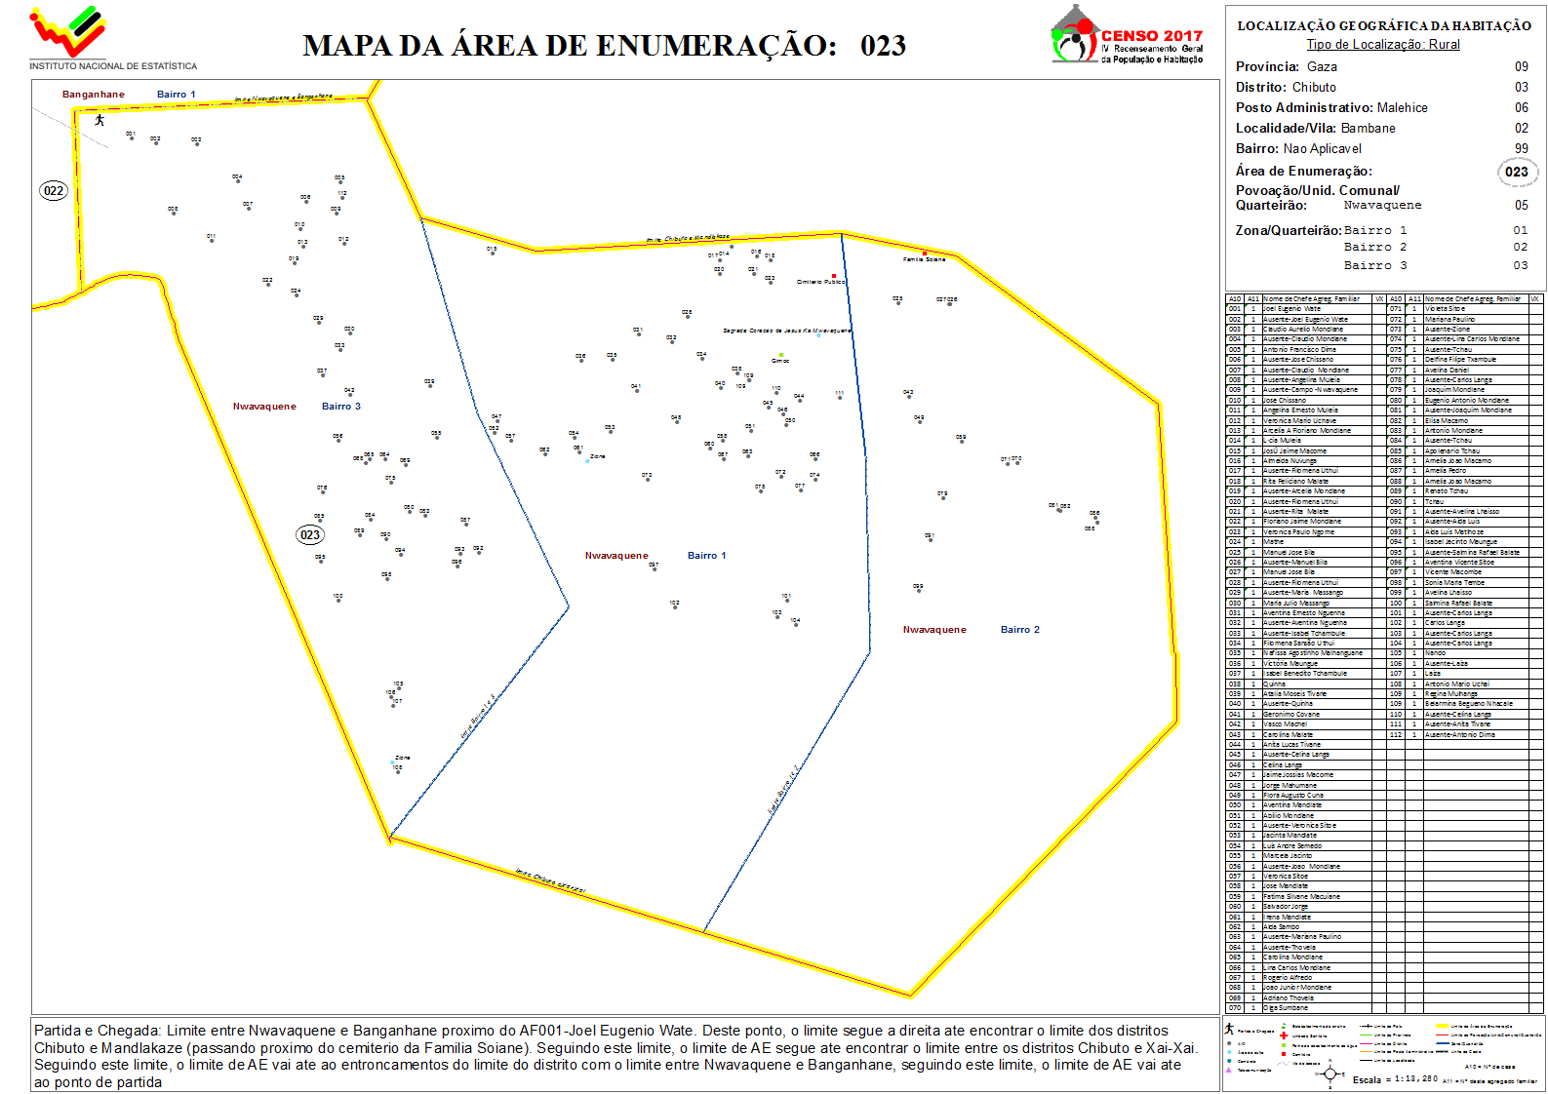
EAS MAPS

Slide 9
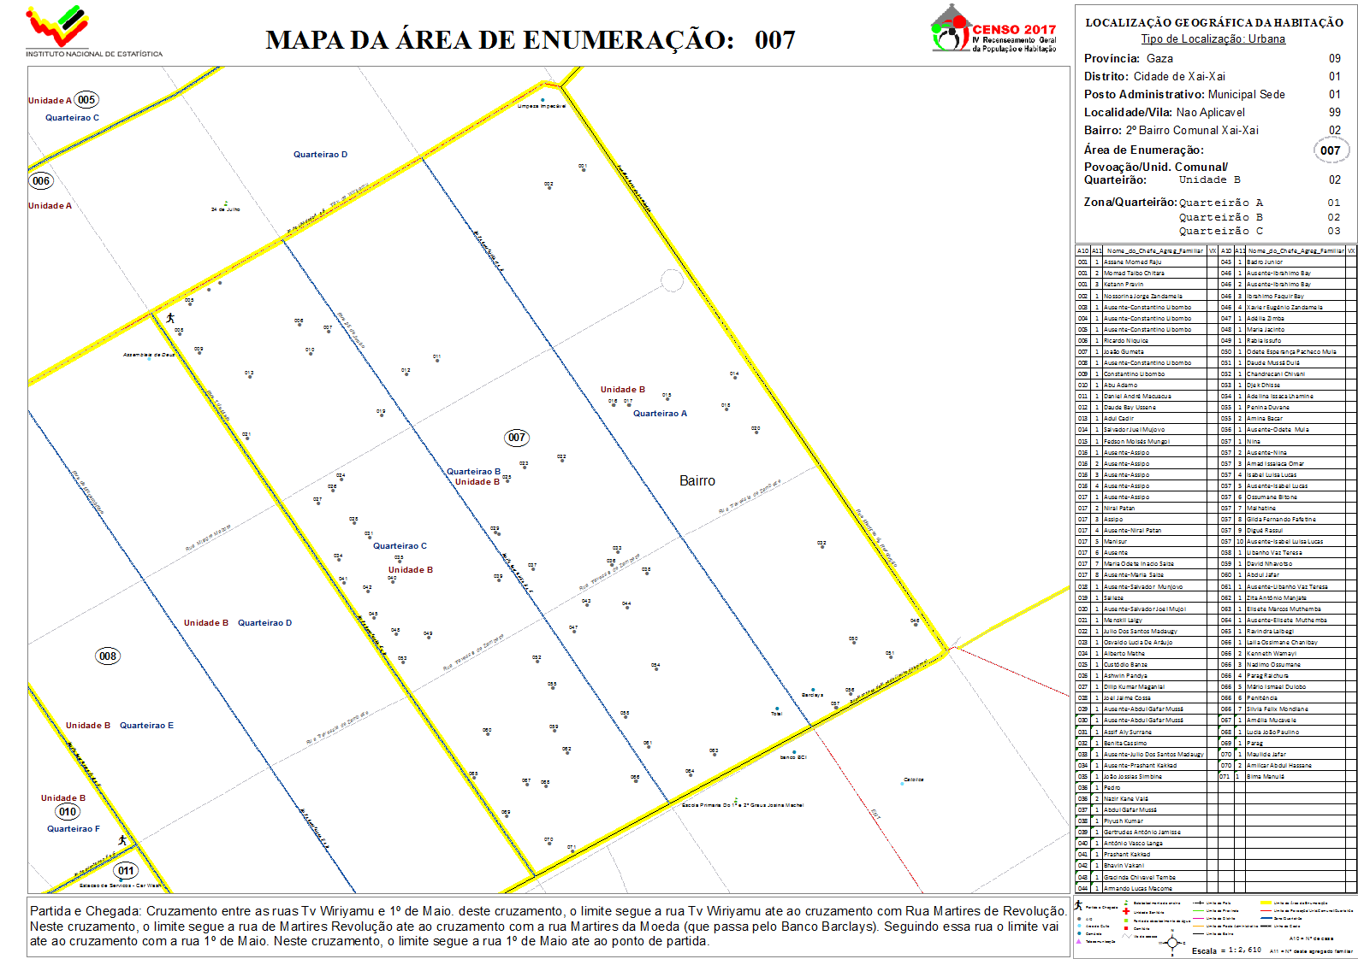
EAS MAPS

Slide 10
Next steps of preparation
1. Conclusion of the Mapping in December
2. Trainning Field Staff
Data Collection in August 2017
Conclusion Data Processing in May 2018
Dissemination starting in July 2018

Slide 11
SUCCESSFUL PH CENSUS
ROUND 2020
WITH FULL DIGITAL DATA CAPTURE
THANK YOU FOR YOUR ATTENTION

