Slide 1


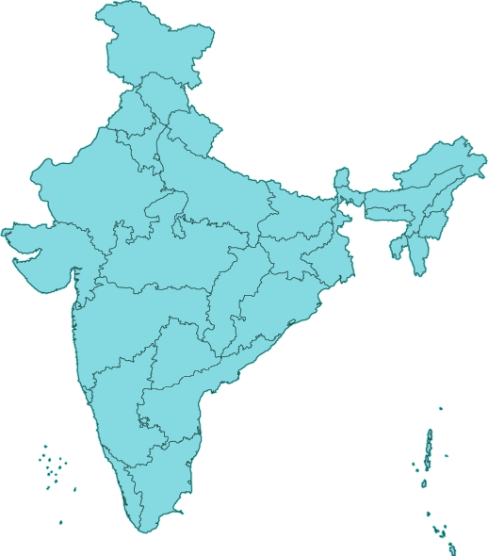
Technology For Census 2021
Issues & Possibilities
INDIA
Office of the Registrar General & Census Commissioner, India
Ministry of Home Affairs
New Delhi

Slide 2
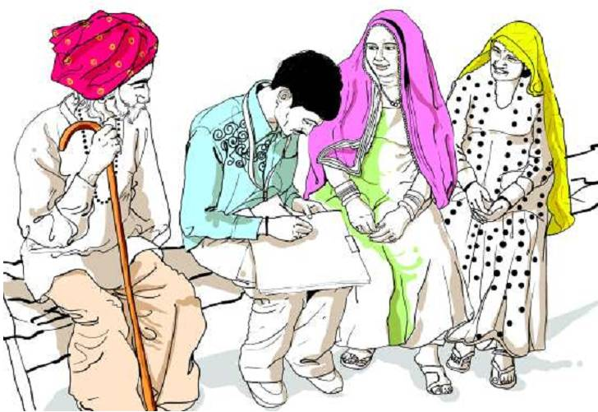
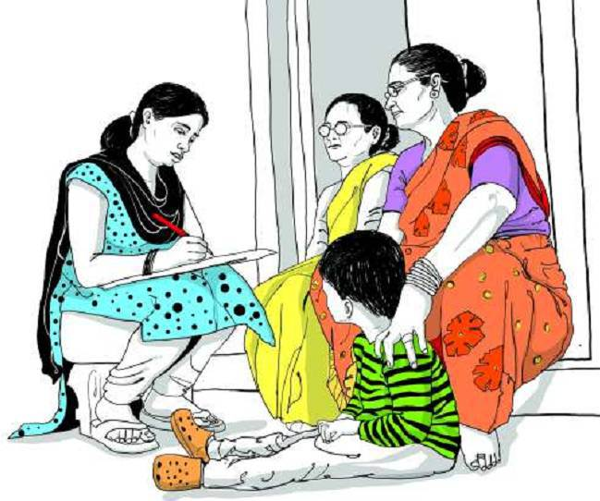
Census 2011
Overview
Conducted in two phases
  Houselisting (April to Sept 2010)
    Information on housing, household amenities and assets
    Frame for Population Census
    Enabled equitable work distribution in the second phase
  Population Enumeration (Feb 2011)
  Face to face canvasser method
  Paper questionnaire
India

Slide 3
Census 2011 Contd.
Diversity
Provinces/States - 35
Districts - 640
Sub-districts - 5,924
Towns/Cities - 7,933
Villages - 640,930
Enumeration Areas (In million) - 2.47
Households (in million) – 249
Population (in million) – 1,211
Enumerators & Supervisors (in million) – 2.7
Ethnic groups - 4,635; Mother tongues – 6,661
 |  | D | I | F | F | I | C | U | L | T | A | R | E | A
 |  | I |  | D | A | T | A | P | R | O | C | E | S | S | I | N | G
 |  | F |  |  |  | E | D | I | T | R | U | L | E | S
 |  | F | U | N | C | T | I | O | N | A | R | I | E | S |  | D
 |  | I |  |  | S | C | A | N | N | I | N | G |  |  |  | I
 |  | C | P | R | I | N | T | I | N | G |  | I |  | C | O | S | T
 |  | U |  |  |  | M |  |  |  |  |  | O |  |  |  | T
 |  | L |  | T |  | A |  | T | R | A | I | N | I | N | G | R
M | O | T | H | E | R | T | O | N | G | U | E | S |  | J |  | I
A |  | P |  | C |  | E |  |  |  |  |  |  |  | U |  | B
P |  | E |  | H |  | R |  |  | V |  |  |  |  | R |  | U
P |  | O |  | N |  | I |  |  | U |  |  |  |  | I |  | T
I |  | P |  | O |  | A |  |  | L |  | C |  |  | S |  | I
N |  | L |  | L |  | L |  |  | N |  | O |  |  | D |  | O
G |  | E |  | O |  | S | U | P | E | R | V | I | S | I | O | N
 |  |  |  | G |  |  |  |  | R |  | E |  |  | C
 |  |  |  | Y |  |  |  |  | A |  | R |  |  | T
 |  |  |  |  |  |  |  |  | B |  | A |  |  | I
 |  |  |  |  |  |  |  |  | L |  | G |  |  | O
 |  |  |  |  |  |  |  |  | E |  | E |  |  | N
 |  | A | W | A | R | E | N | E | S | S
India

Slide 4
Administrative Setup
Registrar General & Census Commissioner (At national level)
Directorate of Census Operations (At Province/State level)
Central
Government
Province/State
Government
State Nodal Officer
(For overall coordination)
Principal Census Officer
(At District/City level)
Charge Officer
(At Sub-District/Town level)
Enumerators and Supervisors
(For Enumeration Areas)
India

Slide 5
Brief Methodology 2011
Unambiguous list of Administrative Units
Estimated population of areas collected from local authority
Carving out the Enumeration Areas (EAs)
Each enumerator assigned with 1 or more EA with a total workload of about 150 Census houses/ 600 to 750 population
An EA may be a complete village or part thereof in rural areas and a well demarcated area in the urban locations.
Data collection through paper questionnaire; door-to-door visit
A supervisor appointed for every six contiguous EAs
India

Slide 6
Brief Methodology 2011 Contd.
Layout Sketch
For complete coverage
Prepared by the enumerator
Free hand drawing
Not drawn to scale
No Latitude/Longitude
Shows
  Boundary of the EA
  Indicative locations of dwellings
  Important features & landmarks
India

Slide 7
Issues in EB Formation (2011)
Huge, in number
Exact population not known (Only approximation)
EBs should not cut across
  Villages
  Panchayats
  Electoral poll booths
  Identified Slums
  SRS Units
  Difficulty in urban areas
  Disproportionate work distribution (1st phase)
Village boundary
SRS Unit boundary
Panchayat
boundary
India

Slide 8

Training Cascade (2011)
National Trainers (NTs) 90
Master Trainer Facilitators (MTFs) 725
Master Trainers (MTs) 54,000
Enumerators & Supervisors 2.7 Million
India

Slide 9

Flow of Materials (2011)
For Field Work
Schedules Printed
At
High-end Presses
Materials supplied
by DCO
Charge Officer
Department of Post
Charge Register
Enumerator
India

Slide 10
Flow of Filled-in Materials (2011)
Return Collection
Enumerator
Supervisor
Charge Officer
For each EB, separately
On Top:
i. Certificate of Complete Coverage
ii. Inventory of used/unused material
Certificate of complete coverage
Set-I & II
Set-III
Enumerator’s Abstract & Filled-in Schedules
(Duly packed in boxes)
Charge Register
of HLO and PE
Along with materials
Received from the Enumerator(s) under his Supervisory Circle
Un-used/spoiled materials along with the inventory
Set-I
Enumerator’s Abstract (1st copy)
Working Sheet
Inventory of Dispatch
(Annex-A)
Certificate of Complete Coverage from Charge Officer, all Enumerators and Supervisors
Set-II
Box inventory (Annex-C)
Layout Sketch
filled-in updated AHL
Inventory of Dispatch
(Annex-B)
Set-III
Box Inventory
(Annex-D)
Enumerator’s Abstract (2nd copy)
Loose filled-in Household Schedules
Storage-cum-Scanning Center
Census Directorate
India

Slide 11
Data Processing (2011)
Stages
Collection of Household Schedules
At scanning center
Scanning of Schedules
Processing of
Images using
ICR technology
Finalization
of Results
Computer Assisted Coding of Alphanumeric Entries
Manual Processing
of unrecognized Numeric Entries
Automatic Data Capture of Numeric Entries
India

Slide 12



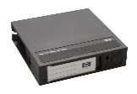


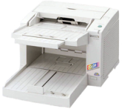
Data Processing (2011)
e-Flow
ASCII FILE
6
Export/Archival
State
Data Center Server
5
Exception
4
Completion
ASCII Files
through
DLT/HDD
3
Tiling
2
Recognition
1
Scanning
Central
Data Processing
Division
India

Slide 13
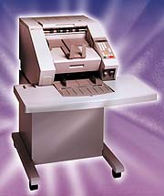


Data Processing (2011)
Data Center Setup
Export station
Controller station
Scanning station
Supervisor Export completed batches as ASCII file for further processing
Copying Data to Media/complete monitoring
Forms are fed thru scanners
batch by batch
Form IMAGES stored in Network DISK
QC & Exception
Server
Supervisors Handle Quality check /Exceptional cases
Recognition stations
Field by field character images are automatically recognized
Tiling & Completion stations
Tile/Correction station - Un-recognized Characters are corrected by OPERATORS
India

Slide 14
Learnings from Census 2011
Hand drawn layout sketch
  May be made scientific
Printing & Mobilizing the materials
  Cost
  Logistics
  Safety
  Inadequacy / Over supply
  Return collection of filled-in materials
Hand written alphanumeric responses on questionnaire
  Capturing issues
Time consumed
  For scanning
  Capturing, Processing, Editing etc.
Data Transfer (Through DLT/HDD)
India

Slide 15
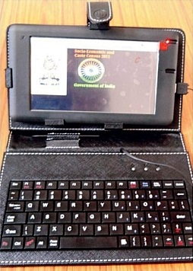
Learnings from
Socio-Economic & Caste Census (SECC) 2011-14
Data Collection through Handheld Devices across India
Time vs. Resources – Trade off
640,000 devices for 2.7 million EAs
Took four years for completion
Two persons per device
  Enumerator
  Device operator
  Power backup issue in rural areas
  Reusability of the devices after operation
India

Slide 16
Preparing For Census 2021
To Begin With
National Database of Usual Residents
  Data collection: 2010
  Database for about 1199.6 million records
  Unique ID numbers with biometric details: About 1044 million
  Database updated: 2015-16
Linkages with Unique ID Numbers (Aadhaar)
India

Slide 17
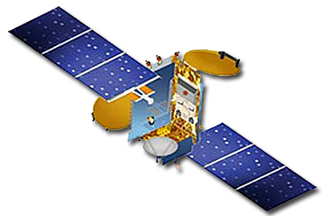

Technology Options For Census 2021
Issues & Concerns
Technology for
  Data collection
  Data processing
  Optimum accuracy from field
  Minimum hassle at desk
Image courtesy: Internet
India

Slide 18
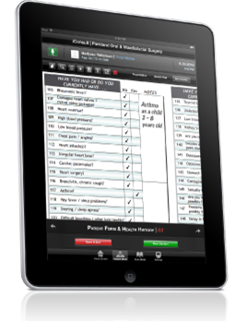
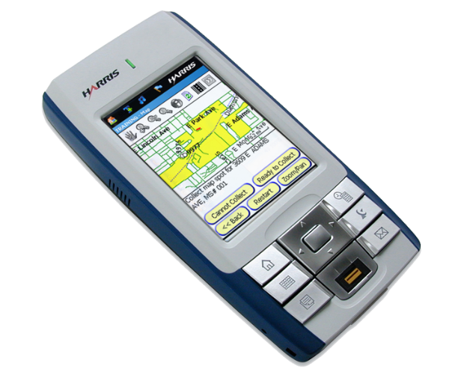
Technology Options For Census 2021 Contd.
Possibilities
Paperless data collection/Handheld Devices
Optimally structured questionnaire
  Dropdown menus/options
Real time data collection
  Updation of preloaded (Available) information
  Addition/Deletion
  On site basic data validation
  Automatic jumps
Online transfer of encrypted data
Image courtesy: Internet
India

Slide 19
Technology Options For Census 2021 Contd.
Issues & Concerns
Huge number of Handheld Devices (HDDs) required for a period of 3 weeks only.
Cost of HHDs
Reusability of HHDs
Power backup in rural areas
Internet penetration
  For online geo-referencing
  For online data transfer
  Skilled & adequate Enumerators for HDDs
Image courtesy: Internet
India

Slide 20
Brainstorming Continues . . .
. . . Thank You
India

