Slide 1
Use of technology in conducting censuses in Latin America and the Caribbean
United Nations Technical Meeting on Use of Technology in Population and Housing Censuses
Amman, Jordan, 28 Nov. – 1 Dec. 2016
Paulo M. Saad
Chief, CELADE-Population Division
Economic Commission for Latin America and the Caribbean

Slide 2
Topics
Changes in data collection technology over the last rounds of censuses
Expected changes for the 2020 round
Reported needs for technical assistance
Sources:
Paper (Notas de Poblacion, 95) on determinants of use of technology in LAC population censuses based on IDB Survey on use of technology in Latin American and Caribbean countries (2012)
CELADE-ECLAC Survey of Latin American and Caribbean Statistical Offices on plans for the 2020 census round, including technical assistance needs (2015)

Slide 3
LAC: Population census according to technological typology
Typology | Step 1 (geographic unit selection) | Step 2 (data collection) | Step 3 (data transfer)
1st Generation | Analogical cartography | Paper | Manual
2nd Generation | Digital cartography GPS | Paper | Scanner
3rd Generation | Digital cartography and questionnaire
4th Generation | Digital cartography and self enumeration

Slide 4
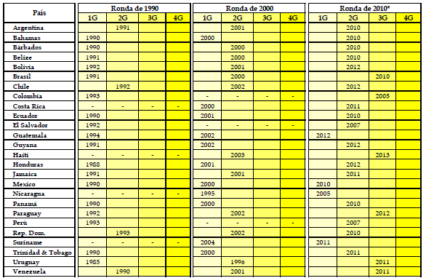
LAC: Technology used in past census rounds

Slide 5
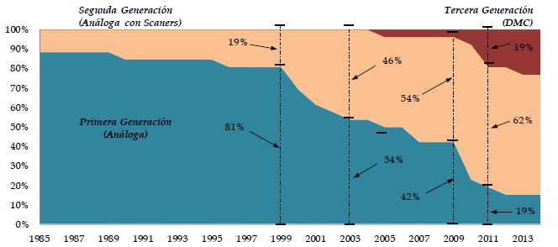
LAC: Changes in census data collection technology (% of countries)

Slide 6
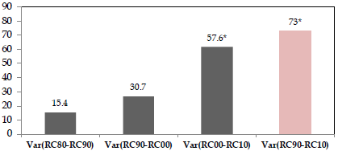
LAC: Changes in technology between subsequent rounds of census (% of countries)

Slide 7
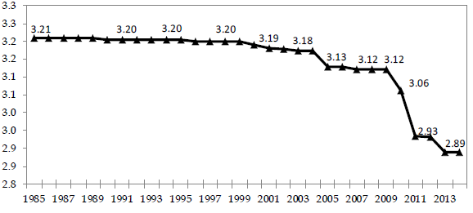
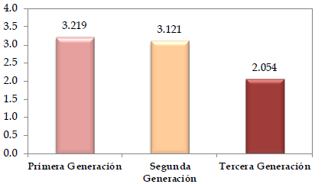
Economic impact of technology change: Average per capita cost of Population Census (in 2000 USD)

Slide 8
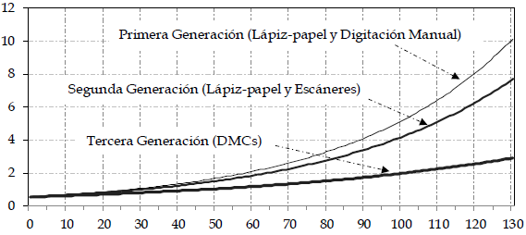
Average per capita cost of Population Census according to number of questions (2000 USD)

Slide 9
Some conclusions
MCD technology reduces per capita cost of censuses (by approximately 35%)
Reduction in per capita costs increases with the number of questions
MCD technology increases total productivity of census staff in the fieldwork
The differential in costs and productivity in favor of DMC is more marked in countries with larger population

Slide 10
ECLAC survey on expected methodological changes and assistance needs
Identify the difficulties faced in the design, planning and implementation of the previous census and foresee the difficulties in the next
Identify the methodological and technological improvements or changes already implemented or planned to be implemented in the next census round
Assess the needs for future technical assistance (in design, plan, implementation of census operation phases)

Slide 11
ECLAC survey on expected methodological changes and assistance needs
Instrument: A survey was sent to the countries between November 2015 and March 2016
Response:
90% in Latin America (18 out of 20 countries)
63% in the Caribbean (14 out of 22 countries)
The answers were not homogeneous as countries are planning to conduct their next census in different dates, mainly in 2020, 2021 and 2022 (some are still planning for their 2010 census, in 2017and 2018)

Slide 12
Contents of ECLAC survey on expected methodological changes and assistance needs
I. Background to the survey, coverage and response
II. General aspects of the census
III. Cartographic update
IV. Methodological Design
V. Contents of the Census Questionnaire
VI. The Census Staff Training Plan
VII. Coverage Evaluation Plans
VIII. Pilot Censuses and Tests
IX. Data Collection
X. Analysis and Dissemination Plans
XI. Countries Needs for Technical Assistance

Slide 13
LAC countries: technology used in previous census and expected to be used in the next
Previous Census | Next Census
 | Paper, manual data entry | Paper , scanner | Mobile collection device | Internet self-data entry
Paper, manual data entry | 3 LAC | 1 LAC | 2 LAC
 |  |  | 3 C
Paper , scanner |  | 5 LAC | 2 LAC | 1 LAC
 |  | 1 C | 4 C
Mobile collection device |  |  | 2 LAC
 |  |  | 1 C
Internet self-data entry |  |  |  | 2 LAC

Slide 14
LAC countries: reported priorities in technical assistance for the 2020 census round
Aspect in need of technical assistance | Priority Index
 | Latin America | Caribbean
Funding | 58 | 81
Use of technologies for data collection | 67 (2) | 81 (1)
Cartography update | 58 | 79
Quality and coverage control | 73 (1) | 79 (2)
Data processing | 49 | 79
Staff training | 56 | 76
Assessment of coverage | 60 | 69
Dissemination of information | 44 | 69
Analysis of information | 42 | 67
Methodological design | 53 | 64
Census questionnaire | 40 | 57
Pilot census | 49 | 55

Slide 15
Use of Data Technologies in all phases of census operation
Field enumeration
Paper or electronic questionnaire: handled or mobile devices (Tablet, Cellular), self-enumeration (internet)
Demographic trends follow up
Data processing
Editing, validation, automatic coding
Storage
Analysis
Analytics (ODS y CdeM)
Bigdata (micro y macro data)
Dissemination
Census products
Training in the use, processing and analysis of census data
Social networks technologies communications
Tables and results output plan
GIS
Web, web scraping apps

Slide 16
Web availability of census microdata for LA countries
dwellings | 105 155 087
households | 96 497 023
Persons | 380 104 982
Total | 581 757 092

