Slide 1
United Nations Statistics Division - Technical Meeting on Use of Technology in Population and Housing Censuses
28 November - 1 December 2016, Amman, Jordan
Overview of the use of technology for data collection in the UNECE Region - practices adopted in the 2010 round and plans for the 2020 round
Paolo Valente, UNECE

Slide 2
Content of presentation:
Overview of census methods in UNECE region, 2000-2020 census rounds
Internet response:
Adoption by UNECE countries
Technical aspects
Costs and benefits
Other technologies (laptops, tablets…)
Plans for use of technology in 2020 round
Conclusions

Slide 3
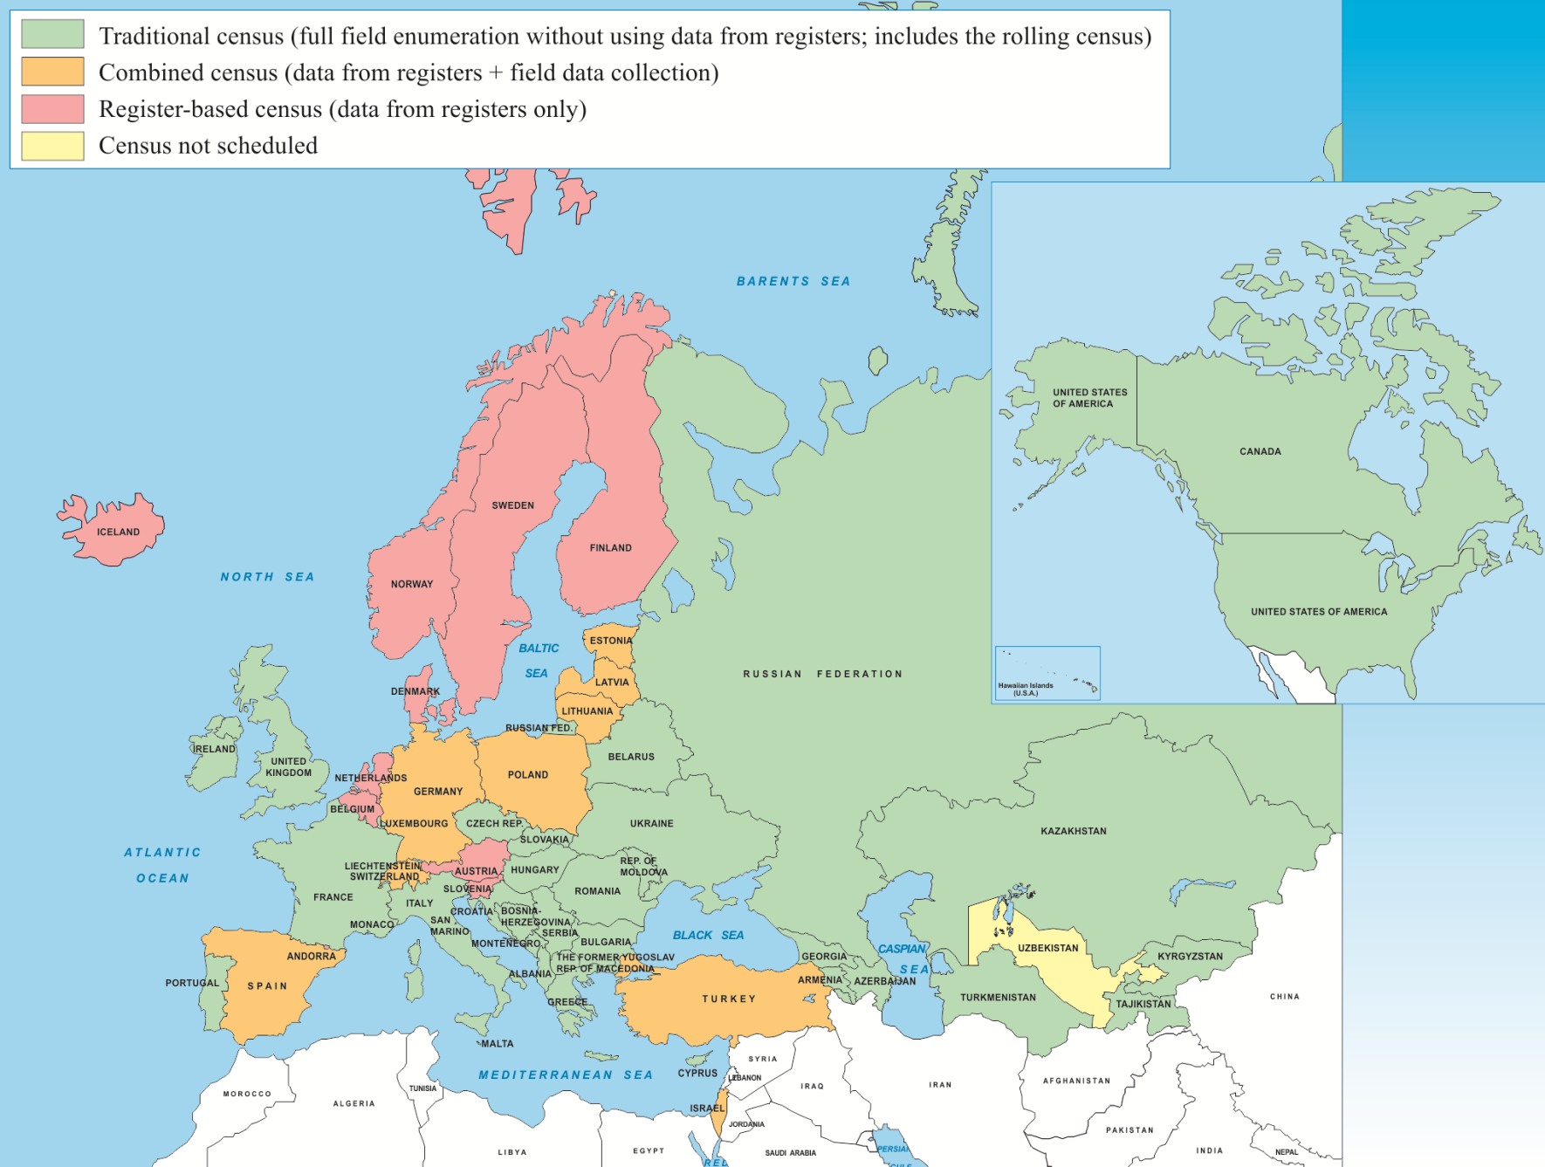
Map of UNECE countries by census method used in the 2010 census round

Slide 4
Number of UNECE countries by census method in the 2000-2020 census rounds
Notes:
The countries adopting a register-based or combined census are concentrated in the EU. For the 2020 round, if only the 32 member countries of the EU and EFTA are considered, then 13 countries plan a register-based census (41%), 9 countries a combined census (28%), and only 10 countries a traditional census (31%).

Slide 5
Internet response Number of UNECE countries using internet response
Notes:
In the 2010 round, the design and/or provision of online response technology was contracted out in 11 of the 18 countries.

Slide 6
Internet response Take-up rates in UNECE countries, 2010 round

Slide 7
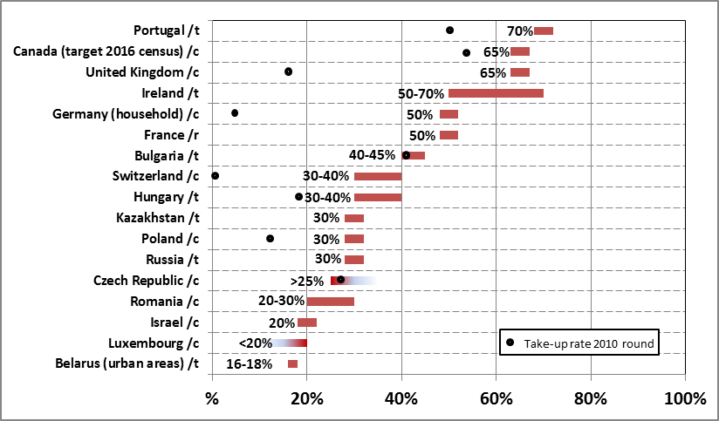
Internet response Assumptions about take-up rates, 2020 round

Slide 8
Internet response Use of Internet response as sole initial mode
Notes:
There was a choice between Internet and other modes (paper forms, face-to-face interviewing, telephone, etc.) when the initial contact was made with the household (13 countries out of 18 - 72%)
Internet response was the sole initial means to respond, with later follow-up by other modes (5 countries out of 18 - 28%)

Slide 9
Internet response Methods used to ensure data security/privacy
Notes:
Unique access codes were provided to each household when entering responses on-line 12
A PIN was provided to allow households to exit prior to completing the questionnaire and return at a later time 7
Visual or Audio CAPTCHA to avoid automatic online registration attack (i.e. robots, botnet, etc.) 5
A physically separate computing infrastructure was set up to collect information, and completed forms were then moved into a separate computing infrastructure from collection 5
Security questions were configured by the household to allow later access to return and complete their questionnaire 1

Slide 10
Internet response Distribution of login and password
Notes:
Printed on the census paper form sent to the respondent's physical address as collected from a register
Printed on paper letter sent to the respondent's physical address as collected from a register
Authentication using bank code details
Not distributed, established on the basis of reference data from registers
Door-to-door through enumerators support
Inside a digital letter sent to the respondent email address

Slide 11
Internet response Data quality control features
Notes:
Automated sequencing of questions so only relevant questions are asked
Use of drop-down response lists for some questions to ensure text/numeric entries matched valid options
Interactive editing to reconcile problem entries
Assisted coding using a similarity search and ranked results based on large dictionary

Slide 12
Internet response Strategies to cope with peak demand
Notes:
Public relations efforts to encourage usage during off-peak times, or to manage expectations
Outsourcing of Internet hosting to increase capacity
Limiting promotion of the Internet response option
Modifying the time periods of response for groups of households to spread the demand

Slide 13
Internet response Cost of developing online questionnaire / internet systems (as % of total census cost)
Notes:
Average 4.5%
No cost savings can be expected in the short term, particularly the first time that internet response is adopted.

Slide 14
Internet response Impact on total census cost and benefit

Slide 15
Types of technology used for field operations in the 2010 round (42 countries)

Slide 16
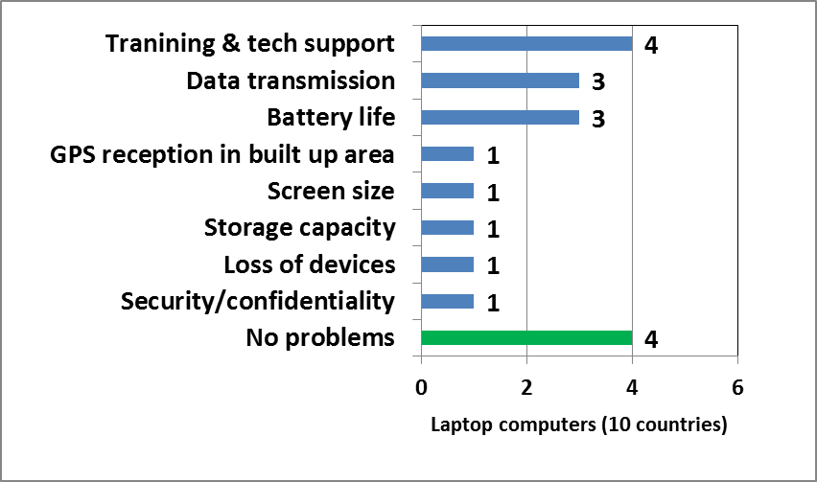
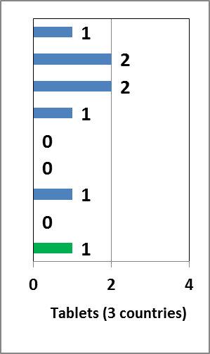
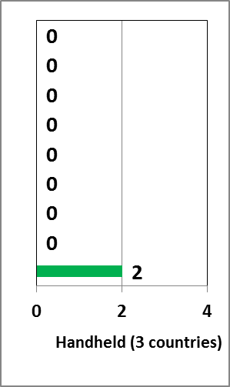
Problems with technology used for field operations in the 2010 round

Slide 17
Time taken to prepare the IT infrastructure for the census (2010 round)

Slide 18
Types of technology used in 2010 round and planned for 2020 round (42 countries)

Slide 19
Possible barriers to the adoption of technologies in 2020 round (42 countries)

Slide 20
Conclusions (1/6) Census methods
In UNECE region, clear trend towards alternative census methodologies, such as fully register-based censuses, or combined censuses
In the 2020 round, the traditional approach will be adopted by less than half of the UNECE countries
Notes:
In the UNECE region, and particularly in Western and Central Europe, there is a clear trend towards alternative census methodologies, such as fully register based censuses, or combined censuses.
In the 2020 round, the traditional approach will be adopted by less than half of the UNECE countries, and less than one third of EU/EFTA countries.

Slide 21
Conclusions (2/6) Adoption of internet response option
Internet response increasingly popular for traditional and combined censuses
In the 2010 round, 18 UNECE countries (41%) adopted the internet response, sometimes with very high take up rates, over 50%
For the 2020 round, internet response to be adopted by almost all the countries with a combined census, and about half the countries with a traditional census
Notes:
Internet response is a technological solution that is becoming increasingly popular to reduce the costs and improve efficiency of traditional and combined censuses.
In the 2010 round a significant number of countries (18, or 41%) adopted the internet response, sometimes with very high take up rates, over 50%.
For the 2020 round it is expected that almost all the countries conducting a combined census, and about half the countries conducting a traditional census will adopt the internet response.

Slide 22
Conclusions (3/6) Internet response – Technical aspects
In most countries, households have choice between internet and other modes
Most common method to ensure data security/privacy is to provide unique access codes, printed on paper forms or letters and mailed
Automatic sequencing of questions and other features allow controlling the quality of data collected
To cope with peak demand, countries encourage the usage during off-peak times, or outsource internet hosting to increase capacity → This remains one of the challenges!
Notes:
In most countries, at the initial contact with the household there was a choice between internet and other modes.
The most common method to ensure data security/privacy is to provide unique access codes, generally printed on paper questionnaires or letters mailed to the households.
Automatic sequencing of questions and other features of internet response allow controlling and improving the quality of data collected.
To cope with peak demand, various countries encourage the usage during off-peak times, or outsource internet hosting to increase capacity. → This remains one of the challenges.

Slide 23
Conclusions (4/6) Internet response – Costs and benefits
Countries spent as much as 12% of the total census cost (on average 4.5%) to develop the online questionnaire and internet systems
In about half the countries, internet response decreased the total census cost, while in several countries the total cost increased
→No cost savings can be expected in the short term
In ALL countries, internet response increased the total census benefit
Notes:
Countries spent as much as 12% of the total census cost (on average 4.5%) to develop the online questionnaire and internet systems.
In about half the countries, internet response decreased the total census cost, while in several countries the total cost increased.
No cost savings can be expected in the short term. However, in all countries internet response increased the total census benefit.

Slide 24
Conclusions (5/6) Other technologies used in the 2010 round
Several countries used laptop PCs (10) and mobile phones (9)
Tablets and hand-held devices/smart phones only used by few countries
Over half the countries that used laptop PCs reported problems, mainly on training/tech support, data transmission and battery life
In most countries the time taken to prepare the IT infrastructure for the census is between 1-5 years → Test! Test!! Test!!! And manage risks!
Notes:
Several countries used laptop PCs (10) and mobile phones (9). Tablets and hand-held devices/smart phones only used by very few countries.
Over half the countries that used laptop PCs reported problems, mainly on training/tech support, data transmission and battery life.
In most countries the time taken to prepare the IT infrastructure for the census is between 1-5 years.

Slide 25
Conclusions (6/6) Plans on technology for the 2020 round
Most popular technologies will include internet response (32 countries), GIS (32), and GPS (16)
Among electronic devices, tablets (20 countries) seem more popular than laptop PCs (13), hand-held devices/smart phones (12) and SMS texting facilities
Most serious barriers to the adoption of technology are financial and staff resources, and expertise
Notes:
The most popular technologies will include internet response (32 countries), GIS (32), and GPS (16).
Among electronic devices, tablets (20 countries) seem more popular than laptop PCs (13), hand-held devices/smart phones (12) and SMS texting facilities.
The most serious barriers to the adoption of technologies are financial and staff resources, and expertise.

Slide 26
UNECE census publications Available at: http://www.unece.org/stats/census.html
Measuring population and housing – Practices of UNECE countries in the 2010 round of censuses
Conference of European Statisticians Recommendations for 2020 Censuses of Population and Housing
→ Due 2017: Guidelines on the use of registers and admin. data for censuses

Slide 27
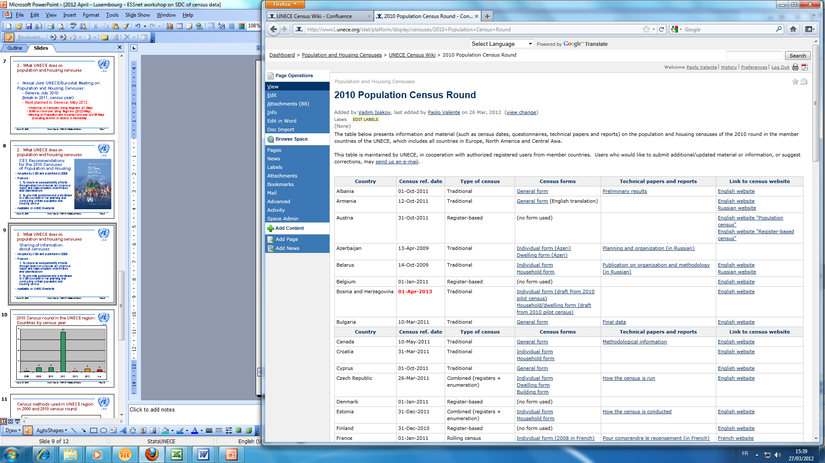
Information and material on censuses in UNECE member countries
UNECE Census Wiki
- Table on 2010 round of censuses in UNECE countries, including:
- Census dates
- Methodology / Use of internet
- Questionnaires (PDF)
- Technical papers and reports
- Link to national census website
- SOON: New table on 2020 round
- Papers on census methodology
Accessible from http://www.unece.org/stats/census.html or using Google:

