Slide 1
Use of Technologies in Population and Housing Censuses: a Global overview
Meryem Demirci
United Nations Statistics Division

Slide 2
Content
Overview of 2010 world programme
Success
Innovations
Use of Technology
Practices in 2010 round
Plans for 2020 round
Challenges
Plans for 2020 world programme
Resolution
International Guidelines

Slide 3
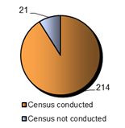
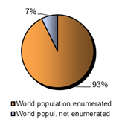
Census implementation
Successes
214 countries or areas out of 235 conducted census enumerating 6.4 billion people representing 93% of world population
Countries that conducted census Population enumerated

Slide 4
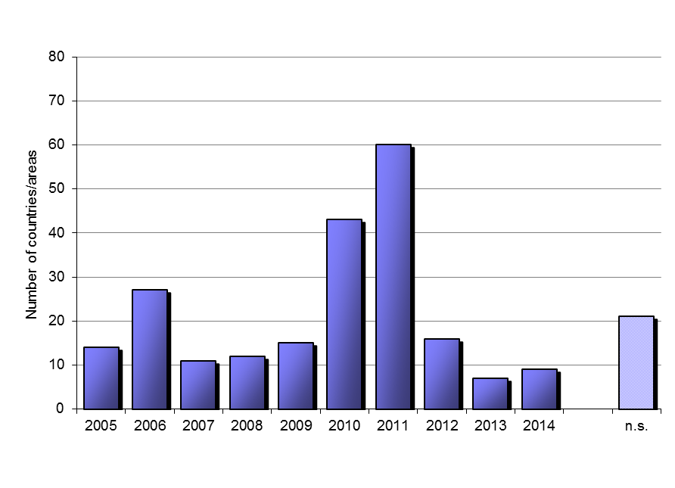
Census implementation
21 countries or areas did not conduct census compared to 26 during the 2000 round
25 countries rescheduled their censuses for 2010 round

Slide 5
Innovations
Use of alternatives to traditional census
Combined census methodology
Fully register-based censuses
Use of advanced technologies
GPS/GIS
Hand-held devices
Internet
For data collection, monitoring, management and dissemination

Slide 6
Trends in the use of technology
Census Rounds
 | Before 1990 | 1990 | 2000 | 2010 | 2020
Mapping | Sketch | Digital Sketch | Digital Sketch | Digital Georeferenced data Sketch
Enumeration | Paper questionnaire | Paper questionnaire | Electronic questionnaire – Internet Paper questionnaire | Electronic questionnaire – Internet, hand-held devices and telephone Real-time monitoring Paper questionnaire
Data Processing | Manual data capture | Optical data capture Manual data capture | Optical data capture Manual data capture | Optical data capture Automatic data capture (Internet and hand-held devices) Web-based manual data capture Manual data capture
Dissemination | Paper publication |  | Paper publications Online / digital publications | Online interactive databases Digital publications Paper publications

Slide 7
UNSD Survey Results
Collecting information on lessons learned from the 2010 round of censuses and plans for 2020 round of censuses
The results will be used to identifying emerging trends and challenges in the 2020 round
Preliminary results based on the information collected from about 100 countries
Number of countries
Africa: 21 North America:3
Asia:26 Latin America: 20
Europe: 35

Slide 8
Census Method

Slide 9
Use of technology for data collection-2010 round-Percent

Slide 10
Method of data collection-Plans for 2020 round

Slide 11
Use of Internet in 2010 and Plans for 2020

Slide 12
Use of CAPI in 2010 and Plans for 2020

Slide 13
Country practice in 2010 round

Slide 14
Most important challenges in 2020 round

Slide 15
Conclusions
Making a sound decision on adoption of electronic data collection is the heart of planning 2020 censuses
Benefits of the use of electronic data collection technologies are well understood – What about its impacts on census business process ???
Redesigning census operation for adoption of technology calls for very early decision making to have appropriate time for planning, designing, testing
significant shift in time schedule of census operation
less time for data processing
more time for planning/preparation/testing

Slide 16
2020 World Population and Housing Census Programme
The United Nations Economic and Social Council approved the 2020 World Census Programme on 5 August 2015
Underscores need for setting quality standards for reliable and accurate results
Emphasizes the importance of the programme to SDG’s
Requests UN to develop statistical standards, methods and guidelines and to monitor the implementation of the World Programme

Slide 17
International Guidelines
Revised Guidelines
Principles and Recommendations for Population and Housing Censuses, Rev. 3 –available online
Handbook on Management of Population and Housing Censuses Revision 2-will be available soon
Plans for revision of:
Economic Characteristics of Population
Editing
Geographic Information System

Slide 18
International Guidelines
Guidelines on the Use of Technology for Enumeration
Development account project-UNSD and Regional Commissions
Aims to strength a capacity of national statistical offices on:
how to make informed decisions on appropriate technologies,
how to efficiently use these technologies in census data collection,
what are possible implications of their use on other aspects of census operation in order to maximize the benefits of this investment
Guidelines
Regional workshops and technical assistance
Technical report on Quality Assurance of Population and Housing Censuses
Technical report on Census for monitoring SDGs

