Slide 1
Building better dissemination systems for national development indicators
Differences between national and international reported indicators
Prepared by
Tran Thi Thu Trang – GSO, Vietnam

Slide 2
Content
5 indicators need to be explained
Reasons for differences
How to solve

Slide 3
5 indicators need to be explained
Internet users
Maternal mortality ratio
Employment-to-population ratio
Children moderately or severely underweight
Notified cases of malaria

Slide 4
1. Internet users (per 100 population) Before adjustment

Slide 5
Internet users (Count.)
1. Definition
Internet users is the number of users of internet. The Internet is a linked global network of computers in which users at one computer, if they have permission, get information from other computers in the network.
2. Method of computation
The total number of Internet users is divided by population and multiplied by 100.
3. Data collection
In VietNam where Internet user surveys are not available, the ITU uses average multipliers to estimate the number of users per subscriber.

Slide 6
Why different?
At first we calculate this indicator using the unit is number of subscribers. After our review unit has changed unit by using the unit is number of user and the result is to change data. We have editted data of this indicator on Countrydata.
The data can also be misleading because of multiple prepaid Internet accounts, free Internet access accounts or public Internet access such as Internet cafes. Besides, in the modern time, internet access is not necessary done by computers but mobile as well, thus, this indicator is not fully covered.

Slide 7
Internet users (Per 100 population) After adjustment

Slide 8
2. Maternal mortality ratio (per 100000 lives birth)

Slide 9
Maternal mortality ratio (Count.)
1. Definition
The maternal mortality ratio is the number of women who die from any cause related to or aggravated by pregnancy or its management (excluding accidental or incidental causes) during pregnancy and childbirth or within 42 days of termination of pregnancy.
2. Method of computation
It can be calculated by dividing recorded (or estimated) maternal deaths by total recorded (or estimated) live births in the same period and multiplying by 100,000.
It also can be calculated directly from data collected through vital statistics registrations, household surveys or hospital studies.

Slide 10
Why different?
Official data are usually obtained from health service records, but few women in rural areas have access to health services.
Available data on levels of maternal mortality are generally significantly underestimated because of problems of misclassification and under-reporting of maternal deaths.
The difficulty in distinguishing deaths that are genuinely related to pregnancy from deaths that are not
The WHO, the UNCEF, the UNFPA have adjusted existing data to take account of these problems and have developed model-based estimates for countries with no reliable national data on maternal mortality. It is these estimates that are usually published in international tables.

Slide 11
3. Employment to population ratio (percent)

Slide 12
3. Employment to population ratio (Count.)
1. Definition
Employment to population ratio is the percentage of total employed workers with total population.
Employed population (working) includes persons aged 15 and over in the reference period (one week)
2. Method of computation
Formula:
Employment to population ratio
= Number of employed workers/Total population x 100
Why different?
The same definition and method, it may be different data source which in Vietnam this indicator was calculated based on database of Population and Housing Census every 10 year and Sample survey on labor –employment every year.

Slide 13
4. Children moderately or severely underweight (percent) – UNSD Prevalence of underweight children under-five years of age-Vietnam

Slide 14
Prevalence of underweight children under-five years of age-Vietnam
1. Definition
It is the percentage of children under age 5 whose weight for age is less than minus two standard deviation below the median.
2. Method of computation
Children whose weight for age is less than minus two SD of the median weight of NCHS reference population is considered malnourished
Formula
Prevalence of underweight children under-five years of age | = | Number of children under 5 whose weight is less than M-2SD of the region in the survey time point | x 100
 |  | Total children under age 5 that were weighted at the same time

Slide 15
Why different?
Data is calculated based on weight not tall
Data on this indicator are disseminated via: report on Annual National Nutrition Survey, National Nutrition Institute; Report on Household living standard survey and international report estimates based on orther source.

Slide 16
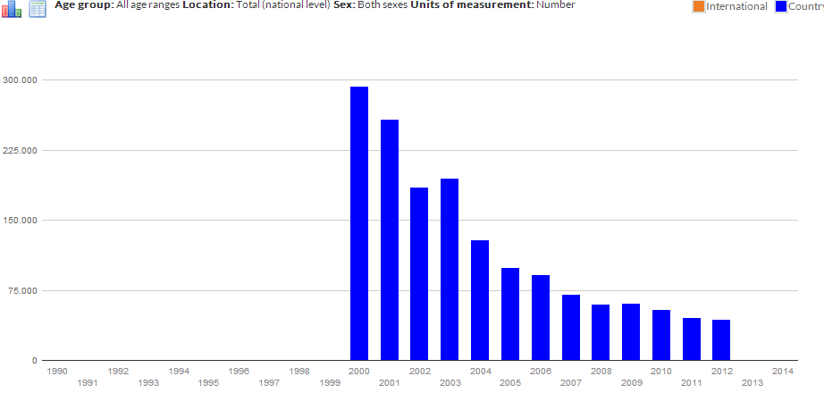
5. Notified cases of malaria (number)

Slide 17
Notified cases of malaria (per 100 000 population) No difference

Slide 18
How to solve
Standardized metadata on national report
Consensus on definitions and calculation methods, data source between national and international metadata
Indicators are specific for Vietnam’s condition, UNSD needs to expand DSD can be mapped
Introducing about this project on http://www.gso.gov.vn/ItemPreview.aspx?ItemID=14920

Slide 19
THANK YOU FOR YOUR ATTENTION

