Slide 1
International data dissemination
or: what do international organizations
do with your data?
Presentation by Sabine Warschburger, UNSD

Slide 2
Data collection at UNSD
Paper questionnaires
Excel sheets
CSV files
XML questionnaire
SDMX
Notes:
Statistical Data and Metadata Exchange (SDMX)
What is it?
An initiative to foster standards for the electronic exchange of statistical information
Goal - explore e-standards that could increase efficiency gains and avoid duplication
Sponsored by BIS, ECB, EUROSTAT, IMF, OECD, UN, WB
What it is not
Not a technology…but implemented using technology (XML EDIFACT syntax and GESMES/TS message)
How does it work?
Exchange partners agree on Data Structure Definitions
Data and metadata exported and imported accordingly

Slide 3
Data dissemination at UNSD
  Until 1995: print publications (yearbooks, manuals)
  1995-2000: CD-ROM, static web pages
  2000-2008: online databases, dynamic web queries
  (UN Comtrade, UN Common Database)
  2008: launch of UNdata – UN System data portal
  2010: World Statistics Pocketbook app for iPhones and iPads
  2012: launch of CountryData – UN national data portal
Notes:
Pressure to reduce paper publications
Delay in print

Slide 4
  UN National Data Portal
  http://data.un.org/countrydata
  Improve coordination in the National Statistical System
  Make access to national data easier
  Reduce data request burden
  Use of latest IT software and practices

Slide 5
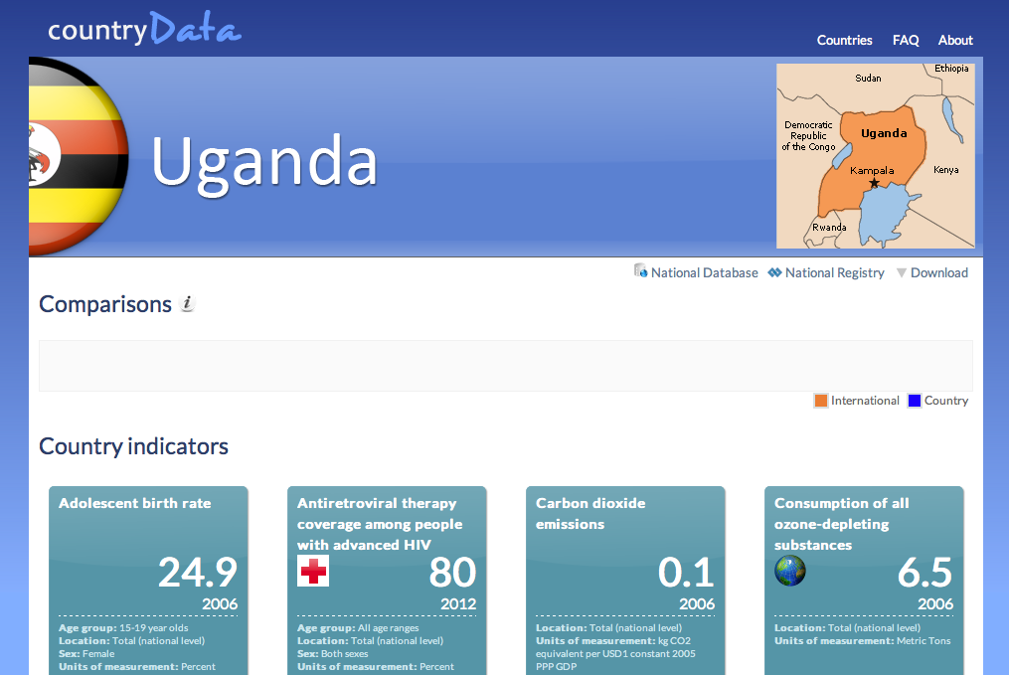

Slide 6
The Committee for the
Coordination of Statistical Activities
39 international and supranational organizations, whose mandate includes the provision of international official statistics … and which have a permanent embedded statistical service in their organization and regular contacts with countries
2 co-chairs
Two sessions per year
22nd session: 4-6 September 2013 in Ankara
Outputs: CCSA endorsed “Principles Governing International Statistical Activities”

Slide 7
Special session on "New approaches for data collection, analyses and dissemination"
Africa’s Information Highway and SDMX implementation on the continent (AfDB)
A free and flexible platform for data collection, analysis and dissemination (FAO)
New approaches for data collecting from the internet: The case of Google Trend (ECB)
Changing Data Sources for Central Bank Statistics (TCB)
Communicating statistics – Turning statistics into knowledge (ECB)

Slide 8
AfDB:
African Information Highway/Data Portal
Main rationale: Improve access to data
http://www.afdb.org/en/knowledge/statistics/open-data-for-africa/
Features:
  Visualize time series
  Perform calculation with built-in tools
  Provide presentation ready graphics
  Perform comprehensive analysis

Slide 9
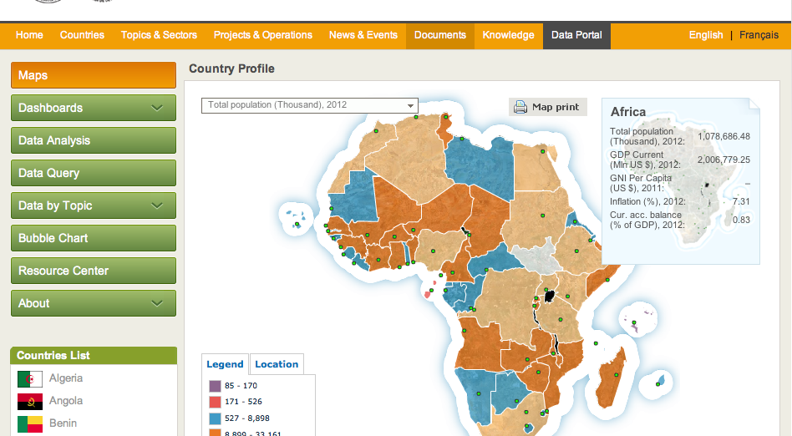
African Data Portal

Slide 10
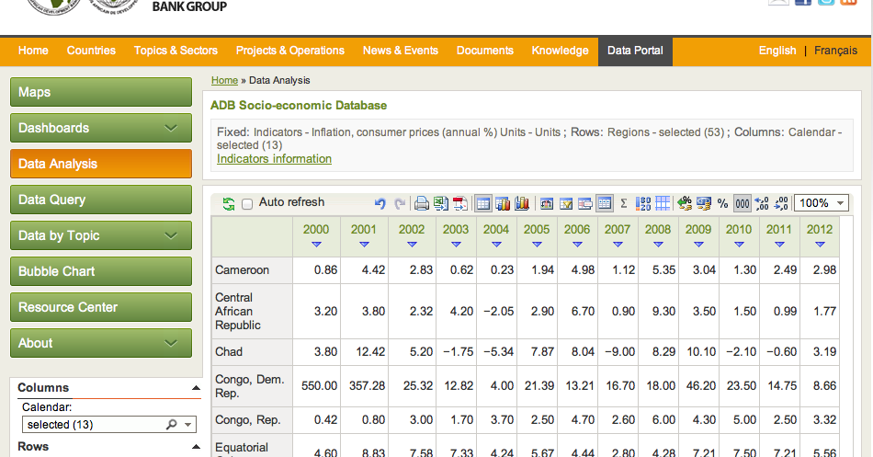
African Data Portal: data analysis

Slide 11
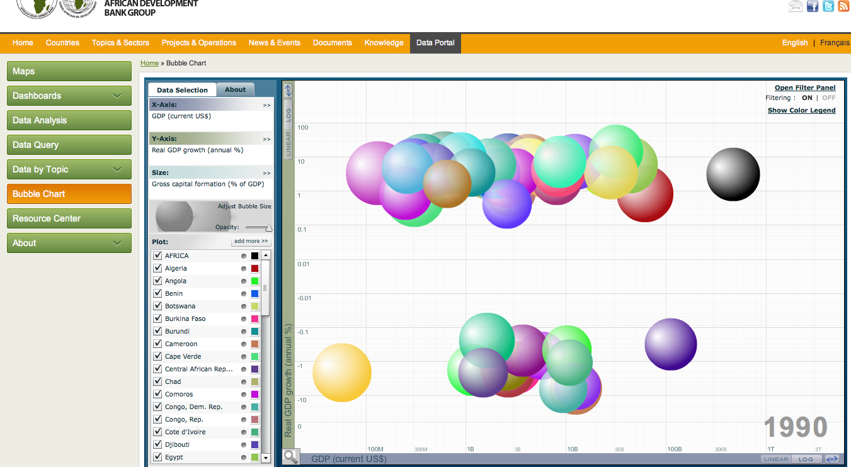
African Data Portal: Bubble chart

Slide 12
African Data Portal and Open Platform
Data Portal implementations have started in more than 60 countries & RECs
43 countries and RECs already have uploaded the real data into the Data Portals
30 of them have been trained
OpenData are now accessible for all African Countries
Data submission tool : Piloted in 3 countries (Nigeria, Rwanda, Tunisia) jointly with IMF

Slide 13
What else do international organizations do with your data?
Non‐official sources may be used by international organisations in compiling official statistics to reach the following objectives:
to give background or context to data from official sources;
to assess data received from official sources on their plausibility;
to apply transformations to national official data in the interests of international comparability or for the purpose of producing new indicators (for example: construct per capita ratios);
to impute national data where national official data do not exist or are of proven poor quality;

Slide 14
THANK YOU

