Slide 1
STATISTICAL Data portal, lesotho
Regional Workshop on Data Dissemination and Communication,
9 – 12 September 2013,
Amman, Jordan
Presented by
Ms ‘Mapule Phahla

Slide 2
Objective of this presentation
Sharing about the data dissemination product provided by the African Development Bank (AfDB) – Integrated Data Management and Dissemination system (The AFDB Statistical Data Portal (DP))

Slide 3
background
Bureau of Statistics (BOS) is government department under the Ministry of Development Planning
BOS is mandated to set up a system for national official statistics on economic, social, demographic, including human resources, and environmental areas in relation to the development needs of Lesotho; and official statistics for purposes of economic and social planning, research, public information and international cooperation, and for related matter.

Slide 4
Background cont’d…
Mission
To Coordinate the National Statistical System (NSS) and produce accurate, timely, reliable, culturally relevant and internationally comparable statistical data for evidence-based planning, decision making, research, policy, program formulation and monitoring and evaluation to satisfy the needs of users and producers.
Vision
To become a leading authority in the collection, production and dissemination of statistics, manned with well trained and motivated staff that is committed to supporting the national development agenda and enhancing socio-economic policy formulation, planning and decision making processes and monitoring and evaluation.

Slide 5
Data dissemination
Dissemination is the process by which producers of microdata from surveys and from public and official statistics make their data available to other users.
These users may include government officials, academic researchers, policymakers, students and the general public.
BOS disseminates statistical data in the following manner:
statistical publications (in printed format or on electronic media)
statistical databases
website
e-mail, etc.

Slide 6
Data portal (dp)
The AFDB Statistical Data Portal (DP) has been developed in response to the increasing demand for statistical data and indicators on African Countries and Bank operations.
The DP provides multiple customized tools to gather indicators, analyze and export them into multiple formats.
The DP allows for visualization of socio-economic indicators over a period of time,
provides access to presentation-ready graphics and facilitates comprehensive analysis on a Country and Regional level.

Slide 7
The system comprises the following modules:
Data Search
Maps
Data Analysis
Dashboards
Bulk Download
Documents

Slide 8
Data search
The Data Search page of the portal enables users to search any indicator data in any of the data sources of Lesotho Data Portal.
Data can be searched according to any criteria
The results can be exported to either XLS or PDF

Slide 9
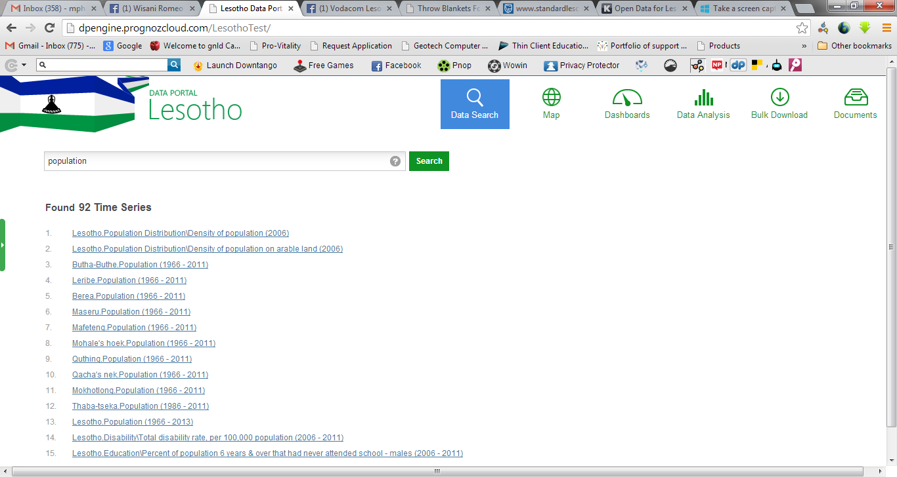

Slide 10
maps
The Map page of the portal enables users to visualize any indicator in any of several preset years on an interactive map of Lesotho
The Map offers several convenient functions
Searching an indicator in the indicators list
Viewing territory details
Using and configuring legends
Exporting the Map

Slide 11
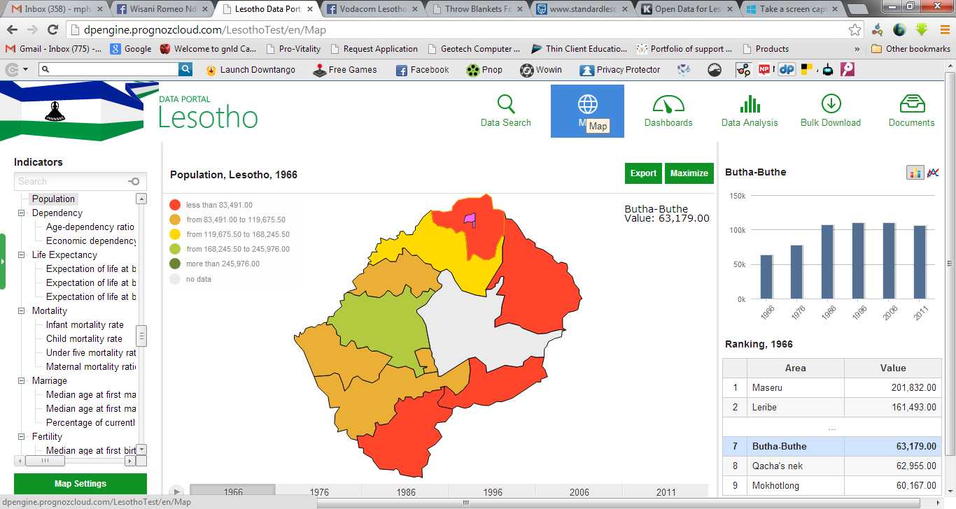

Slide 12
dashboARDS
The dashboards page of the portal shows tables, charts and maps for various indicators.

Slide 13
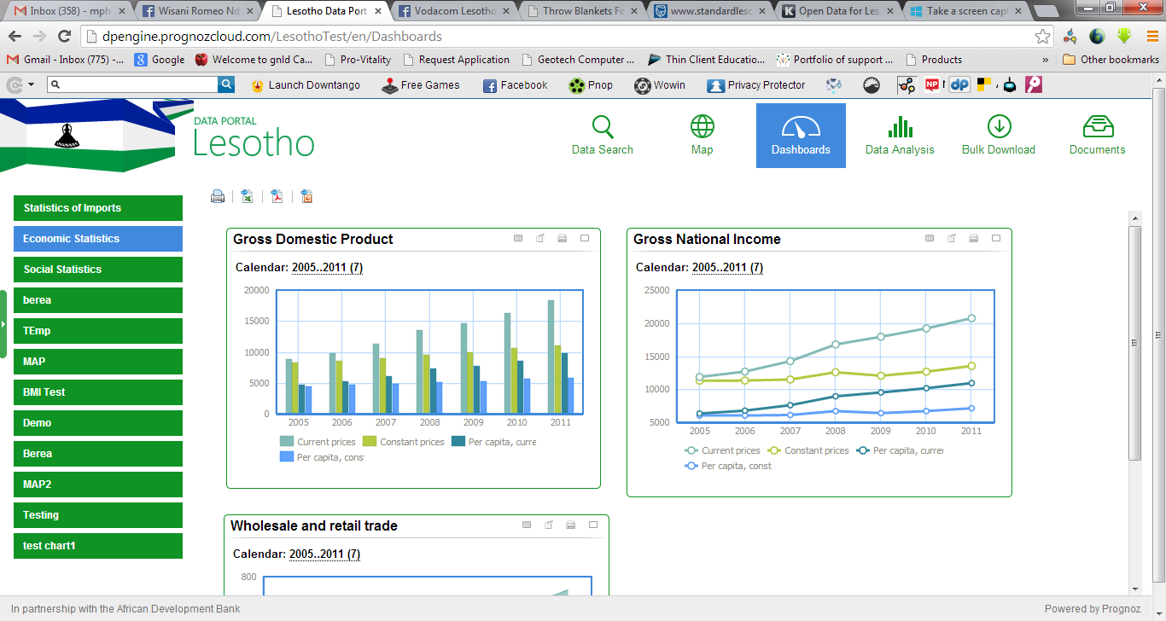

Slide 14
Data analysis
The data analysis page of the portal offers a powerful tool for slicing and visualizing the data.
The data is provided in several dimensions, such as Calendar, Items and Indicators

Slide 15
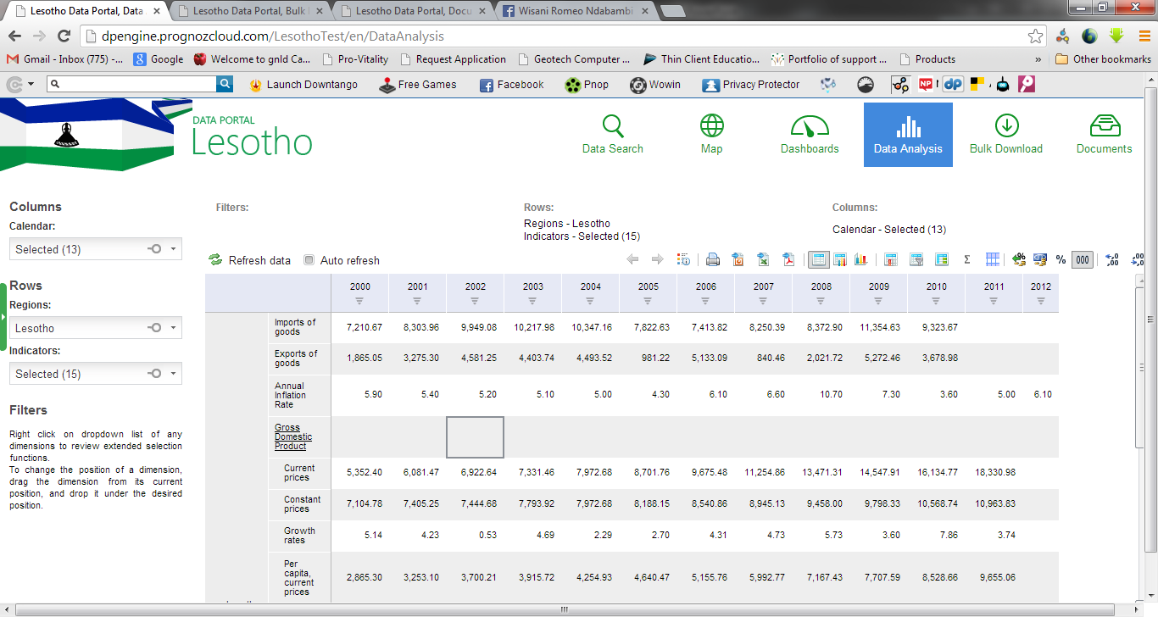

Slide 16
Bulk data download
The bulk download page of the portal provides users the ability to export data to TXT, CSV, XLS, MDB and DBF formats for further use in different statistical applications

Slide 17
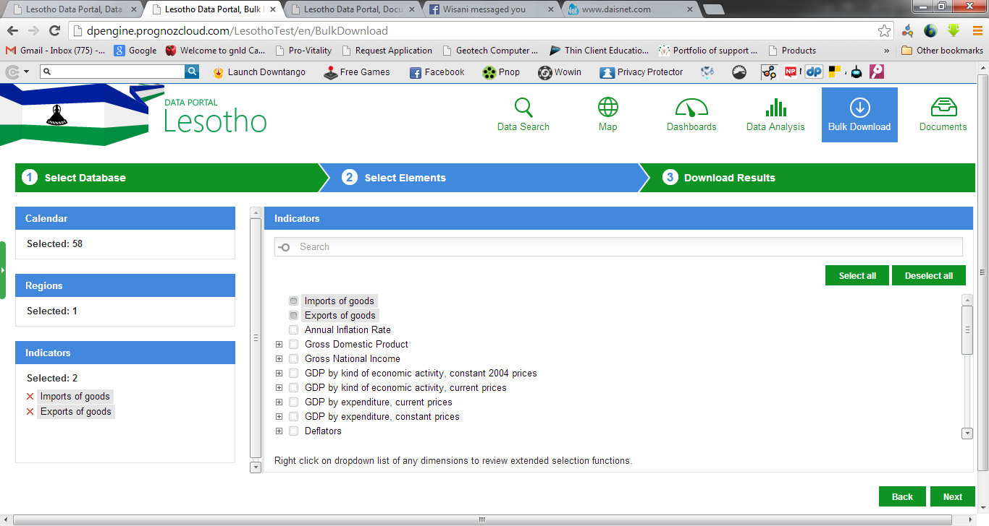

Slide 18
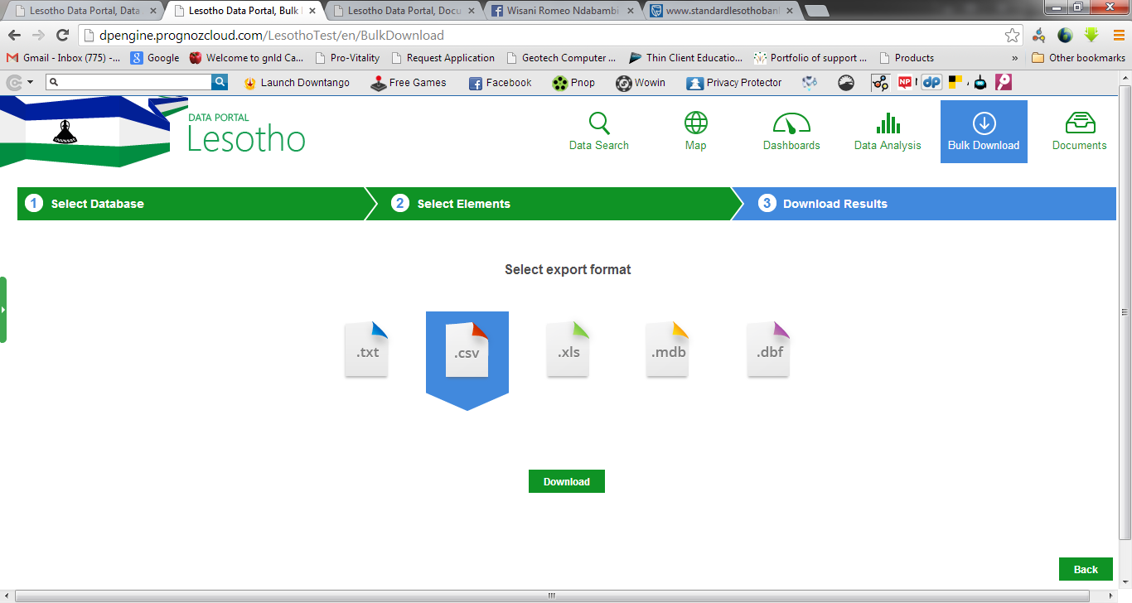

Slide 19
documents
The documents page of the portal enables the users to browse and download various documents and publications

Slide 20
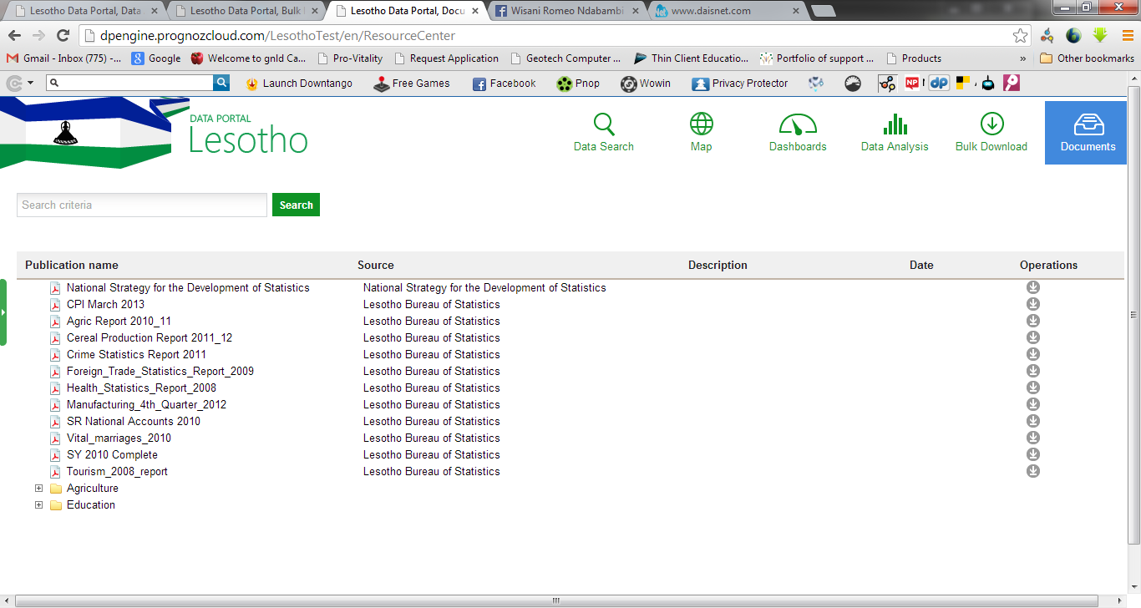

Slide 21
END OF THE PRESENTATION
THANK YOU

