Slide 1
National Study on Domestic Violence against Women Sharing Experience from Viet Nam
International Seminar on Gender Statistics
Incheon, Republic of Korea, 12-14 November 2013
Nguyen Thi Viet Nga
General Statistics Office of Vietnam

Slide 2
1. Context before the study
VN Gov. ratified several core international human rights treaties, including those on civil and political rights (ICCPR), economic, social and cultural rights (ICESCR), racial discrimination (CERD), gender equality (CEDAW) and child rights (CRC)
The 2002 CPRGS identified gender inequality and domestic violence as obstacles to development.
The Central Committee of the Communist Party issued Directive in 2005, which states that the government should “have in place specific plans and measures to prevent and combat domestic violence”.
2 laws on GE and DV but there is still a gap between the theory and practical implementation at all levels.
Data on VAW from reporting system is not reliable, some small-scale quantitative and qualitative study could not show a national picture of VAW
Notes:
Traditionally, domestic violence and intimate partner violence are considered sensitive and private issues in Viet Nam, a country with more than 80 million population.
However, several legislative and policy documents since 1992 address the issue and include measures to provide protection to those experiencing domestic violence and promote gender equality.
The 2002 Comprehensive Poverty Reduction and Growth Strategy identified gender inequality and domestic violence as obstacles to development and included as one of its objectives reducing the vulnerability of women against family violence. Subsequently, the Central Committee of the Communist Party issued Directive in 2005, which states that the government should “have in place specific plans and measures to prevent and combat domestic violence”.
There is still a gap between the theory and practical implementation at all levels
Some small-scale quantitative and qualitative study could not show a national picture of VAW
A sound legal framework on gender (DV law in 2006, GE law 2007)
One of the outcome Gov-UN Join Program on GE (2009-2011): Strengthened evidence-based data and data systems for promoting gender equality

Slide 3
2. Methodology and sample
Quantitative component : 4838 women in 63 provinces in Vietnam which representative for 6 regions in Vietnam
To provide data on prevalence, causes, consequences, coping strategies, risk and protection factors ....
Method: Population-based household survey – face to face interviews with women using structured questionnaire.
Sampling: Only one woman per household.
Qualitative component: 90 In-depth interviews and 12 Focus Group Discussions (in 3 provinces )
The research was initiated since June 2009 and the national report was launched in Nov 2010
Notes:
3

Slide 4
3. Questionnaire adaptation
Review of the WHO Multi-country Study survey questionnaire by the research team (version 10)
Translation of the questionnaire into Vietnamese from English
Sharing of the questionnaire with relevant authorities, experts, and other stakeholders working on gender in Viet Nam
Discussions, adaptation of the questionnaire
Pre-field testing of the questionnaire in Ha Noi and Tien Giang.
Finalization of the questionnaire (also during the training course).
Notes:
4
Safety of respondents
Increased resource needs: increasing the number of questions in the questionnaire means longer time required to complete one questionnaire. This also has implication on the total number of working hours required to complete the field data collection, as well as longer time required for training field workers
: It is not ideal to include various topics in efforts to capturing various information as each topic requires specific steps, questions, and set-up to collect reliable data to produce valid results. It may appear feasible and appropriate to include some topics (e.g. questions on child abuse). However, it can create a new set of issues which may not be appropriately addressed (e.g. what to do when a case of child abuse is found during the interview).

Slide 5
4. Identification of type of violence
The word ‘violence’ was not used, but a range of behaviour-specific questions (acts)
Women aged 18 - 60 years old were asked whether they have ever experienced behaviour-specific acts related to:
Physical violence
Sexual violence
Emotional abuse
Economic abuse
The term ‘ever married’ and ‘husband’ includes 1% of women who ever have other partners (dating/cohabiting).

Slide 6
Physical violence by husband Has your husband ever.....
Slapped or threw something at you that could hurt you?
Pushed or shoved you or pulled your hair?
Hit with his fist or with something else that could hurt you?
Kicked, dragged or beat you up?
Choked or burnt you on purpose?
Threatened to use or actually used a gun, knife or other weapon against you?
Moderate
Severe
Notes:
It is best to ask about specific acts. These are the acts that are asked about, one by one, to measure physical violence by current partner or any other partner (refer to slide). They are very similar to what is done in other studies.
For each of the acts she is also asked whether it happened in the past 12 months or before the past 12 months and how often this has happened (frequency).
In the analysis and presentation we make a classification in Moderate and severe as follows.
This classification is justified also because of the much stronger association with injuries. Although we should remember that this classification does not take into consideration the subjective suffering and impact on the woman.

Slide 7
Sexual violence by husband
Were you ever physically forced to have sexual intercourse when you did not want to?
Did you ever have sexual intercourse you did not want because you were afraid of what he might do?
Ever force you to do something sexual that you found degrading or humiliating?
Ever force you to have sex with another person?
Notes:
In the study for the measurement of sexual violence the respondent is being asked about the following acts:
Has your current husband or any other partner ever physically…..(see slide).
Last point > VN specific

Slide 8
Emotional abuse by husband
Insulted you or made you feel bad about yourself?
Belittled or humiliated you in front of other people?
Done things to scare or intimidate you on purpose, e.g. by the way he looked at her, by yelling or smashing things?
Threatened to hurt someone you care about?
Threatened to or thrown you out of the home?
Notes:
Last point > VN specific
Does not claim to be exhaustive so may not cover all

Slide 9
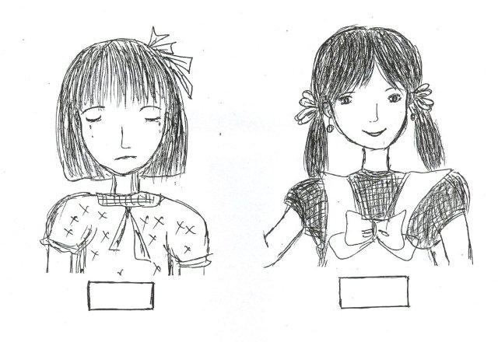
Physical violence after age 15 by others than husbands
Sexual violence after age 15 by others than husbands
Childhood sexual abuse (retrospectively asked before age 15 years) by others
Childhood sexual abuse 2nd opportunity
Notes:
Contexts, who, last 12 months, how many times
For CSA, age it first happened and age or perpetrator

Slide 10
Reference periods
Life time: did it ever happen?
Current/past 12 months: did it happen in the past 12 months?
Notes:
Reference periods for measurement of violence
Both time periods are important and reveal different aspects of the problem. The lifetime prevalence of violence (or “ever experienced violence”) measures whether a certain type of violence has occurred in her life, even if it was only once. In this sense, it is cumulative and, as per definition, it would increase with age. It reveals how many women experienced violence at some time in their lives. This is especially important for advocacy and awareness creation.
Prevalence in the 12 months preceding the survey (“current violence”) reflects types of violence only when they occurred in the past 12 months. This is by definition lower than lifetime prevalence because it measures only violence that occurred recently. The proportion experiencing violence in the past 12 months is significant in understanding the situation at one point in time: the present situation. This is significant for drafting intervention programmes (e.g. how many women would currently need services). The 12-month period is also significant for monitoring change to determine the impact of these programmes.
[Caution is always required with the interpretation of change of prevalence. Sometimes when awareness is increased, more women disclose violence and the prevalence rate will go up – which does not necessarily mean that the violence has increased.]

Slide 11
5. Safety & ethical issues
The name of study changed to “Women health and life experience”, term “violence” not used in any documents for culturally sensitive reasons
The guidelines on ethic and safety considerations from WHO applied strictly in all actions.
Confidentiality agreement: All staff signed a confidentiality agreement as part of their work contract
Informed consent: The invitation letter sent to selected women explained the elements in the informed consent: confidentiality, voluntary participation, right to refuse to answer, etc.
The set of materials was given to the interviewed women well in advance
One woman per household , One site, one day
Interview venues: in a neutral location instead of the homes
…..

Slide 12
6. Training schedule
Week 1
Sensitization to concepts of gender and violence
Exposure to support options for women living with violence
Aim and overview of the study questionnaire
Interviewing techniques and safety measures
Week 2
Sampling procedures, including repeated visits to reduce non-response
Pilot testing of questionnaire/module and all field procedures, including logistics, safety measures, supervisory procedures, debriefing and feedback sessions
Final adjustments to questionnaire and field procedures
Separate sessions for supervisors on supervisory procedures

Slide 13
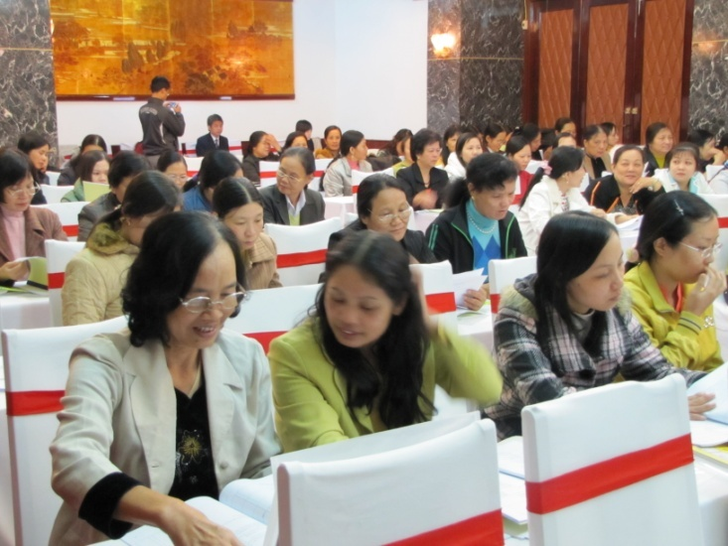
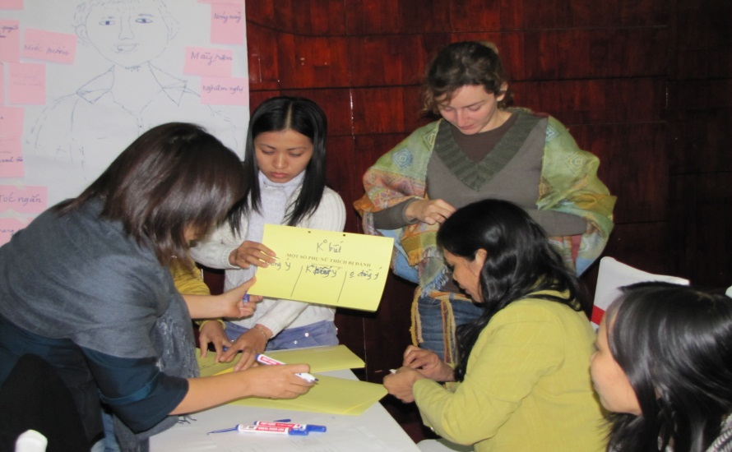
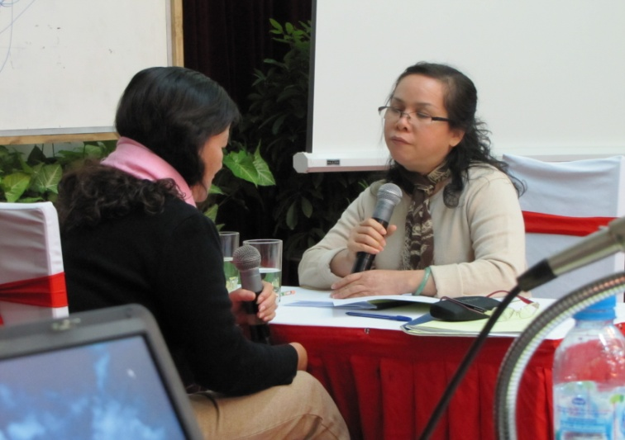
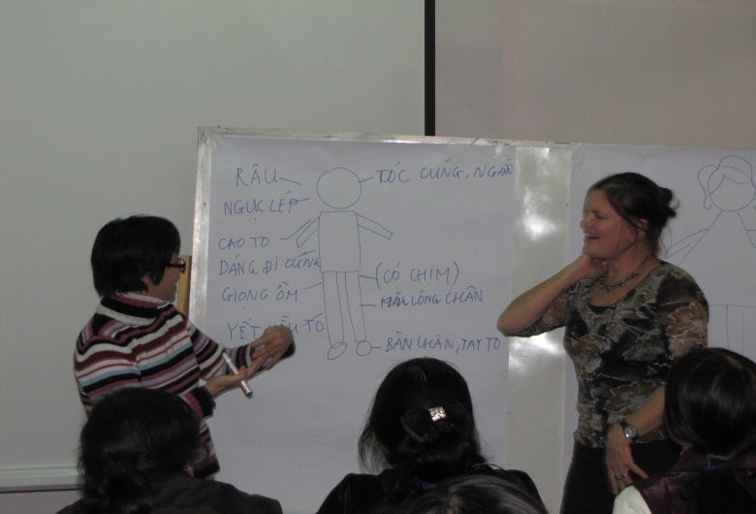
Traiing & Pilot test - preparations

Slide 14
7. Staff mobilization
Field workers were mobilized from PSOs and GSO
Field workers must be female,
Age between 30 and 60 years old.
Ability to interact with all classes of people, maturity and life experience
71 Fieldworkers were selected for the fieldwork.
Field team composition: team leader, editor, 3 interviewers
Notes:
14

Slide 15
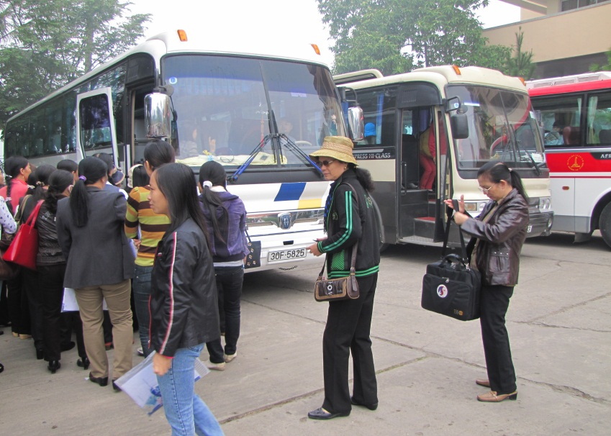

Slide 16
8. Key Findings
“He beat me, then he pulled me like a dog from gate to inside house, my hair was messed up… My god, he took the small chair from the dining table, he took a brick to beat me… He took off his shoes and threw them at my face, that was painful. I ran away but I could not run fast enough, he took the chair and threw it towards me. …”

Slide 17
Prevalence of ever-physical, sexual and or emotional violence by husband, among ever-married women, by region, Viet Nam 2010 (N=4561)
Notes:
Main indicator of partner violence globally: including physical or sexual violence
Nationwide: 32% ever physical violence by husband
10% sexual
34% both (and/or) > 1 in 3 (as elsewhere)
By region: wide variation. But always 3-4 times more women reporting lifetime physical than sexual.
Combined is only slightly more than sexual: thus most who report sexual also report physical
17

Slide 18
Prevalence of moderate and severe physical violence by husband, among ever-married women, by age, Viet Nam 2010
Notes:
Severity: same graph as before: lifetime physical – which proportion of violence is severe? One third to one half, this means more than a slap, but severe acts – a large proportion

Slide 19
Prevalence of violence by persons other than husband, among all interviewed women, Viet Nam 2010
Notes:
Differences in nature:
Perpetrators of phys and sex are usually different.
Sometimes one off assaults (not repeated)

Slide 20
Perpetrators of non-partner physical violence, as reported by women who experienced such violence (since the age of 15 years)
Notes:
Mainly family members

Slide 21
Percentage of abused women injured due to physical or sexual violence by husband, Viet Nam 2010
Notes:
Direct impact: injuries
26-27% ever injured among those who experienced violence
Injuries are evidence for severe violence
Half of them hurt enough to need health care (part only got)
Half telling the real reason to health care staff

Slide 22
Proportion of women who told someone, among women who experienced physical or sexual violence by husband, Viet Nam 2010 (N=1546)
Notes:
50% ưho never told to any one

Slide 23
“When he threatened me too much, I went to village headman to ask for support. However, he did not listen to me. He said ‘This is your family matter. You can do what you want’.”
Notes:
When they sought help they often did not feel helped and pushed back into enduring...

Slide 24
Proportion of women who sought help from official agencies, among women who experienced physical or sexual violence by husband,
Viet Nam 2010 (N=1546)
Notes:
Nearly 90% (87) victims of DV, who never seek help from any official agencies.
Women are keeping silence...

Slide 25
9. More than a number
Interviews complete after 1.5 hour (85min)
Questions on feeling of interviewees after interview completion
(better, the same or worse after interview)
80% respondents felt better after the interview.
90% victim of violence stated that they felt better after the interview
99% agree to be contacted again.
25
Notes:
25

Slide 26
More than a number… (cont.)
“I feel a lot better having talked with you. I could not figure out why I told you all these secrets of my life that even my mother is not aware of. I thank you very much for listening to my unhappy stories. I’ll take your advice. I will not kill myself."
“I think women who suffered from violence should raise their voice and ask for help or for counseling. It can vary case by case but we should not keep silent. Keeping silent is dying.”
Respondents in quantitative component
26
Notes:
26

Slide 27
More than a number…
“I did not sleep that night and in my mind was still the image of the woman who had been beaten up by her husband and traumatized spiritually".
“I kept recalling her eyes and her face when she told me about her story of misery...“
“She came to see me hoping to get help. Since I could not help her directly in any way I felt so bad and kept thinking of her. It’s been more than 5 months since the survey ended I still can not get over the terrible feeling of not have been of any help.“
Quantitative interviewers
Notes:
27

Slide 28
Challenges in ata dissemination
Ensure that findings are properly interpreted and used to advance policy and intervention development
Strong National ownership of the data and the findings
Sharing findings and lobby activities:
in confidential ways
in official documents
with official seals
Plan for safeguarding of Master database (where is it kept, who has access, who is responsible for giving permission to use; prepare policy on use of data
Raw data and follow up activities: remember ethical issues of confidentiality
Notes:
Lobbly activities in Vietnam (English and Vietnamese?!)
Properly interpreted: New Zealand case or in VN: EM, costing and other studies
Raw data and follow up activities: New Zealand case and Vietnam (back to field? And chase victim about their use of service?

Slide 29
You can find the report at
http://www.gso.gov.vn/default_en.aspx?tabid=487&ItemID=10693
THANK YOU!

