Slide 1
Changing the terms of economic and policy debates: the importance of collecting and archiving time use surveys in the promotion of gender justice
Kimberly Fisher
Centre for Time Use Research
Department of Sociology, University of Oxford

Slide 2
125 years of time use surveys
Many large scale time-use surveys 1930s-1960s (Mass Observation in UK, USDA farm surveys, BBC & NHK surveys, Szalai multinational project) – but these obscure
lack of tools to analyse data (until recently)
challenged economic blind spots
association with unfashionable progressive research

Slide 3
Economic blind spots
Economic policy as developed in the 20th century assumed
Complete separation of domestic & public spheres – things in the domestic sphere have no policy relevance
Things of importance to policy makers have unambiguous financial value which over-rides other associated value
We only need to measure financial value to understand societies

Slide 4
Notes:
Friedan Feminine Mystique; Vanek Scientific American, Szalai 65

Slide 5
Radical challenge of time use
Basic assumptions from early applications of large-scale time use studies 1900-1940s
To understand behaviour, you must consider activity patterns in total – the focus on isolated elements distorts and obscures the picture
All activities are important research subjects
Domestic activity which had been ignored made visible & part of political agendas

Slide 6
Wider implications for gender research
Significance of measuring unpaid work well-covered in this conference, but other gender issues arising in current developments in time use research
Methodology collects gendered information people do not recognise consciously
Gender dimensions of national well-being accounts
Gender dimensions of environmental research
Rethinking work-life balance

Slide 7
Collecting information people do not recognise consciously
Valuing care activities and unmasking the time commitments care requires which carers themselves do not recognise
Can help identify need for services and support to protect the well-being of older women carers – with Michael Bittman, Trish Hill, & Cathy Thomson
GPS tracking methods picking up gendered dimensions of movement people do not notice

Slide 8
Movement & synchronicity as measures of integration
Whether people with disabilities access a range of public spaces
Whether ethnic or religious minorities, single mothers, older people, immigrants, Lesbian Gay Bisexual & Transexual make the same use of social spaces, services, shared leisure time

Slide 9
National well-being accounts
Subjective wellbeing (SWB) increasingly recognised as an alternative indicator of personal and societal progress (as opposed to GDP and other financial and resource-based measures - Stiglitz Commission agenda)
SWB retains the social elements of society rather than reducing societies to commodities and consumption (Easterlin paradox)

Slide 10
National well-being accounts
Distinction between ‘life-domain/generalised’ vs ‘emotional/hedonic’ wellbeing
How happy/satisfied are you with your life in general? (Easterlin, Oswald, Helliwell)
How much time do you spend doing enjoyable activities? (Kahneman & Kruegar, Juster & Stafford, Robinson, Gershuny)

Slide 11
National well-being accounts
Cross-national comparability problems
Lose link between policy impacts on daily routines & association between routines & emotions
Behaviours (& associated emotional responses) occur in bounded cycles rather than sequences of isolated units
Policy interventions have knock-on consequences
Cannot know if emotional change correlated with policy-influenced behaviour change reflects the policy or knock-on consequences

Slide 12
Gender in national well-being accounts
Gender consequences of high importance in national well-being accounts – the experience of all activities - including those performed largely by women – matter in national rankings and assessment of progress
Highlights gender consequences of policy changes and regularises gender concerns

Slide 13
Gender & environmental impact of daily behaviours (research with Roujman Shabazian & Mohammad Sepahvand)
While more women in state-level politics is associated with higher-levels of environmental policies in the USA
More women in managerial roles and professional jobs is associated with lower-levels of environmental legislation
% of elected state officials who are women | 1.626 | **
% managers/professionals who are women | -1.508 | *

Slide 14
Gender & environmental impact of daily behaviours
Diary data offer an essential element in the mix of research monitoring human impact on the planet as reveal how people change total behaviours, not merely considering individual behaviours in isolation
Diary data also reveal complexities between care for people and care for the planet – the gender & environmental inclination links are complex

Slide 15
Gender & environmental impact of daily behaviours
Changing behaviours to reduce impacts on the planet also has potential to change power dynamics between groups in societies, and diaries offer one significant tool to measure the gender dimensions of such shifts

Slide 17
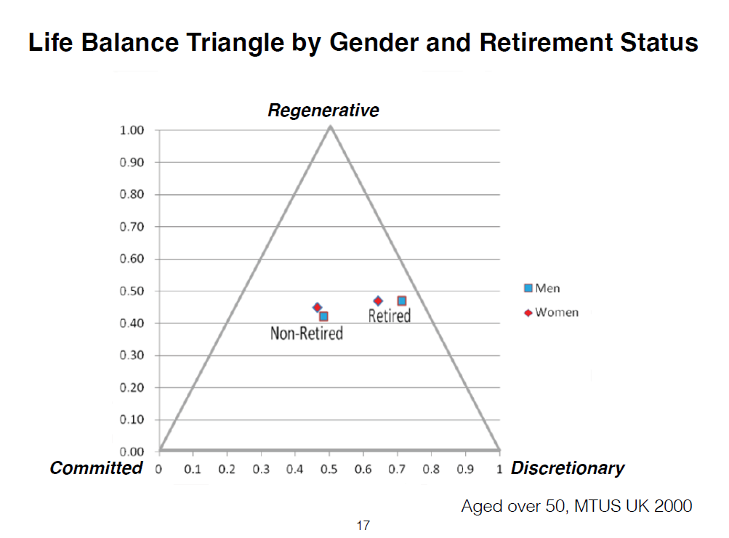

Slide 18
Time diaries matter in gender research
Time diaries collect comprehensive pictures of human behaviour, fill in gaps ignored by conventional economics – particularly those blind spots that have led to invisibility of gender in public policy
Collect gendered aspects of behaviour that people do not register consciously
Reveal many dimensions of social change for women and men

Slide 19
Diaries matter in gender research
Change in gender relations slow – data have long useful life
Older datasets obscure and difficult to access – but they are there – we have the historical time series to make significant investigations if we restore and use these resources
Essential to archive and preserve access to time use data to monitor and understand changing gender relations

Slide 20
Time Archives Introduction
Centre for Time Use Research
University of Oxford, UK
http://www.timeuse.org/

