Slide 1
Improvements in the 2014 Korean Time Use Survey
Jehyeok Choe & Jonghee Choi & Uiyoung Kim
(Statistical Research Institute)
2013. 11.

Slide 2
Contents
1. Description of KTUS
2. Sample Design for the Previous KTUS
3. Improvements in Sample Design for the coming 2014 KTUS
4. Improvements in Classification of Activities for the 2014 KTUS
5. Conclusion

Slide 3
Description of KTUS
Objectives
To provide basic data required for understanding people's life style and their quality of life by measuring how people spend a 24 hour period
To understand time spent on unpaid housework to analyze the economic value of housework and to provide basic data required for integrating the satellite account of households into the national account system
To provide basic data for establishing various policies related to work and family equilibrium, labor, welfare, as well as for academic research.

Slide 4
Description of KTUS-2
History
 | 1999년 | 2004년 | 2009년 | 2014년
Sample Size | 17,000hhlds (43,000persons, 86,000 diaries) | 12,750hhlds (32,000persons, 64,000diaries) | 8,100hhlds (21,000persons, 42,000diaries) | 12,720hhlds (31,800persons, 63,600diraries)
Sample Frame | Economically active population Survey | Economically active population Survey | 2008 social survey | -
The number of surveys per year | One survey(Sept.) | One survey(Sept.) | Two surveys (Mar.& Sept.) | Two or three surveys per year

Slide 5
Description of KTUS-3
Target Population
All residents living in households in Korea aged 10 years and over
Periodicity : every 5 years
Sample Size (base on 2009)
21,000 persons
All household members aged 10 years and over of 8,100 households from 540 Enumeration Districts (15 households per ED)
Data Collection Methods
Questionnaires : Face to face interviews
2 days of diaries: self-recorded
Record their own activity for two consecutive days in 10 minutes intervals

Slide 6
Sample Design for the Previous KTUS
Sampling Design
Stratified two stages cluster sampling design
Stratification of ED: 25 strata based on 16 metropolitan cities/provinces and Eup(town), Myun(township)/Dong
Stage1: Selection of independent samples of EDs from each stratum through a pps sampling design
Stage2: Select households from a selected ED using simple random sampling and measure all the eligible household members in the selected household
*ED: Enumeration Districts(consist of 40~60 hhls)
Limits of the Previous 3KTUS
Difficult to evaluate the seasonal effect due to the lack of representativeness
March and September in 2009 share the same environmental characteristics
→ Need to sample representative data collection periods

Slide 7
Improvements in Sample Design for the 2014 KTUS
Relationship between temperature and activities(as of 2009 KTUS)
Time spent on sleeping, working and watching TV reduce as temperature goes up, excluding housework

Slide 8
Improvements in Sample Design for the 2014 KTUS
Relationship between rainfall and activities(as of 2009 KTUS)
Time spent on sleeping, housework and watching TV increase as rainfall goes up, excluding working

Slide 9
The Pattern of Spending Time on Activities
Varies
as the Weather Changes

Slide 10
Improvements in Sample Design for the 2014 KTUS
The optimal number of strata
summer, winter, and hot fall
As result of cluster analysis, 2~3 strata shows optimum

Slide 11
Improvements in Sample Design for the 2014 KTUS
Stratification of days to fully represent the whole year
Stratification of days using cluster analysis
Clustering variables: Weather during five years from 2008 to 2012( temperature, rainfall, wind speed, humidity, sunshine duration, cloudiness etc.)
Similar results from Principal Component Analysis considering the correlation among variables
2 strata of days: summer and the rest
April, August in 2014
3 strata of days: summer, winter, and hot fall
July, September and November in 2014

Slide 12
Improvements in Sample Design for the 2014 KTUS
Ongoing research
Selection of survey periods(10~14days)
Optimal sample size of ED and households
Construction of weights for data analysis
Decide 2014 KTUS sample frame
using 2013 the Social survey sample frame or KTUS’ own sample frame from the population and household census
Patterns of diary days-dates by group in the 2009 KTUS

Slide 13
Improvements in Classification of Activities for the 2014 KTUS
Classification of activities is crucial in the analysis of time use data
Consideration of improvement
Reflect on social trends
Maintain backward comparability
Improve international comparability with time use data among different countries; HETUS classification, MTUS classification, Revised UNSD’s ICATUS

Slide 14
Improvements in Classification of Activities for the 2014 KTUS
Procedures for preparing the 2014 KTUS classification of activities
Literature reviews & benchmarking international classification
Gathering opinion from KTUS users
Writing up the 2014 KTUS classification draft
Revising the draft
Meetings with current/previous staff of KTUS (checking difficulties in practice)
Meetings with outside experts/KTUS users (checking the balance between backward comparability and the need for improvements)
Conducting a pilot survey (Sep. ’13)
The Korean Official Statistics Committee meeting (’14): finalizing the 2014 KTUS classification of activities

Slide 15
Improvements in Classification of Activities for the 2014 KTUS
Benchmarking HETUS, ICATUS, and MTUS for international comparability
Efforts for detailed measure for Unpaid Work
Childcare : adding a 2-digit category for care of elementary school l children in
lower grades
Volunteering : widening the scope of volunteering activities
Added items reflecting changes in social trends
Pet care (added in the 2-digit category)
Purchasing services for domestic works (added in the 3-digit category)
Using smart devices (added in the time use diary)
In accordance with international concept: “With whom” (who did the main activity with → who were with)

Slide 16
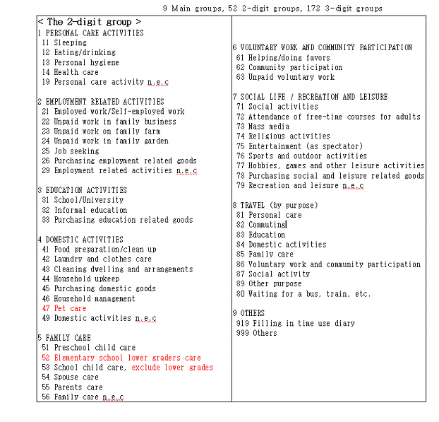
Improvements in Classification of Activities for the 2014 KTUS

Slide 17
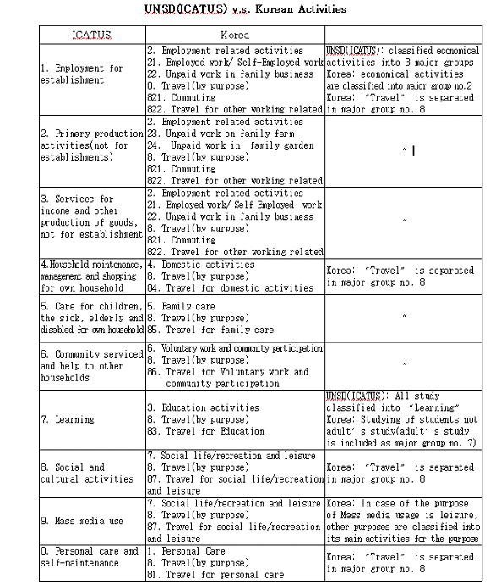
Improvements in Classification of Activities for the 2014 KTUS

Slide 18
Conclusion
To achieve valid time use results
Select a sample of days that represents the whole year survey periods
Decide optimal sample size of ED and households
Decide survey periods of 10 days or 14 days to cover each day

Slide 19
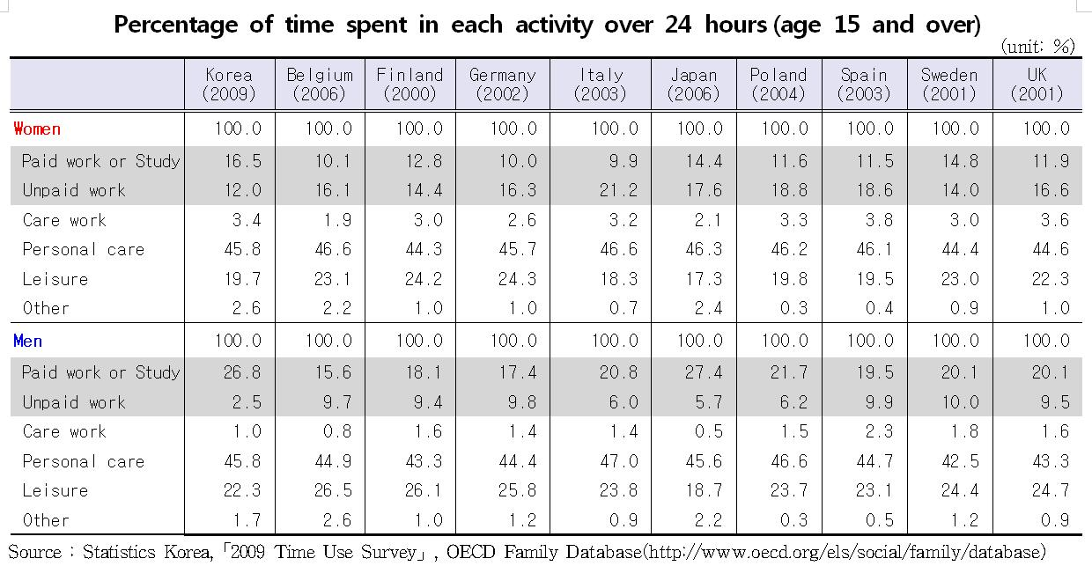
Appendix-Results of 2009

Slide 20
Appendix-Results of 2009
4.8
1.4
3.4
4.2
1.5
Notes:
Compared to time spent in each activity through the
In almost all countries, women spend more time on Unpaid work and care work than men.
For unpaid work
Korean women spend 4.8 times more than men in 2009 with recording the largest differences while Sweden recorded the smallest differences with 1.4 times more than men
For care work
Almost countires, Women spend at least twice as much time on care work than men. The largest differences are recorded for Japan and Korea where women spent on average 4.2 and 3.4 times more time on care work than men, respectively. While the smallest diff is recorded for Spain average 1.5times more than men
Unpaid work

Slide 21
Thank you
Q/A

