Slide 1
The Role of Statistics in relation to the WLB Policy and it’s Implementation
International Seminar on Gender Statistics 2013
12 Nov. 2013
Seung-Ah Hong(KWDI)

Slide 2
Contents
1
1
Introduction: Degeneration of Low Fertility
2
2
The Dual-Earner Family and WLB
3
3
Work-Life Balance among Korean Men and Women
4
4
WLB Policy: Focused on the Parental Leave
5
5
Some Suggestions

Slide 3
Ⅰ. Introduction: Degeneration of
Low Fertility

Slide 4
Degeneration of decreasing fertility
Is there a possible connection between policies of parenthood and fertility?
Low fertility as a universal social problem
Many countries struggle to respond to the low fertility with family and gender policies
Recent Policy Agenda focused on WLB of working parents, especially young generation
Low fertility shares its roots with WLB

Slide 5
Low Fertility
No desire to childbirth
Childbirth
Childrearing difficulty
Childrearing
Childcare cost
Childcare Cost
Child meaning
Child meaning
Designed by Guild Design Inc.

Slide 6
Demographic Changes(TFR, 1970~2010)
Korean society has witnessed a drastic fall in the fertility rates over the past four decades.
source: Statistics Korea

Slide 7
Changes in the Labor Market
Women’s labour market participation has remained below 50% for the past two decades
source: Statistics Korea

Slide 8
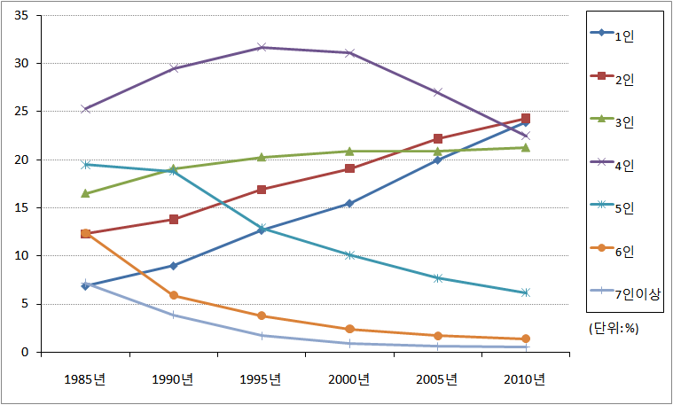
Changes to Family
Family structure is shrinking, while nuclear families is increasing rapidly
Nuclear families divided into smaller structures, such as elderly couples, or one-person households
source: Statistics Korea

Slide 9
Ⅱ. Dual-Earner Family
and WLB

Slide 10
Background
Lisbon Strategy(EU)
Participation of women in economic activities is indispensable for a sustainable development and growth.
Noticeable change at present is that women’s childbirth and childrearing is no longer affecting women attaining a lifetime employment.
Dual-earner families contribute to household finance and are effective in reducing child poverty (Esping-Anderson, 2002).
Lack of care within family - “Care-deficit”

Slide 11
Dual-earner Family and WLB
Women’s responsibility of childreaing causes a fatal influence on women’s economic activities such as career interruption, vulnerable situation in the labour market.
The young generation emphasises their work as life-long task and need several ways the can get the Balance btn work and family life.
WLB is an increasingly important issue nowadays, especially for working parents and potential parents.

Slide 12
WFB Work-Family Balance Policy
Work-family balance policy
“Social policy for supporting working parents as it helps parents
with young children reconcile both their work and family life”
For women, by alleviating childrearing burden on a family, they can maintain their career.
For men, it provides the opportunity and time to participate in childrearing.

Slide 13
Work and Life Balance
Three Pillars
Childcare Policy
Working Time Policy
Leave Policy
Availability of service
Affordability of service
Access of service
Reduction of Working Time
Flexible Working Time
Part-time work
Maternity Leave
Parental Leave
Paternity Leave
Family Care Leave

Slide 14
Ⅲ. Work-Life Balance among Korean Men and Women

Slide 15
Working parents and WLB in Sweden, the UK and Korea
(Hong, etc., 2009)
Countries& firms
Sweden, UK, Korea
Wholesale/retail Service and IT industry
Interviewees
Employees who are taking care of children under 12 years
Survey
Sample
Sweden(413)
UK(400)
Korea(800)
Time
2009. 6. ~ 8
face to face interview

Slide 16
Working Time and Family Time of the Dual-Earners Couples
(Hong & Kim, 2011)
Region
Methods
Cases : 1,500 persons
Working parents who care
children under 13 yrs
Period
2011.3.25-3.31
Cases
Period
Survey
Region
Seoul, Busan, Daegu,
Inchon, Gwangju, Daejun,
Ulsan
Methods
Web Survey

Slide 17
Changes of women’s work attitudes
source: Statistics Korea

Slide 18
Working Life and Family Life
Time Balance
Paid/unpaid working hours
Division of Domestic work
Family Time
paid work
caring children
cooking and domestic work
Responsibilities of cooking and housework
family time on weekdays
Numbers of dinner with
family members
Designed by Guild Design Inc.

Slide 19
Paid and Unpaid Working Hours of Workers in Sweden, the UK and Korea
People would like to make the balance between working and family life.
The working hours was divided into paid and unpaid working hours.
Men work more hours in the labour market but less hours at home than women.
Women work more hours at home but less hours in the labour market than men.

Slide 20
Paid and Unpaid Working Hours of Workers
in Sweden, the UK and Korea
Sweden
Caring & helping children with their study
Cooking &
other housework
UK
Caring & helping children with their study
Cooking &
other housework
Korea
Caring & helping children with their study
Cooking &
other housework
Sweden
Caring & helping children with their study
Cooking &
other housework
UK
Caring & helping children with their study
Cooking &
other housework
Korea
Caring & helping children with their study
Cooking &
other housework

Slide 21
Gender division of labor in the household
If the burden of childrearing and housework is concentrated on one side, it provides the structural environment to incur women’s job interruption.
Comparing the gender division of three countries, Swedish workers are equally sharing the housework, Korean workers show the most unequal division of labour between men and women.
These are the main factors that discourage women’s possibility of WLB.

Slide 22
Working time and Family time
source: Hong, et al.(2009)
source: Hong & Kim(2011)

Slide 23
Family Time
The appropriate amount of time to share with family is indispensable to make the harmony between work and family.
Swedish workers spent more than four hours a day with family, while British and Korean workers answered that they spent more than 2 hours but less than 4 hours per day with their family.
Also, it is important that how many times do they have dinner with their family members at home. The results notify that Korean workers are suffering from not only the lack of time to share with family but also the poor conditions to make chance to be with their family.

Slide 24
Comparison of Family Life: days having dinner with family
source: Hong, et al.(2009)

Slide 25
Preferred Work Schedules by working parents and their children
Source: Hong & Kim (2011)

Slide 26
Ⅳ . WLB Policy : focused on the Parental Leave

Slide 27
Policy for Work-Family Balance: Parental Leave
Korea's work-family balance policy has two characteristics:
Firstly, social interest in work-family balance and policy concerns started to develop later than other OECD countries.
Secondly, nevertheless, the development and introduction of the system have been accelerated.

Slide 28
Policy for Work-Family Balance: Parental Leave
Parental Leave
2007 ~
1988 ~ 2006
1 year of Childcare leave to each parent (2008)
Childcare leave (<6 years) (2008)
Flexibility in usage(2008)
Paternity leave (2007)
Flat rate payment → Pro rata pay
(2010)
1953 ~ 1987
Eligibility for men to use childcare leave(1995)
Paid maternity/ childcare leave (2001)
Childcare leave (<3 years)
Introduction of maternity leave (1953)
Introduction of unpaid childcare leave (<1 year) (1987)

Slide 29
Policy for Work-Family Balance: Parental Leave
Maternity leave, childcare leave, paternity leave and family care leave implemented after the revision of policies in 2001.
Since several revision, the law offers the flexible options for working parents, one-year leave, the right to shorten work hours for childcare, pro rata paying system, etc.
In spite of the rapid policy development, the number of workers using the leave policy has been on a steady rise.

Slide 30
Usages of parental leave by gender
unit: persons, days
 | 2005 |  | 2010 |  | 2012
 | women | men | women | men | women | men
users | 10,492 | 208 | 40,913 | 819 | 62,279 | 1,790
ratio | 98.1% | 1.9% | 98.1% | 1.9% | 97.2% | 2.8%
average days | 211 | 185 | 281 | 240 | 289 | 238
source: Ministry of Employment and Labor

Slide 31
Usages of Maternity / Childcare Leave by gender
source: Ministry of Employment and Labor

Slide 32
Parental Leave: Perception, Implementation, Usage
source: Hong, et al.(2009)

Slide 33
Childcare Policy
1991
2010
2004
2005
public aid recipients
public aid recipients
Public aid recipients
low-income family
low-income family
children of single-parents
children of single-parents
children of disabled parents
children of disabled parents
multi-cultural family
working parents

Slide 34
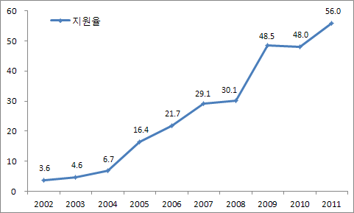
Childcare Policy
unit: %
<Figure> Change of the childrens’ rates who benefit public-fund
No. of children benefit public-fund(0~4세)
총 아동수(0~4세)
Notes: rates=
source: Statistics Korea, Ministry of Health and Welfare

Slide 35
Policy development and it’s Implementation
Four points
Korea was relatively late in paying social and policy attention on reconciliation of work and family
Rapid policy development within short period
Korean policies also experienced the same path as other countries
The remaining problem we have to solve is to encourage and strengthen the policy implementation

Slide 36
Ⅴ. Some Suggestions

Slide 37
Women’s work and WLB
When we move on to the women’s employment, the importance of WLB should be emphasized.
WLB policies might be policies to support women’s labour market attachment by providing supports to their pregnancy, childbirth and childcare.
The Swedish WLB policies have two pillars: the Swedish welfare model and gender equality.
The UK case, although the UK cannot be told as a country with developed WLB, the government has provided the foundation of WLB such as flexible working hours, part-time employment, etc.

Slide 38
Some Suggestions
There should be a role of statistics to show how many women are interrupting their jobs due to childcare, especially in relation to the childrens’ age, the number of children, etc.
(Example)
Women’s Employment rate by the number of children, the age of the youngest children, etc.
Women’s Interrupting Rates and the rate of returning their jobs
The Change of the Job Status due to their job interruption

Slide 39
Some Suggestions
There should be a role division and sharing responsibility between
government and businesses.
Sweden
Parental Insurance: Deals with related finance issues and
administration process
Firms: Allow time-off for employees and alternative
human resource can be employed in short-term

Slide 40
Some Suggestions
In order to settle parental leave system, socio-cultural change is necessary.
To encourage the use of parental leave, business culture and social environment is important.
In case of Korea, “5 working days per week”,
which is enforced since 2004, should be more widely applied to form
the foundation of parental leave system

Slide 41
Some Suggestions
Procedural effort to induce corporate participation and cooperation is needed
To the extent the market accepts, a strategy for creating measures concerning coexistence of both work and family life are needed.
In England recently, in order to motivate work-family balance policy,
the government is encouraging voluntary participation of businesses,
rather than imposing heavy restriction

Slide 42
Some Suggestions
Roles and attitudes of business are also important
According to research conducted by European countries Tactical opposition of businesses and employers makes it difficult to take a parental leave
Employees also point out that long working hour is the biggest obstacle
(Stancanelli, 2003; Sundstrom & Duvander, 2000).
Research in Korea also shows that at a firms’ viewpoint family-friendly recruitment policy reduces cost of recruiting and maintaining human resources, and also has other advantages such as increasing employee’s job satisfaction(Kim, 2001).

Slide 43
Thank You

