Slide 1
19th ICLS revised standards: Statistics of work, employment and labour underutilization
Elisa Benes
benes@ilo.org
ILO Department of Statistics

Slide 2
Forms of work
New reference concept Work
Covers ALL productive activities
Maintains coherence with 2008 SNA
Employment definition refined
As work for pay, profit
Measured based on existing principles
Other forms of work measured separately
Own-use production work
Unpaid trainee work
Volunteer work

Slide 3
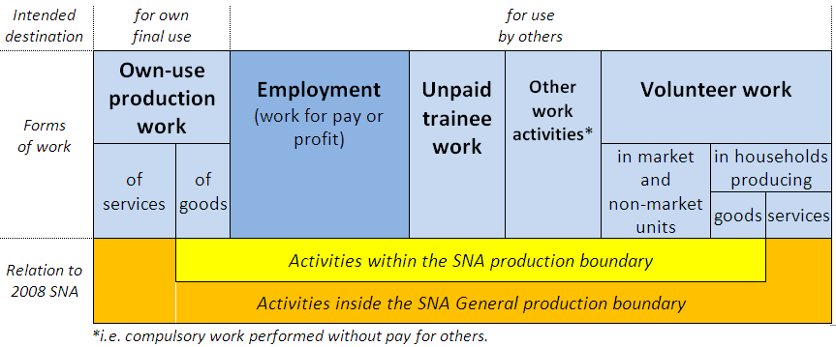
Forms of work
Reference concept for Labour Force statistics
Work: “Any activity performed by persons of any sex and age to produce goods or provide services for use by others or for own use”

Slide 4
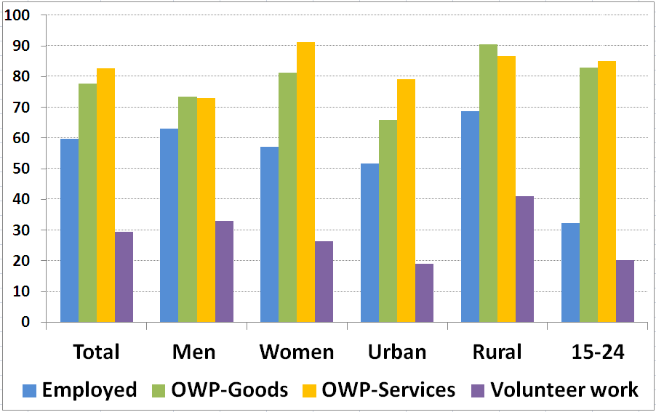
Participation in each form of work, %WAP (Liberia, 2010)
Source: ILO calculations based on national data (2010)

Slide 5
Measurement approaches: As per objectives & source
Short reference period(s)
1 week / 7 days - 1 month / 4 weeks
1+ hours of work activity
Long reference period(s)
12 months, year, season, ...
Recall (month-month, job/activity)
Broad working time categories (FT / PT)

Slide 6
Classifications of WAP: Two alternative classifications
Labour force status
In short reference period
Activity principle, 1-hr criterion, priority rule
Main form of work
In short or long reference period
Priority to any form of work over other activity
As self-declared

Slide 7
Labour force status classification
Employed (for pay/profit)
Unemployed (seeking + avail.)
Outside the labour force
Seeking, not available
Available, not seeking
Others, want work
Others, do not want work
Labour force
Extended
labour force
Potential labour
force

Slide 8
Labour force status: As per current standards...
ALL OTHERS, whether or not:
ALL who work for pay
-Provide services for own final use
ALL who work for profit
-Volunteer providing services for others
ALL who work for training
ALL who produce goods
for own final use
ALL who volunteer for org.
ALL who volunteer to produce goods for others
Without employment
Persons in employment
Unemployed
Inactive

Slide 9
…Labour force status in revised proposal
ALL OTHERS > age, whether or not:
ALL who work for pay
-Provide services for own final use
ALL who work for profit
-Employers
-OAW in market units
-Contributing family workers
-Members of market producer coop.
-Volunteer providing services for others
-Work unpaid for training
-Produce goods for own final use
-Volunteer through / for organizations
Volunteer producing goods for others
Without employment (for pay/profit)
Persons in employment (for pay / profit)
Unemployed
(seeking + available for work for pay/profit)
Outside the labour force
Underutilized labour
(with unmet need for employment (for pay/profit)

Slide 10
Labour underutilization
Working age population
Labour force
Outside the labour force
Employed (for pay/profit)
Unemployed
Potential
Labour Force
-seeking, not available
-available, not seeking
Time-related underemployed
Others:
-want
-do not want
Labour underutilization
(unmet need for employment)

Slide 11
New indicators highlighted as part of national set
Labour underutilization (LU1-LU4)
As headline measures with unemployment
Focus on insufficient quantity of work for pay/profit
% Subsistence foodstuff producers
To monitor extent, trends & highlight for policy
To assess issues with labour market integration
Headline measures for other forms of work
% Own-use producers of goods by activity
% Own-use providers of services by activity
% Unpaid trainees by programme type
% Volunteer workers by type

Slide 12
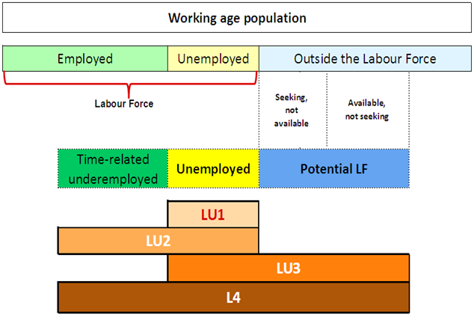
LU1-LU4: Composite measures

Slide 13
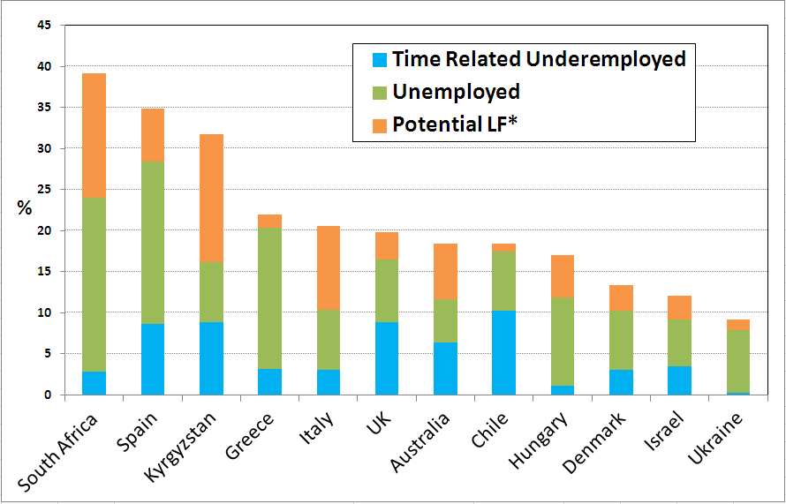
Illustration: Labour underutilization Composite indicator (LU4)
Source: ILO calculations based on national data (2011)

Slide 14
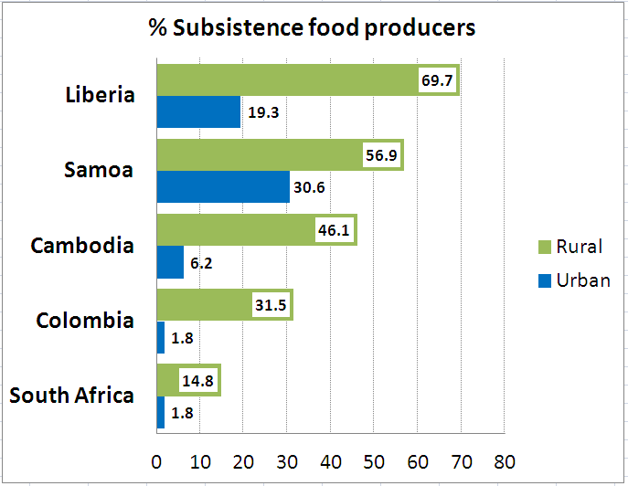
Illustration: New rate of subsistence foodstuff producers (%WAP)
Source: ILO calculations based on national data (2010-2012)

Slide 15
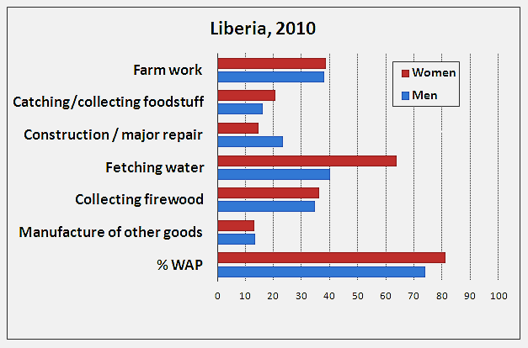
Illustration: Own use producers of goods by activity clusters (% WAP)
Source: ILO calculations based on national data (LFS-CWIQ, 2010)

Slide 16
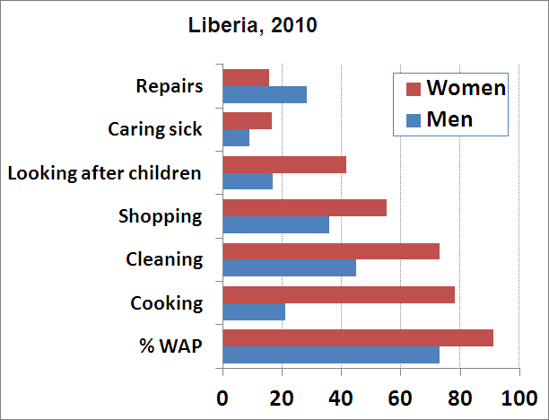
Illustration: Own use providers of services by activity clusters (% WAP)
Source: ILO calculations based on national data (LFS-CWIQ, 2010)

Slide 17
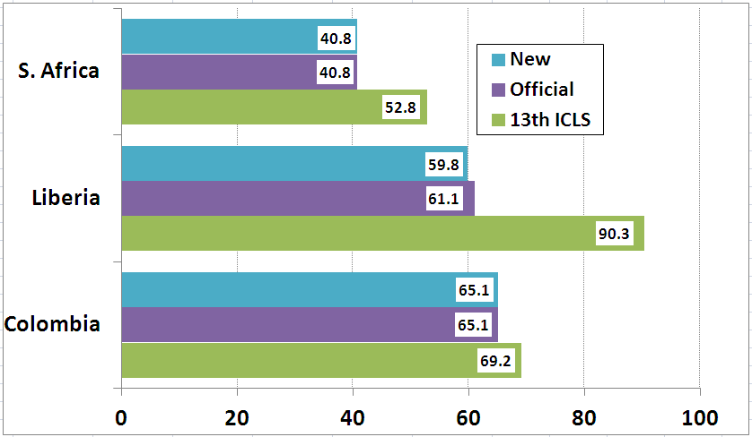
Impact of revisions: Illustration Employment to Pop. Ratio (15-64 yrs)
Depends on existing coverage of activities within 2008 SNA & prevalence in the country
Source: ILO calculations based on national data (2010-2011)

Slide 18
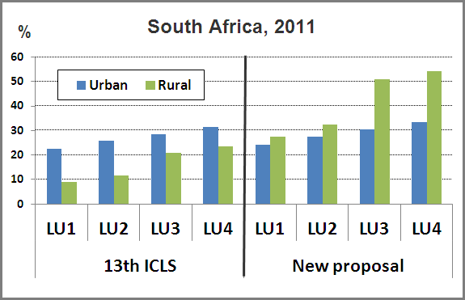
Impact of revisions: Illustration Unemployment & LU measures
Source: ILO calculations based on national data (2011)

Slide 19
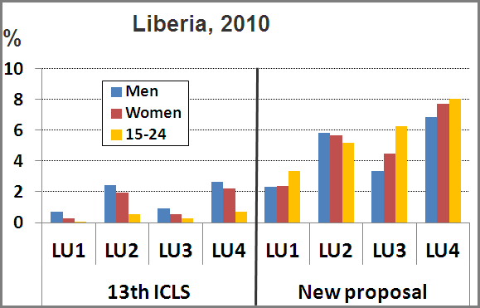
Impact of revisions: Illustration Unemployment & LU measures
Source: ILO calculations based on national data (2010)

Slide 20
Implications
Terminology
Concepts & definitions
Classifications
Core / non-core topic guidance

Slide 21
More details
www.ilo.org/19thICLS
Thank you

